Slide 1

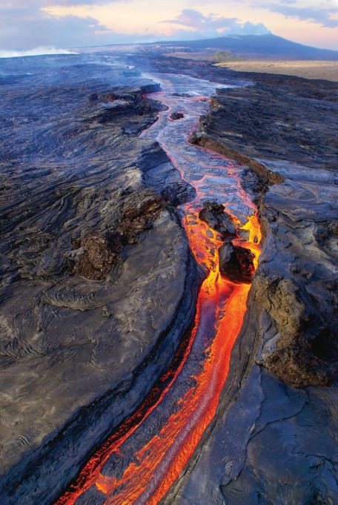
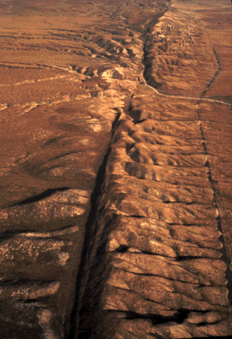
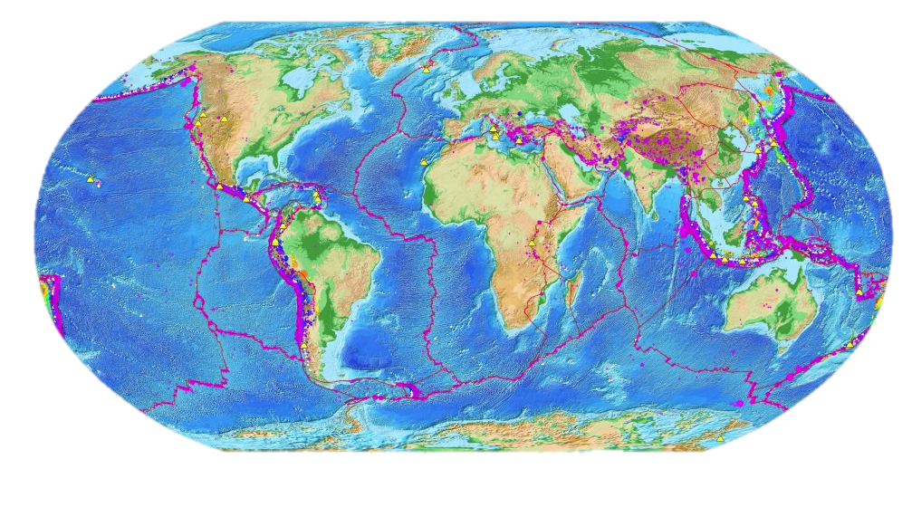
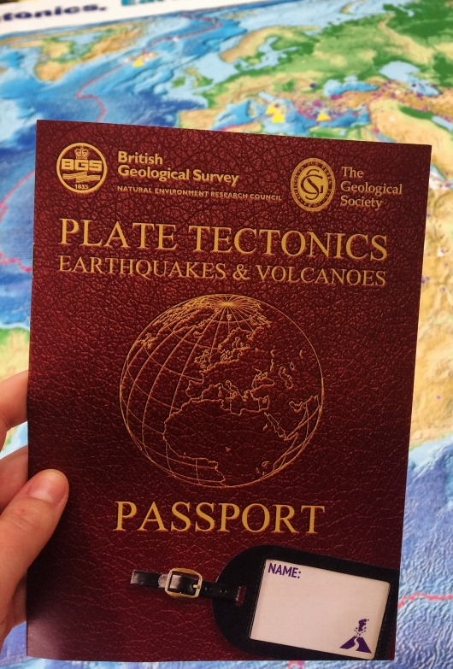
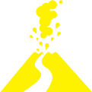


Plate Tectonics, Earthquakes and Volcanoes
Notes:
This presentation has been designed to be used with the plate tectonics passport activity booklet and floor map. These notes are also available to download on the Geological Society resources webpage
How to run the passport activity
This activity requires the ‘plate tectonics passport’ and ‘site information sheets’ (downloadable from the Geological Society resources webpage) and we suggest using our ‘plate tectonics floor map’ (available to download as 16x A4 sheets on the Geological Society resources page – you could print these out as A3 sheet to make the map even bigger!)
This activity works best in a large hall/room (big enough for the floor map to fit on the floor) with access to a smartboard/over head projector to run through the presentation.
Suitable for KS2 pupils (age 7-11) – could be adapted for other key stages.
Estimated running time – 1 hour
Some suggested questions to ask are highlighted in bold
Suggested lesson plan
Run through the introduction (up to slide 9) as a whole class. Get children to find different plates, continents, plate margins etc. on the floor map as the notes suggest. Cut out the arrows and plate names prior to the lesson for use on the map.
Split students into 5 groups
Each group starts at a different site (e.g. Iceland) and answers the questions in the passport booklet using the site information sheets (downloadable from Geological Society website).
Depending on available time each group may not be able to complete all 5 sites – but all sites will have been covered by at least one group.
Assemble children together again to go over booklet answers and discuss the different tectonic scenarios they have looked at. Summaries of each tectonic site and answers to passport questions and are found in slides 10-19.
The Geological Society gives permission for presentations to be adapted where appropriate.

Slide 2
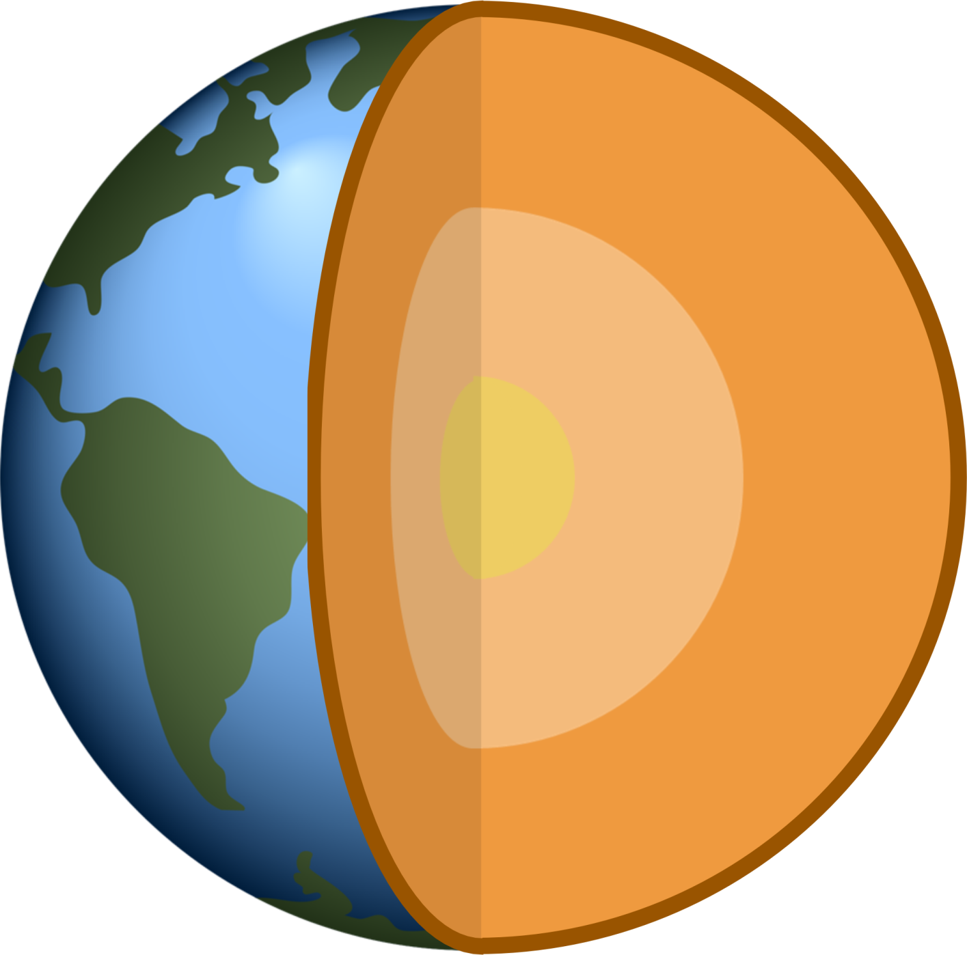
Structure of the Earth
What are the different layers of the Earth?
Notes:
Ascertain class knowledge
How many layers are on the diagram?
The Earth is made up of four different layers (a bit like an onion!)
Does anyone know what these layers are called?
Right in the centre of the Earth is the inner core.
What do you think the inner core is made from?
The inner core is a huge solid ball of iron and nickel metal, with temperatures between 5000 and 6000°C. This is as hot as the surface of the Sun! These temperatures on land would be easily hot enough to melt metal but due to the immense pressure of the other layers squashing down on it, the inner core is actually completely solid.
The next layer is the outer core. This is a layer of liquid nickel and iron with temperatures similar to the inner core. The outer core can flow and is what causes the Earth to have a magnetic field.
The next layer is called the mantle. It is a 2900km thick layer of solid rock, it is not a liquid but parts of the mantle can melt to form pockets of liquid rock called magma. It is cooler than the inner and outer core but still very hot with temperatures between 500 and 4000°C.
Does anyone know what the final of the Earth is called?
Crust: The thinnest and outermost layer of the Earth and it’s where we are. All of the Earth’s oceans, rivers, mountains, volcanoes, hills and valleys are part of the crust. The Earth’s crust is made up of heavy oceanic crust, which forms the ocean basins, and lighter continental crust which forms the landmasses.

Slide 3
Structure of the Earth
Inner core
6000°C
Solid metal
Notes:
What are the different layers of the Earth?
Right in the centre of the Earth is the inner core.
The inner core is a huge solid ball of iron and nickel metal. It is thought to be around 6000°C, this is as hot as the surface of the Sun! These temperatures on land would be easily hot enough to melt metal but due to the immense pressure of the other layers squashing down on it, the inner core is actually completely solid.

Slide 4
Structure of the Earth
Outer core
4500-6000°C
Liquid metal
Notes:
What are the different layers of the Earth?
The next layer is the outer core. This is a layer of liquid nickel and iron with temperatures similar to the inner core. The outer core can flow and is what causes the Earth to have a magnetic field.

Slide 5
Structure of the Earth
Mantle
200-4000°C
Solid rock
Notes:
What are the different layers of the Earth?
The next layer is called the mantle. It is a 2900km thick layer of solid rock. It is not a liquid layer sometimes parts of the mantle can melt to form pockets of liquid rock called magma.
It is cooler than the inner and outer core but still very hot with temperatures between 200 and 4000°C.

Slide 6
Structure of the Earth
Crust
0-200°C
Solid rock
Notes:
What are the different layers of the Earth?
Crust: The thinnest and outermost layer of the Earth and it’s where we are. All of the Earth’s oceans, rivers, mountains, volcanoes, hills and valleys are part of the crust.
The Earth’s crust is made up of heavy oceanic crust (basalt), which forms the ocean basins, and lighter material (granite) which forms the continental crust.

Slide 7
- Volcanoes
What are these slabs?
- Earthquakes
Notes:
The Earth’s crust and uppermost mantle (known as the lithosphere) is broken up into slabs which fit together like a huge jigsaw puzzle, does anyone know what geologists call these huge slabs? They are called (lithospheric) plates.
The red lines on the map show the edges of the plates which are called plate boundaries.
If you look carefully at this map, what do you notice about the plate boundaries? (Use the key)
Plate boundaries are where most of the volcanoes and earthquakes occur. This means they are extremely important for geologists to study.
Plates are referred to as oceanic plates when most of the crustal part of the plate is composed of oceanic crust (show on the map) and continental plates where a large part of the crust forming the plate is composed of continental crust (show on map). Most of the plates are named after the continents and oceans.
If you have the floor map get students to place plate names on the correct plates (some are more difficult than others!), otherwise do the same using the map on this slide. Next slide shows correct plate names.

Slide 8
Major plates
North American plate
Eurasian plate
Caribbean plate
Pacific plate
Cocos plate
Indian
plate
African
plate
Philippine
plate
Pacific plate
Nazca
plate
South American plate
Australian plate
Antarctic plate
Notes:
Here are the names of the major and some of the minor tectonic plates.
Tectonic plates move around on top of the mantle. They move very slowly at a rate of a few mm per year, (about the same rate your fingernails grow). Over millions of years the plates can end up moving around thousands of kilometers. They can be pushed together to form mountain belts and spread apart to create ocean basins.
The meeting points between the tectonic plates are called plate boundaries (get students to stand on plate boundaries on the map and work out which plates they are between).
Earth’s tectonic plates are always on the move. At plate boundaries plates can either be moving towards each other, away from each other, or along slide each other.

Slide 9
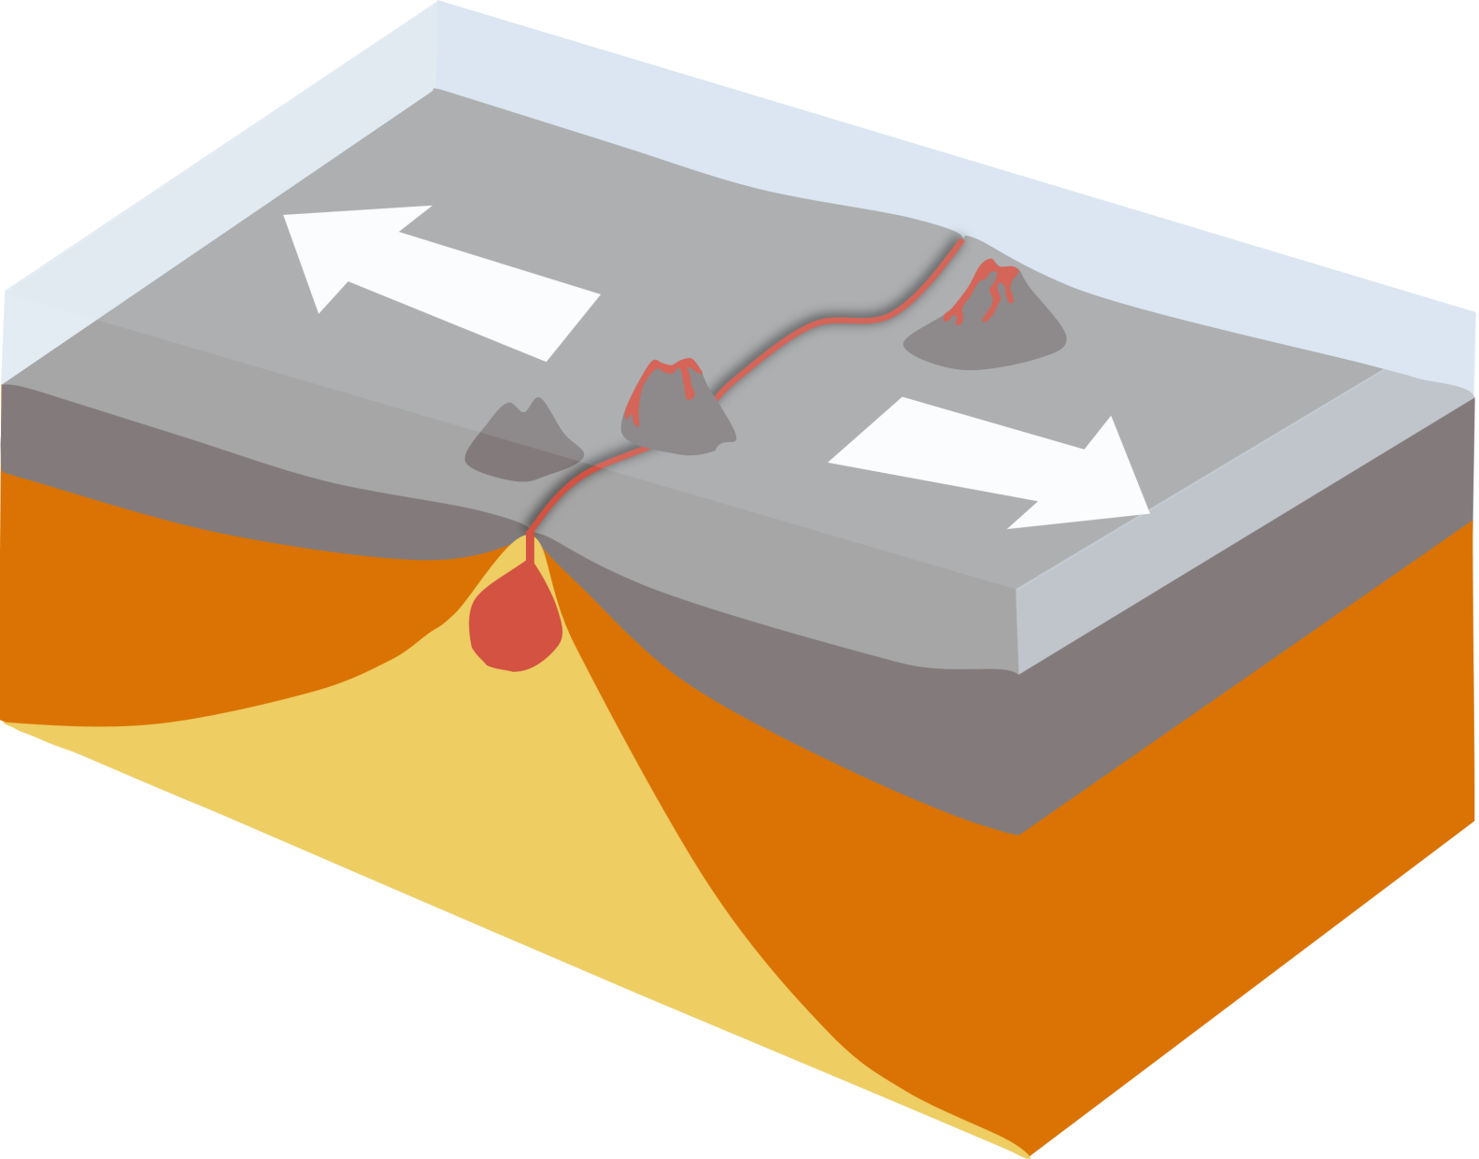
Divergent boundary
Notes:
If plates are moving away from each other this is called a divergent (or constructive) boundary.
When these plates pull apart hot magma rises up to fill in the gap and new crust is created between the two plates.
The Mid Atlantic Ridge is an example of a divergent plate boundary on Earth. Get students to find the Mid Atlantic ridge (runs down middle of Atlantic Ocean) and place arrows in appropriate directions to show divergent margin, i.e. North American and Eurasian plates moving away from each other – note also that Iceland is on the Mid Atlantic Ridge.

Slide 10
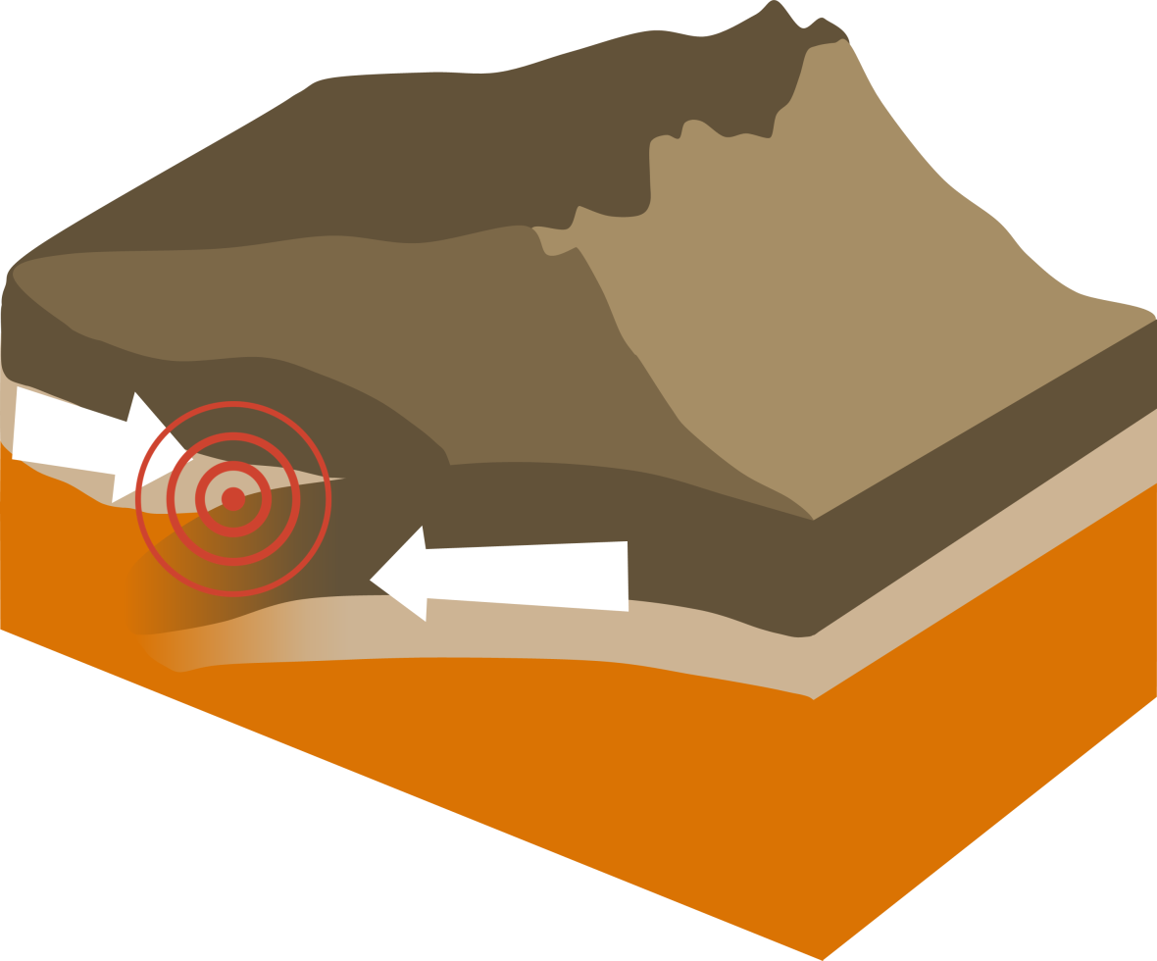
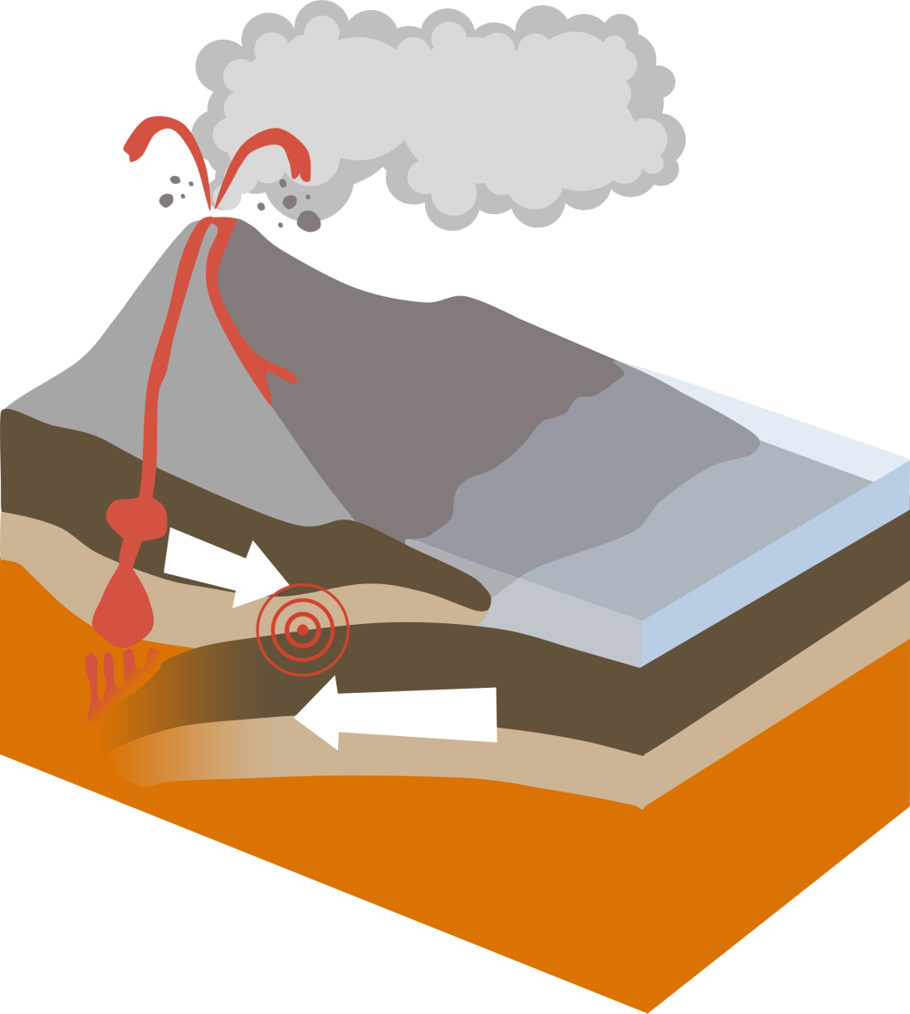
Convergent boundary
Notes:
Where plates are moving towards each other this is called a convergent (or destructive) boundary.
Old plates either sink down into the mantle and become slowly recycled, or they slide upwards to form mountain ranges.
At subduction zones, rocks sink down into the Earth’s mantle where they can melt to form magma (molten rock). This magma can rise and erupt on land as lava to forms volcanoes.
As well as having lots of volcanic activity, subduction zones also get a lot of earthquakes. As one plate sinks downwards it grinds against the plate above and can become stuck due to friction. Pressure builds up and eventually the plates jolt past each other with a tremendous amount of force. The built up energy is released as seismic waves which shake the Earth – this is an earthquake.
Get students to find the Andes mountain range (runs down the western edge of South America) and place arrows showing a convergent margin i.e. South American and Nazca plate moving towards each other. This is an example of a subduction zone one plate being subducted under another which can form volcanoes.
Also get students to find the Himalayas (between India and Asia) and place arrows showing a convergent margin between the Indian and Eurasian plates– both plates are being forced upwards here and form fold mountains rather than volcanoes

Slide 11
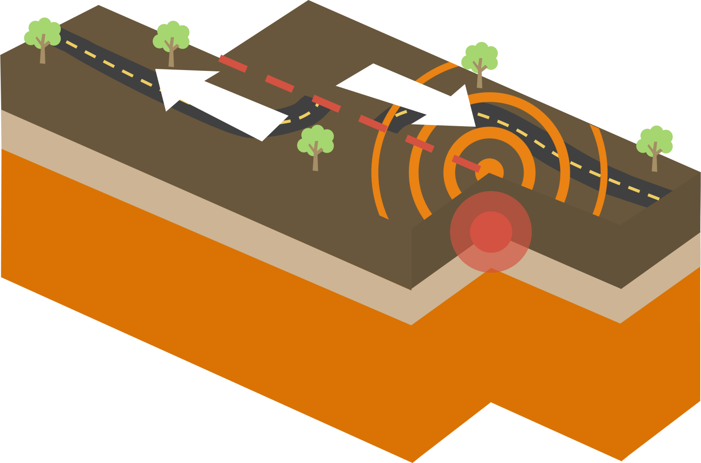
Transform boundary
Notes:
The third type of boundary is called a transform or conservative boundary.
Here the plates do not move towards or away from each other but instead slide past each other.
Lots of earthquakes occur at transform boundaries but no new crust is made and no old crust is subducted.
Get students to find San Andreas Fault (California, West USA) and place arrows on map to show plate movements at a conservative boundary – both Pacific and North American plate moving North West but North American plate is moving more slowly.

Slide 12
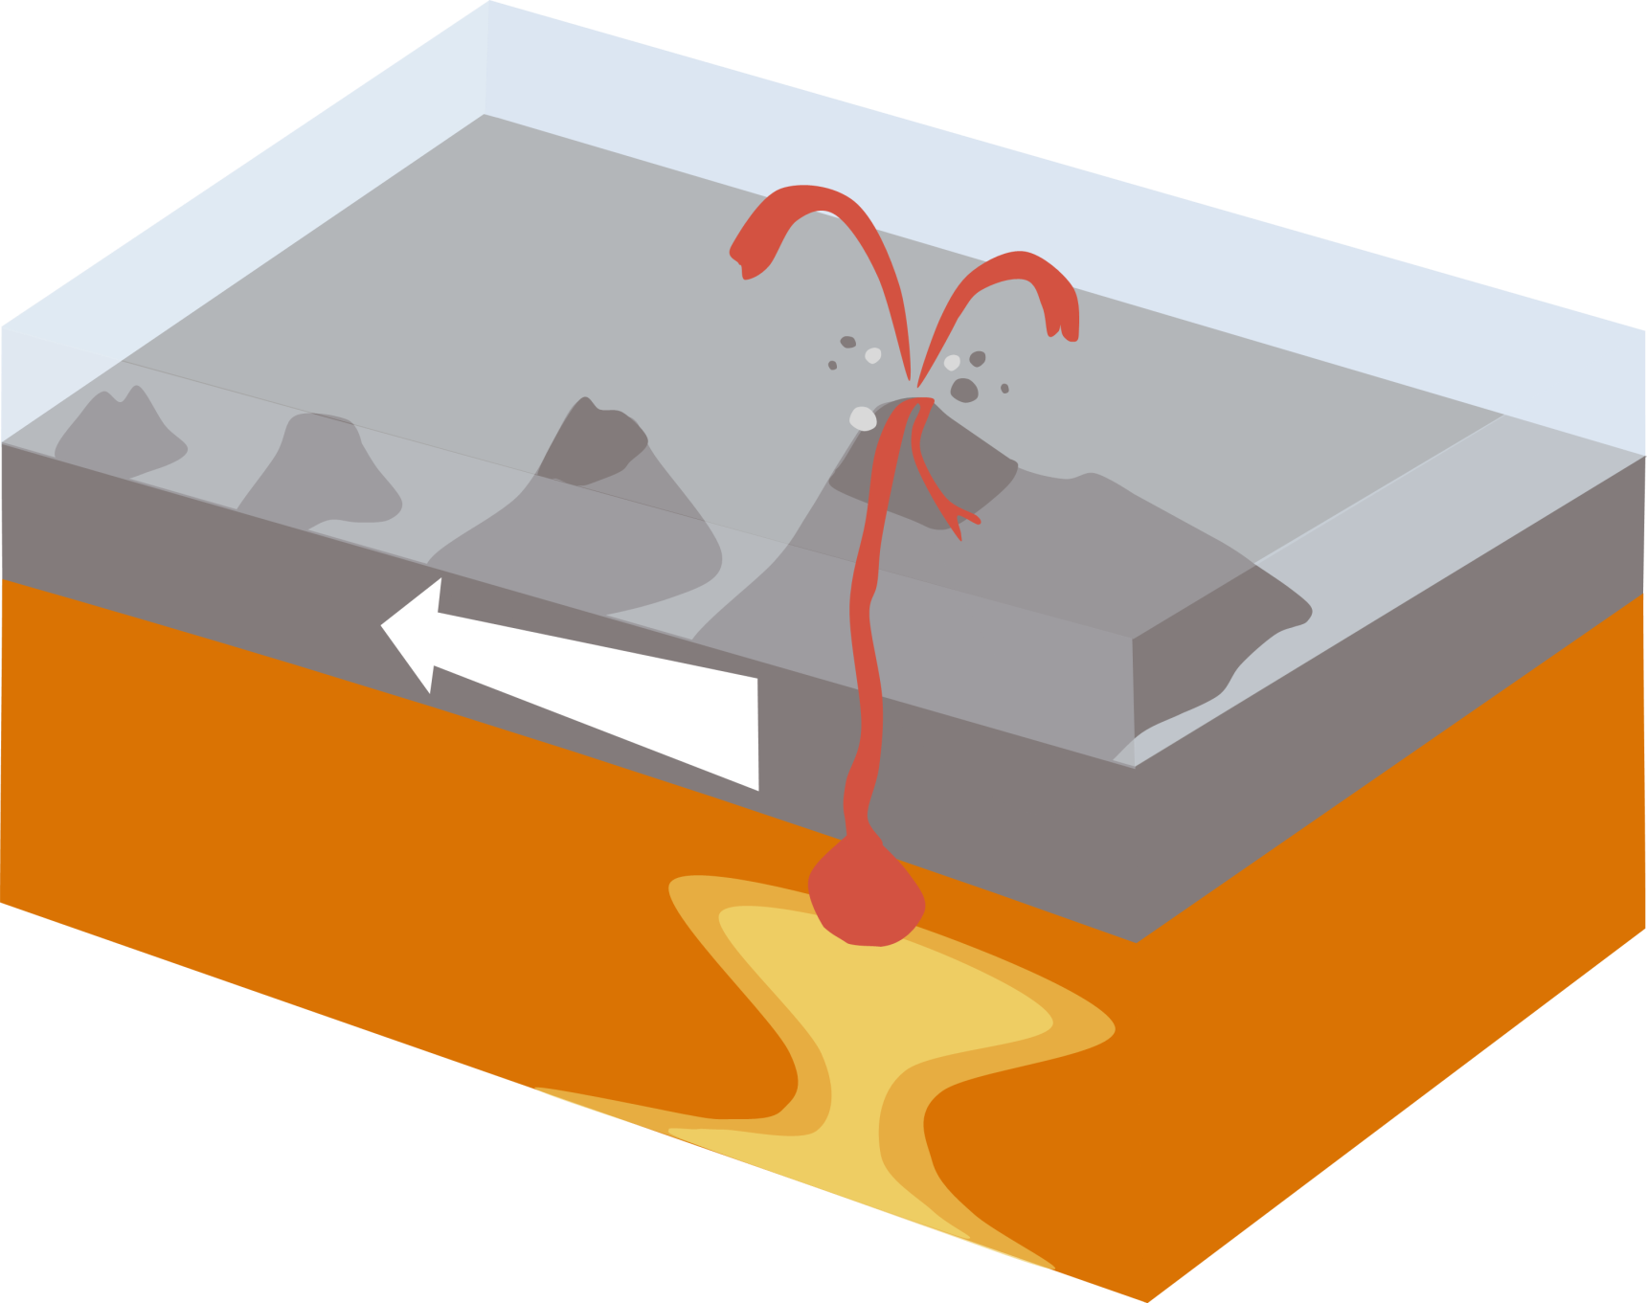
Hot Spot
Notes:
Most volcanic activity occurs at plate boundaries; however sometimes volcanoes can form in the middle a plate far away from any plate boundary. An example of this is the volcanoes on the Hawaiian Islands which are located in the middle of the Pacific Plate, 3,200km away from the nearest plate boundary.
Get students to find Hawaiian islands (Pacific Ocean, west of Mexico)
These volcanoes form due to the presence of a ‘hotspot’, a region of super-heated rocks in the Earth’s mantle. This region of hot mantle causes magma to rise and erupt as lava on the ocean floor, creating underwater volcanoes called seamounts. When these seamounts grow tall enough, they breach the surface of the ocean and become volcanic islands like the Hawaiian Islands.
The chain of Hawaiian Islands has been created because the Pacific Plate has been gradually moving, like a conveyor belt, over the stationary mantle hotspot for millions of years. As new oceanic crust is positioned over the hotspot, volcanic islands are formed from the rising magma.
As the crust then moves away from the ‘hotspot’ these volcanoes lose their supply of hot magma and become extinct. Therefore the youngest island in the chain, which is currently the Big Island of Hawaii, is the only volcanically active island.
Students should now be able to complete page 1 ‘What is plate tectonics’ in the passport booklet

Slide 13
Transform
Divergent
San Andreas Fault
Iceland
Hawaiian Islands
Himalayas
Japan
‘Hot Spot’
Convergent
Notes:
Here are some examples of different plate boundaries. Now we are going to have a look at each of our 5 passport sites.
Find each of the five sites (Iceland, Himalayas, Japan, San Andreas Fault, Hawaiian Islands) on the floor map and recall which plate boundaries they represent. (Japan is a convergent margin)

Slide 14
Now it’s your turn!
Travel across the map using the site information sheets to fill in your plate tectonics passport!
Notes:
Split children into 5 groups. Start each group at a different site on the floor map. Students will need to read the site information sheets to be able to answer the questions in the passport booklet.

Slide 15
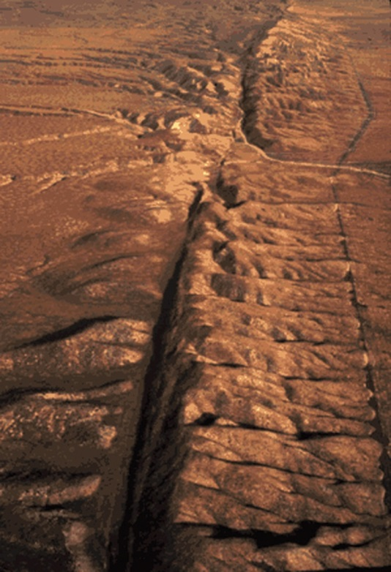
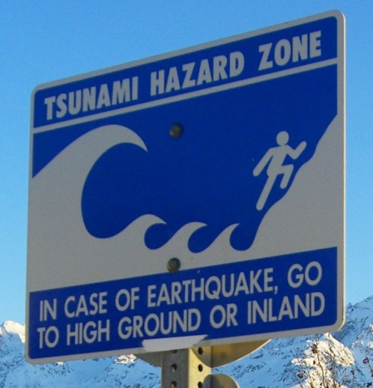
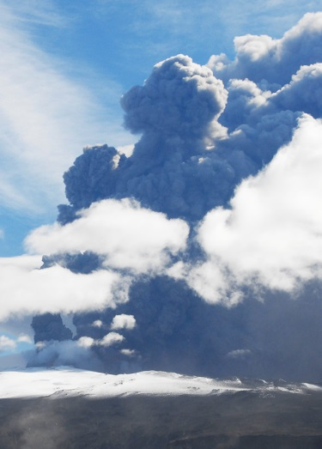
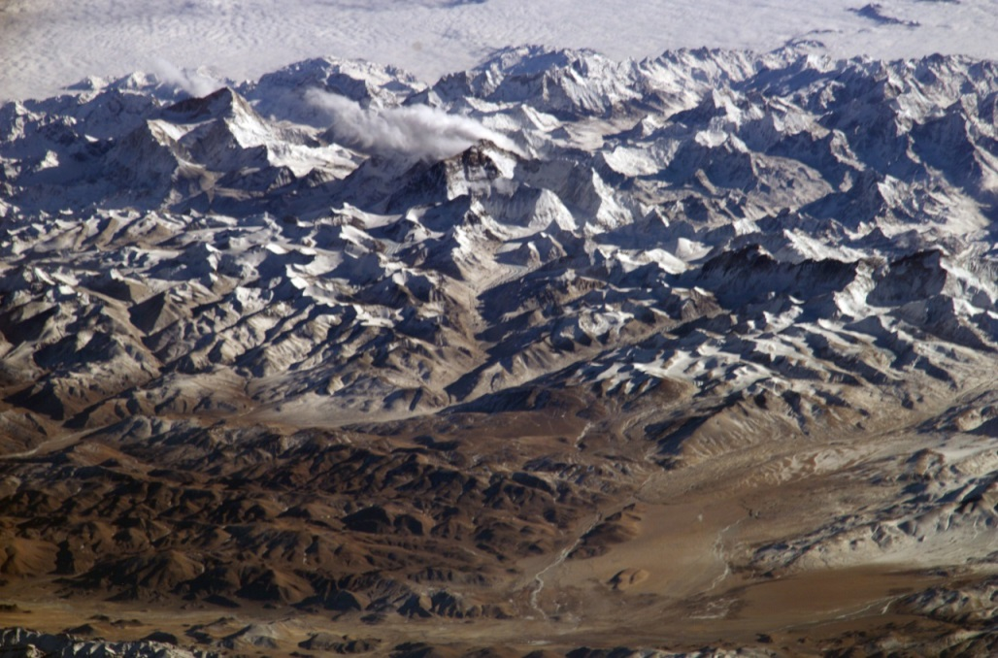

Answers and site summaries

Slide 16
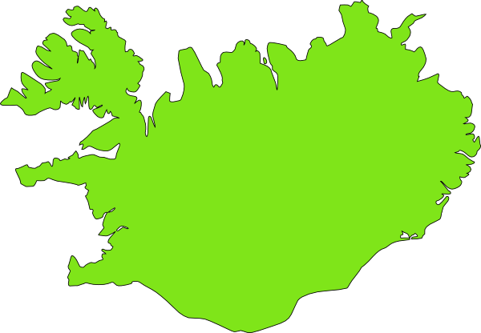


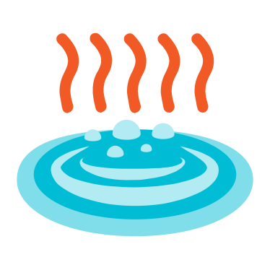

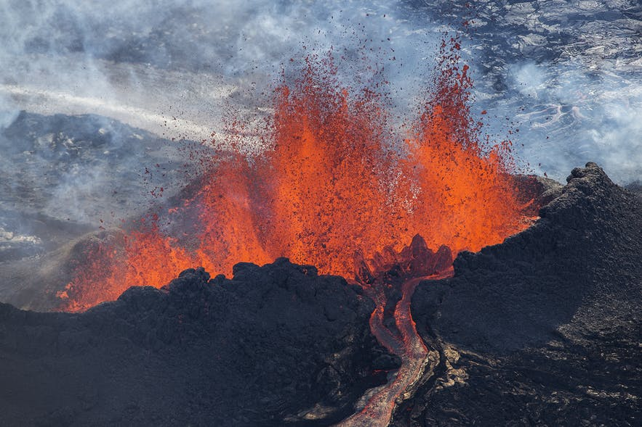
Iceland
Krafla
Bardabunga
Grímsvötn
Hekla
Eyjafjallajökull
Katla
= volcano
www.guidetoiceland.is
Notes:
Iceland is located on the Mid Atlantic Ridge, what type of plate boundary is this?
Divergent boundary, Eurasian and North American plates are moving away from each other
What geological landforms do we find in Iceland?
Volcanoes
Why do we get volcanoes in Iceland?
Volcanoes are formed because as the plates move apart, hot mantle rock oozes upwards directly underneath the Mid-Atlantic Ridge above Iceland. When this hot rock gets close to the surface it melts and then erupts as lava on the surface forming the volcanic island of Iceland.

Slide 17

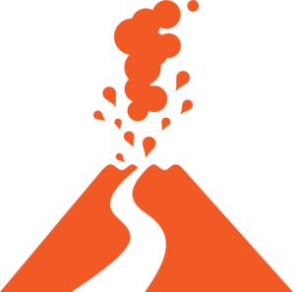
Answers!
Iceland
Katla, Eyjafjallajökull, Krafla, Grimsvotn, Hekla, Bardabunga
Ash particles from volcanic ash clouds can damage aeroplane engines
Geothermal energy from the Earth can used to heat homes and generate electricity
Notes:
Q1. Can you name any of Iceland’s volcanoes?
Q2. How might eruptions form Iceland’s volcanoes affect air travel?
Q3. How is Iceland’s volcanic energy used in people’s homes?

Slide 18


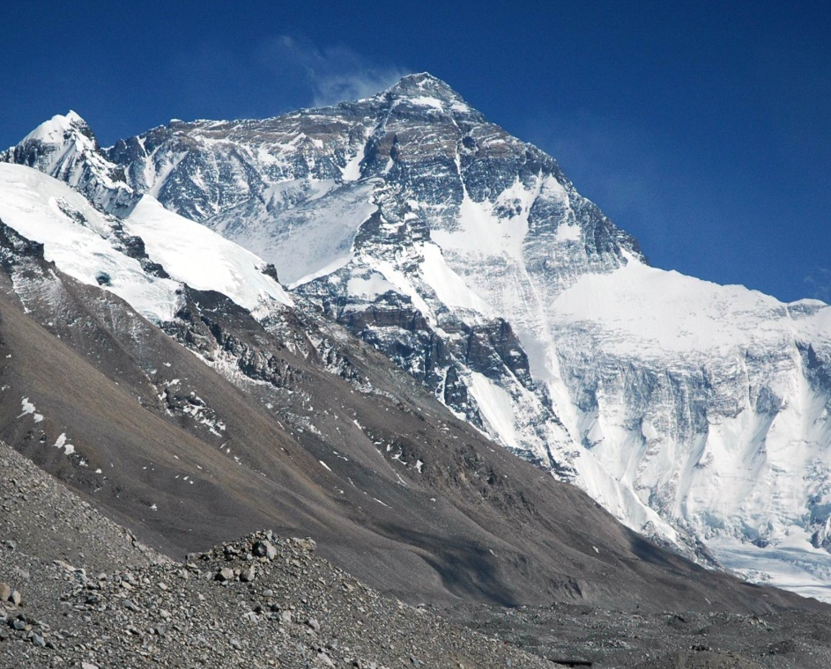
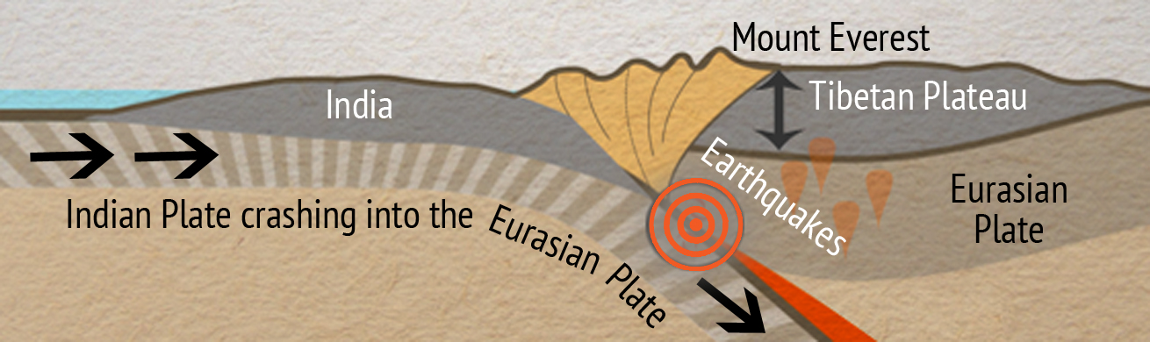
The Himalayas
Notes:
Where are the Himalayas and what are they?
Nepal/India, highest mountain range on Earth
What is the name of the highest peak in the Himalayas? Mount Everest (Guess how tall it is? 8848m)
If we get a mountain range being pushed up what directions do you think these plates are moving in?
Towards each other. In this case the Eurasian plate is moving south and Indian plate is moving north.

Slide 19
Answers!
The Himalayas
Convergent plate boundary
A huge earthquake occurred in Nepal in April 2015
The rocks at the top of Mount Everest contain fossils from ancient sea creatures. These rocks must’ve been formed under the sea before they became part of the mountain.
Notes:
Q1. What type of plate boundary created the Himalayas?
Q2. What devastating natural disaster occurred in Nepal in April 2015?
Q3. How do we know that some of the rocks that now form the Himalayas used to be part of the sea floor?

Slide 20
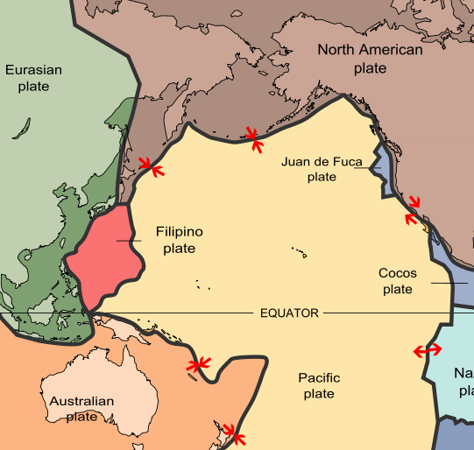


Japan
Notes:
What did you notice about Japan on the floor map?
Japan is covered with so many earthquakes and volcanoes that you cannot see its outline on the map properly
Why do you think there are so many earthquakes and volcanoes in Japan?
Japan lies at the boundary of four different plates: the Pacific plate, North American plate, Philippines plate and Eurasian plate
All of these different plate boundaries make Japan’s tectonics very complicated, so we are going to focus on the northern part of Japan. Here the Pacific plate is moving towards and sinking beneath the North American plate.
When one plate sinks beneath under another plate what do geologists call this?
Convergent (destructive) boundary, subduction zone, subduction

Slide 21
Answers!
Japan
Convergent plate boundary
Tsunamis are huge waves that can be triggered by earthquakes. When they crash on land they can kill and injure thousands of people and completely wipe out buildings and homes.
Pacific Ring of Fire
Notes:
Q1. What type of plate boundary causes volcanoes and earthquakes in Japan?
Q2. What are tsunamis and why are they dangerous?
Q3. What do we call the region on earth where most volcanic eruptions and earthquakes occur?

Slide 22
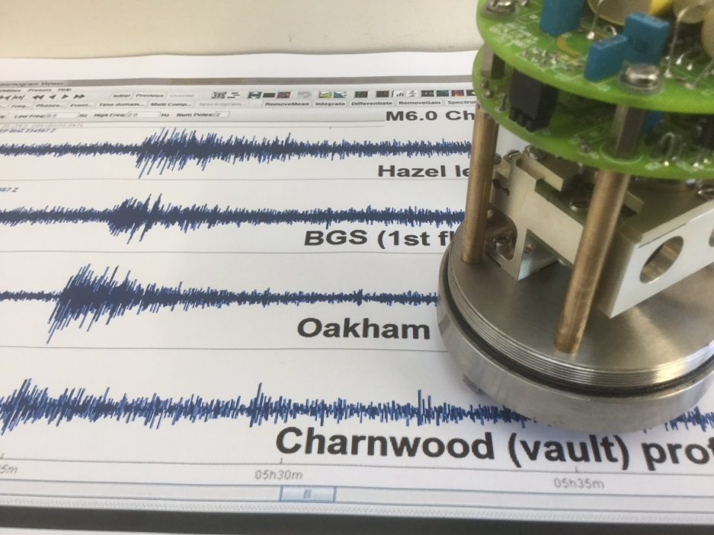
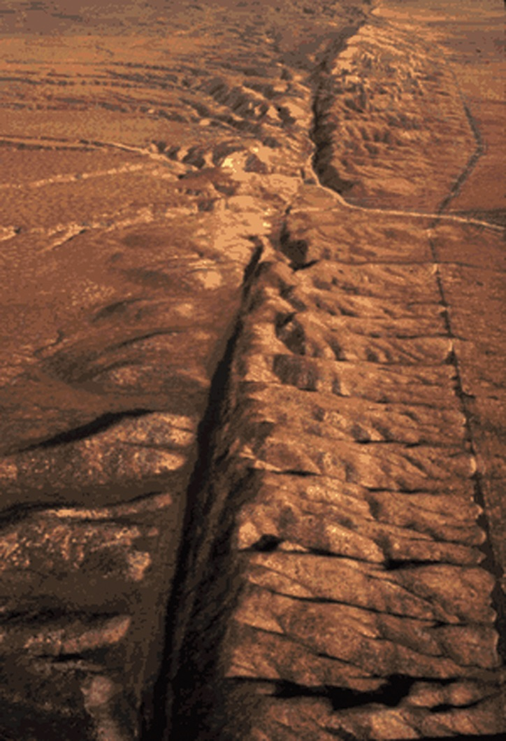
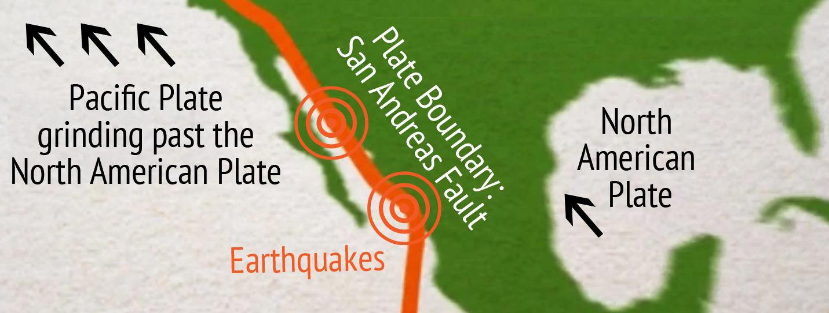
San Andreas fault
Notes:
Where is the San Andreas Fault? California
How are the plates moving at the San Andreas Fault? Same direction, North West
What natural hazards occur due to the plates rubbing alongside each other?
Earthquakes are common because as the plates grind past each other they can become stuck due to friction (if you have any sandpaper you can demonstrate this) pressure then builds up and suddenly the plates jolt into a new position causing an earthquake.

Slide 23
Answers!
San Andreas Fault
A transform boundary is where plates are moving alongside each other
Geologists can measure the magnitude of earthquakes by using an instrument called a seismometer.
The Pacific plate and the North American plate are moving in a North West direction
Notes:
Q1. What is a transform boundary
Q2. What equipment do geologists use to detect earthquakes?
Q3. Which direction are the North American and Pacific plates moving in?

Slide 24

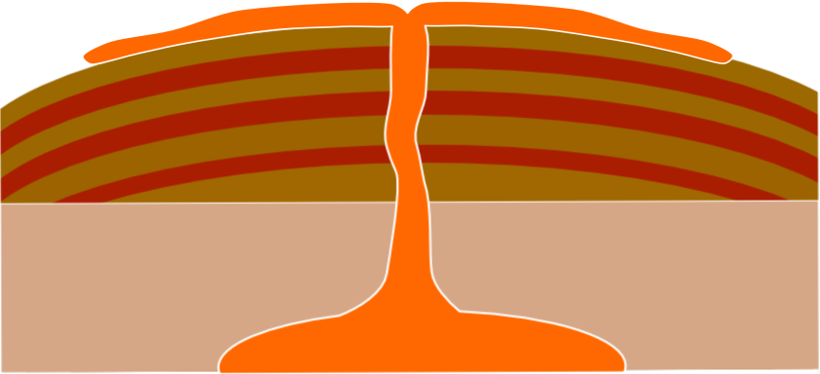
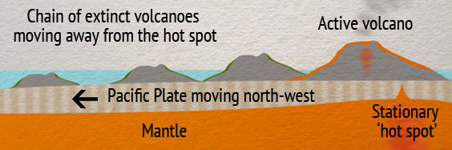
Hawaii
Shield volcano
Notes:
What do you notice about the Hawaiian islands compared with the other sites? They are not near a plate boundary.
Unlike most volcanoes, the Hawaiian Islands have formed due to the presence of a ‘hot spot’ which is a region of super-heated rocks in the Earth’s mantle. This region of hot mantle causes magma to rise and erupt as lava on the ocean floor creating underwater volcanoes. When these volcanoes grow high enough they breach the surface of the ocean and become volcanic islands like the Hawaiian Islands.
Why do we get a chain of volcanic islands instead of one huge volcano?
The Pacific plate is moving over the hotspot, so a chain of volcanoes is created.

Slide 25

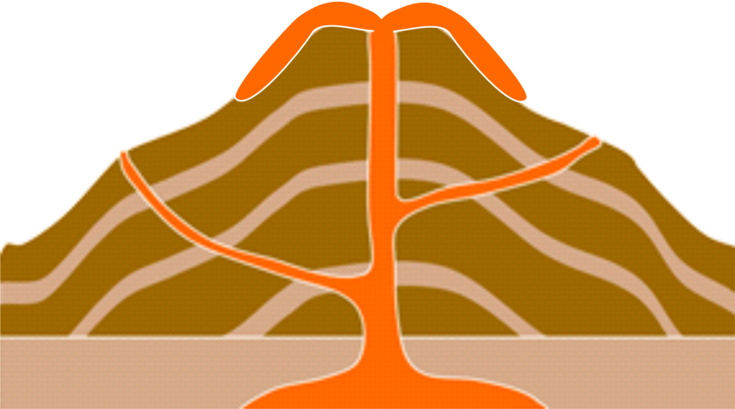
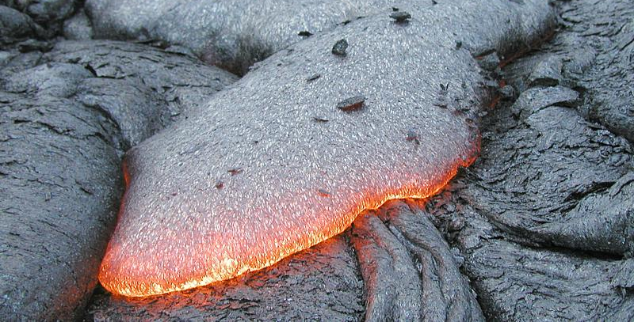
Answers!
Hawaii
Thick lava
Gentle slope
Runny lava
Steep slope
Shield volcano
Stratovolcano
Basalt forms from shield volcanoes
Notes:
Q1. Can you draw the shapes of a shield volcano and a stratovolcano?
Q2. What type of rock forms from lava erupted at shield volcanoes?

Slide 26
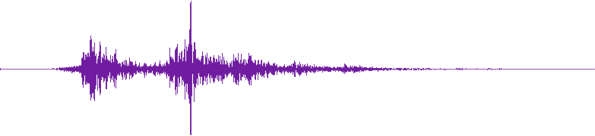
Extra!
Make a fact file about a past earthquake or volcanic eruption.
Notes:
Extra task for homework/further lesson
Possible case studies to research:
Volcanic eruptions:
Mount Vesuvius, Italy - AD79
Mount St. Helens, Washington, USA - 1980
Mount Pinatubo, Philippines - 1991
Nevado del Ruiz, Columbia – 1985
Eyjafjallajökull, Iceland - 2010
Mount Etna - 2018
Earthquakes:
Los Angeles earthquake - 1994
Japan/Tohoku earthquake - 2011
Nepal/Gorkha earthquake - 2015
Haiti earthquake - 2010
Mexico City – 2017

Slide 27
Plate Tectonics, Earthquakes and Volcanoes

