Slide 1



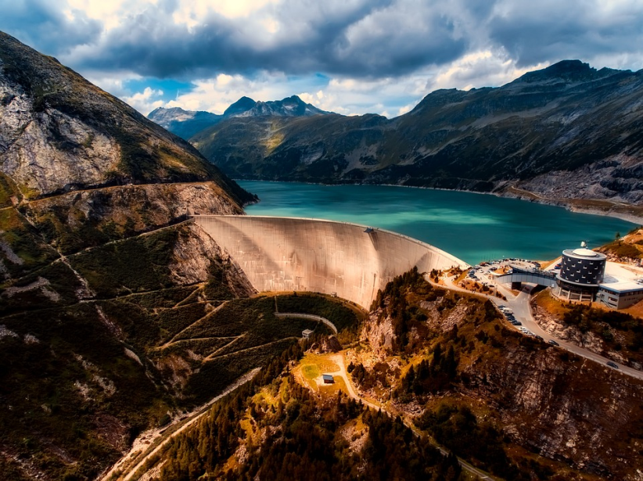
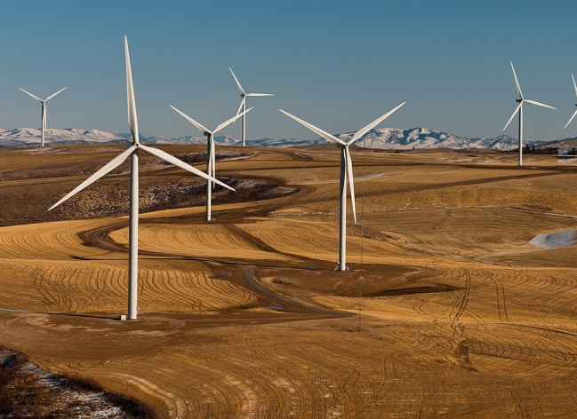
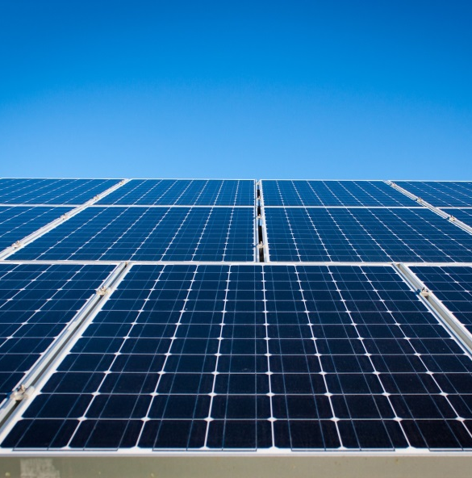
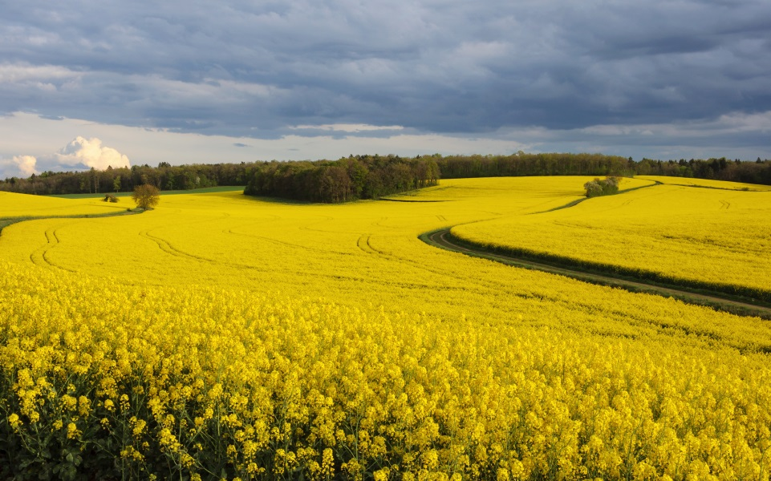
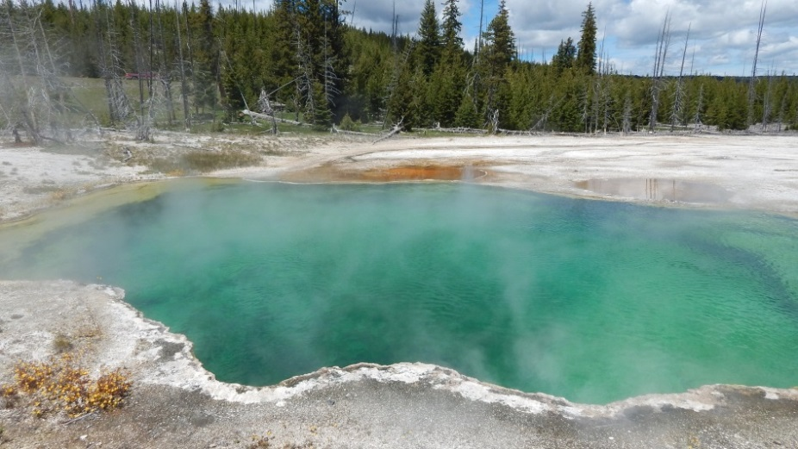
Notes:
KS3
human geography relating to the use of natural resources
Energy
energy changes in a system involving heating, doing work using forces, or doing work using an electric current: calculating the stored energies and energy changes involved
power as the rate of transfer of energy
conservation of energy in a closed system, dissipation
calculating energy efficiency for any energy transfers
renewable and non-renewable energy sources used on Earth, changes in how these are used
Managing climate change
involves both mitigation
(reducing causes) and
adaptation (responding to
change).
Managing climate change:
•• mitigation – alternative energy production, carbon capture,
planting trees, international agreements
•• adaptation – change in agricultural systems, managing water
supply, reducing risk from rising sea levels.
case study of a tropical rainforest to illustrate:
•• energy development, - Costa Rica HEP
A case study of a hot desert to illustrate:
•• energy, ?
A case study of a cold environment to illustrate:
•• energy –Iceland geothermal
Features of sustainable urban living:
•• water and energy conservation
Energy:
•• the changing energy mix – reliance on fossil fuels, growing
significance of renewables
•• reduced domestic supplies of coal, gas and oil
•• economic and environmental issues associated with exploitation
of energy sources.
Areas of surplus (security) and deficit (insecurity):
•• global distribution of energy consumption and supply
•• reasons for increasing energy consumption: economic
development, rising population, technology
•• factors affecting energy supply: physical factors, cost of
exploitation and production, technology and political factors.
Impacts of energy insecurity – exploration of difficult and
environmentally sensitive areas, economic and environmental costs,
food production, industrial output, potential for conflict where
demand exceeds supply.
Overview of strategies to increase energy supply:
•• renewable (biomass, wind, hydro, tidal, geothermal, wave and
solar) and non-renewable (fossil fuels and nuclear power) sources
of energy
•• an example to show how the extraction of a fossil fuel has both
advantages and disadvantages.
Moving towards a sustainable resource future:
•• individual energy use and carbon footprints. Energy conservation:
designing homes, workplaces and transport for sustainability,
demand reduction, use of technology to increase efficiency in the
use of fossil fuels
•• an example of a local renewable energy scheme in an LIC or NEE
to provide sustainable supplies of energy.
Tar sands
Coal gasification
Methane hydrates
Fracking

Slide 2

UK mix of renewable energy
Why we need renewable energy
Wind
Solar
Hydroelectric
Geothermal
Biofuels

Slide 3


What are renewable energy resources?
What are some examples of renewable energy resources?
Which renewable energy resources do we use in the UK?
Notes:
Recap/ teachers to ascertain class knowledge

Slide 4

The UK uses renewable energy resources to generate heat and electricity. Put these renewables in order from largest to smallest contributors to electricity generation.
Landfill gas
Largest contributor
21%
Solar PV
29%
6%
Onshore Wind
Hydroelectric
4%
Offshore Wind
Other bioenergy
Smallest contributor
28%
12%
UK Electricity generation by fuel source 2017 – Department for Business, Energy & Industrial Strategy
Notes:
5 minute activity in partners

Slide 5
The UK uses renewable energy resources to generate heat and electricity. Put these renewables in order from largest to smallest contributors to electricity generation.
Largest contributor
Onshore Wind
29%
Other bioenergy
28%
Offshore Wind
21%
Solar PV
12%
Hydroelectric
6%
Landfill gas
Smallest contributor
4%
UK Electricity generation by fuel source 2017 – Department for Business, Energy & Industrial Strategy

Slide 6

42%
24.5%
21%
9%
>2%
UK Electricity generated 2016 Department of Business, Energy and Industrial Strategy
Notes:
The graph shows the total electricity generated by the UK in 2016 (data from Department of Business, Energy and Industrial Strategy) – most of the UKs power is generated from gas (42%) but renewables contribute a large proportion (24.5%).
Generating electricity from renewable sources is more complicated than from fossil fuels so it requires lots of new technology which is expensive to research and develop.

Slide 7
Why do we need renewable energy resources?
Why can’t we just continue to use non-renewable resources?
Notes:
Recap/ teachers ascertain class knowledge

Slide 8

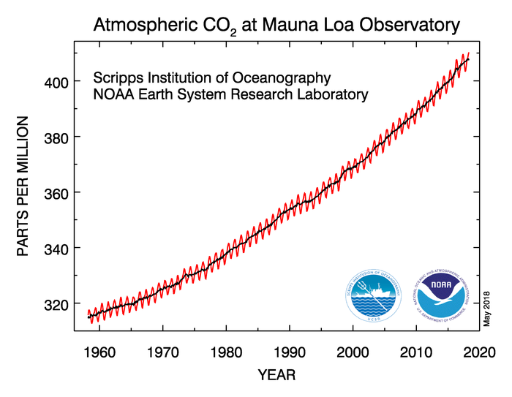
CO2 is at 407ppm (Oct 2018) increased by 90ppm in the last 70 years
Global warming ~1.1°C in the past 200 years
Ocean acidification
Rising sea level ~3.2mm each year
Decreasing ice sheet mass
Retreating glaciers
Decreasing Arctic ice at a rate of 13% each decade
Renewable energy is crucial for mitigating climate change
Notes:
Renewable energy is crucial for being able to reduce the amount of CO2 we are pumping into the atmosphere and oceans to be able to mitigate dangerous levels of climate change. Climate change mitigation is a huge concern for governments around the world and with an ever increasing energy demand, especially in newly industrialized countries, we need to look for different ways of producing energy that is sustainable for future generations.
Global warming – the Earth’s average temperature has risen by 1.1°C since the late 19th century – most of this warming has occurred in the last 35 years at the fastest rate in recorded history. Global warming occurs when carbon dioxide and other greenhouse gases collect in the atmosphere and absorb sunlight and solar radiation that have bounced off the Earth’s surface. Normally, this radiation would escape into space—but these pollutants, which can last for years to centuries in the atmosphere, trap the heat and cause the planet to get hotter - the greenhouse effect.
NASA Youtube video showing planet warming → https://www.youtube.com/watch?time_continue=9&v=s3RWTTtPg8E
Ocean acidification – carbon dioxide reacts with ocean water to produce acid (H2O + CO2 → H2CO3 (carbonic acid)) lowering the pH of the ocean (making it more acidic). When conditions are too acidic corals cannot absorb the calcium carbonate they need to maintain their skeletons and they dissolve. This is known as coral bleaching and results in the loss of vital reef habitats home to thousands of species of marine life. Carbon absorbed by ocean surface layers is increasing by 2 billion tonnes every year and coral reefs are suffering ever increasing levels of bleaching.
Sea level rise – 3.2mm each year – due to melting ice sheets and thermal expansion of water
Ice sheet mass – Greenland and Antarctic ice sheets decreasing by 413 gigtonnes each year. Arctic ice - decreasing by 13% each decade
Glacier retreat – glaciers are retreating around the world particularly in the Alps, Himalayas, Andes, Rockies, Alaska and Africa

Slide 9
RESEARCH ACTIVITY
Research one renewable energy resource used in the UK to answer the following questions:
How is this energy resource used to generate electricity? – include a simple diagram
How much of the UKs electricity is currently generated from this resource, and how has this changed over time?
What are the positives of using this energy resource?
What are the negatives of using this energy resource?
Notes:
Use ipads/computers to research a renewable energy resource. Choices could be wind, solar, geothermal, biofuels, hydroelectric, wave etc. Split into groups or individual research. Questions could just be answered in exercise books or be used as a basis to create an information pamphlet, poster or presentation.

Slide 10


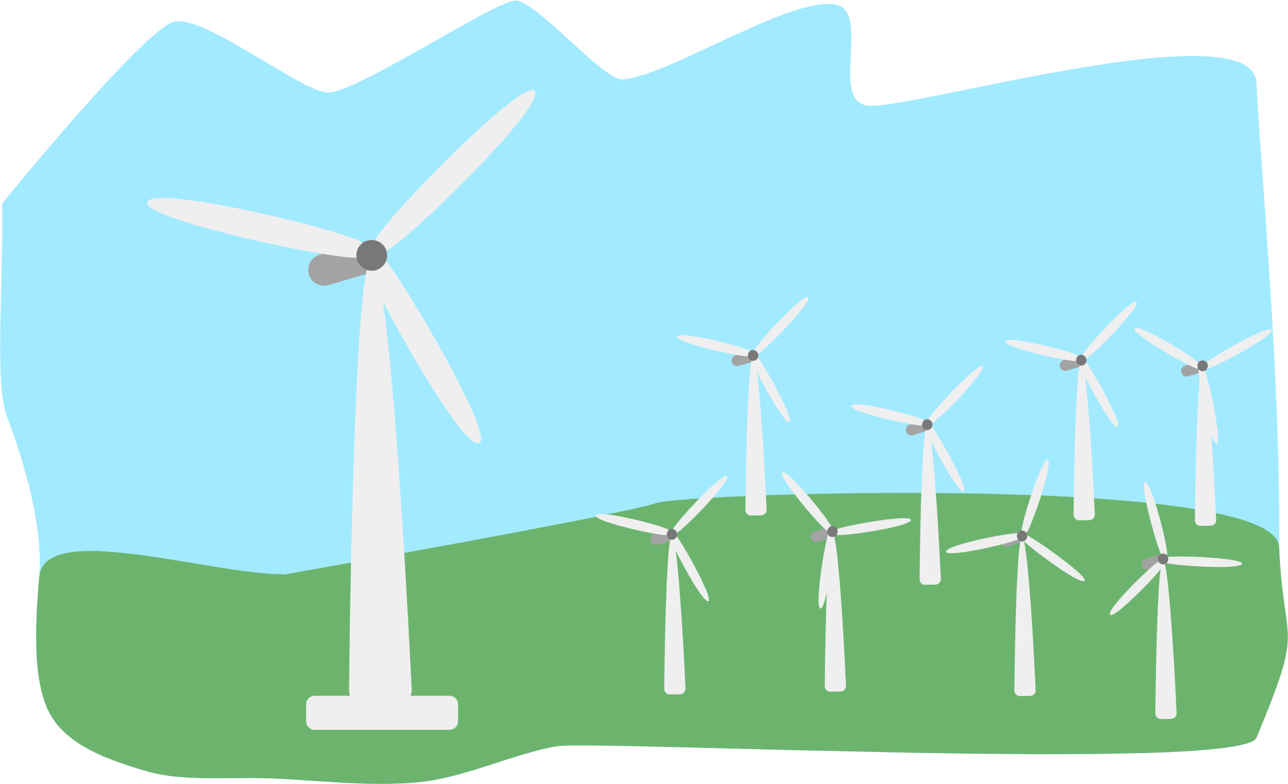
Wind farm
Propeller Blade
Strong winds
Clear hilltop
Turbines in prevailing wind direction
Nacelle containing generator
Tower
Wind turbine
Notes:
Wind turbines are built to harness wind energy (kinetic energy). When the wind blows the blades move and spin a turbine connected to a generator which produces electricity. Wind turbines essentially work in the opposite way to a fan, instead of using electricity to make wind, they use wind to make electricity.
In order to create enough energy capable of powering thousands of homes, energy companies build large wind farms with lots of wind turbines. Wind turbines need to be built in the direction of prevailing winds and ideally on a clear hill top.

Slide 11
The amount of power, and therefore electricity, a wind turbine can produce is largely based on wind velocity using this equation:
Power = ½ ρAV³
ρ = air density; ~1 kg m³
A = swept area (π r² )
V = velocity (m s⁻¹)
Higher wind speed = lots more power
Larger wind turbine = more power
Power is measured in Watts
Notes:
Note because the velocity is cubed in this equation the doubling of wind speed causes an eight-fold increase in power.

Slide 12
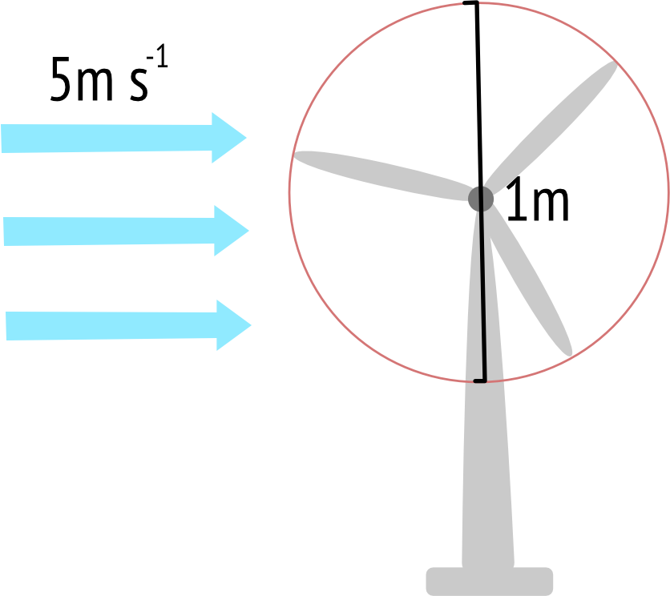
How much power can be generated in this situation?
Power = ½ ρAV³
ρ = air density; ~1 kg m³
A = swept area (π r² )
V = velocity (m s⁻¹)
Power is measured in Watts
Notes:
Try doubling the wind speed to get an eight-fold increase in power
0.5((π × 0.5²)(5³)) = 49.1 Watts
0.5((π × 0.5²)(10³)) = 392.7 Watts

Slide 13
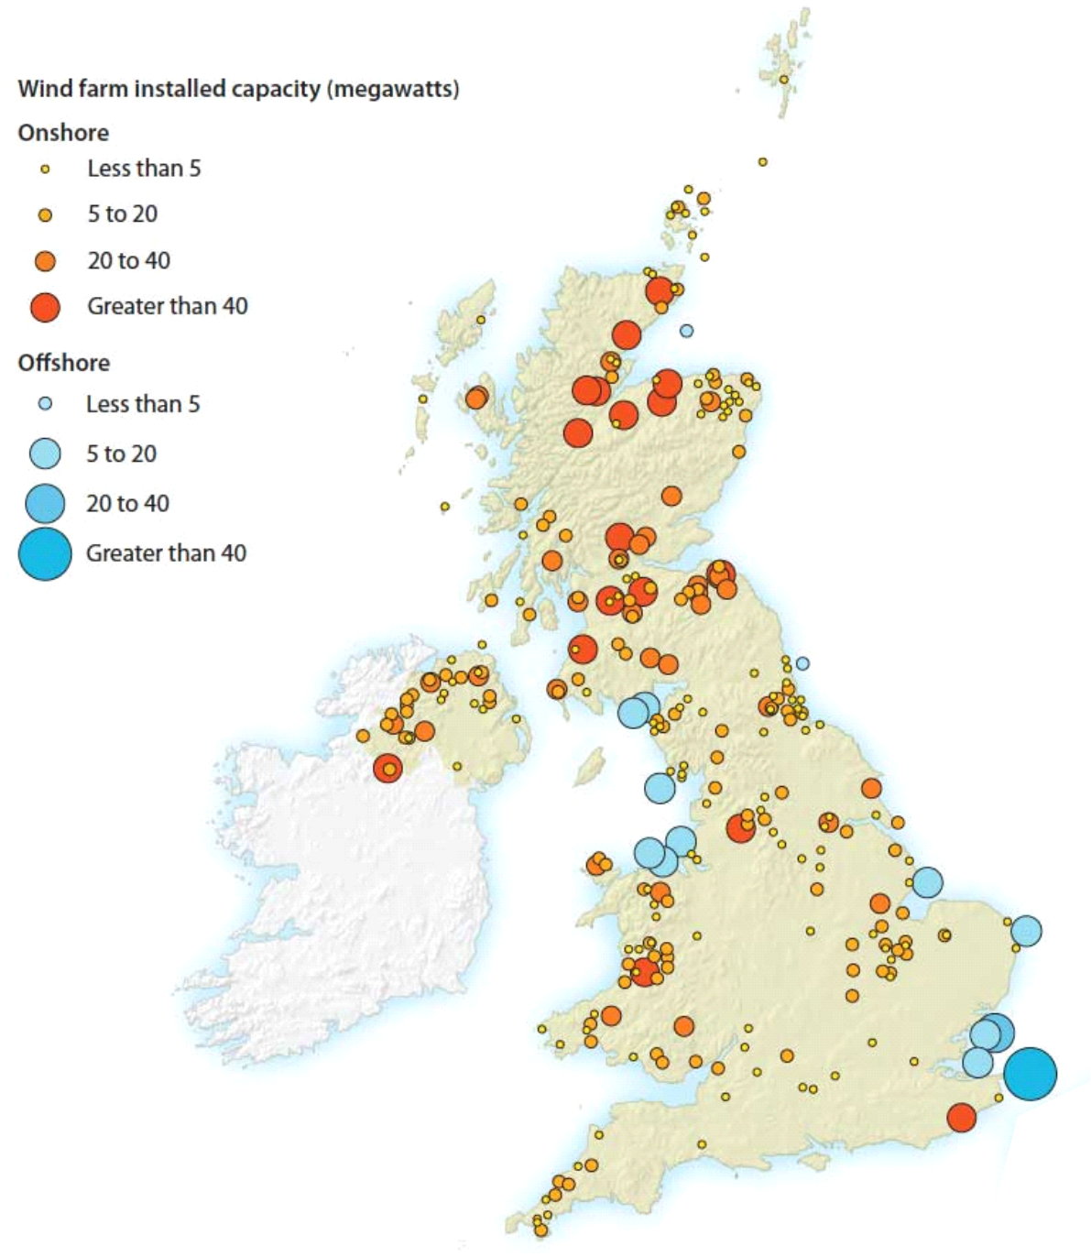
UK has 9,220 wind turbines (Oct 2018) with a capacity for 20.1 gigawatts – 6th largest producer of wind power in the world
In 2017 17% of UK electricity was generated from wind power (29% by renewables in total)
© 2014 Syon Geographical Ltd.
Notes:
Wind turbines are built to harness wind energy (kinetic energy). When the wind blows the blades move and spin a turbine connected to a generator which produces electricity. Wind turbines essentially work in the opposite way to a fan, instead of using electricity to make wind, they use wind to make electricity.
In order to create enough energy capable of powering thousands of homes, energy companies build large wind farms with lots of wind turbines.
The UK currently has 8,680 wind turbines (2018) with a capacity for 18.4 gigawatts of power making it the 6th largest producer of wind power in the world. In 2017 15% of UK electricity was generated from wind power. Website shows current UK power being generated by wind - https://www.thecrownestate.co.uk/energy-minerals-and-infrastructure/offshore-wind-energy/offshore-wind-electricity-map/
Discuss why there might be more wind farms in Scotland than in the south west of England? - If there isn’t any wind, then no electricity will be generated by the wind turbine – Scotland is more windy! Engineers do a lot of measurements and calculations before they build wind turbines to figure out the best areas to place them. The wind doesn’t blow all the time but the important thing is how much the wind blows on average.
One major issue that people have with wind turbines is that they can ruin the look of the landscape, they can also be harmful to birds who might fly into them.

Slide 14

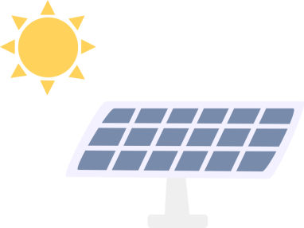
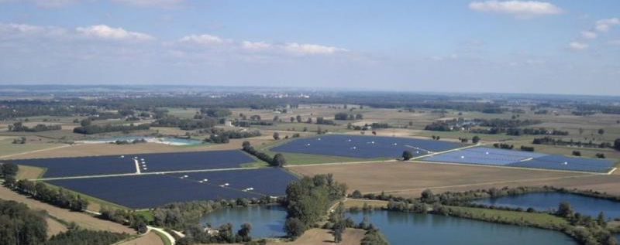
25.7 MW Lauingen Energy Park in Bavarian Swabia, Germany

Slide 15
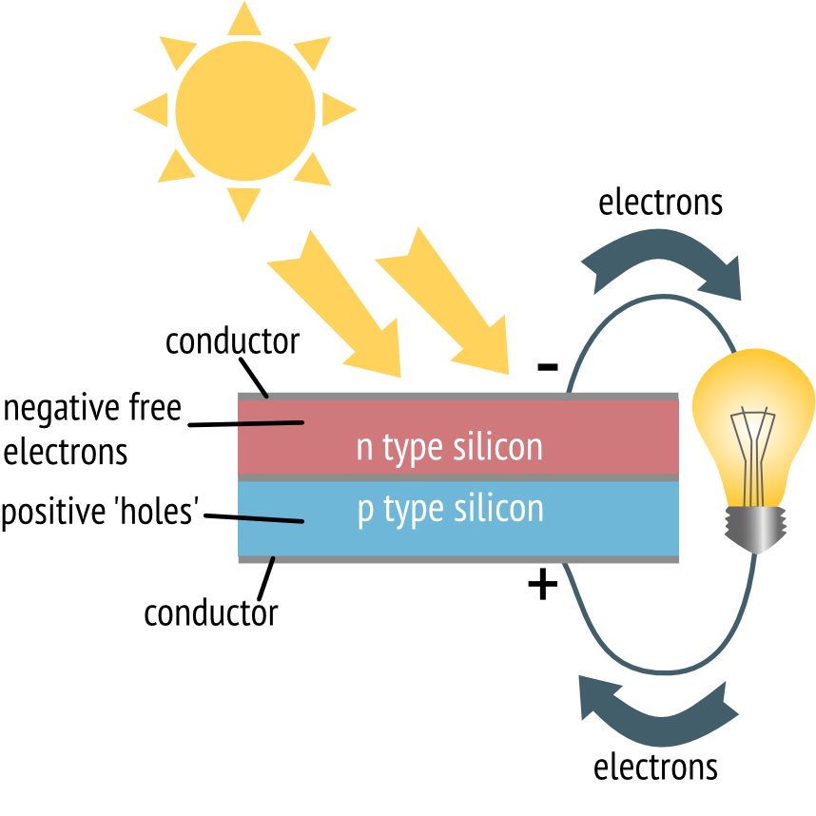
Thermal solar panels are used to generate heat energy,
Photovoltaic (PV) cells made from silicon turn sunlight directly into electricity
3.4% of total electricity was generated by Solar PV in the UK in 2017 (29% by renewables in total)
Notes:
Solar power is generated directly from sunlight (photons). Solar thermal panels are filled with water which heats up in the sunlight. The heated water is then pumped through a tank heating the water that is connected to the taps in the house.
Solar photovoltaic (PV) cells use the suns energy to convert are made from two layers of silicon crystal. When photons hit the top layer of silicon they ‘excite’ the negatively charged electrons in the silicon atoms giving them enough energy to move towards the positively charged lower layer, inducing an electrical current.
3.4% of total electricity was generated by Solar PV in the UK in 2017 (29% by renewables in total)

Slide 16
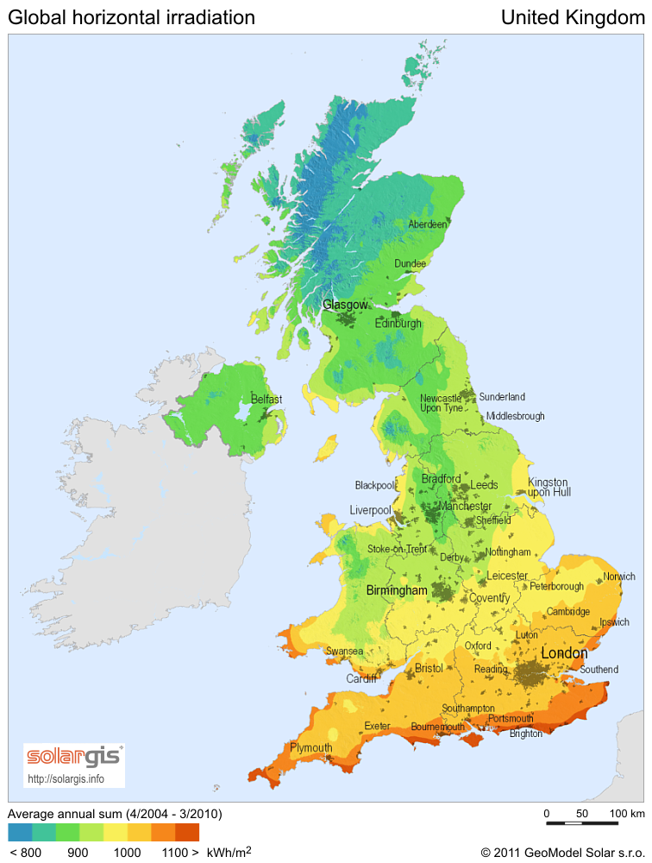
South of UK has ‘solar potential’ equal to Germany which generates 7% of electricity from solar PV.
Solar panels are expensive. You need a lot of them and they require rare metals such as cadmium and indium.
An average UK house uses around 3kW of energy each year – you need 12-15 solar panels to generate this much power.
UK solar energy potential
Notes:
In 2017 3.4% of electricity generated in the UK was done so using Solar PV (11,479 GWh)– electricity generated by renewables in total was 29%.
UK solar potential - while the sunniest parts of the UK receive much less solar radiation than the sunniest parts of Europe, the south of the UK has comparable sunlight with that of central European countries, including Germany, which generates about 7% of its total electricity from solar power. Google is planning to use satellite imagery to map the solar potential of the UK’s rooftops as part of a push into the renewable energy industry.
ISolar power has no fuel costs, does not produce greenhouse gases and can provide electricity to remote areas. However, because PV cells require rare metals like cadmium and indium, they are very expensive. The average house in the UK uses around 3kW of energy each year – you would need between 12-15 PV cells to generate this much power. And although more efficient PV cells are being developed, currently they can only process 15-25% of the sun’s energy into electricity, making electricity generated from solar power expensive.

Slide 17


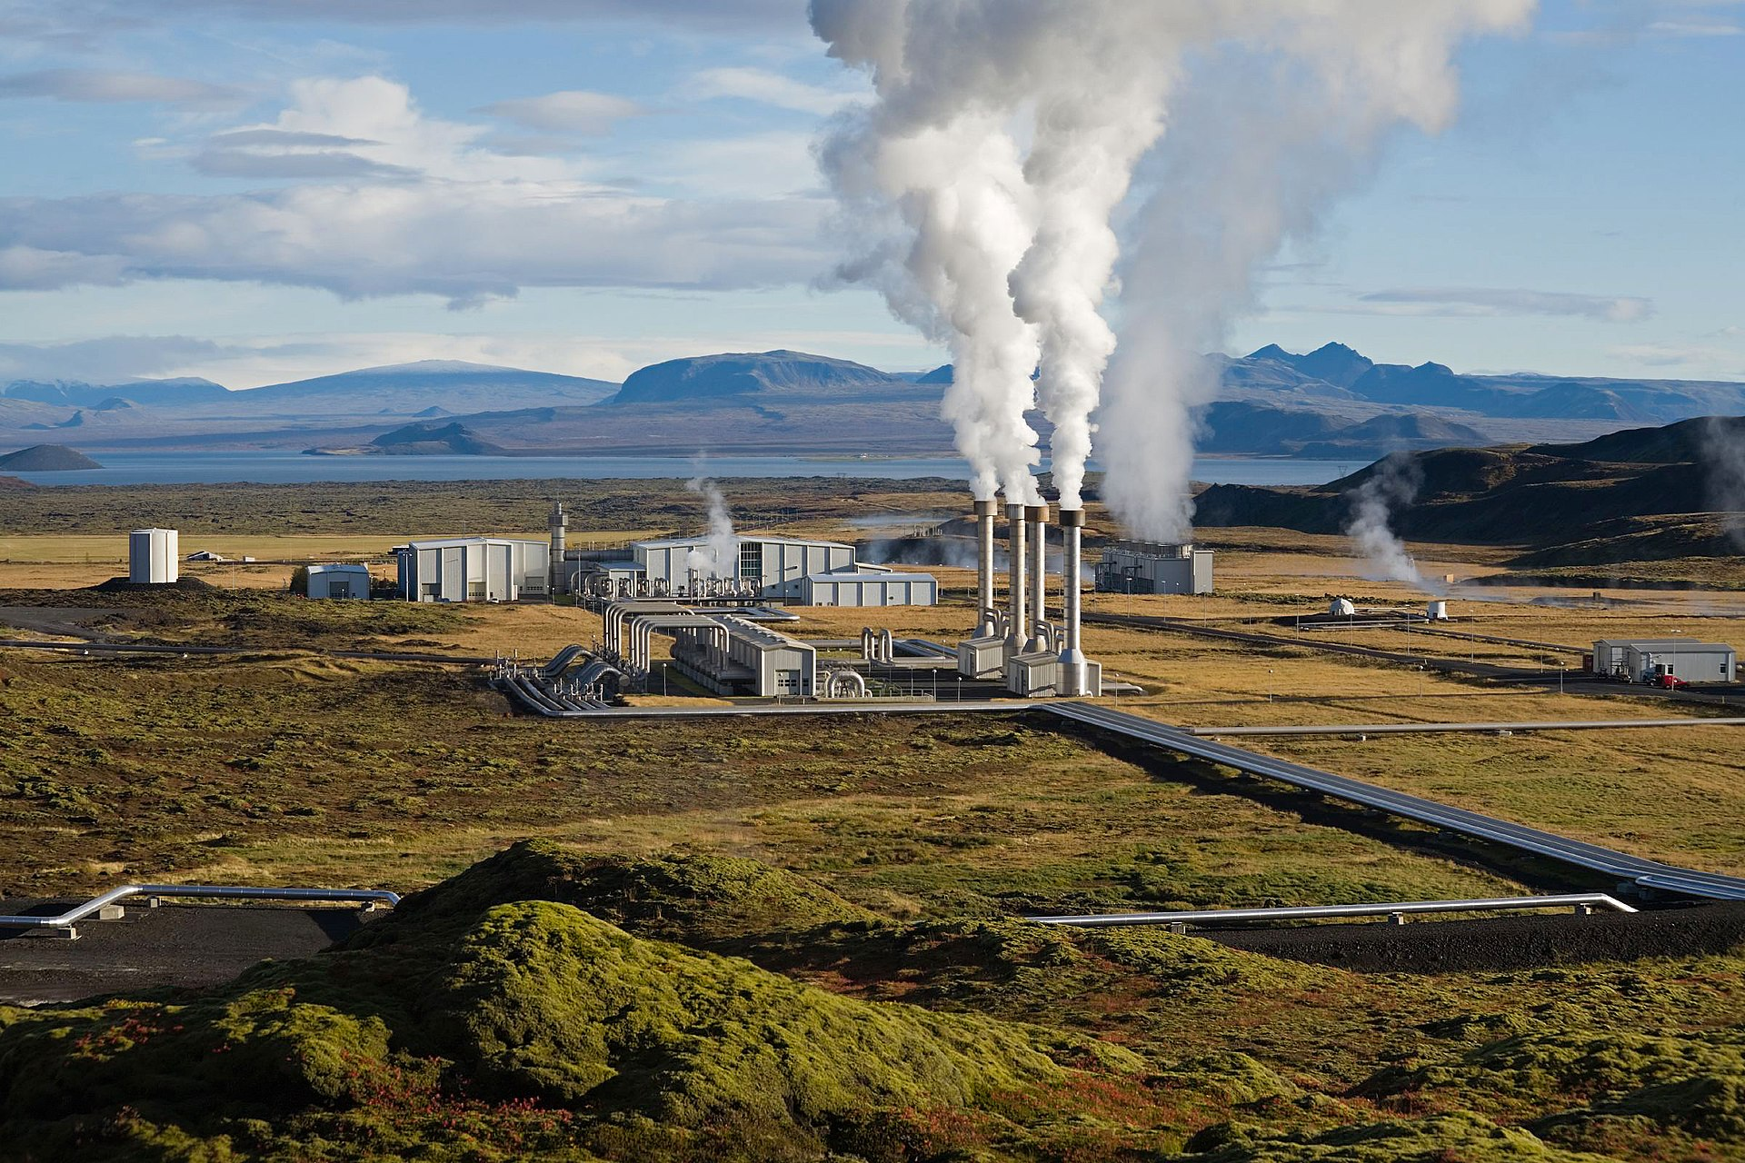
Notes:
How does geothermal energy work?
Which countries are famous for using geothermal energy?
What is geothermal energy commonly linked with? (plate boundaries, volcanoes, hot springs)
Where does the heat come from?
– ascertain class knowledge

Slide 18
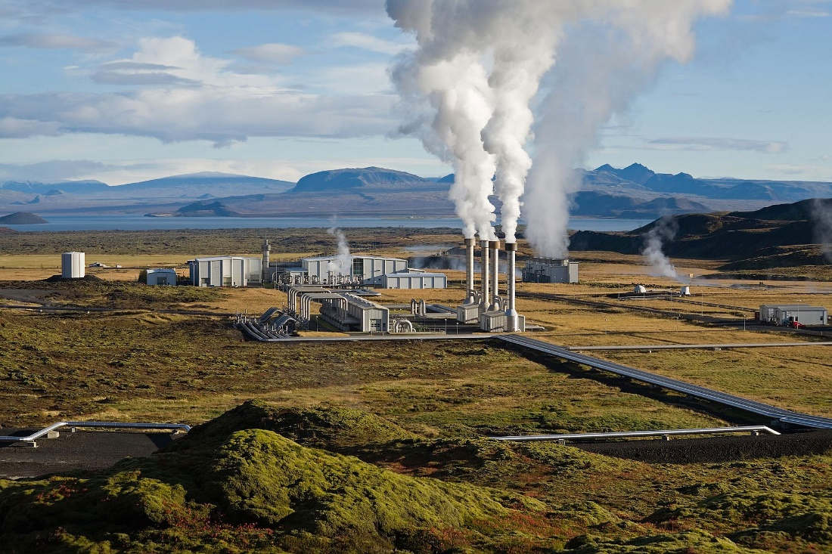
Geothermal energy = heat energy from the Earth
Decay of radioactive elements and residual heat from planetary formation 4.5 billion years ago
Water is pumped down into hot rock where it is heated.
Steam can then be used to heat buildings directly or to generate electricity by spinning a turbine.
Nesjavellir Geothermal Power Station, Iceland
Notes:
Geothermal energy is heat energy from the Earth generated by the decay of radioactive elements and residual heat from the Earth’s formation 4.5 billion years ago. Hot springs have been used since Palaeolithic times for bathing and the Romans harnessed geothermal energy for underfloor heating and to heat their public baths, however nowadays geothermal energy is better known for electricity generation.
To use geothermal energy water is pumped down into hot rocks through pipes where is it heated. When this water and steam comes back up to the surface it can be used directly to heat people’s homes, buildings, greenhouses etc., or the steam can be used to generate electricity through spinning turbine connected to a generator.
Geothermal energy can only be harnessed where the rocks are hot enough. This is generally around plate boundaries like in Iceland, New Zealand and Italy, where heated rocks tend to be much closer to the surface. However, recent technological improvements have increased the geographical range of geothermal power. In the UK, granite beneath Cornwall has been targeted as a potential source for geothermal power.

Slide 19
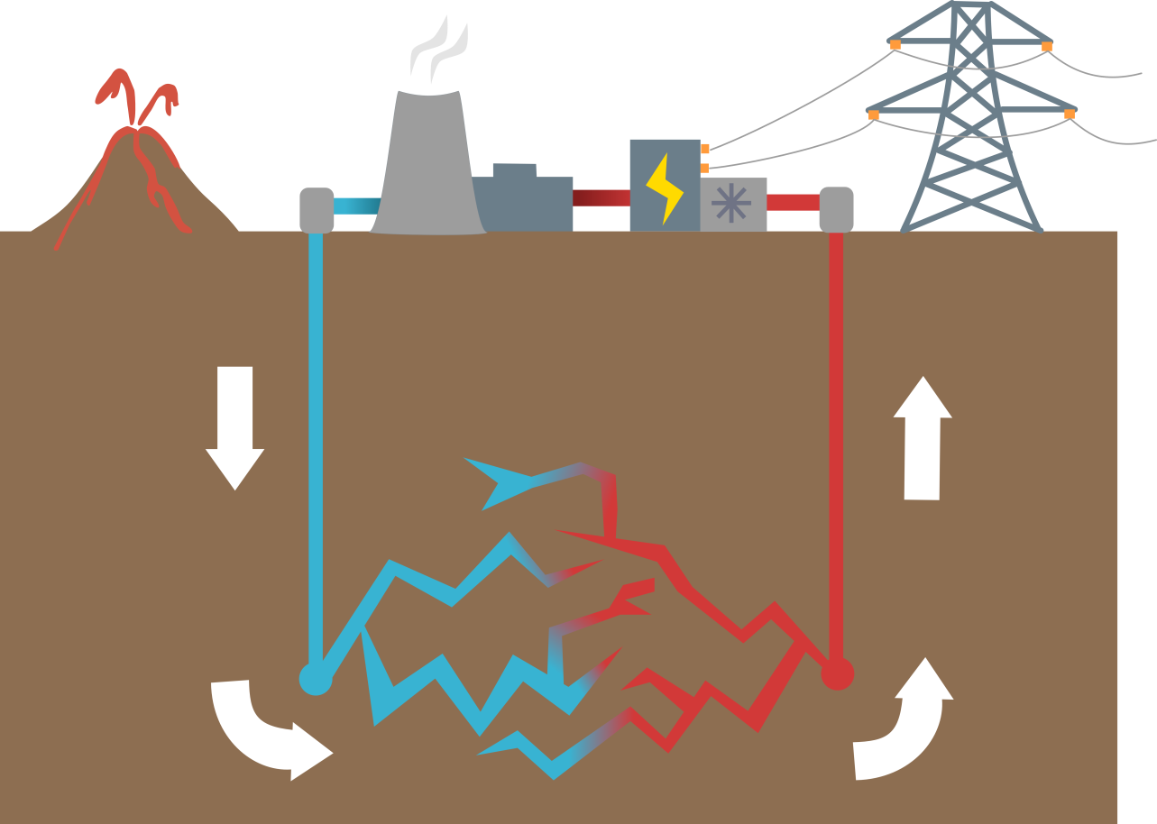
Generator
Electricity pylon
Cooling tower
Turbine
Homes and buildings
Injection well
Steam
Hot water
Cold water
Water is heated
Notes:
Geothermal energy is heat energy from the Earth generated by the decay of radioactive elements and residual heat from the Earth’s formation 4.5 billion years ago. Hot springs have been used since Palaeolithic times for bathing and the Romans harnessed geothermal energy for underfloor heating and to heat their public baths, however nowadays geothermal energy is better known for electricity generation.
To use geothermal energy water is pumped down into hot rocks through pipes where is it heated. When this water and steam comes back up to the surface it can be used directly to heat people’s homes, buildings, greenhouses etc., or the steam can be used to generate electricity through spinning turbine connected to a generator.
Geothermal energy can only be harnessed where the rocks are hot enough. This initially was only at plate boundaries as hot rocks tend to be much closer to the surface in these situations e.g. in Iceland, New Zealand, Japan, the Philippines, Indonesia and Italy. However technology improvements in the last 20 years have increased the geographical range so that electricity generation by geothermal energy is no longer limited to plate boundaries.

Slide 20
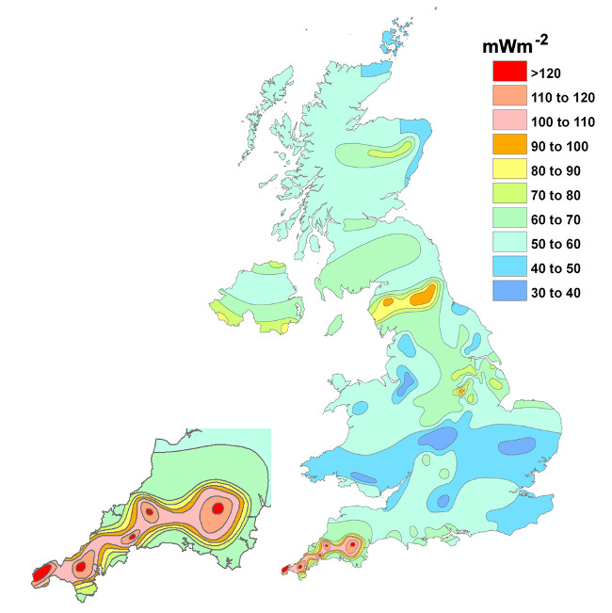
~ 190 ˚C granite 4.5km beneath Cornwall.
United Downs Geothermal Energy Project has funding to build a pilot geothermal energy plant
10MW of electricity and 55MW of heat.
Geothermal energy beneath Cornwall could meet all of Cornwall’s demand for electricity and up to 20% of the UK’s demand.
© BGS (NERC)
Notes:
Hot granite beneath Cornwall, known as the Cornubian Batholith (formed around ~280 million years ago in the Variscan orogeny) gives Cornwall the highest heat flow in the UK - the granite at 4.5km beneath Cornwall is ~ 190 ˚C . The red zones one the map correlate with plutons form the batholith
United Downs Geothermal Energy Project has secured funding to build a pilot geothermal energy plant (£10.6 million - European Regional Development Fund, £2.4 million - Cornwall Council, £5 million - private investors). It is estimated that it will be able to produce 10MW of electricity and 55MW of renewable heat. Water will be pumped down deep wells to heat up and then the steam will be used to generate electricity and heat.
Geothermal energy beneath Cornwall could meet all of Cornwall’s demand for electricity and potentially up to 20% of the UK’s demand so it is an important area of research.

Slide 21

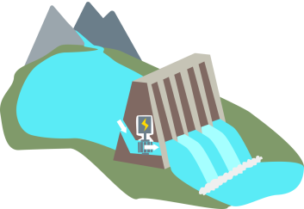
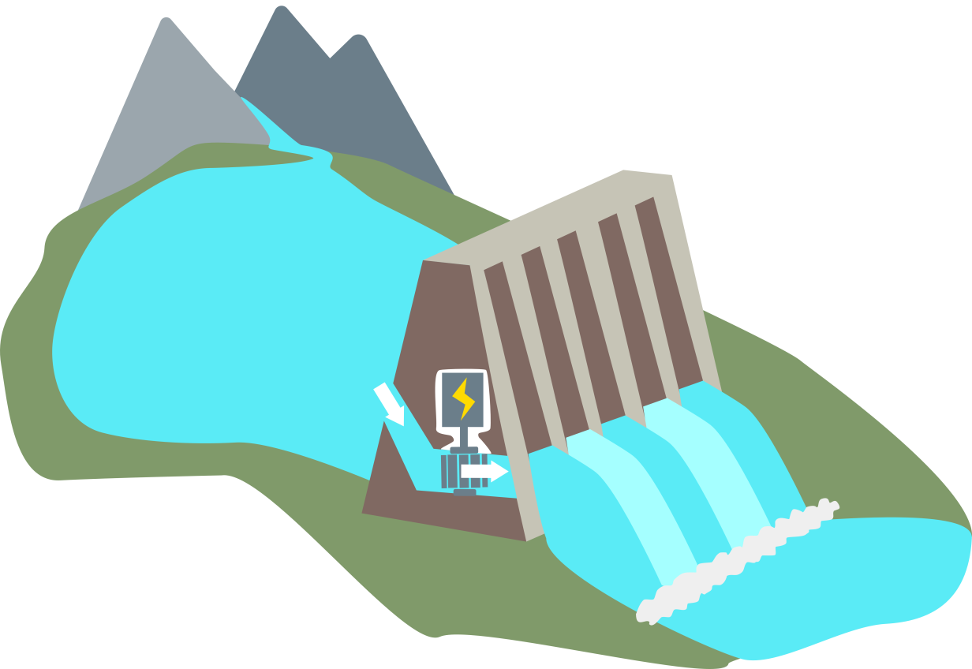
Hydroelectric power harnesses the kinetic energy of running water.
Hydroelectric dam
Water flows downwards with gravity to spin a turbine.
More reliable than solar and wind power.
Hydroelectric dams are very expensive and can harm wildlife.
1.5% electricity from hydroelectric schemes in the UK (29% total)
Reservoir of water
Generator
Turbine
Notes:
Hydroelectric power harnesses kinetic energy from running water. Hydroelectric dams are built to store large amounts of water in reservoirs made from flooding river valleys. When electricity is needed, water is let out through pipes in the dam. The water flows downwards under the influence of gravity and turns turbines linked to generators to generate electricity.
Hydroelectric power is more reliable than wind and solar power, although hydroelectric dams are expensive and depend on finding a suitable valley site to build and flood. This in turn effects the people and animals living there as well as impacting on the migration patterns of fish.

Slide 22
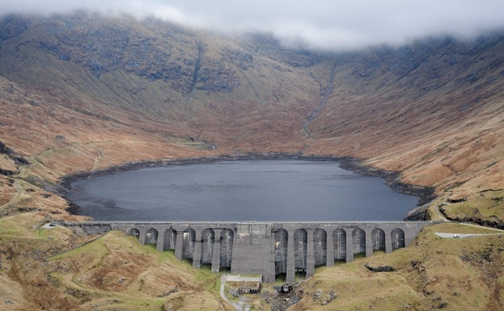
705 GWh per year
Cruachan Power Station, Argyll and Bute, Scotland
Notes:
Mountainous regions like the Scottish highlands and North Wales are good for hydroelectric power because they have steep topography and high rainfall. The UK currently generates about 1.5% of its electricity from hydroelectric schemes - most of which are in the Scottish Highlands.

Slide 23


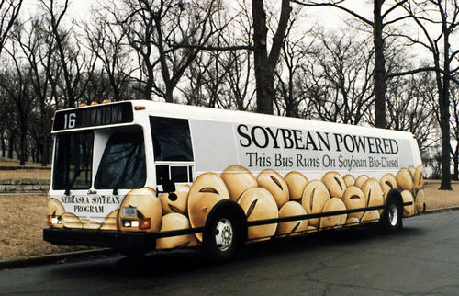
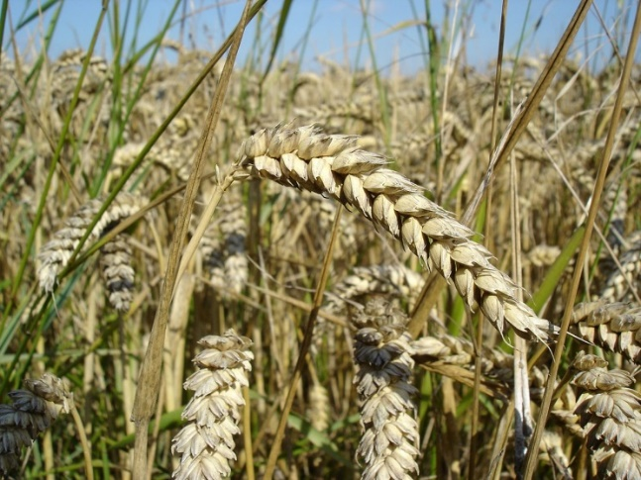
Biofuel - either directly from plants or from waste.
Main UK sources are wheat and cooking oil
Bioethanol – used as fuel and as a petrol additive to increase octane and lower carbon emissions
Biodiesel – used as fuel and used to reduce levels of particulates and carbon monoxide in diesel powered vehicles
Notes:
Biofuels are fuels produced from biomass either directly from plants or indirectly from agricultural, commercial, domestic and/or industrial waste. They similar to fossil fuels but they are made from plants grown today rather than plants that grew millions of years ago. They can be made quickly so they are renewable. The two main types of biofuel are bioethanol and biodiesel.
Bioethanol is an alcohol made by fermentation of crops such as corn, sugarcane and sweet sorghum. It is used as a petrol additive to increase octane and lower carbon emissions or can be used directly as a fuel.
Biodiesel is an oil based biofuel produced from vegetable fats such as rapeseed, sunflower seed, soya bean and palm oil. It is used to reduce levels of particulates, carbon monoxide, and hydrocarbons from diesel-powered vehicles or directly to fuel vehicles.
In 2015, biofuels accounted for 4% of total transportation fuels worldwide. The global production of biofuels is dominated by the US and Brazil – producing 72% of all biofuels in 2015 – followed by Europe (EU–28), which produced 12%.
Ideally biofuels should be carbon neutral because they absorb as much carbon dioxide from the atmosphere whilst they are growing as they give off when they are burnt. However at present because fossil fuels are used in the production of biofuels, for example in making fertilizers and in fueling farm equipment they are not currently carbon neutral, although they do still release less CO2 than burning fossil fuels directly.

Slide 24
Biofuel makes up 3% of all UK road and non-road fuel (2016) and 9% of UK electricity generation
In 2016 93,000 ha were used for biofuels, 41,000 ha of this was to grow wheat (DEFRA)
Ethical and environmental issues
Notes:
The main sources of biofuel in the UK are wheat and used cooking oil.
In 2016, 93,000 ha of land was used to produce crops for biofuels, 41,000 ha of this land was to grow wheat (DEFRA). If all the extra emissions involved in changing land use to grow wheat were accounted for, biofuel based on wheat was actually worse for the environment than regular petrol or diesel in 2016 (Sustainability of liquid biofuels, Royal Academy of Engineering).
UK produces 16 million tonnes of waste each year – RAE suggest that it should focus on using waste fuels like chip fat, landfill gas, forest and sawmill residue, whiskey manufacturing dregs and even sewer ‘fatbergs’ instead of wheat.
RAE recommends that the UK government set a cap for all crop-based biofuels to limit the use of farmland for wheat.
Also ethical issues – lots of land used to grow crops for biofuels, wheat in the UK or sugarcane in Brazil and USA, this land could be use to feed people.

Slide 25

Iceland – geothermal and hydroelectric
Costa Rica - hydroelectric
Brazil- biofuels

Slide 26


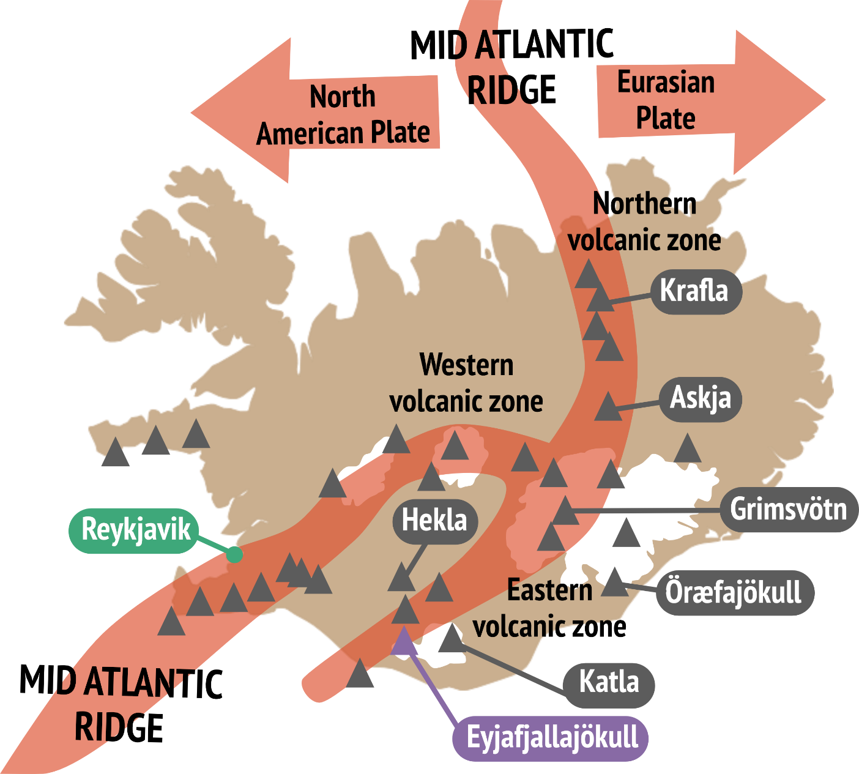

Slide 27

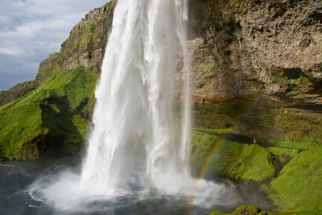
Iceland lies on the Mid Atlantic Ridge a region of sea floor spreading = lots of hot rocks!
Annual rainfall 2,000mm (UK ~885mm/year)
600 hot springs and 20 high-temperature steam fields >150 °C.
Nesjavellir Geothermal Power Station
Notes:
Iceland lies on the Mid Atlantic Ridge a region of sea floor spreading (divergent/constructive plate margin) it is a very volcanic country and the rocks beneath its surface are hot. Iceland also gets a lot of rain, much of this rain filters down into the Earth’s crust through cracks and pores where it is naturally heated by the hot surrounding rocks and it then travels upwards to the surface. Sometimes this hot water explodes out as geysers other times it creates hot springs like the blue lagoon.
Iceland has over 200 extinct and active volcanoes, 600 hot springs and 20 high-temperature steam fields that are at least 150 °C. Iceland currently generates over 85% of heating and 27% of its electricity from geothermal energy. Iceland’s mountainous and glacial geography also means that it can also generate 70% of its electricity from hydropower from glaciers and rivers in the interior of the country.
The move from oil-based heating to geothermal heating saved Iceland an estimated $8.2 billion from 1970 to 2000 and lowered the carbon dioxide emissions by 37%. However Iceland is still dependent on fossils fuels for its shipping boats, cars and buses – this reliance actually makes it one of the highest emitters of CO2 per capita (because of its very small population of ~320,000). Research is underway into using hydrogen fuel cells to power buses and cars – so that Iceland can be 100% renewable.

Slide 28
85% of Iceland’s heating and 27% of electricity comes from geothermal energy.
70% of Iceland’s electricity comes from hydropower from glaciers and rivers.
Hydropower saved Iceland an ~ $8.2 billion from 1970 to 2000 and lowered its CO₂ emissions by 37%.
Still dependent on fossils fuels for ships, cars and buses –actually one of the highest emitters of CO₂ per capita.
Research into hydrogen fuel cells to power buses and cars.
Nesjavellir Geothermal Power Station
Notes:
Iceland lies on the Mid Atlantic Ridge a region of sea floor spreading (divergent/constructive plate margin) it is a very volcanic country and the rocks beneath its surface are hot. Iceland also gets a lot of rain, much of this rain filters down into the Earth’s crust through cracks and pores where it is naturally heated by the hot surrounding rocks and it then travels upwards to the surface. Sometimes this hot water explodes out as geysers other times it creates hot springs like the blue lagoon.
Iceland has over 200 extinct and active volcanoes, 600 hot springs and 20 high-temperature steam fields that are at least 150 °C. Iceland currently generates over 85% of heating and 27% of its electricity from geothermal energy. Iceland’s mountainous and glacial geography also means that it can also generate 70% of its electricity from hydropower from glaciers and rivers in the interior of the country.
The move from oil-based heating to geothermal heating saved Iceland an estimated $8.2 billion from 1970 to 2000 and lowered the carbon dioxide emissions by 37%. However Iceland is still dependent on fossils fuels for its shipping boats, cars and buses – this reliance actually makes it one of the highest emitters of CO2 per capita (because of its very small population of ~320,000). Research is underway into using hydrogen fuel cells to power buses and cars – so that Iceland can be 100% renewable.

Slide 29

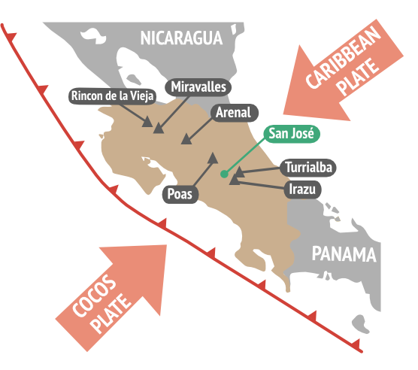
Notes:
Map of Costa Rica showing convergent plate boundary (teeth on upper plate) and major volcanoes.

Slide 30
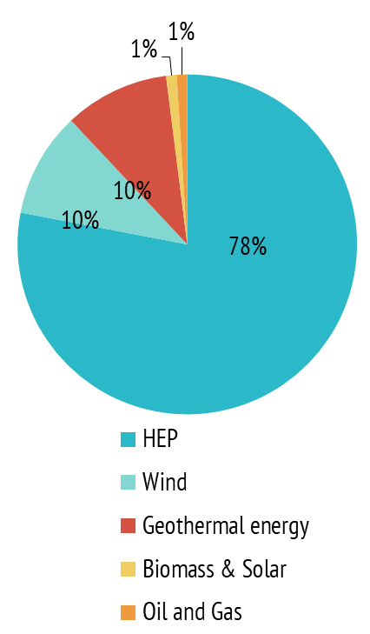
Electricity generation in Costa Rica 2017
High concentration of rivers, dams, and volcanoes
Annual rainfall 2,926 mm - 4th highest rainfall per capita
Renewable energy supplied 99% of electricity in Costa Rica in 2017, 78% of which was hydropower, 10% geothermal and 10% wind
For 300 days in 2017 and again in 2018 Costa Rica generated all of its electricity from renewable energy sources.
Notes:
Costa Rica has a high concentration per capita of rivers, dams, and volcanoes, and 4th highest rainfall per capita: average 2,926 mm/year - good for renewable energy generation.
The elimination of the military in 1948 freed up millions of dollars which is now invested in social programs and renewable energy generation
Renewable energy supplied 99% of electricity in Costa Rica in 2017, 78% of which was HEP. For 300 days in 2017 and again in 2018 Costa Rica generated all of its electricity from renewable energy sources.
Lake Arenal Dam was built in 1979 as the first dam intended solely for hydroelectric power usage. It provides enough electricity to power 12% of Costa Rica.

Slide 31
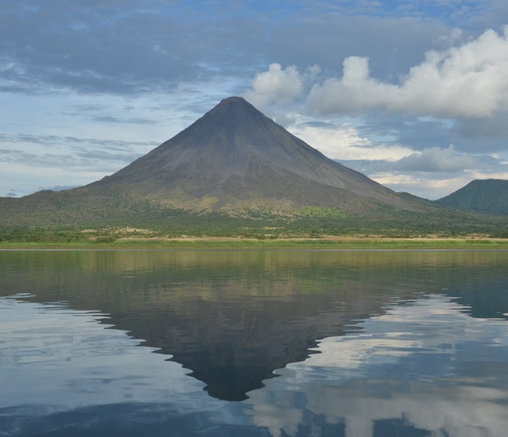

Lake Arenal Dam provides enough electricity to power 12% of Costa Rica.
99% electricity is from renewables but 70% energy consumption in Costa Rica is from transport which runs on petroleum
Costa Rica has 287 cars per 1,000 people, greater than the world and Latin American average.
Growth in car ownership has also made San José the most congested city in Latin America
Lake Arenal, Costa Rica
Notes:
Whilst 99% electricity in Costa Rica is from renewables which but 70% energy consumption in Costa Rica is from transport which runs on petroleum
Costa Rica has approx 287 cars per 1,000 people, greater than the world and Latin American average.
Growth in car ownership has also made San José, the capital of Costa Rica, the most congested city in Latin America
Costa Rica’s goal is to be carbon neutral by 2021
Costa Rica’s hosts more than 5% of the world’s species biodiversity despite a landmass that covers 0.03% of the planet.
While dams provided the majority of the country’s electricity, they can have destructive environmental and social consequences, such as affecting previously healthy rivers, disrupting wildlife and displacing indigenous communities.

Slide 32
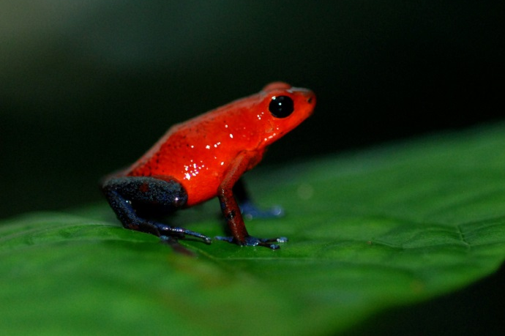
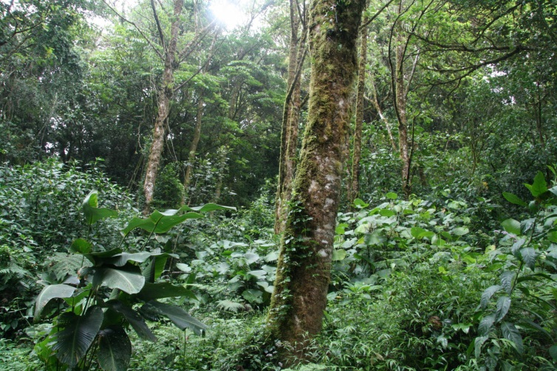
Costa Rica’s goal is to be carbon neutral by 2021
Costa Rica’s hosts more than 5% of the world’s species biodiversity despite its landmass covering 0.03% of the planet.
Dams can environmental and social consequences - affecting previously healthy rivers, disrupting wildlife and displacing indigenous communities.
‘Blue jeans’ poison dart frog
Monte Verde cloud forest
Notes:
Whilst 99% electricity in Costa Rica is from renewables which but 70% energy consumption in Costa Rica is from transport which runs on petroleum
Costa Rica has approx 287 cars per 1,000 people, greater than the world and Latin American average.
Growth in car ownership has also made San José, the capital of Costa Rica, the most congested city in Latin America
Costa Rica’s goal is to be carbon neutral by 2021
Costa Rica’s hosts more than 5% of the world’s species biodiversity despite a landmass that covers 0.03% of the planet.
While dams provided the majority of the country’s electricity, they can have destructive environmental and social consequences, such as affecting previously healthy rivers, disrupting wildlife and displacing indigenous communities.

Slide 33

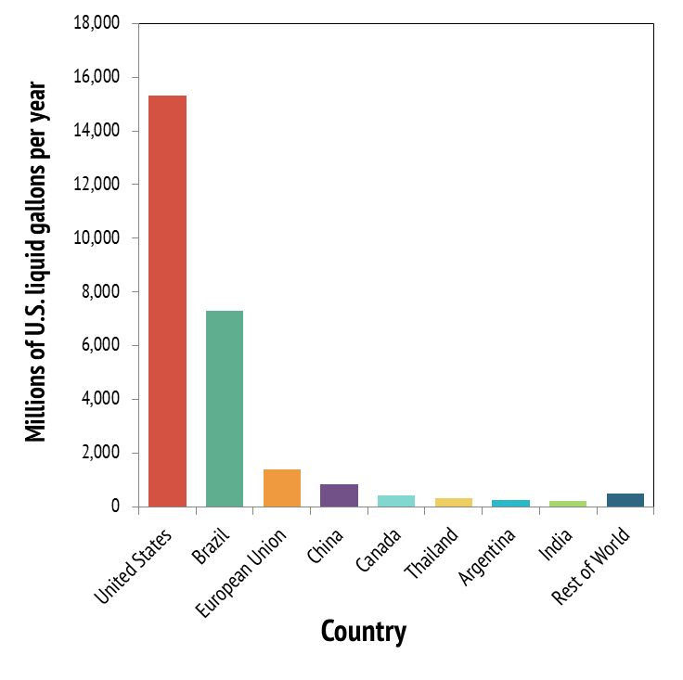
Leading producers of bioethanol 2016
Made from sugarcane
Brazil is 2nd largest producer of bioethanol after USA
produced 7.295 billion US gallons of ethanol in 2016, 27.4% of total ethanol production.
Replaced 42% of its gasoline needs with bioethanol.
Notes:
Sugarcane has been grown in Brazil for hundreds of years
Brazil is the 2nd largest producer of bioethanol after the US.
In 2016 Brazil produced 7.295 billion US gallons of ethanol from sugarcane= 27.4% of the world's total ethanol production.
Brazil has replaced 42% of its gasoline needs with bioethanol.

Slide 34
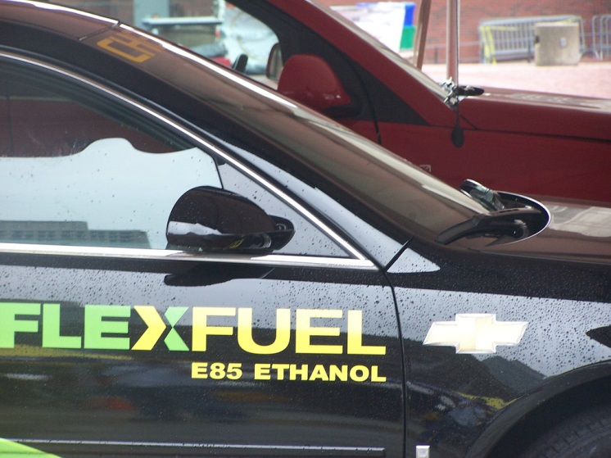
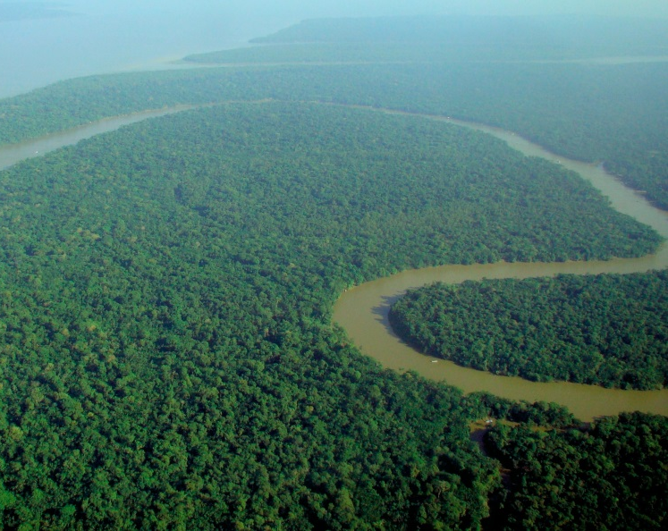
90% of new cars are flex fuel (run on either gasoline or pure ethanol)
Since 2003, the combination of sugarcane ethanol and flex fuel vehicles has reduced Brazil’s emissions of carbon dioxide by more than 350 million tons.
Consumes rainforest land - deforestation and biodiversity
Notes:
90% of new cars sold today in Brazil are flex fuel (can run on either gasoline or pure ethanol) due to consumer demand
Since 2003, the combination of sugarcane ethanol and flex fuel vehicles has reduced Brazil’s emissions of carbon dioxide by more than 350 million tons.
Growing sugar cane for ethanol has resulted in greater demand for rainforest land- concerns about deforestation and biodiversity
Direct emissions from bioethanol are up to 90% lower than those of gasoline or diesel fuels but indirect emissions associated with production and land clearing for sugarcane cropping vary greatly and can be significant.
Sugarcane production use lots of water - up to 4 litres of water are needed to produce 1 litre of ethanol produced.

Slide 35
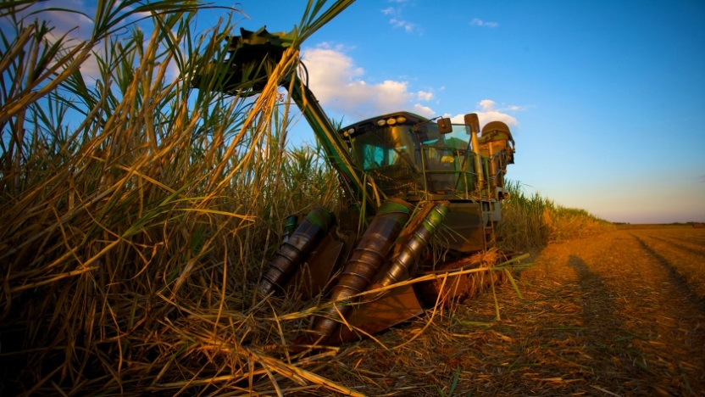
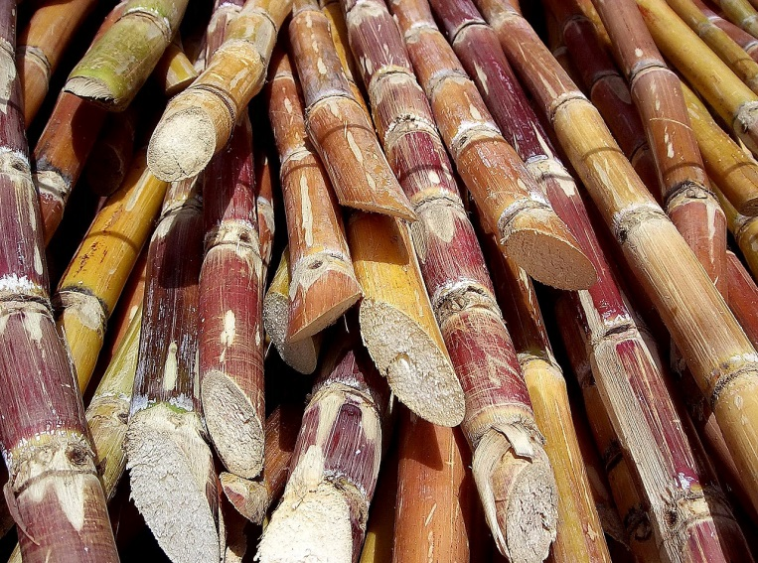
Emissions from bioethanol are ~ 90% lower than those of gasoline or diesel fuels
Emissions associated with production and land clearing.
Use lots of water - up to 4 litres of water are needed to produce 1 litre of ethanol produced.
Notes:
90% of new cars sold today in Brazil are flex fuel (can run on either gasoline or pure ethanol) due to consumer demand
Since 2003, the combination of sugarcane ethanol and flex fuel vehicles has reduced Brazil’s emissions of carbon dioxide by more than 350 million tons.
Growing sugar cane for ethanol has resulted in greater demand for rainforest land- concerns about deforestation and biodiversity
Ethanol was badly hit in the global recession of 2008 as the Brazilian government gave subsidies to petrol - but is now recovering.
Direct emissions from bioethanol are up to 90% lower than those of gasoline or diesel fuels but indirect emissions associated with production and land clearing for sugarcane cropping vary greatly and can be significant.
Sugarcane production use lots of water - up to 4 litres of water are needed to produce 1 litre of ethanol produced.

Slide 36

Research renewable energy in another LIC/NEE country e.g. Indonesia
What renewable energy resources are used?
What percentage of total energy use is from renewables?
How is the country trying to increase their use of renewables?
What problems may it face?

Slide 37

The UK uses a mix of non-renewable and renewable fuels
Renewable energy resources are crucial for lowering carbon dioxide emissions and enabling a secure energy future
Important renewable energy sources include wind, solar, geothermal, hydroelectric and biofuels no energy resource is perfect - each comes with their own positives and negatives
Iceland, Costa Rica and Brazil renewable energy case studies
Notes:
Further work – research and produce a tourist information leaflet on an eco-city
Research somewhere where renewable energy is being used in the UK

