Slide 1


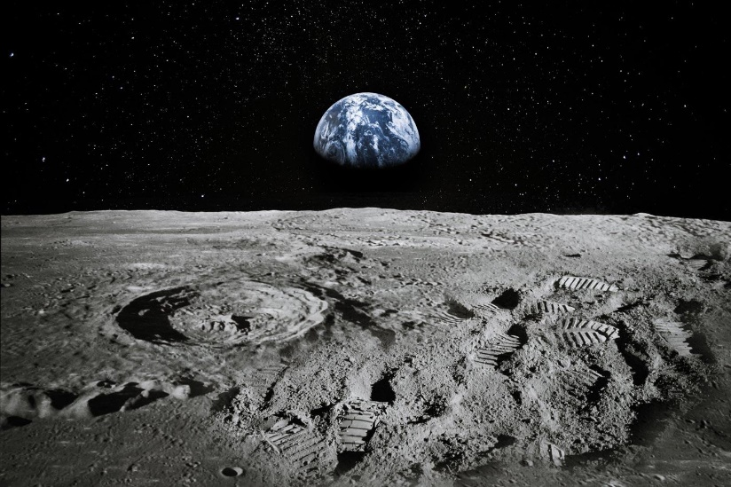
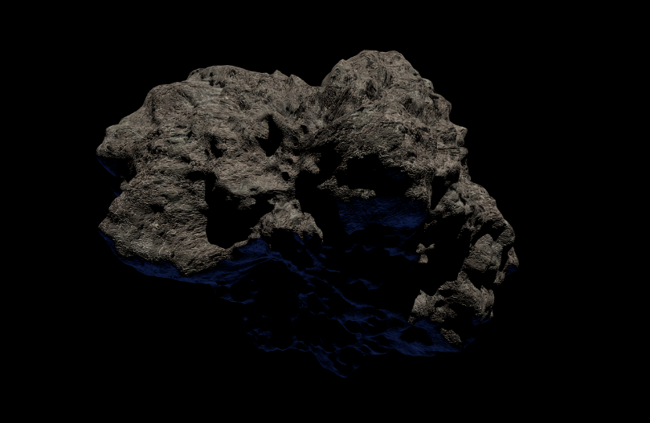
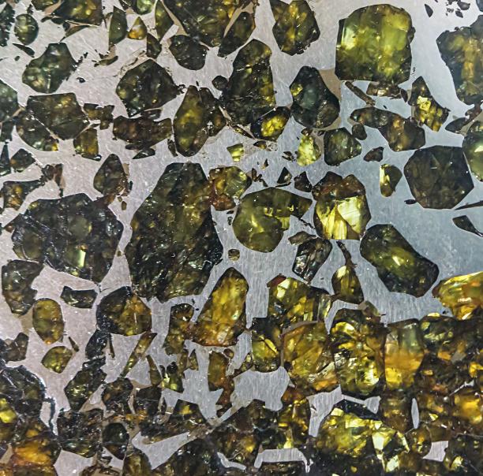
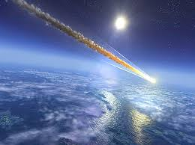
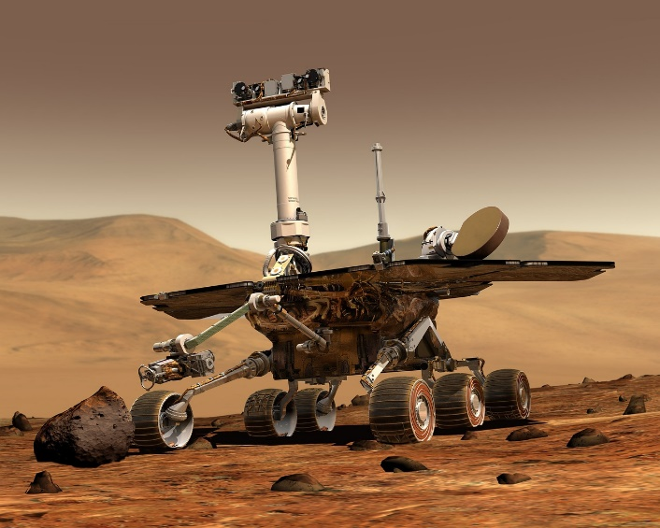
Notes:
In this lesson, you will be introduced to space rocks! What they are, how they form, and how to identify them.

Slide 2

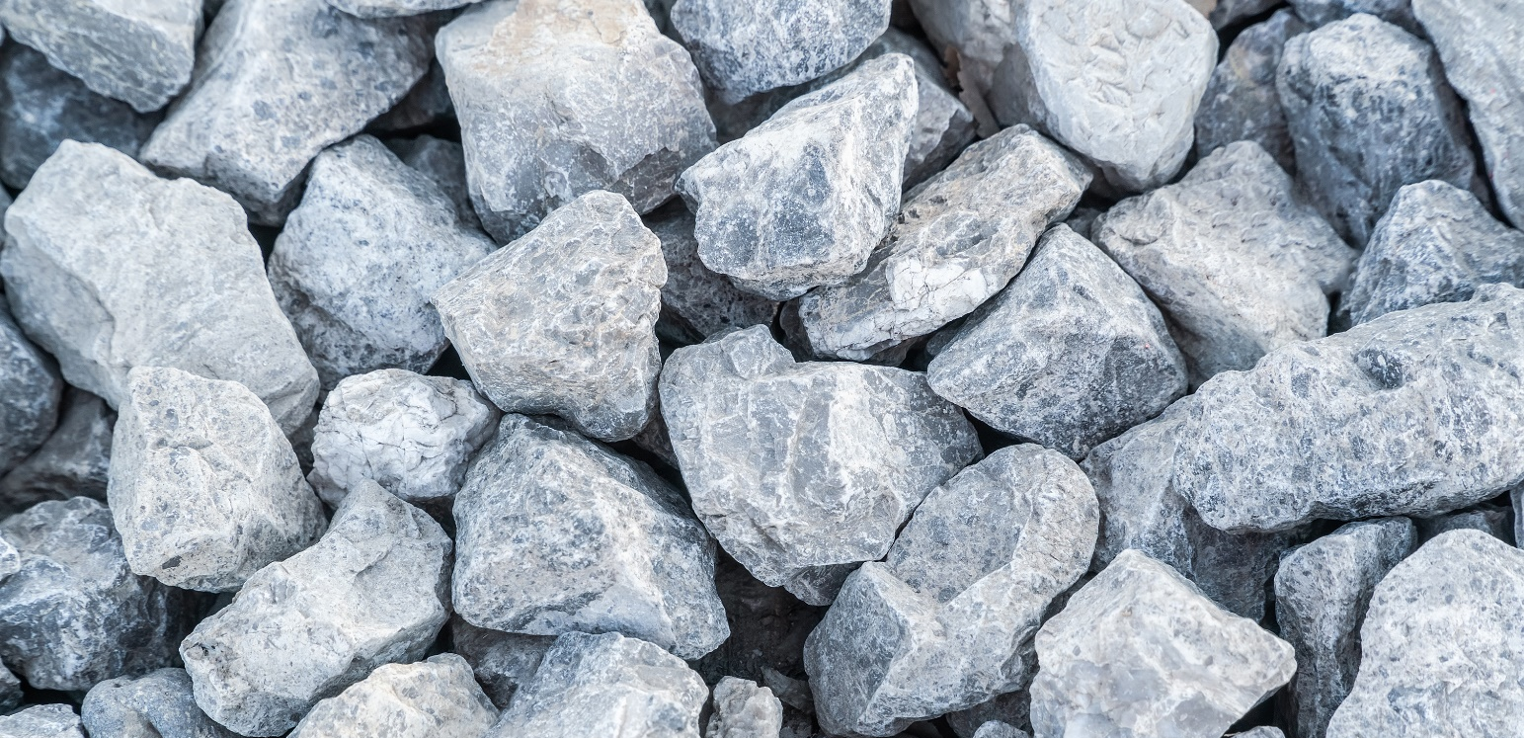
?
Notes:
The surface of the Earth, known as the crust, is made entirely from rock. All of the mountains, volcanoes, ocean floors, valleys, canyons, hills and cliffs are part of the Earth’s crust and they are all made from different types of rock.
Wherever you are on Earth there will always be rock beneath your feet. But what actually is a rock?

Slide 3

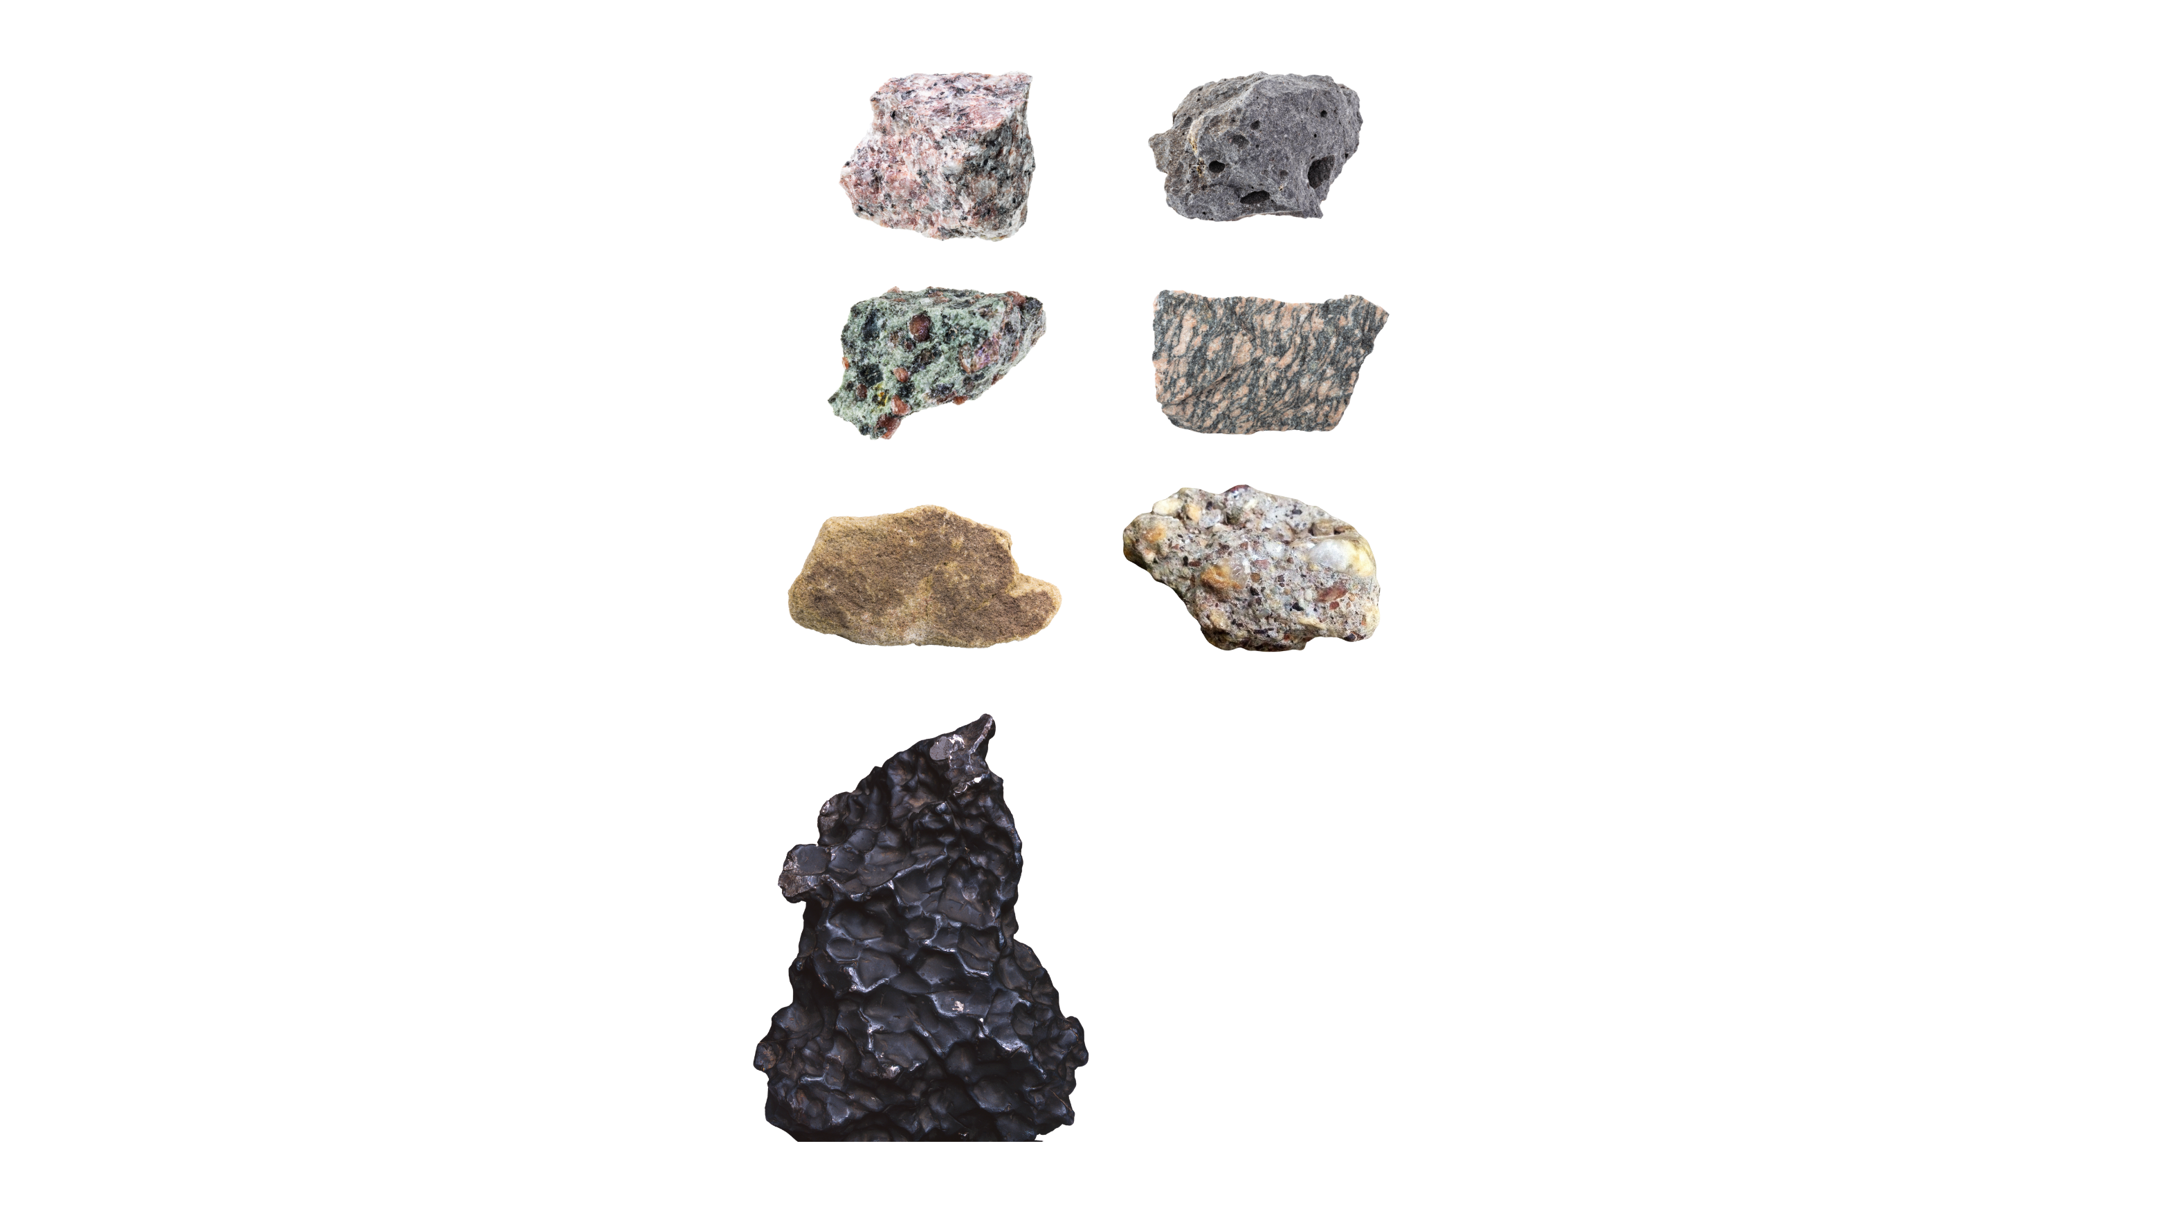

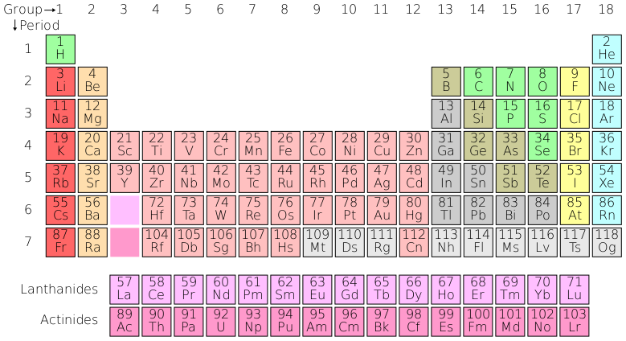
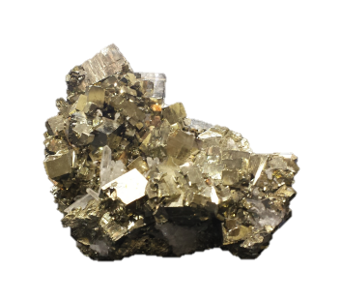
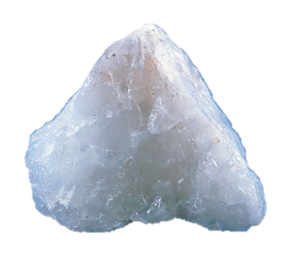
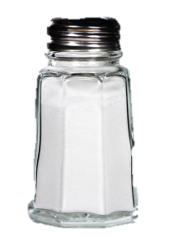
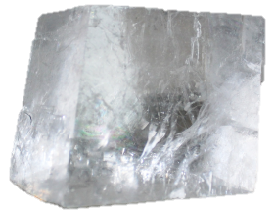

Sandstone
Conglomerate
Basalt
Eclogite
Quartz
Granite
Pyrite
Calcite
Halite (salt)
Gneiss
Notes:
All rocks are made from a mixture of minerals, which are made out of chemical elements. If you imagine a rock is a cake then minerals are the ingredients that make them.
Some rocks, like granite, are made from interlocking mineral crystals that fit tightly together. Other rocks like sandstone and conglomerates are made up from broken fragments, or grains, of older rocks and minerals which have been cemented together.

Slide 4

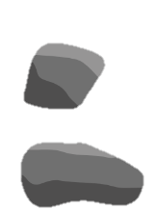



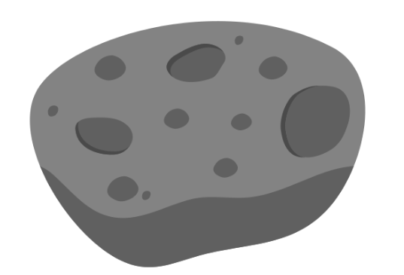
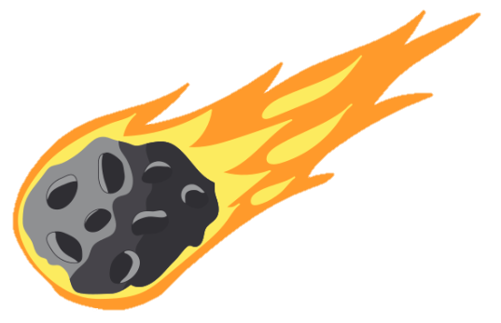
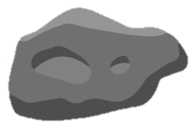
Meteorites
Asteroid
Meteoroids
Meteor
Planet
Meteor
Notes:
Just like on Earth, there are many rocks in space. You’ve probably heard a few words for them before, but what do we call them?
A planet is a large, spherical rocky body. An asteroid is much smaller, but still pretty big, and it doesn’t have to be spherical. Asteroids range in size between a few hundreds of metres, to 300 km!
Smaller rocks in space are called meteoroids, and they’re usually fragments of asteroids that hit each other.
When a meteoroid enters the Earth’s atmosphere, it starts burning up, forming a stunning phenomenon called a meteor, or a shooting star.
If any amount of rock survives going through the atmosphere, it lands on Earth as meteorites.
Note for teachers: if you prefer, instead of running the animations on this slide, you could play the first minute of this video from the Royal Observatory Greenwich: https://www.youtube.com/watch?v=rVdniqc_G_Q

Slide 5


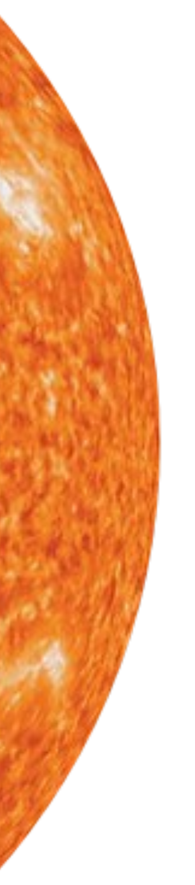
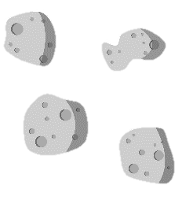
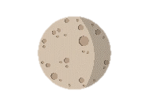


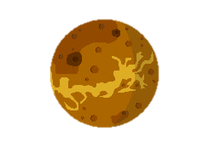
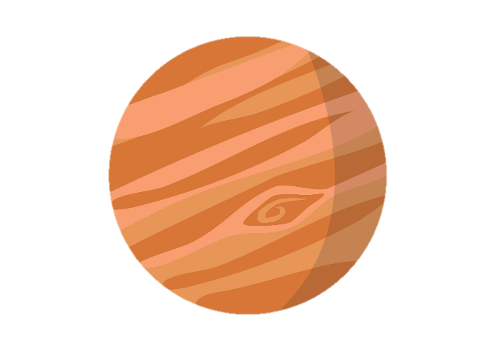
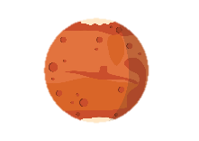

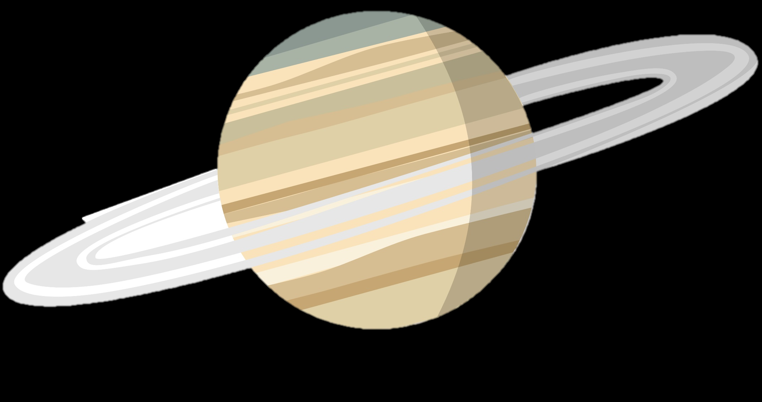



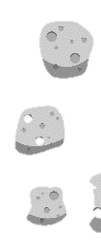
OUTER PLANETS
INNER PLANETS
ASTEROID BELT
Not to scale
Notes:
As a recap, this is our Solar System! Before we can go explore any further, we will need a semi-permanent base on our closest planetary neighbour – the Moon!
Can anyone point at the Moon?

Slide 6

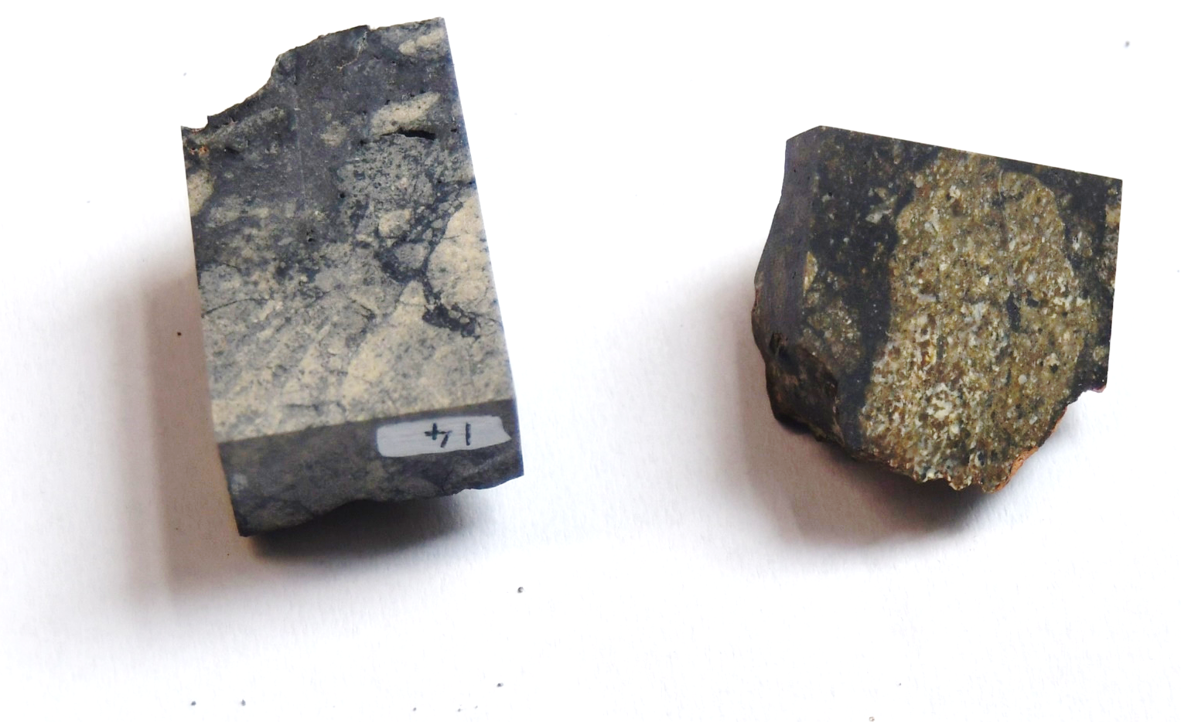
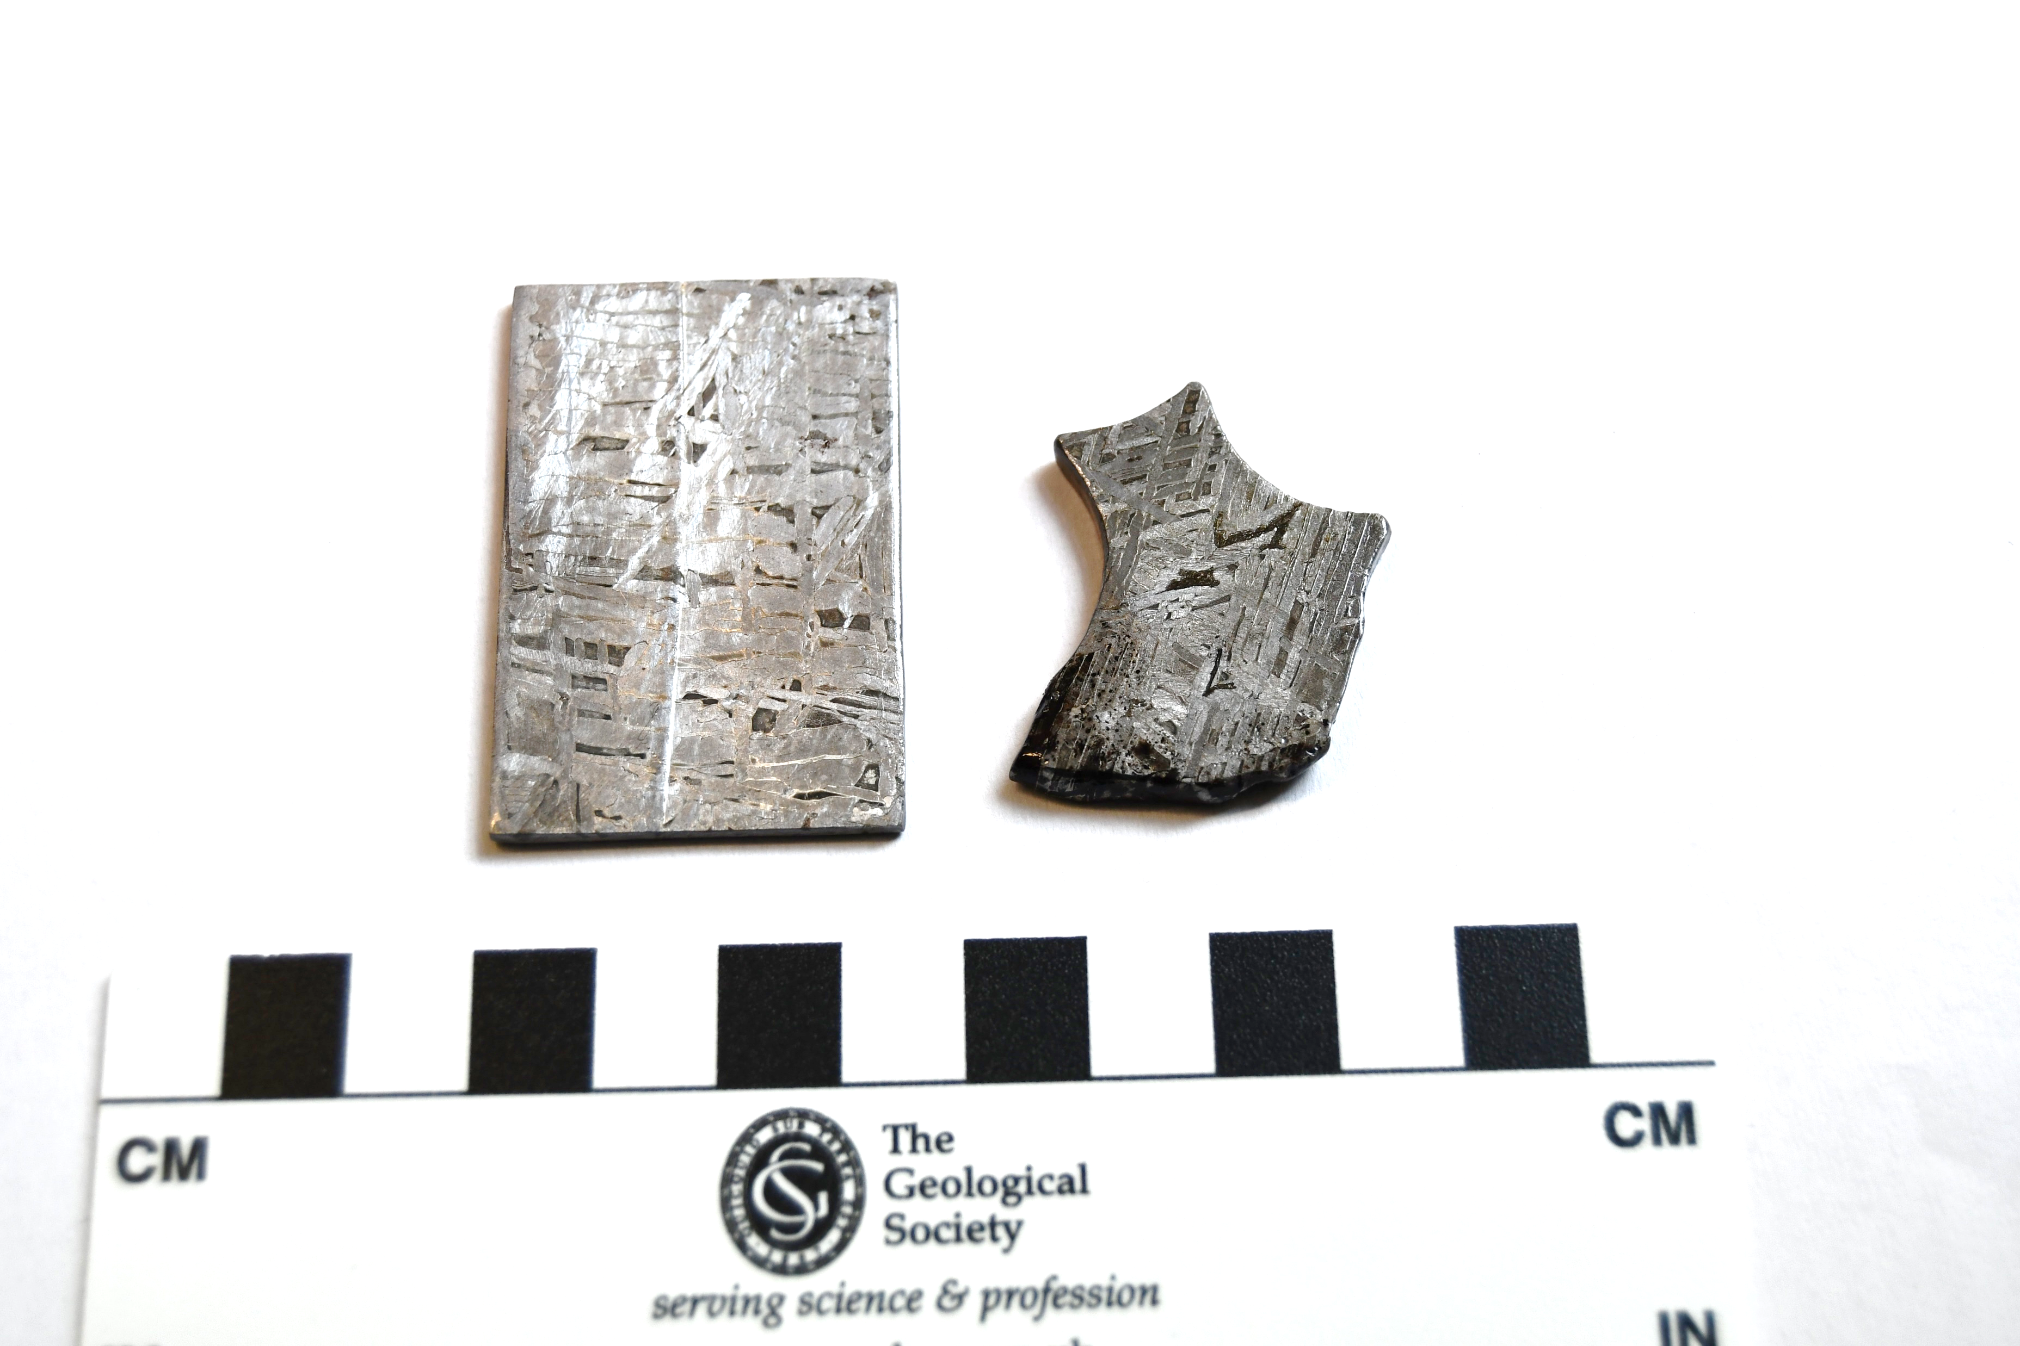
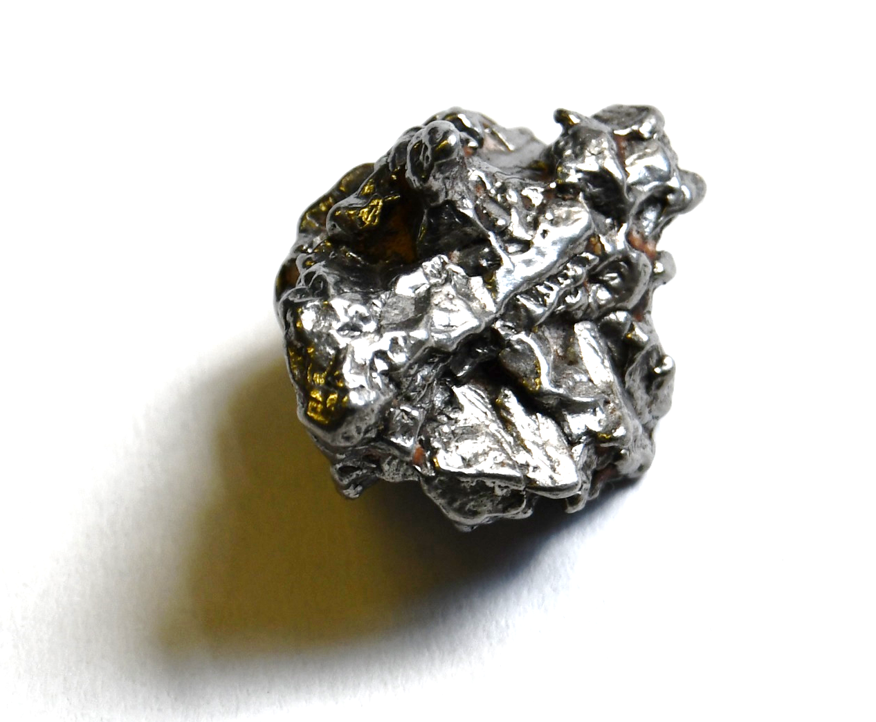
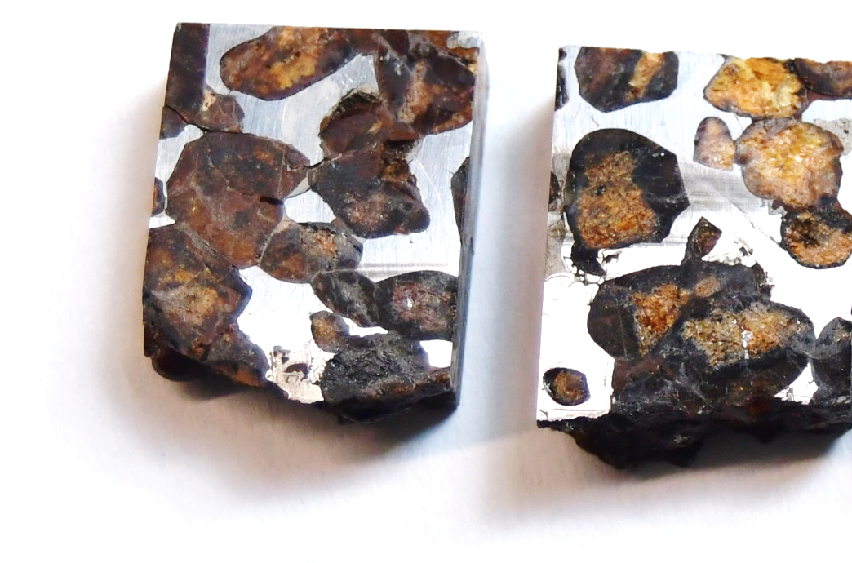
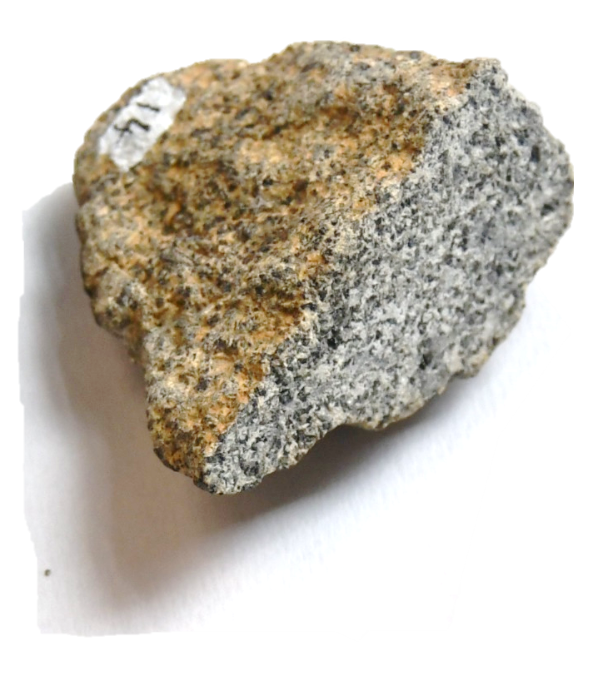
Stony Iron Stony-iron
Made of the same rock-forming minerals as earth rocks
Usually from the surface of a rocky body
Like igneous and volcanic rocks on Earth
Made of metal, mostly iron
Usually from the deep inside of a rocky body
Very different from Earth rocks!
Combination of rock-forming minerals and metal
Formed through mixing of stony and iron meteorite material
Very different from Earth rocks!
Notes:
Stony meteorites are made of the same minerals as Earth rocks and they usually look the same as Earth rocks, just a bit darker. They usually come from the surface of a rocky body.
Iron meteorites are made of almost pure iron. They usually come from the deep interior of a rocky body.
Stony-iron meteorites are half and half. They form when the two types of meteorites above somehow get combined into one rock!
Iron and stony-iron meteorites don’t have a direct equivalent to Earth rocks that we know of. Maybe rocks like this exist deep in the Earth, but it would be too deep for us ever to reach them! That’s why studying meteorites is the closest we can get the finding out what the Earth’s deep interior is like.

Slide 7



Step 1: Rock observations!
Go to each rock station and make observations about the rocks:
1. What colour(s) do you see?
2. Do you see any shiny metallic bits?
3. Does the inside look different from the outside? How?
4. What does the outside look and feel like?
- smooth, rough, or shiny
- glassy (looks like glass, doesn't have to be clear)
- pitted (small shallow holes)
5. Does it feel unusually heavy, unusually light, or just right?
Notes:
Before they can figure out which rocks came from outer space, they need to make basic rock observations, just like they would if they were on a meteorite expedition!
Note: a handout is provided to write down observations on.

Slide 8
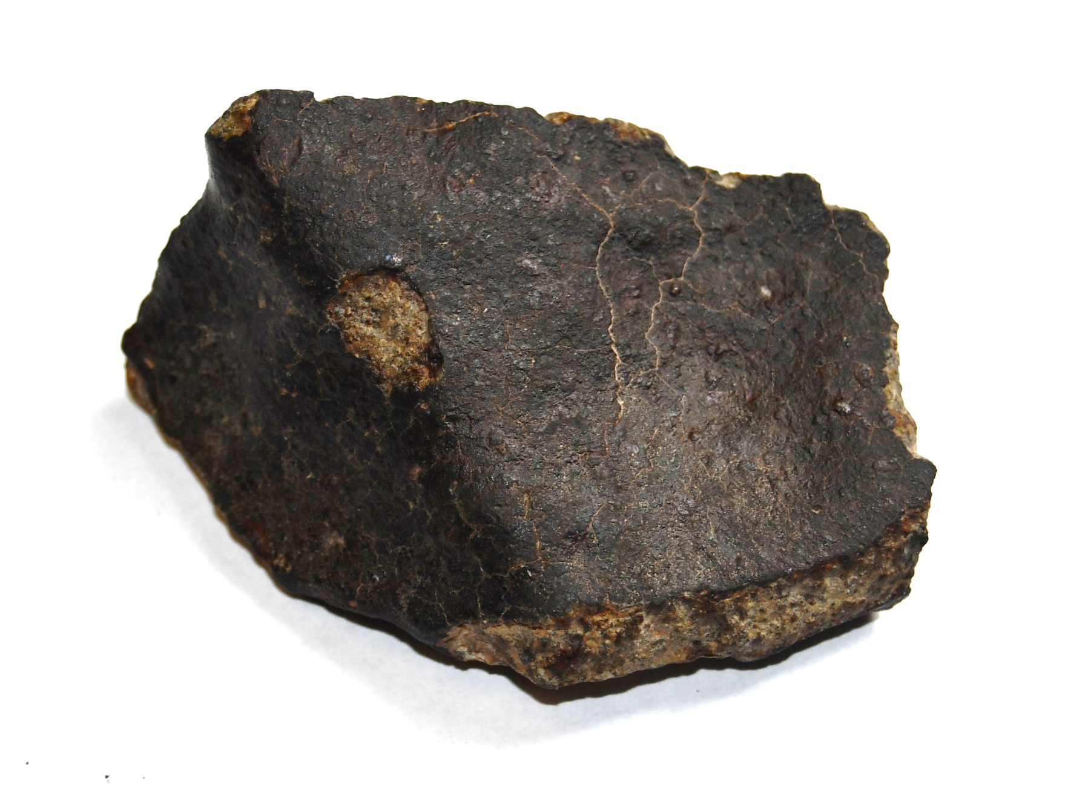

Step 2: Meteorite checklist
Go through your observations and tick the box next to each question if the answer is yes:
Is it unusually heavy?
Does it have a dark outside crust?
Does the outside have an irregular shape (not round, looks broken or jagged) with fingerprint-sized pits (small shallow holes)?
Can you see metal?
Notes:
Based on their previous observations, the students can now try to figure out if something is a meteorite based on this checklist. The answer does not have to be ‘yes’ to all questions for something to be a meteorite, but the more positive answers, the more confident they can be that they found a meteorite.
The last question refers to metal in general too (if a meteorite is entirely metallic), or small grains.

Slide 9


Slide 10

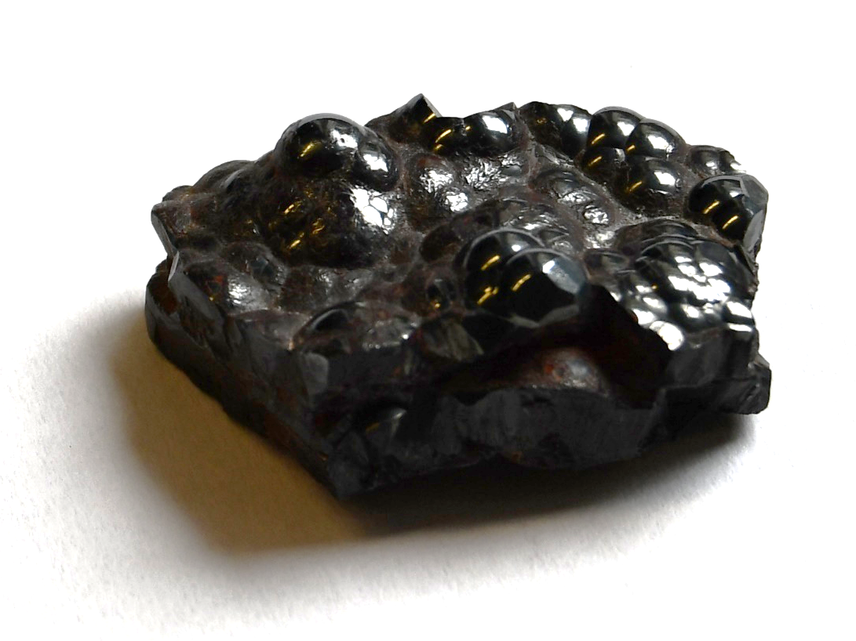

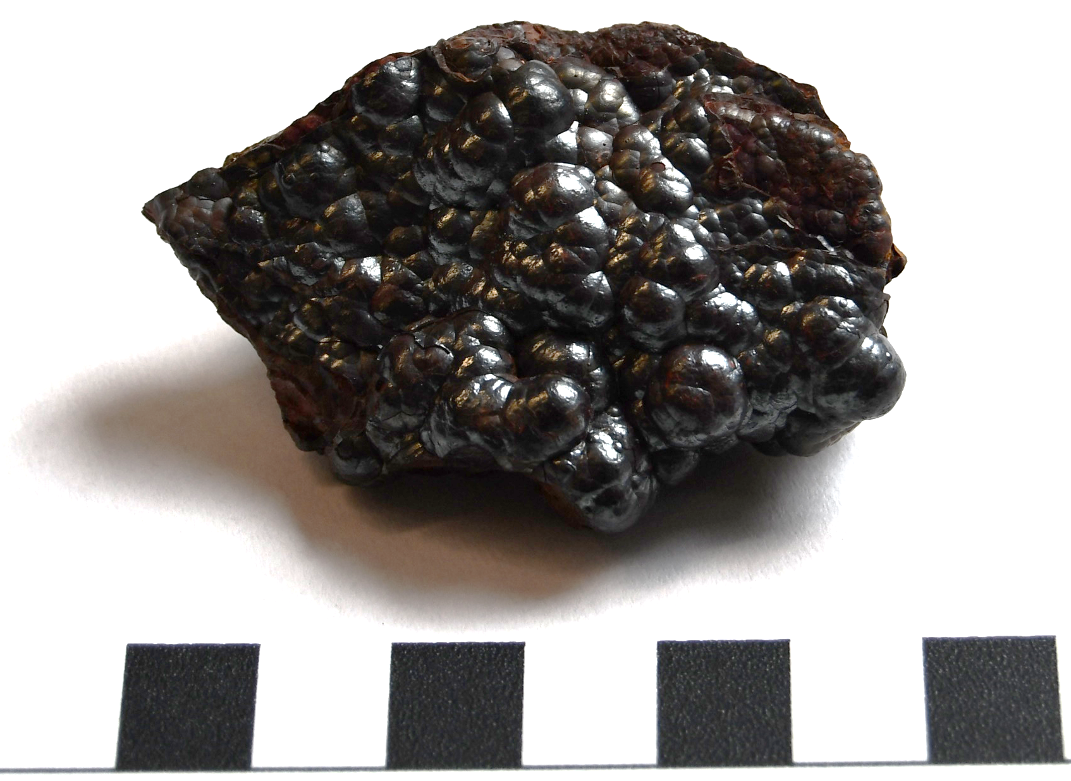
Meteorite checklist:
Is it unusually heavy?
Does it have a dark outside crust?
Does the outside have an irregular shape, with fingerprint-sized pits?
Can you see little metallic bits?
x
x
This is…
Haematite!
This is a mineral from the Earth. It’s often confused with meteorites, but haematite has round bumps rather than pits on the outside.
1 cm

Slide 11

Meteorite checklist:
Is it unusually heavy?
Does it have a dark outside crust?
Does the outside have an irregular shape, with fingerprint-sized pits?
Can you see little metallic bits?
This is…
Iron meteorite!
They form in the cores of differentiated asteroids, and they’re made entirely of metal.
1 cm

Slide 12

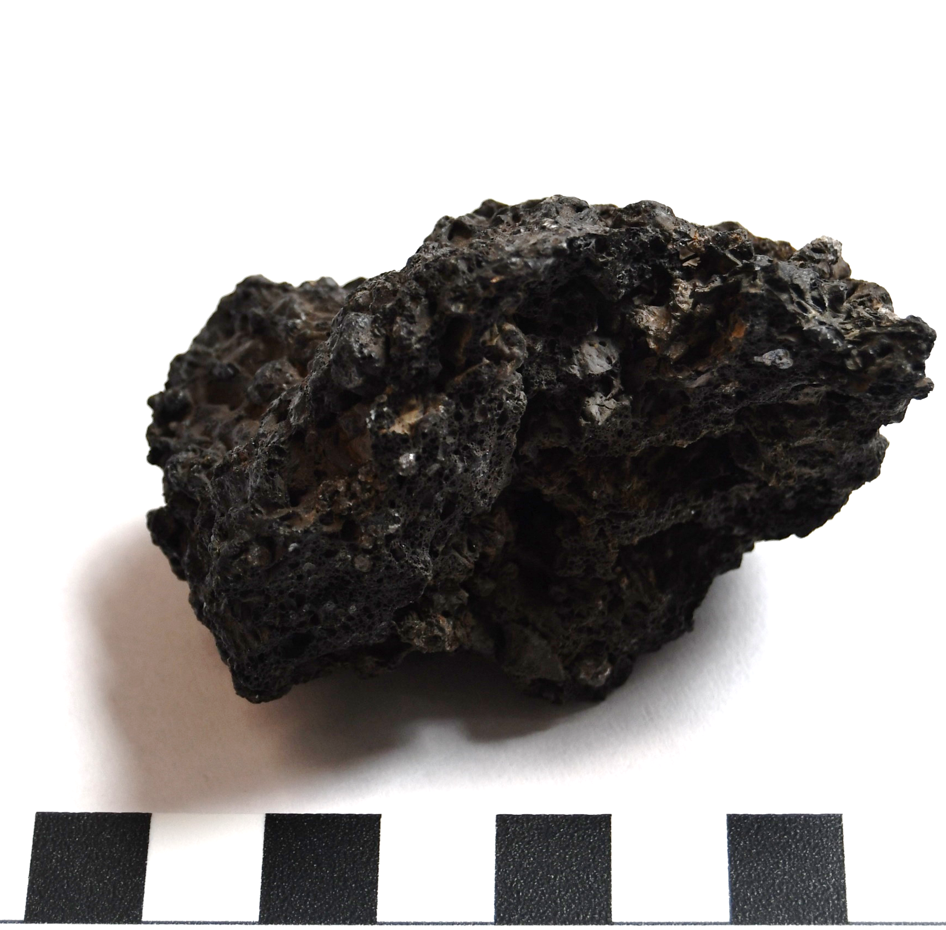
Meteorite checklist:
Is it unusually heavy?
Does it have a dark outside crust?
Does the outside have an irregular shape, with fingerprint-sized pits?
Can you see little metallic bits?
x
x
x
x
This is…
Lava!
It came out of a volcano on Earth, hence the little bubbles!
1 cm

Slide 13

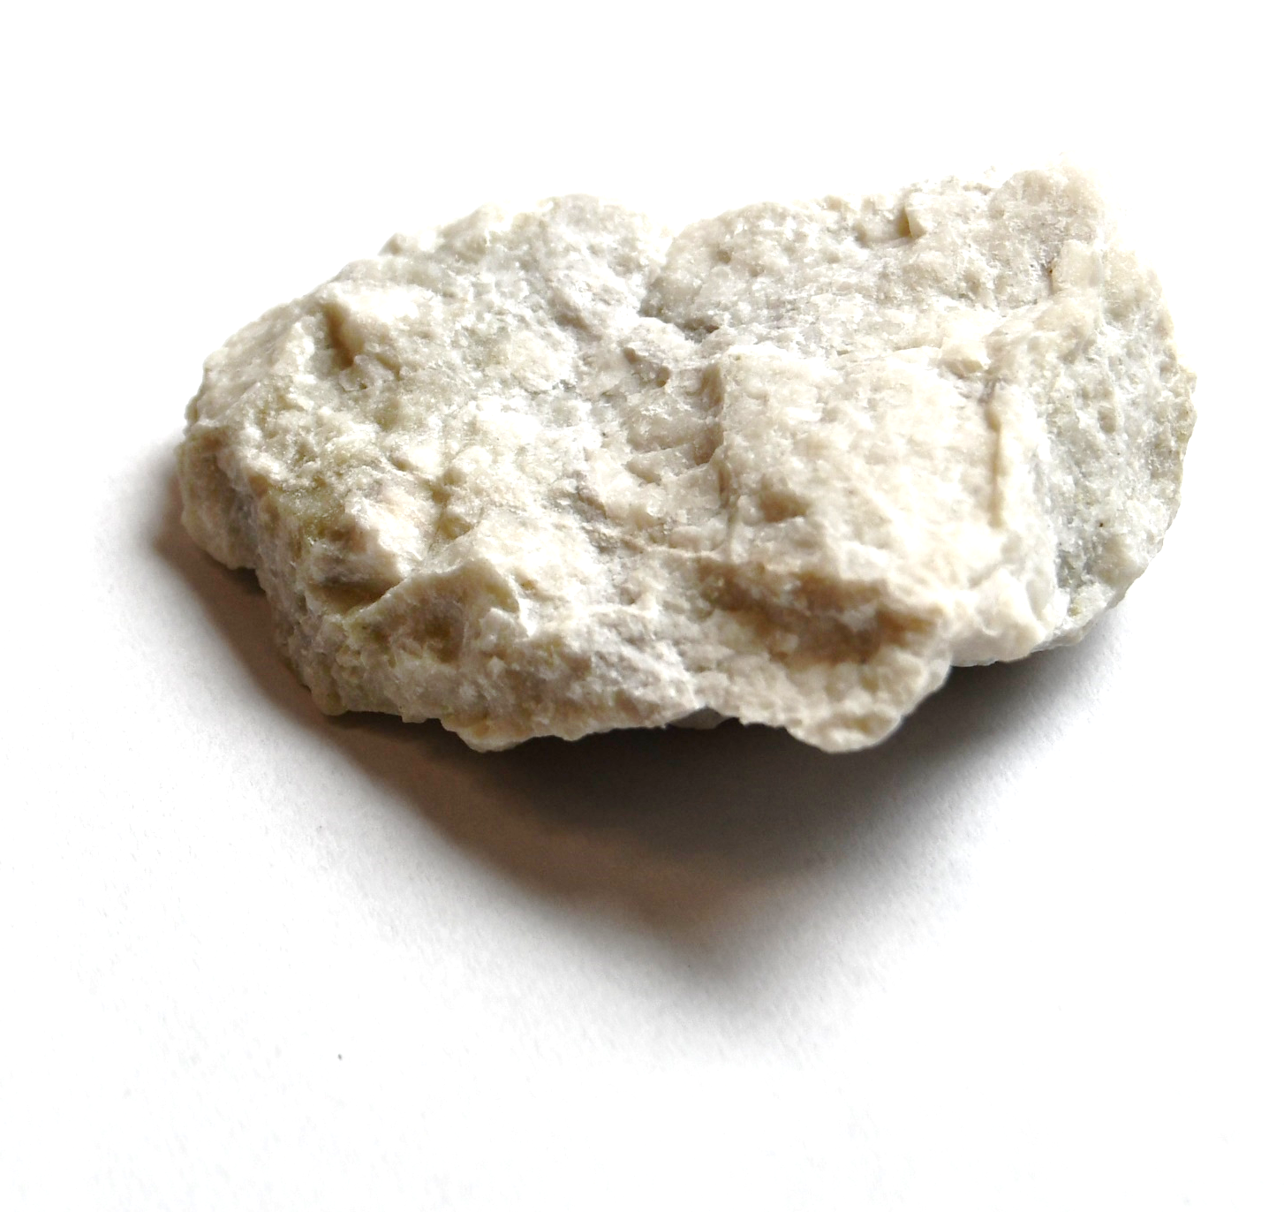
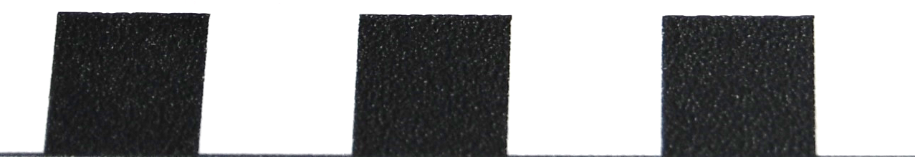
Meteorite checklist:
Is it unusually heavy?
Does it have a dark outside crust?
Does the outside have an irregular shape, with fingerprint-sized pits?
Can you see little metallic bits?
x
x
x
x
This is…
Anorthosite!
This is an igneous rock formed on Earth when magma gets into the crust but never erupts. It’s similar to the rocks on the Moon!
1 cm

Slide 14

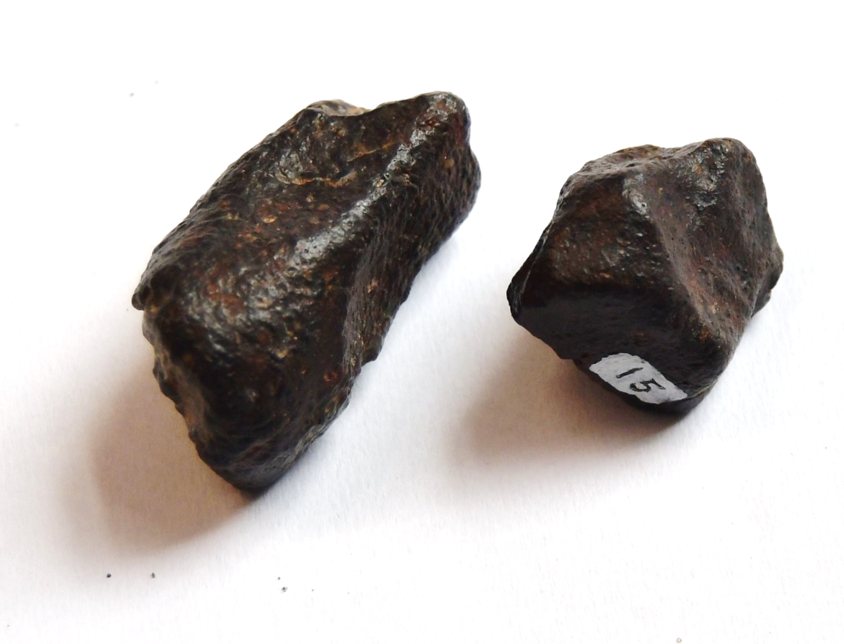
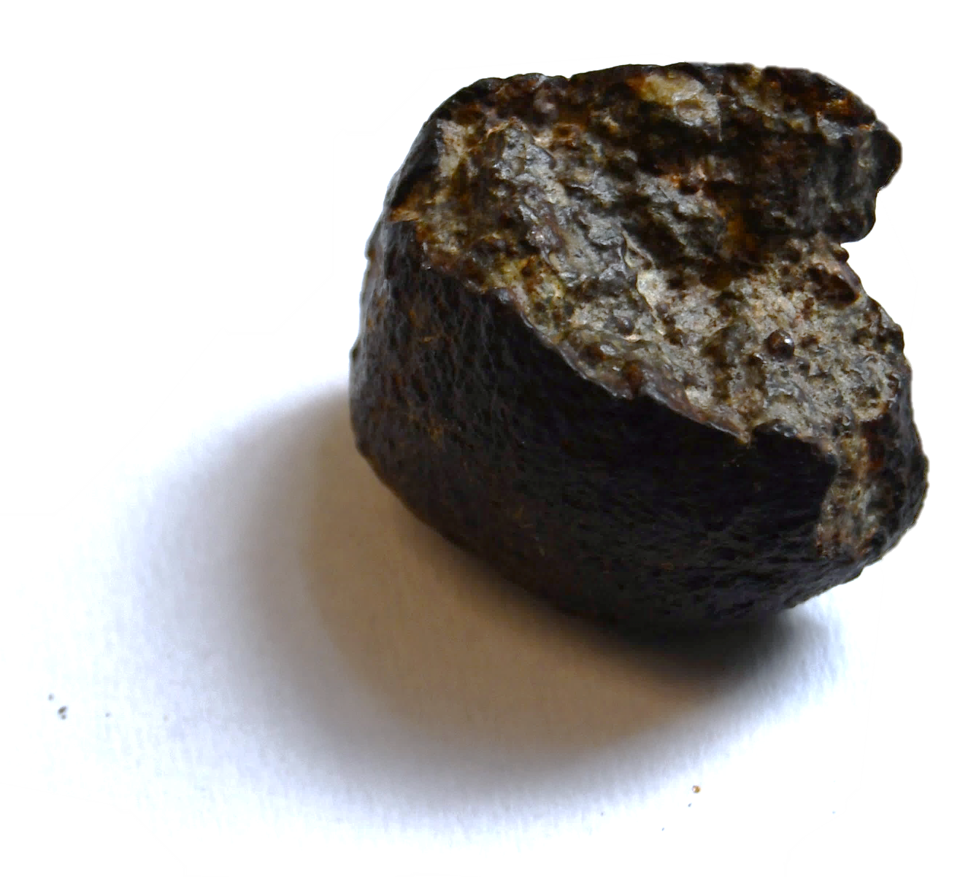
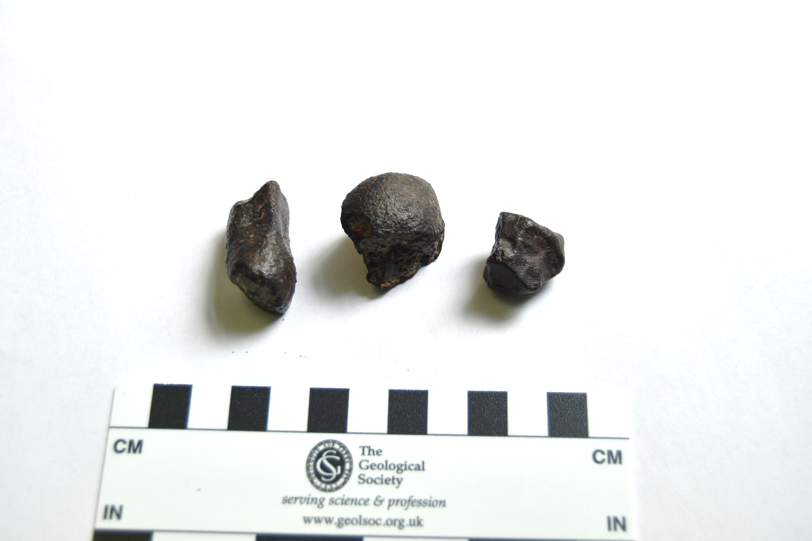
Meteorite checklist:
Is it unusually heavy?
Does it have a dark outside crust?
Does the outside have an irregular shape, with fingerprint-sized pits?
Can you see little metallic bits?
x
x
This is…
Stony meteorite!
It may not be heavy, but the dark, glassy, pitted outside crust gives it away as a meteorite.
1 cm
Notes:
Note: some samples have very small (sub-millimetric) metal grains which students might identify using a hand lens.

Slide 15

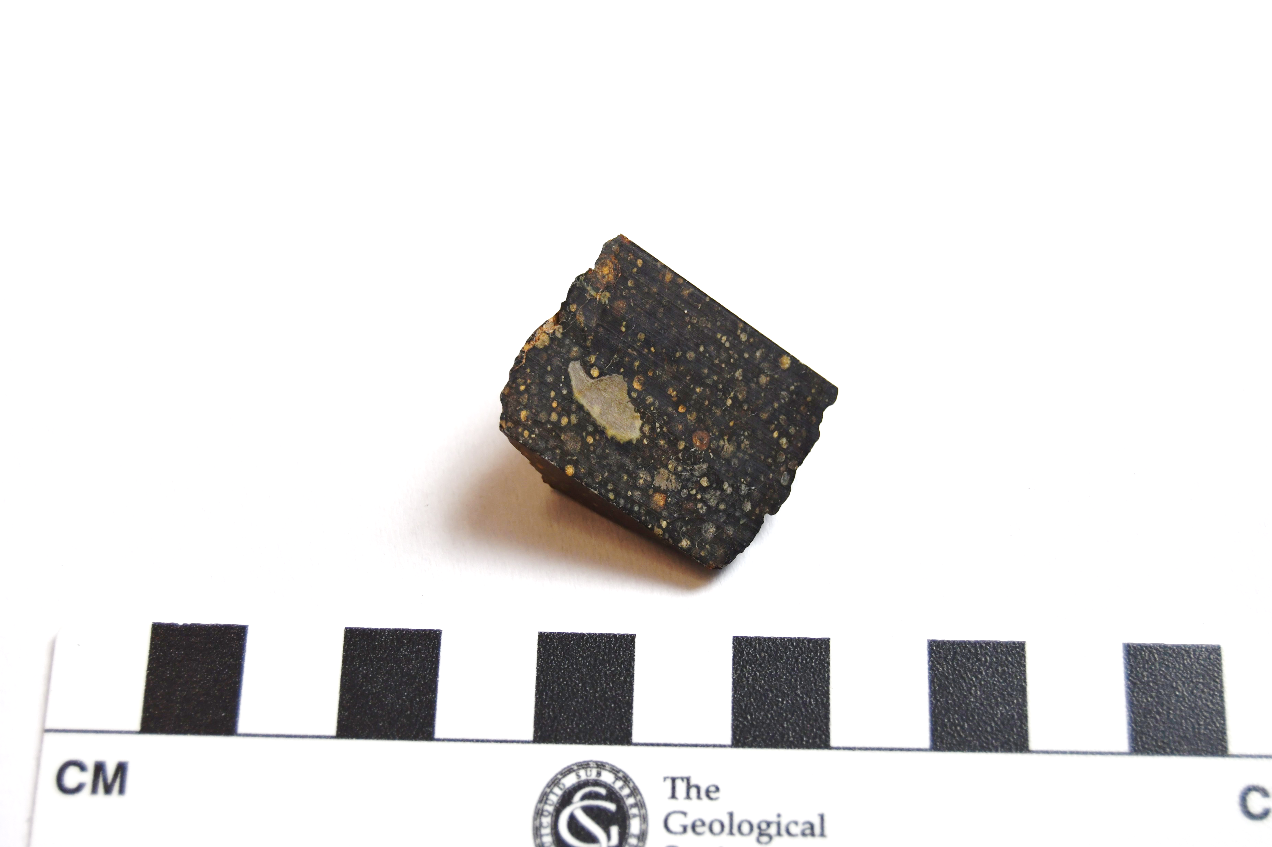
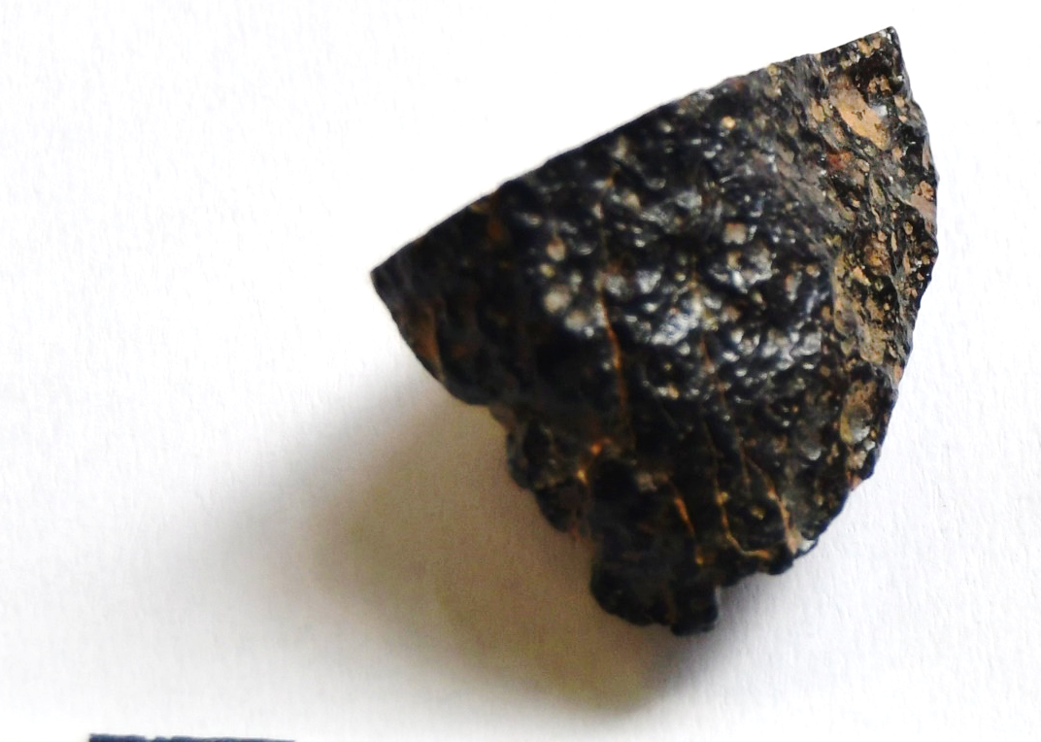
Meteorite checklist:
Is it unusually heavy?
Does it have a dark outside crust?
Does the outside have an irregular shape, with fingerprint-sized pits?
Can you see little metallic bits?
x
x
This is…
Stony meteorite!
It may not be heavy, but the dark, glassy, pitted outside crust gives it away as a meteorite.
1 cm
Notes:
Teacher notes: these meteorites actually do contain very small metal grains (<1mm size), so a very observant student using a hand lens may spot some.

Slide 16

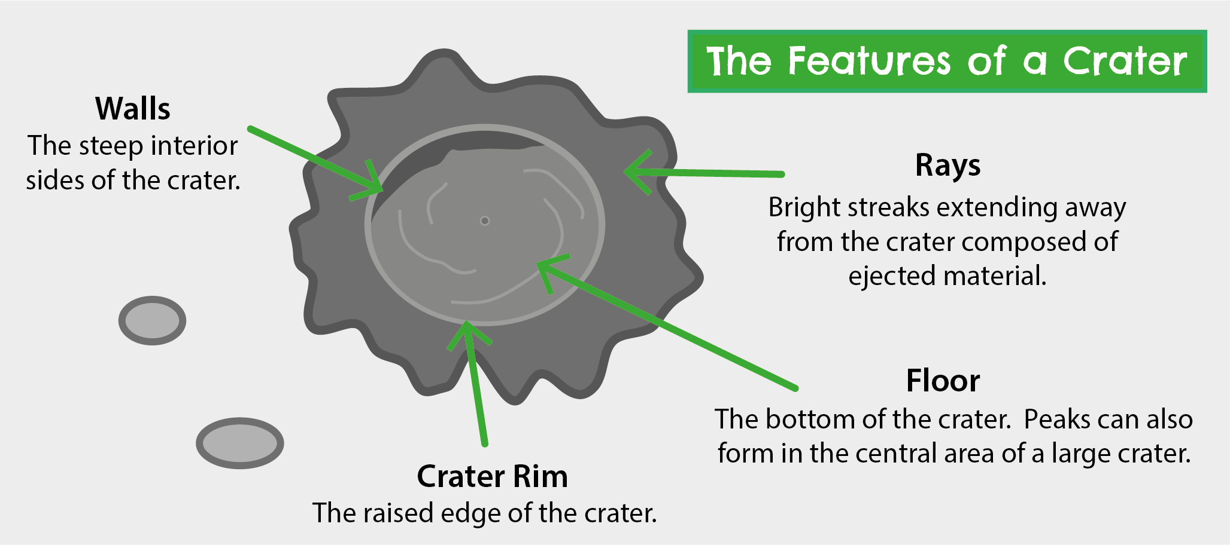
Image: Geobus
Notes:
[Optional slide]
When a meteorite hits a planet or asteroid, it forms a crater – a circular hole which has the elements on this diagram: a crater floor, walls, rims, and rays of ejecta.
Have a feel of the 3D samples on the tables. Can you find these features? Is there anything else you notice?

Slide 17

Thank you for your attention!
Contact our education team at education@geolsoc.org.uk
This lesson was created as part of a project funded by the
UK Space Agency ‘Space for All’ fund

