Slide 1



Annual General Meeting
Thursday 23rd May 2024
EARLY CAREER NETWORK
For the next generation of geoscientists

Slide 2
What is the Early Career Network?
Formed in 2019 as a sub-group of the Geological Society of London, aimed principally at those within 10 years of completion since their first geoscience degree.
Aims & Objectives
Promote and support professional development and chartership of its members.
Improve value for money for early career fellows of GSL.
Promote diversity, inclusion and equality across geoscience.
Organise events and activities across the UK, including the annual Early Career Geologist Award
Help with work placements, skill development and other aspects of employability.
Committee
Minimum of 10 members including 5 officers: Chair, Vice-chair, Secretary, Treasurer, External Group Liaison.
All fellows of GSL are eligible to stand for election to the committee.
Members shall serve for a period of 3 years, and may be re-elected for a second 3-year term.
Officers will be appointed by internal vote on an annual basis.
The Vice-Chair will succeed the Chair at the end of their 1-year term in that officer role.
Membership
Open to all interested in the ECN activities, free of charge.
Access and/or preferential rates will be given primarily to Fellows or Candidate Fellows of the Geological Society.

Slide 3


2023-24 Year In-Review
Our committee members contributed to careers advice, CV workshops, and discussed the various sectors that a career in geoscience can lead to.
Update to the ECN Terms of Reference
Matthew Johnson resigned from the committee.
September 2023 saw 4 new committee members
Dr Awei Mabi, Jocelyn Barker, River Adler Stewart and Jean-Jaques Ferguson
The Early Career Network attended the Geological Societies Geoscience Careers Fair in November 2023.
Investing in our outreach capability and secured additional funding for the coming year.

Slide 4

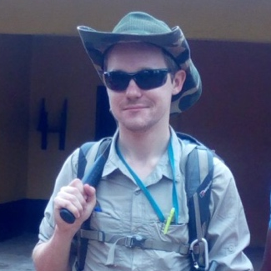

Huw Richards
Committee Member
2018 - 2024
Huw has been an integral member of the ECN committee since its formation in 2018.
Some achievements…
Introduction to IOGas software
QGIS for Geologists – ECN member discounts
Hosting the Early Career Geologist Award 2022
DeBeers Diamond Foundation Course
Committee Member:
Huw Richards
Sr. Exploration Geologist

Slide 5
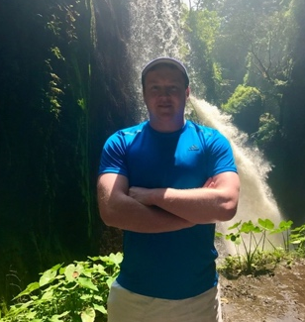

Matthew Sharp
Chair of the ECN 2020 – 2024, Committee Member 2018-2020
Matt has led the ECN as Chair through difficulties of Covid lockdowns and represented the group in the Professional & Chartership committee, Regional Group meetings and steered the group’s activities as well as other GSL events.
Matt has been an unwavering support of the ECN, its committee and its members, providing career and chartership guidance and leading the group’s activities.
Matt Sharp
CTO, Hotspur Geothermal

Slide 6
2024-25 Year Ahead
2024 Events & Financial plan presented by ECN Treasurer River Stewart
Month | Planned Activities | Estimated Costs | Remaining Budget
January 2024 | Reset of annual budget | - | £1000
February / March | Design and purchase of event banners | 180.00 (Design) 93.96 (purchase 2#) | £726.80
April 2024 | Sponsorship from Arcadis | £833.33 added to budget | £1560.13
May 2024 | Early Career Geologist Award 2024 & AGM | £735.12 | £825.01
July / August | ECN Careers Advice & Summer Social | £300 | £425.01
September 2024 | ECN Public Lecture – Topic & Speaker TBC Burlington House | £100 | £325.01
November 2024 | Geological Society – Careers Day | £100 | £225.01
December 2024 | ECN Winter Networking Social | £225 | 0.01

Slide 7
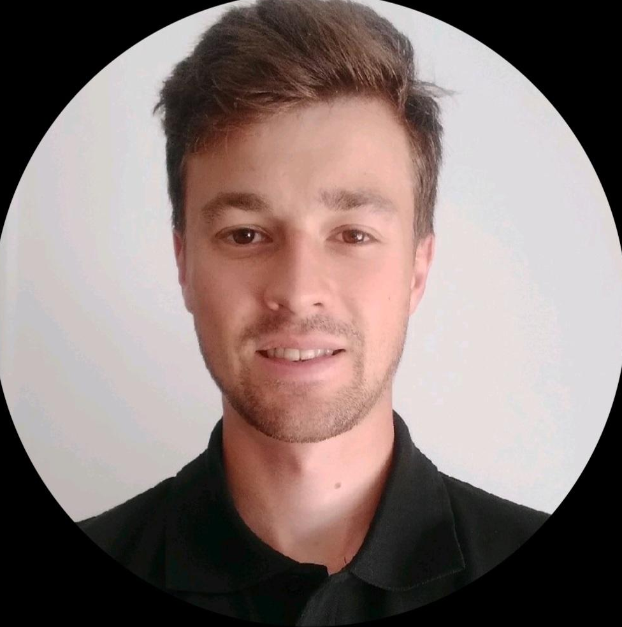
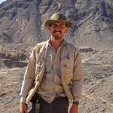
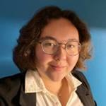



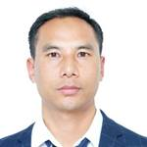
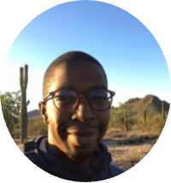
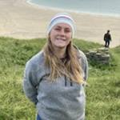
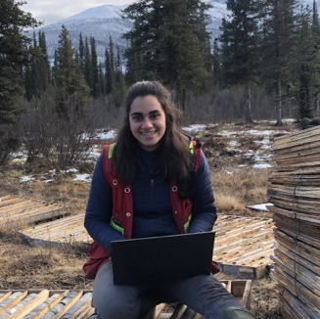
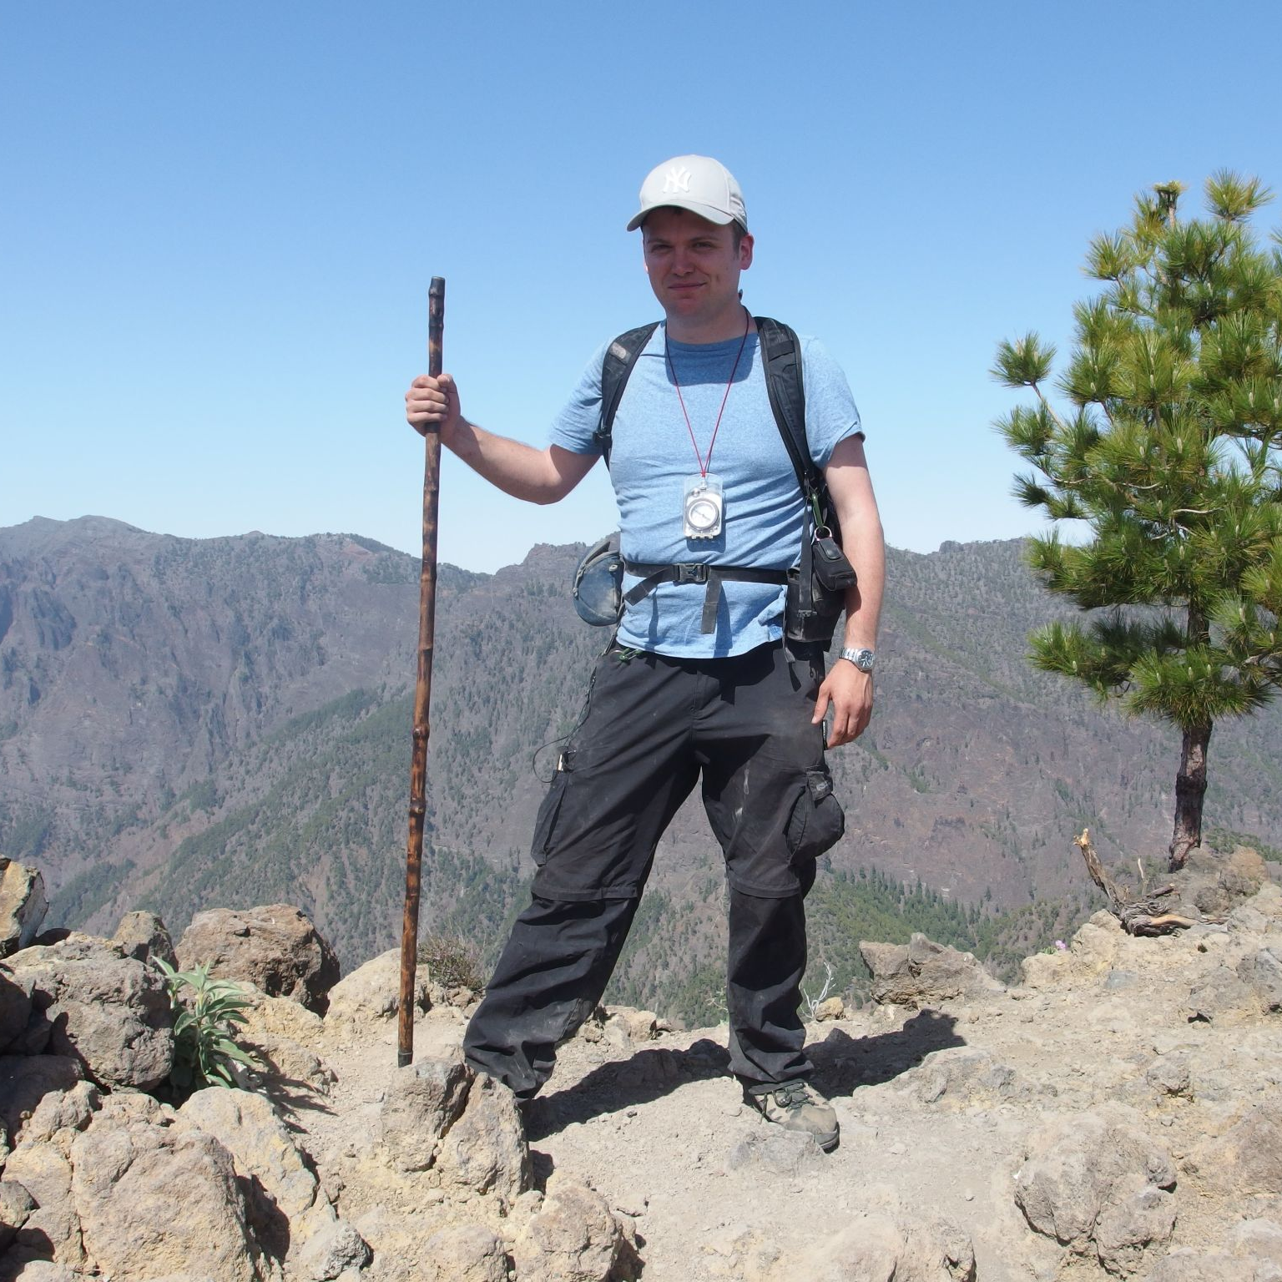
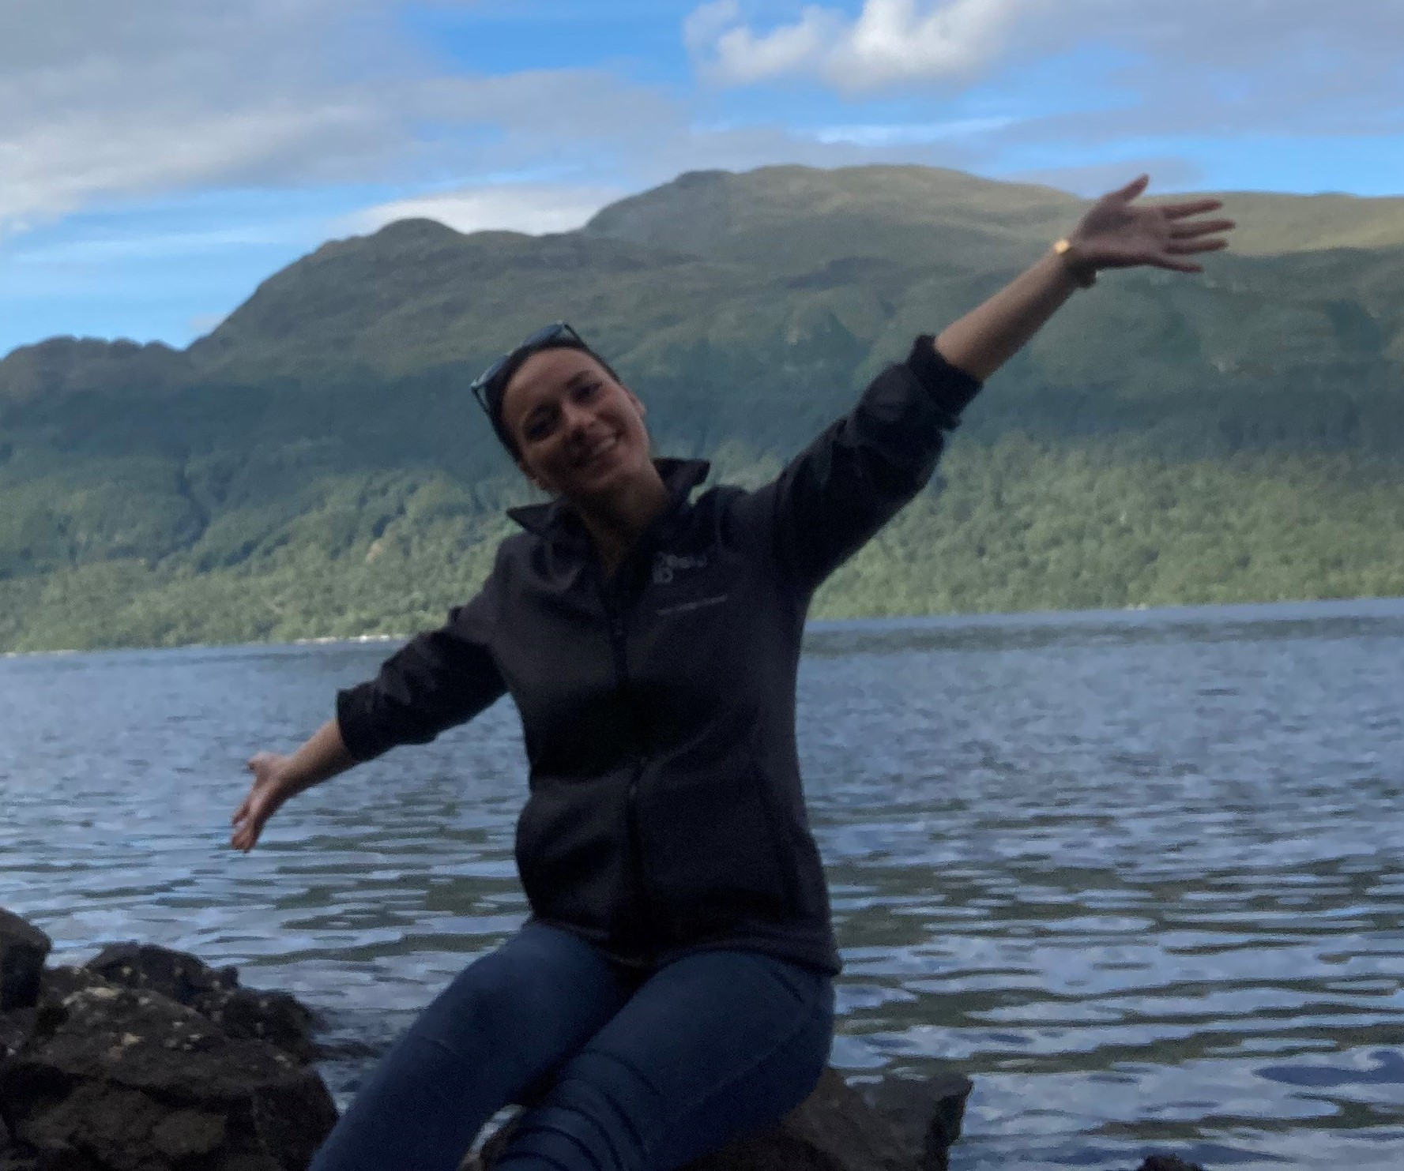
Meet the Committee 2024
Would you like to join the ECN Committee?
(3-Year Term
2024-27)
Apply via email to geolsocecn@gmail.com
Introduction and background, including why you would like to join the ECN Committee
Positions available: External Group Liaison, Vice-Chair
Max 1 A4 page
Deadline: 18th June 2024
VACANT
Chair:
Dan Hope
Senior Consultant (Site Investigation)
Secretary
Jean-Jaques Ferguson
Exploration Geologist
Treasurer
River Adler Stewart
Undergraduate Student, University of Portsmouth
External Group Liaison:
Vacant
Committee Member:
Dr Awei Mabi
Senior Lecturer
Committee Member:
Alex Christopher
Senior Multi-Commodity Analyst
Committee Member:
Jocelyn Barker
Sustainability Consultant
Committee Member:
Ayesha Landon-Browne
PhD Candidate & Exploration Geologist
VACANT
VACANT
Committee Member:
Dr. Simon Groom
Engineering Geologist
Committee Member:
Harriet Warnock
Civil Engineer
Committee Member:
Vacant
Committee Member:
Vacant

