Slide 1


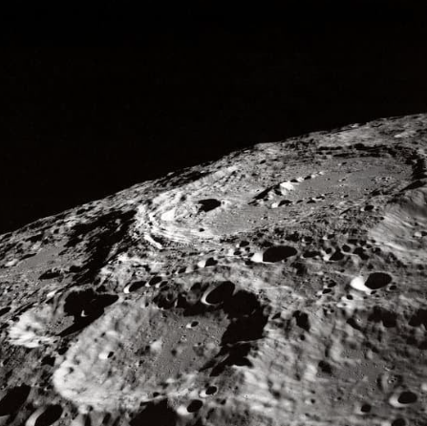
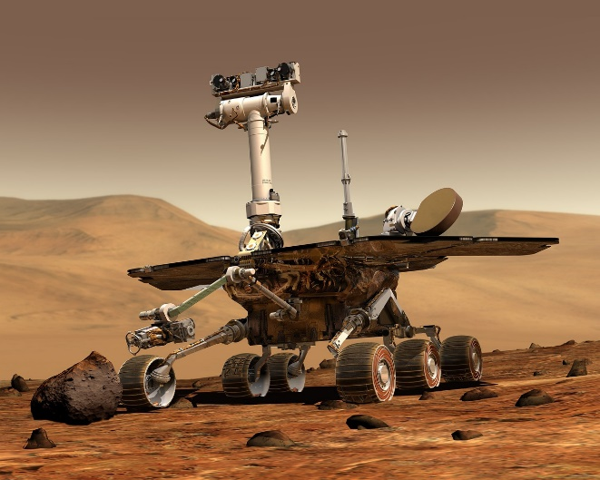
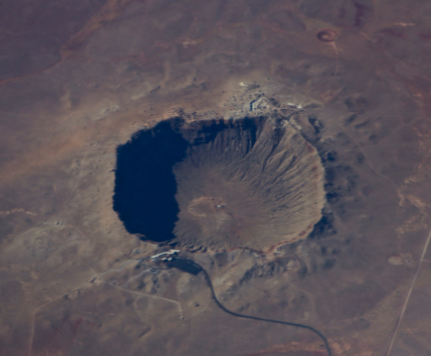
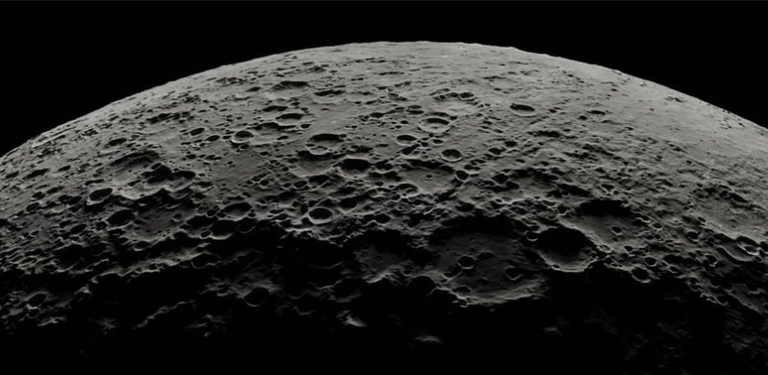
Notes:
In this lesson, pupils will learn about impact craters – what they look like, how they form, and what the rocks in a crater are like.

Slide 2

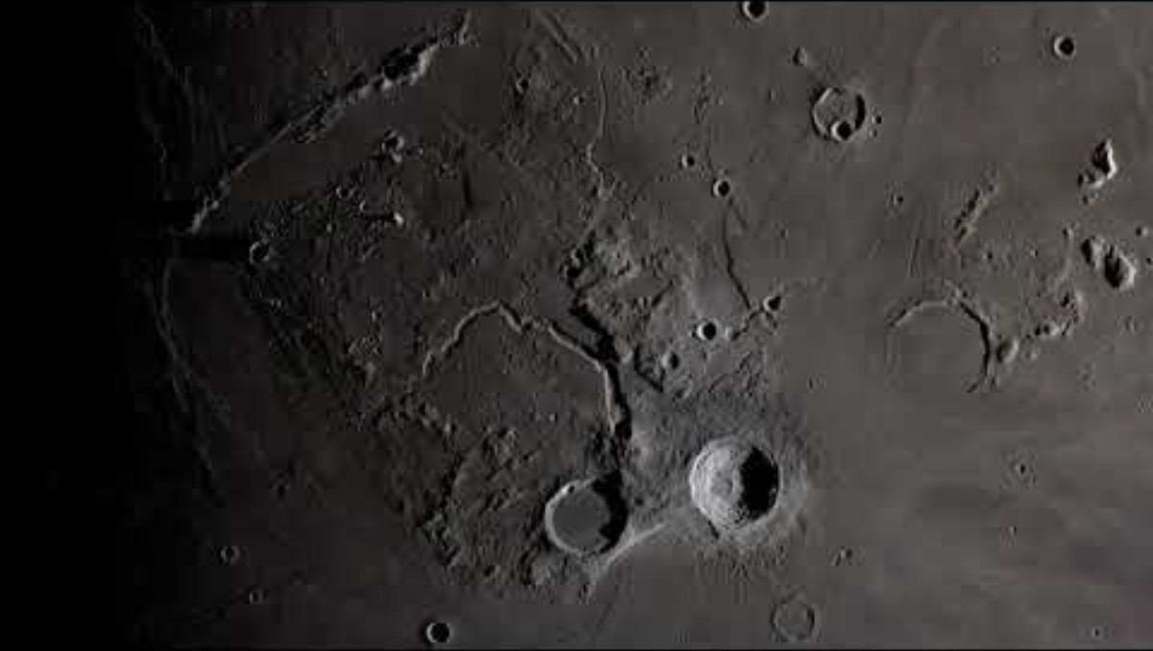
Notes:
Does anyone know what happens when a meteorite hits a planet?
Answer: a crater forms! A crater is a round hole or depression in the surface of a planet.

Slide 3

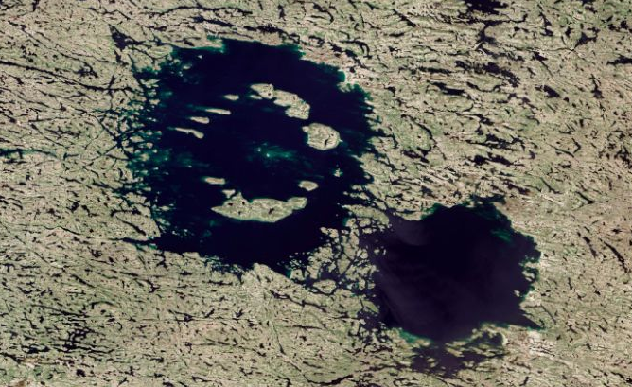
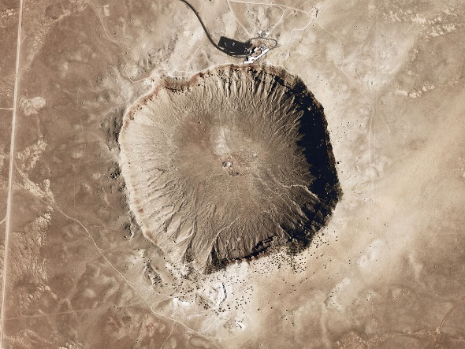
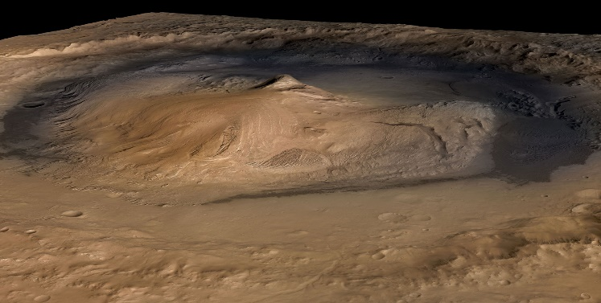
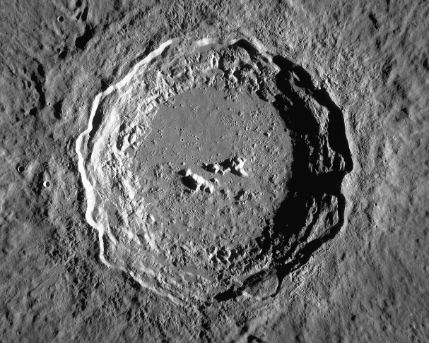
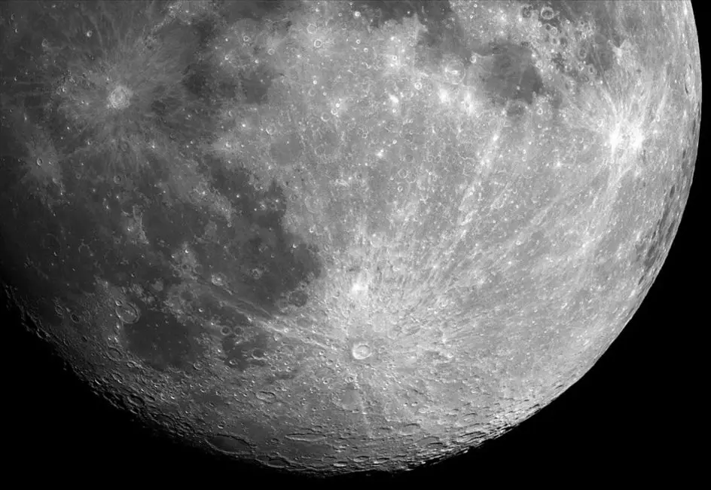
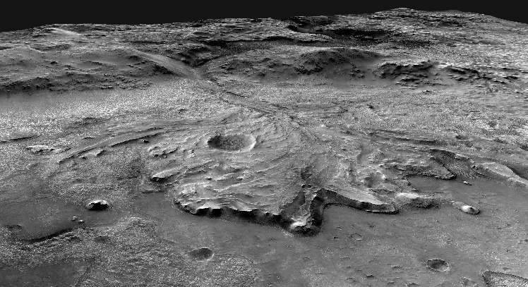
Earth:
Mars:
Clearwater craters, Canada
Barringer crater, USA
Gale crater
Moon:
Photo: NASA
Photo: NASA
Photo: NASA
Jezero crater
Copernicus crater
Tycho crater
Photo: USGS
Photo: NASA
Photo: NASA
Notes:
Can you name a place in the solar system that has craters?
Answer: Craters are almost everywhere! All the inner planets, especially Mars and Mercury, have lots of craters. There are some craters on Venus too, lots on the Moon, and most asteroids have craters as well.
We also have impact craters on the Earth (e.g. the Barringer crater in Arizona), but most of them are buried or erased (like the Chicxulub crater, made by the meteorite which killed the dinosaurs, which is buried)

Slide 4

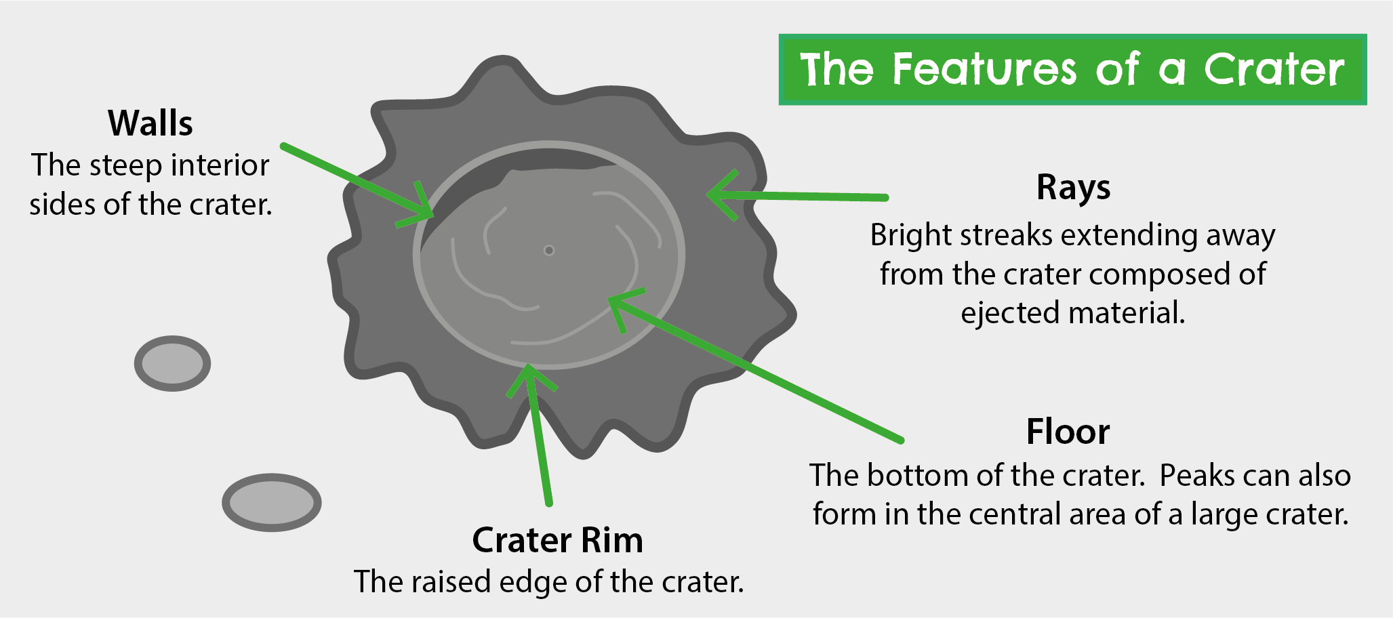
1. Have a look and feel of the craters on your tables. Can you find the features below on the samples?
Image credit: Geobus
2. Pick a crater between 2 and 6 and do the short exercise on your handout.
Notes:
Now for our first activity! Have a look at the crater samples on your tables. Can you find the features on this slide? You’re looking for a crater rim, walls, floor and ejecta.
(Note: the students will not be able to find ejecta rays because these are not obvious on the 3D samples)
Please pick a crater between 2 and 6 and do the short exercise on the handout. Craters 2 to 6 all have the same scale, so the exercise is best suited to those.

Slide 5
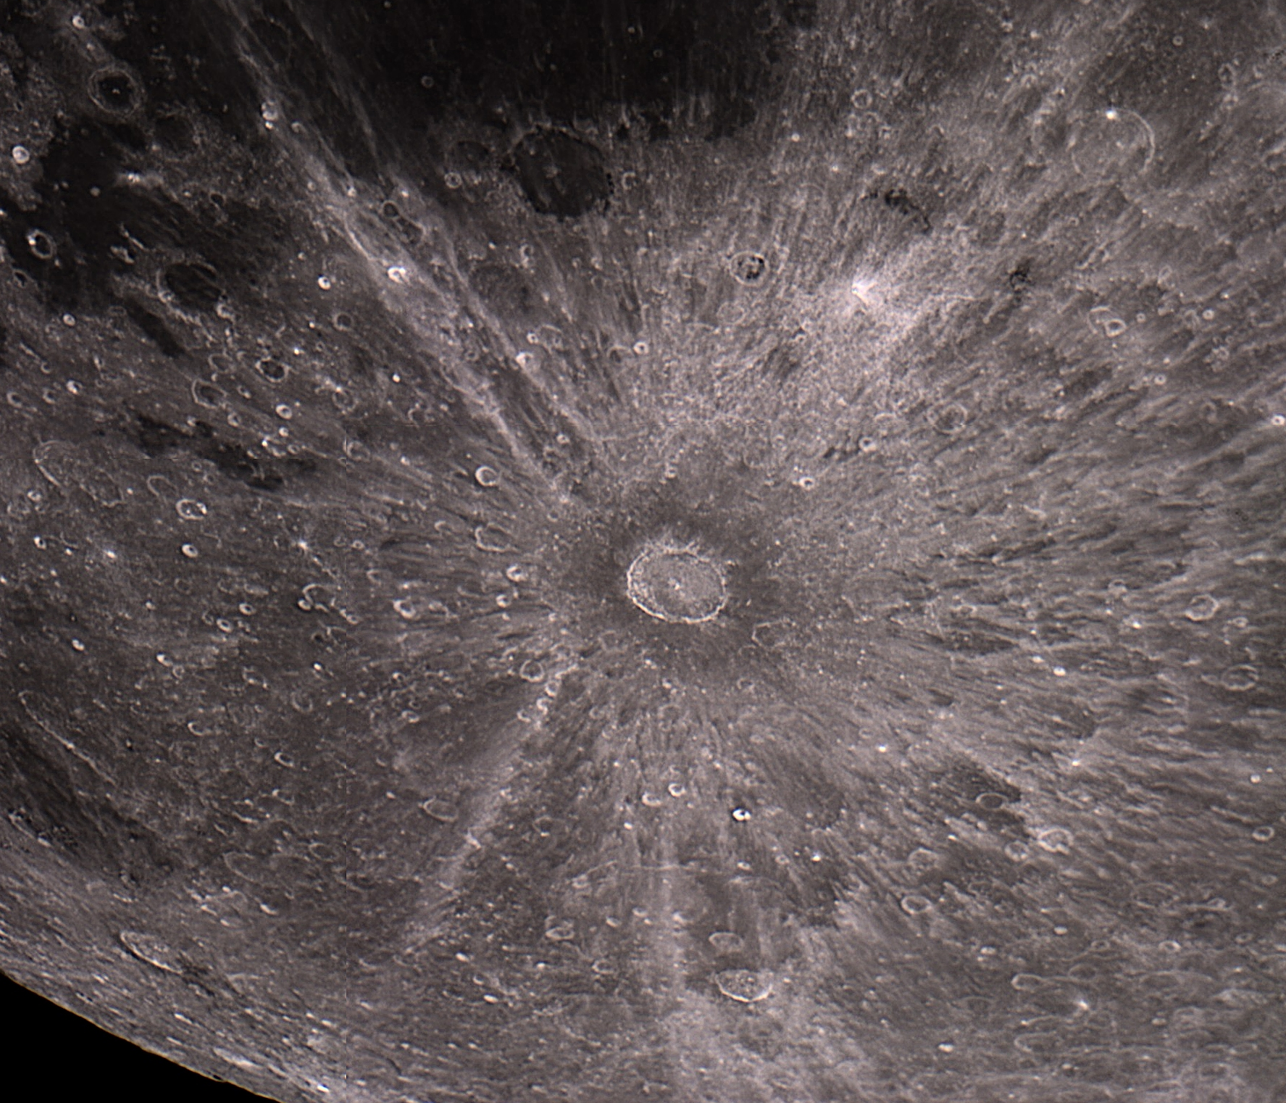
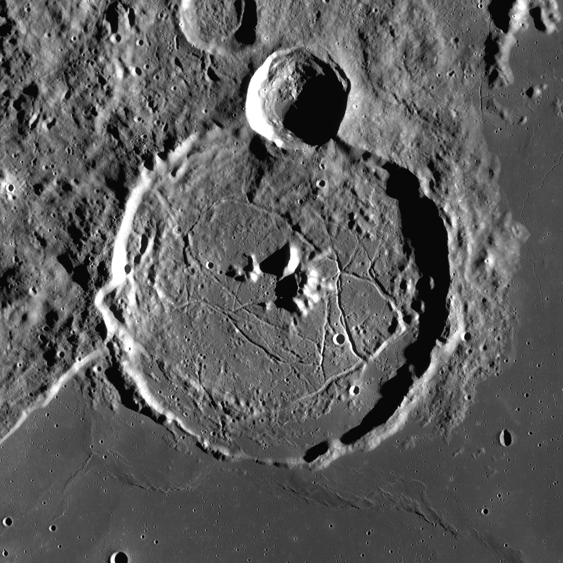
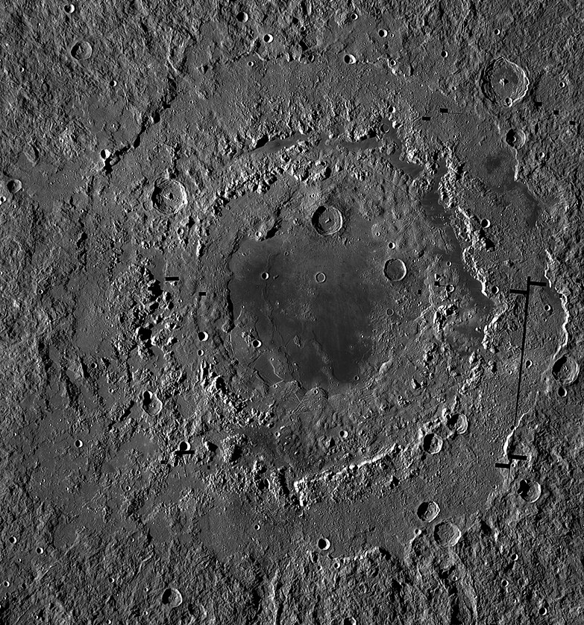
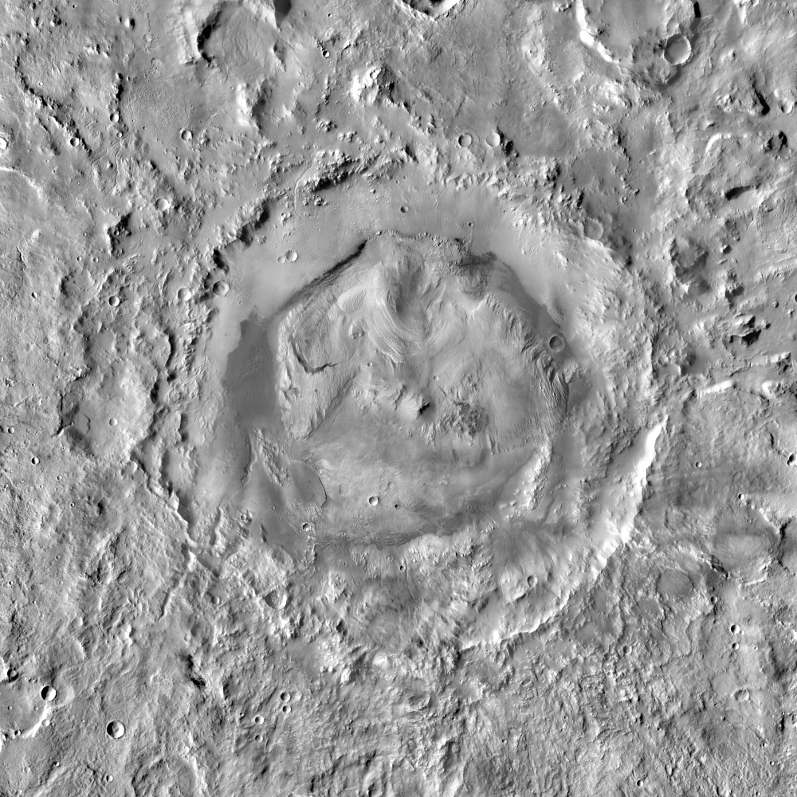
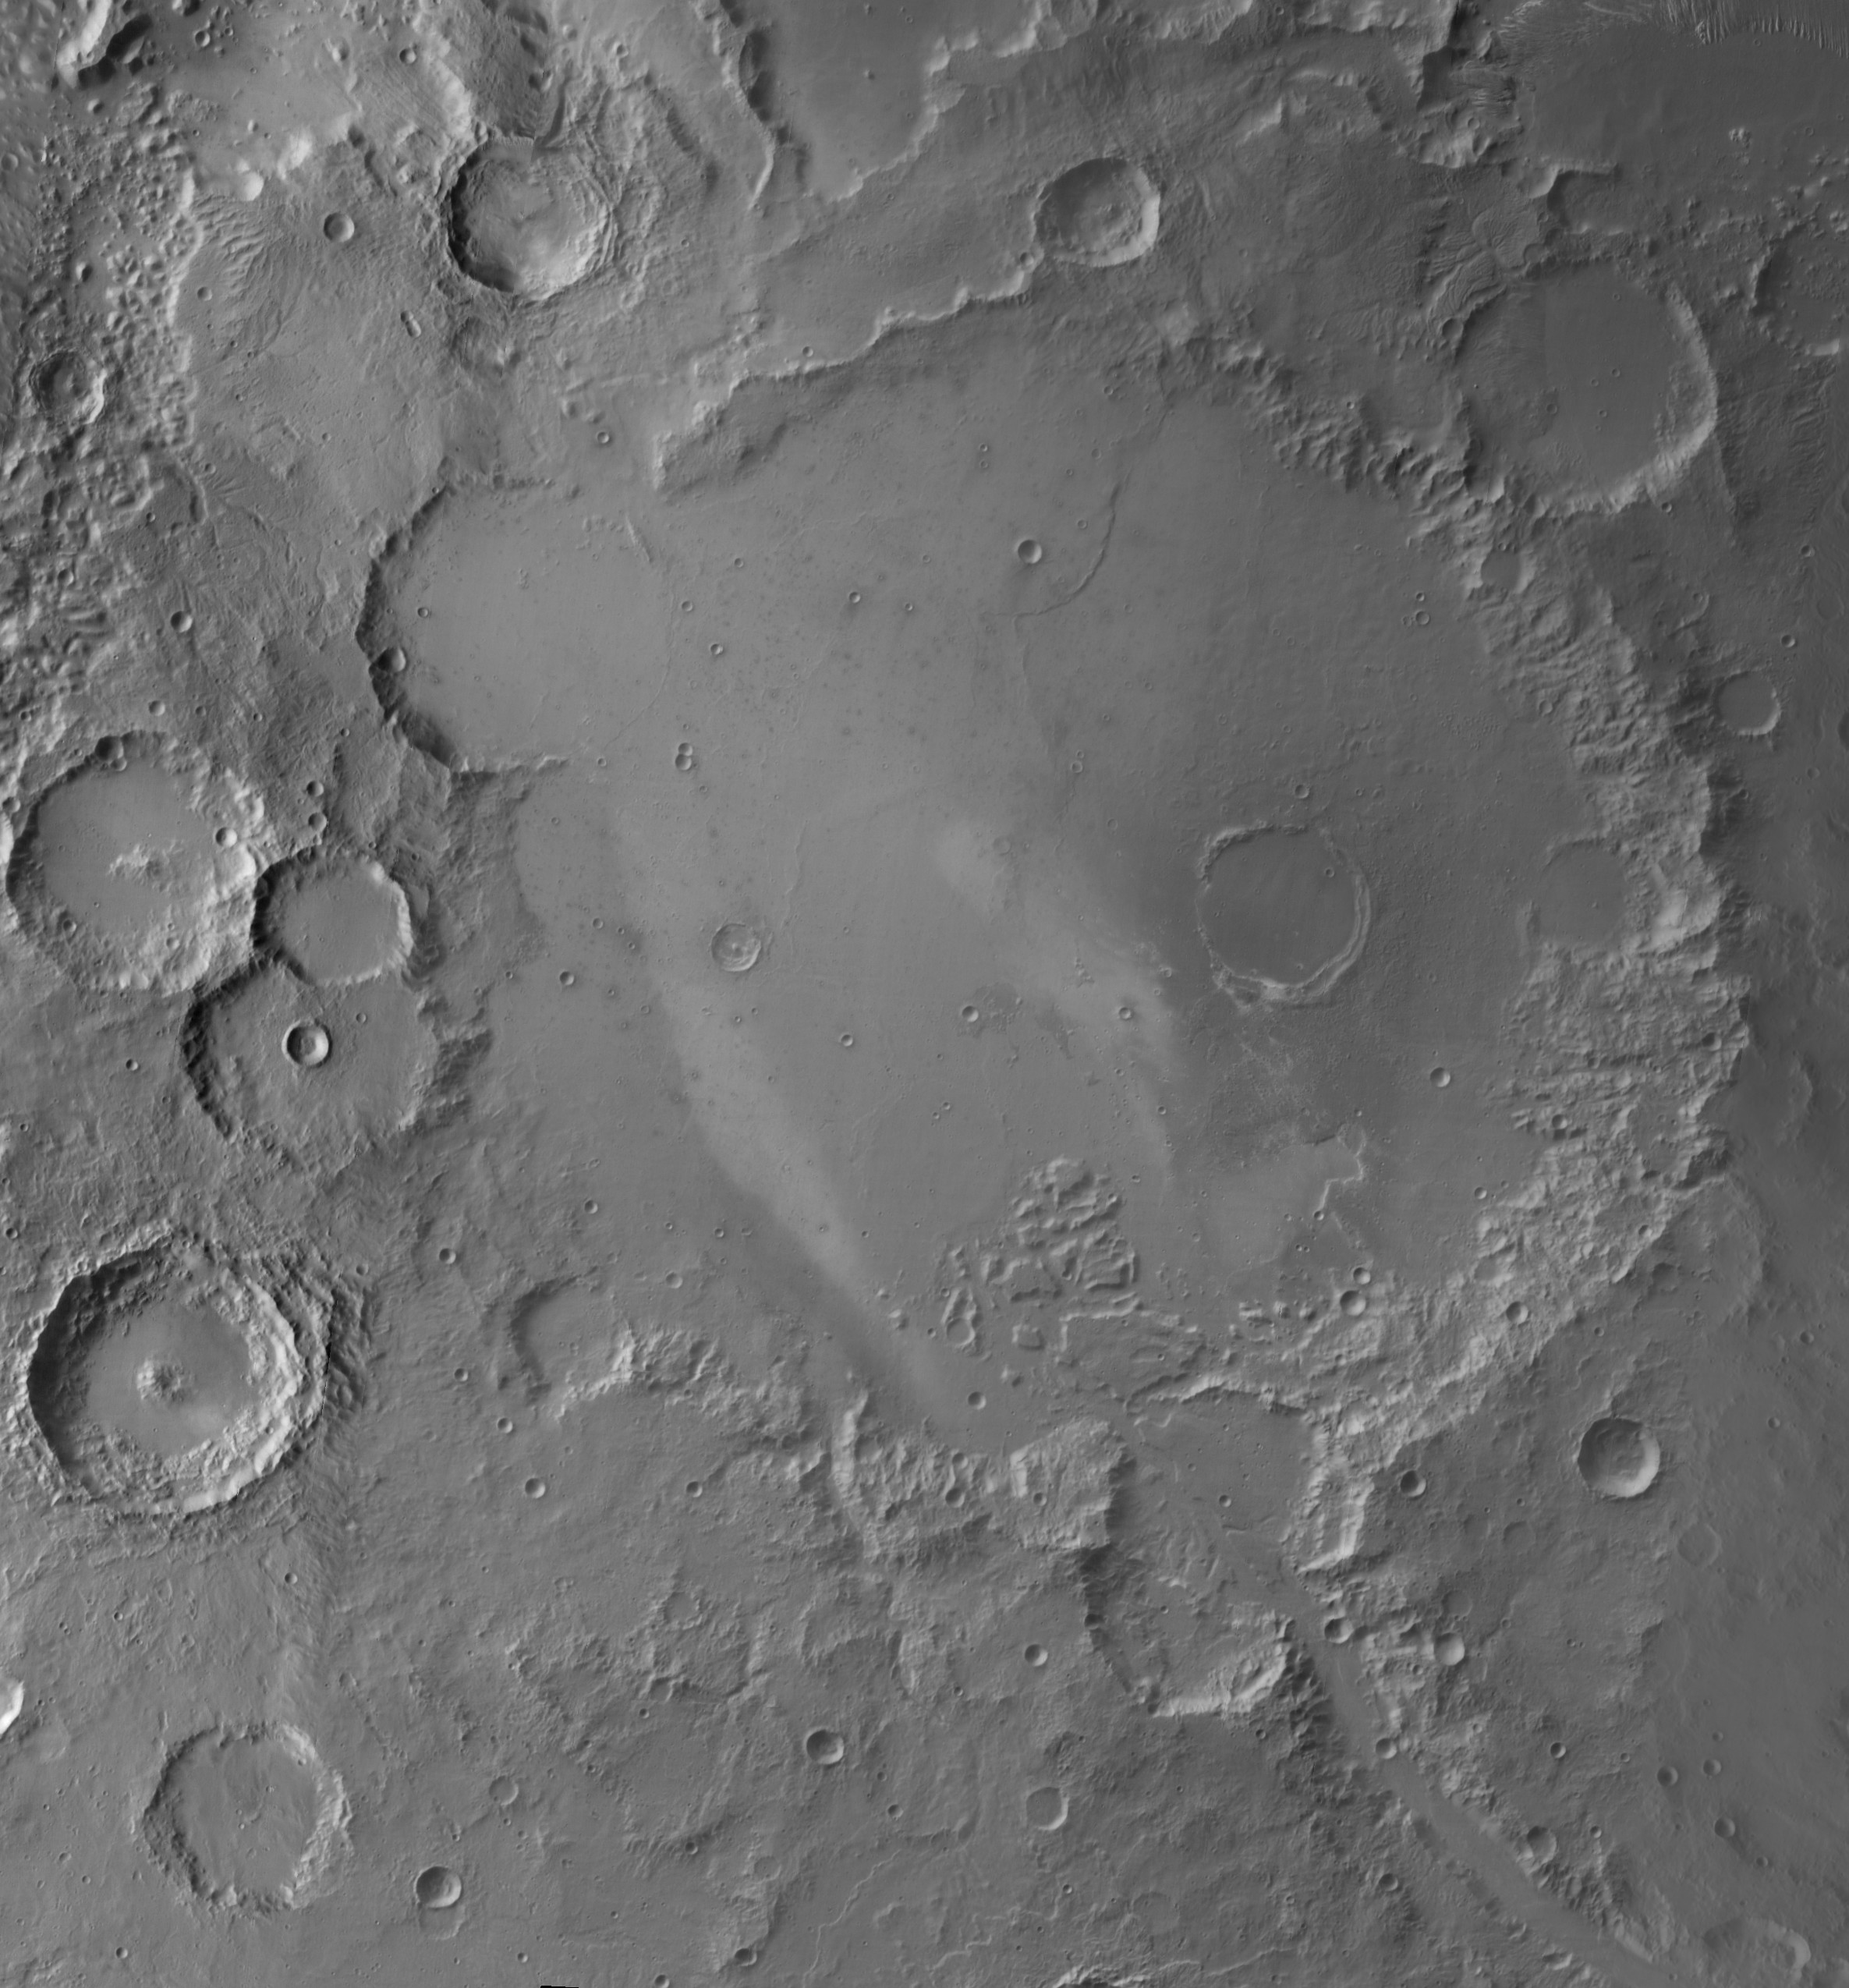
Moon:
Copernicus crater
Tycho crater
Gassendi crater
Mare Orientale
Mars:
Earth:
All images courtesy to NASA
Gale crater
Gusev crater
Barringer crater

Slide 6

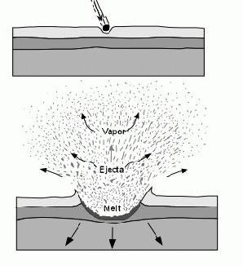
Have you noticed any other crater features?
Rims
Walls
Floor
Notes:
So how do craters form? A crater is caused by a smaller object (like a meteorite) crashing into a bigger object (like a planet).
The small object travels very fast, so when it hits, it creates an explosion and lots of rock gets thrown out from the impact site. This material forms rims which are taller than the surrounding area. At the same time, the explosion causes a depression (hole) that’s either flat or bowl-shaped. The flat or bowl-shaped bottom of the depression is called a crater floor, and the sides are called walls.
Have you noticed any other features on your craters?
The main complex feature of a crater is the central peak(s), which are peaks formed in the central area of a large crater. They form when the impact is very powerful – immediately after the initial impact, the rocks relax and go back up, forming a peak in the middle (you can use a bouncy castle analogy, which is not perfect but will help them visualise the process better)
Other features that they might notice are below, with explanations for your reference. If they don’t notice them, no need to bring them up.
Multiple rings: Very large craters (termed impact basins) can have as many as 5 or 6 circular rings of mountain chains surrounding the main crater. Their formation is not fully understood, but one proposed theory is that the central peak is so large that it becomes unstable, collapsing to form several rings. An example of a multi-ring basin is Mare Orientale on the Moon.
Terraced walls (stair-like): sometimes, the walls become too steep to remain stable, so they form several terraces
Broadly speaking, an impact has 3 stages:
1. Compressional stage
When a meteorite (impactor) approaches a planet, it moves at very high speed (higher than the speed of sound), and has large kinetic energy. On impact, energy is conserved and the kinetic energy transfers to the planet. The kinetic energy of the impactor is now 0 because it is stationary. The portion of the planet that is impacted wants to “move away” because it now has high kinetic energy. However, the entire planet is unlikely to move (unless the impactor is really large, like in Moon-forming impact), so the kinetic energy manifests as a collisional shockwave propagating away from the impact. Any energy that can’t be accommodated as movement will be converted to heat (there is a lot of heating!). The result of the compressional stage is relatively small hole, which happens very quickly.
A note for students taking Physics: a shock wave is a longitudinal wave (the oscillation is to and from source, in the direction of travel).
2. Excavation stage
Immediately after the compression, the impacted area depressurises, leading to massive excavation of material from the impact area. The opposite of a shockwave happens: a wave travels in the opposite direction than the shockwave (here, upwards through the atmosphere or space), and because it has so much space to expand and little resistance, it leads to a large amount of material being excavated, forming a crater. This is essentially an explosion, and it’s the reason why most craters are circular.
The excavated material is initially fine debris, vapour and melt droplets, and after that, a cone-shaped curtain of ejecta spreads upwards and outwards, forming rays of ejecta.
3. Modification stage
This stage leads to further changes to a crater due to really powerful impacts. They lead to the formation of complex crater features (see next section).

Slide 7
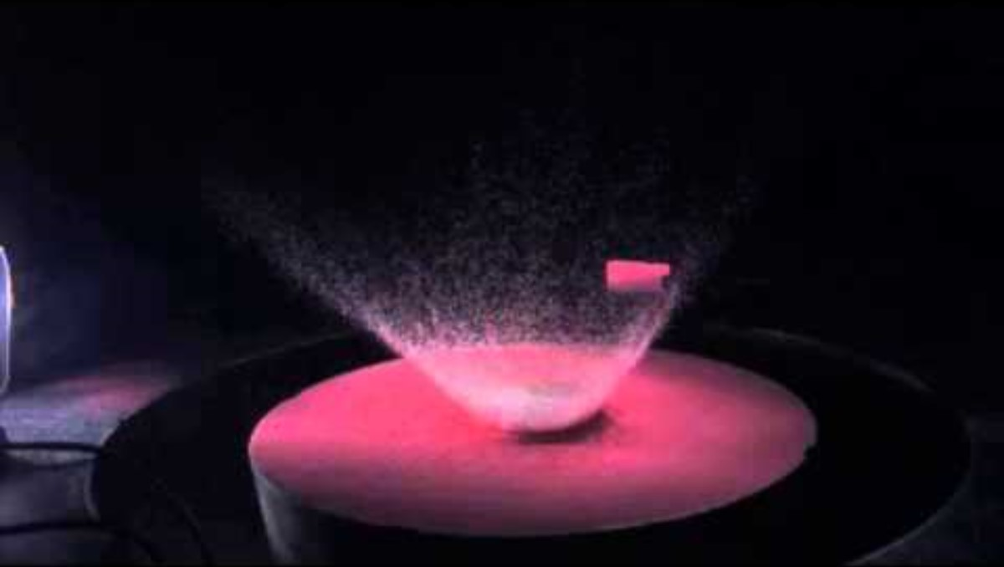
Notes:
Optionally, you could play this short NASA video of a hypervelocity impact to illustrate crater formation.

Slide 8
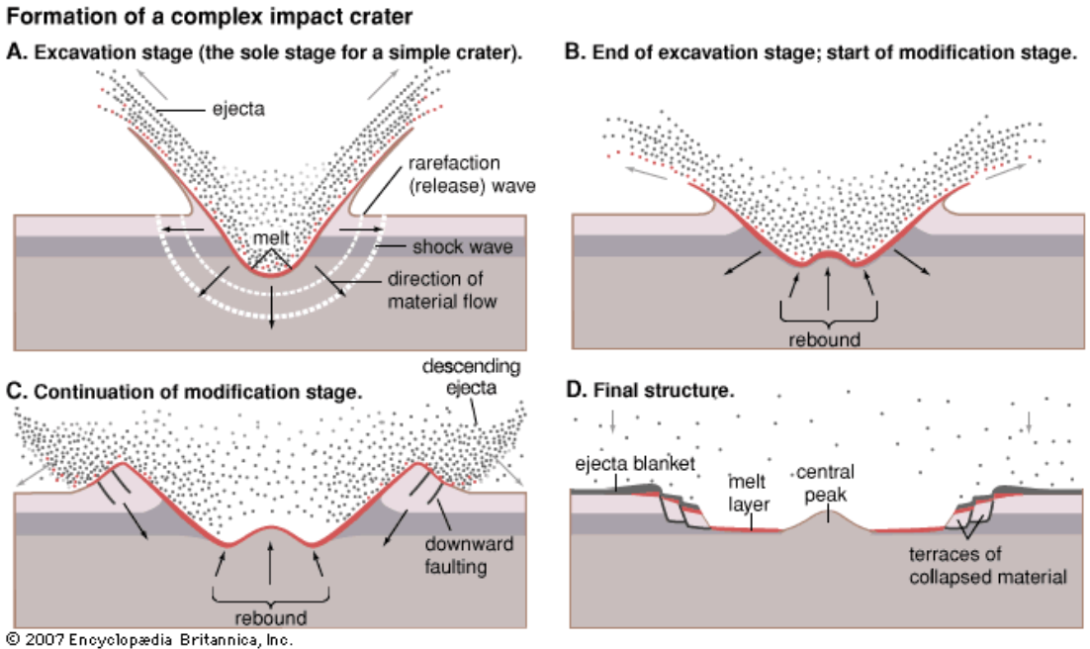
Notes:
Complex features:
Central peak(s): peaks formed in the central area of a large crater. They form when the impact is so powerful that the area in the middle rebounds after the impact, when the pressure of the impact is gone
Terraced walls: sometimes, the walls become too steep to remain stable, so they can form several terraces
Multiple rings: Very large craters (termed impact basins) can have as many as 5 or 6 circular rings of mountain chains surrounding the main crater. Their formation is not fully understood, but one proposed theory is that the central peak is so large that it becomes unstable, collapsing to form several rings. An example of a multi-ring basin is Mare Orientale on the Moon.
All these features happen in an optional third stage of crater formation (the modification stage).

Slide 9

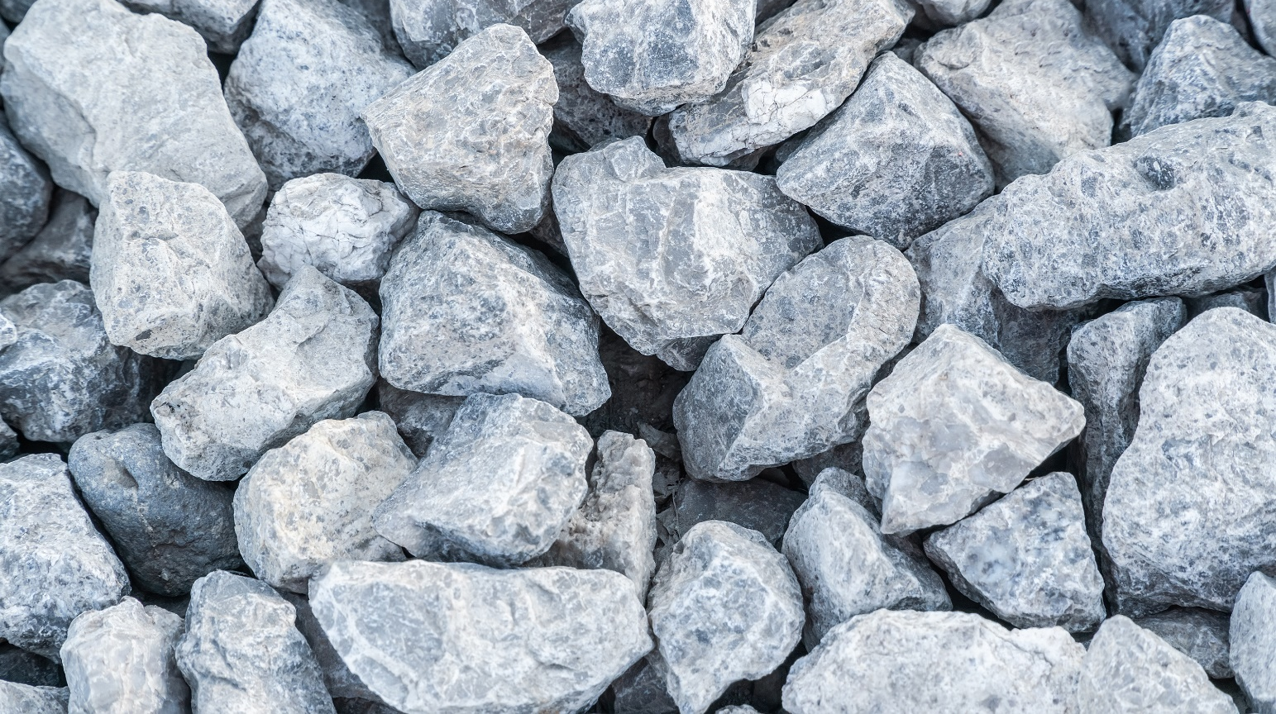
?
Notes:
What do you think happens to the rocks a meteorite lands on?
Answer: they can get squashed, broken up, or they can melt. Sometimes, all of these things happen to just one rock! For this reason, impact rocks are quite complicated and there are many subtypes. Altogether, they are known as impactites.

Slide 10
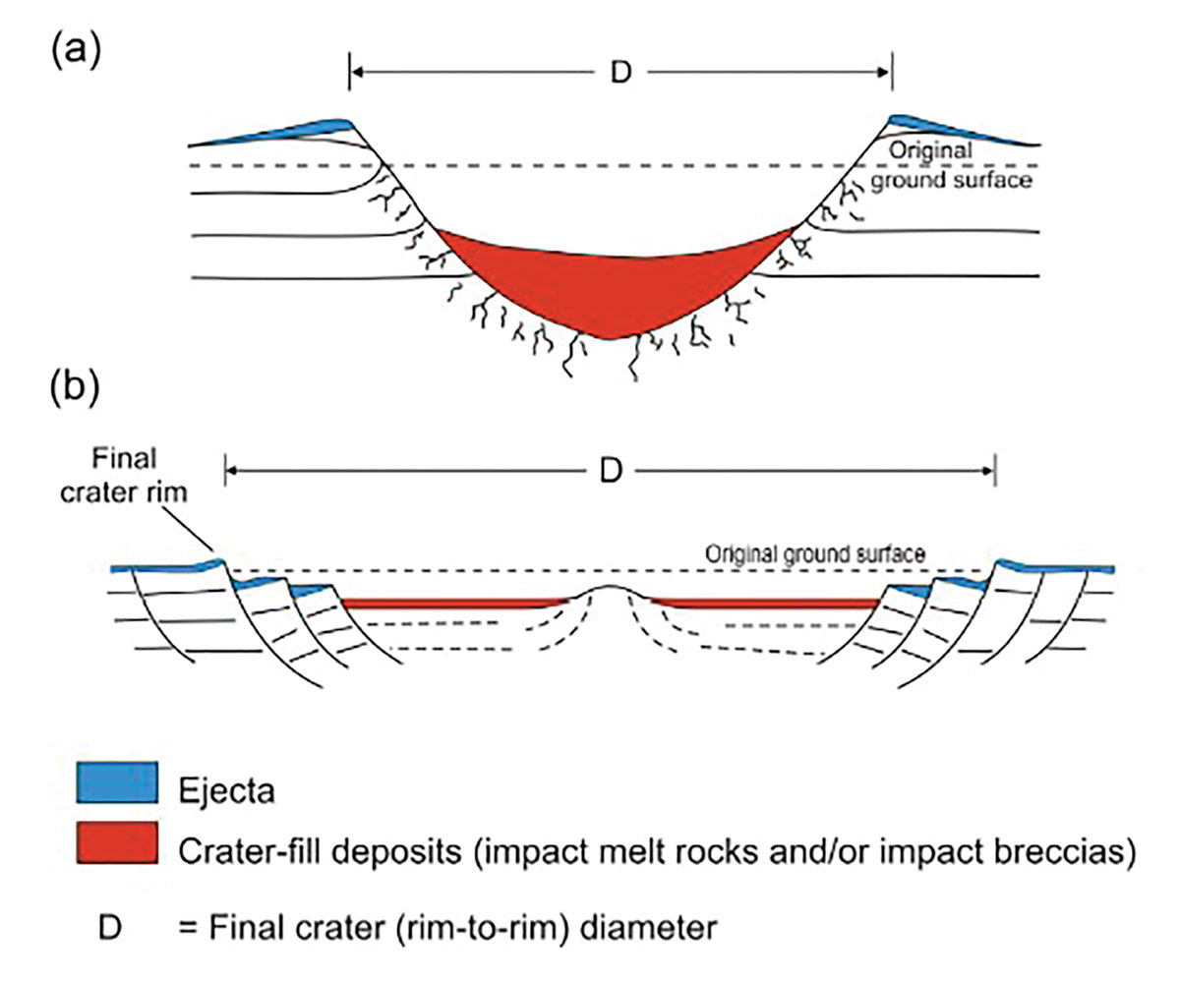
Simple craters
Rocks created or modified by impacts are called impactites. We will look at 2 types today:
1. Impact glasses
  Formed when rock melts, gets thrown out of a crater and cools very quickly in the air
  Usually found in the ejecta outside the crater
2. Impact breccias
  Breccia = rock containing broken up fragments of other rocks
  Formed when the bedrock is fragmented by the force of impact
  Can contain molten or glassy bits, especially closer to the initial impact
  Usually found inside a crater
Impact glasses
Impact breccias
Complex craters
Impact glasses
Impact breccias
Notes:
Note to teachers: this is highly simplified, and in reality, any rock generated by a meteorite impact is quite complex. Here are a few things we omitted for simplicity:
Impact glasses can be found inside craters if that is where they fell, or if sedimentary processes brought them back into the crater
Equally, impact breccias are not only found inside craters. It’s possible for them to be thrown out of the crater as ejecta too. Some might also be underneath the crater, if they impact fractured the bedrock.
There are types of impactites not mentioned here:
Impact melts = rocks that melt completely because of an impact. If they cool down slowly, they don’t become glassy, instead resembling igneous rocks (even though their impact origin makes them metamorphic). Impact glasses are a subtype of impact melts.
Shocked rocks = rocks affected by shock metamorphism. Shocked rocks don’t melt or brecciate, but the pressure and heat of an impact causes different minerals and textures to form through shock metamorphism.

Slide 11


Look at the rocks on your tables and make the following observations:
1. Colour(s)
2. Does it contain grains, crystals or clasts? How big are they?
3. What does the outside look and feel like? (smooth, rough, shiny, glassy, pitted?)
4. Do you notice anything else?
Don’t forget to use your hand lenses!
Notes:
Look at the rocks on your tables and make some observations. Don’t forget to use hand lenses!

Slide 12


Slide 13

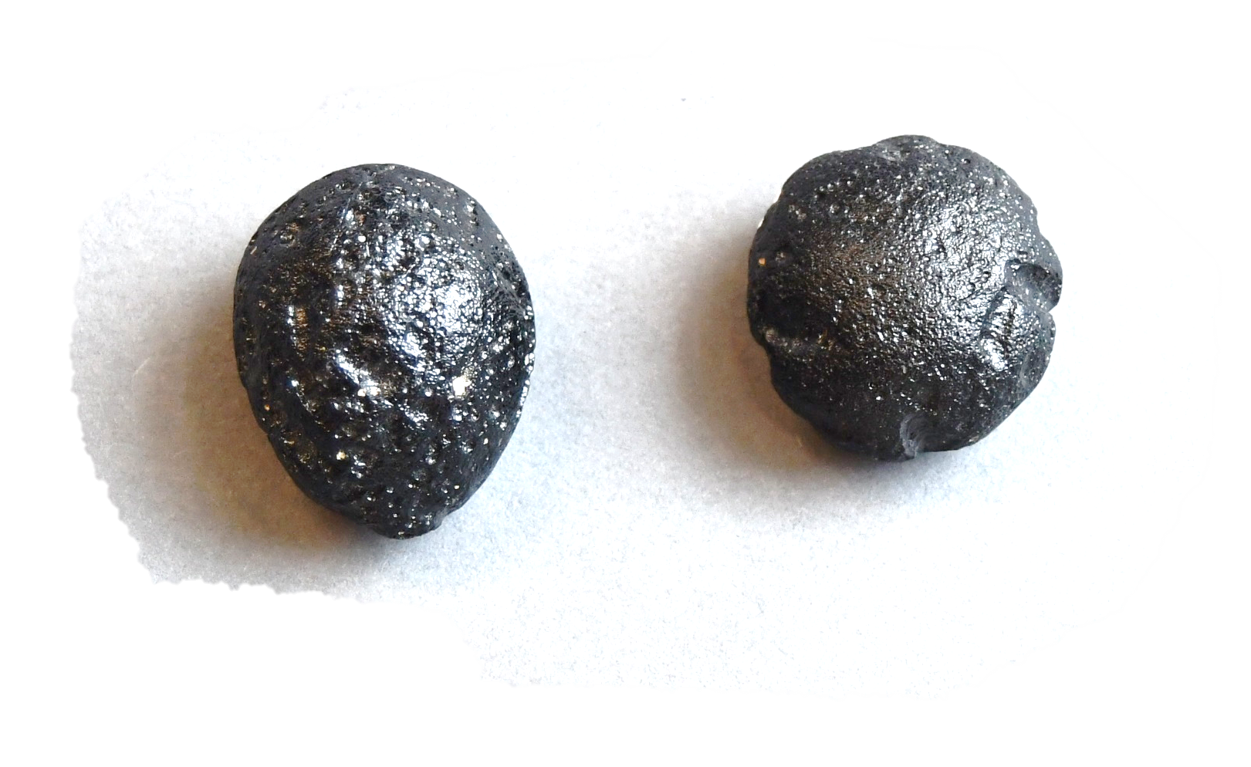
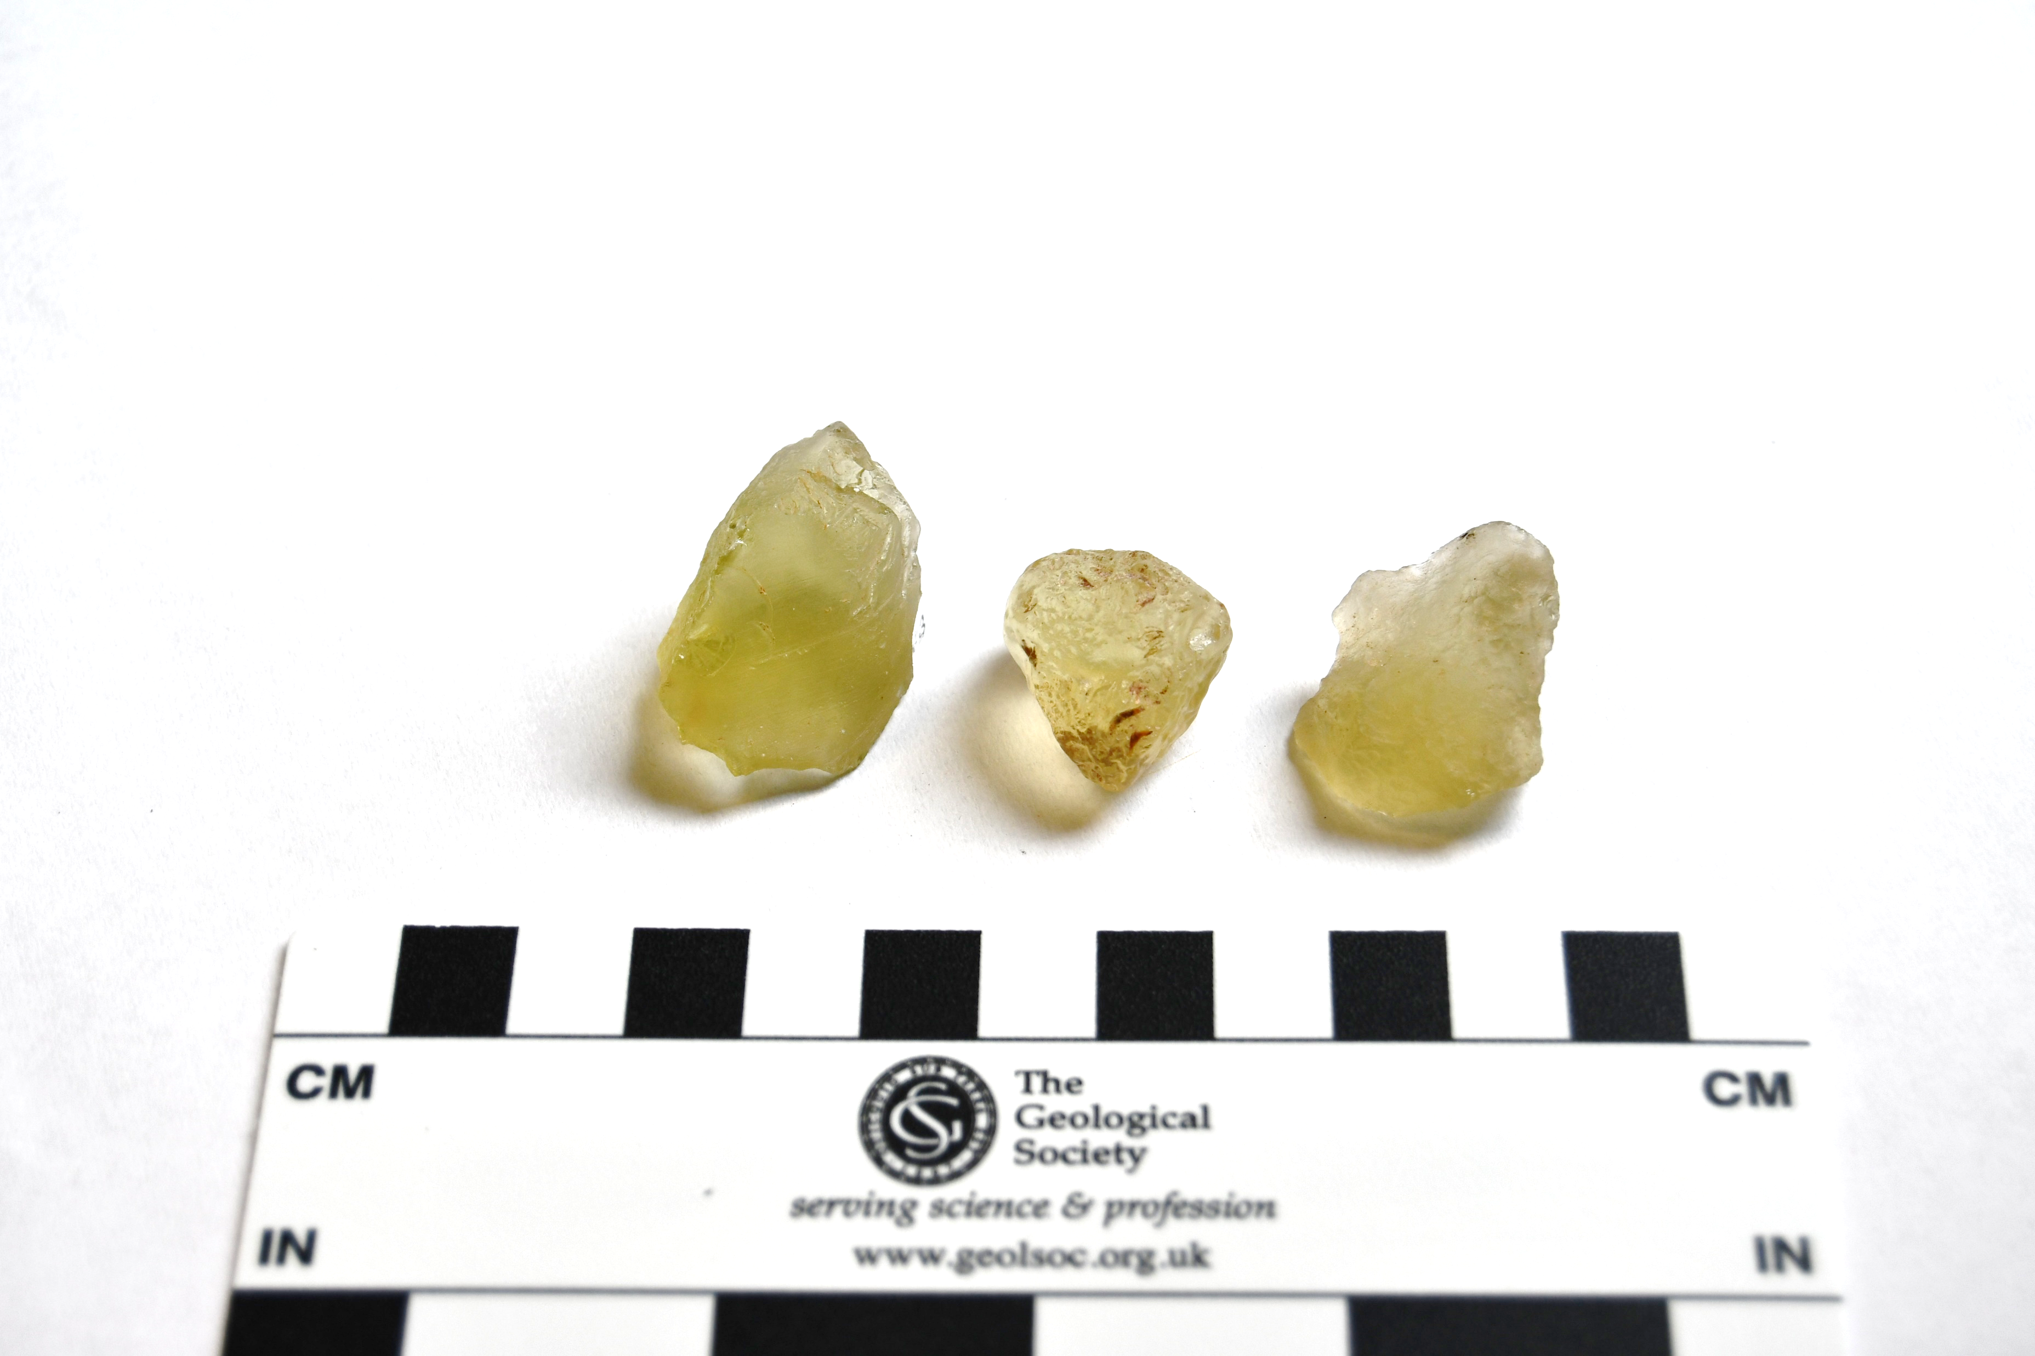
Black
No grains or crystals visible
Glassy exterior, with small bubbles
What is it?
A bicolite is an impact glass.
It forms when rocks from a crater melt and then cool down very quickly.
Fun fact: this rock is very similar to obsidian because they were both liquid rock that cooled very quickly
1 cm

Slide 14

Yellow/light green
No grains or crystals visible
Smooth, glassy exterior
Partially transparent
What is it?
Libyan desert glass is an impact glass, like bicolite.
It forms when rocks from a crater melt and then cool down very quickly.
Fun fact: the colour of impact glasses is determined by the contents of the bedrock. Desert glass is yellowish-green because it’s formed out of sand.
1 cm

Slide 15

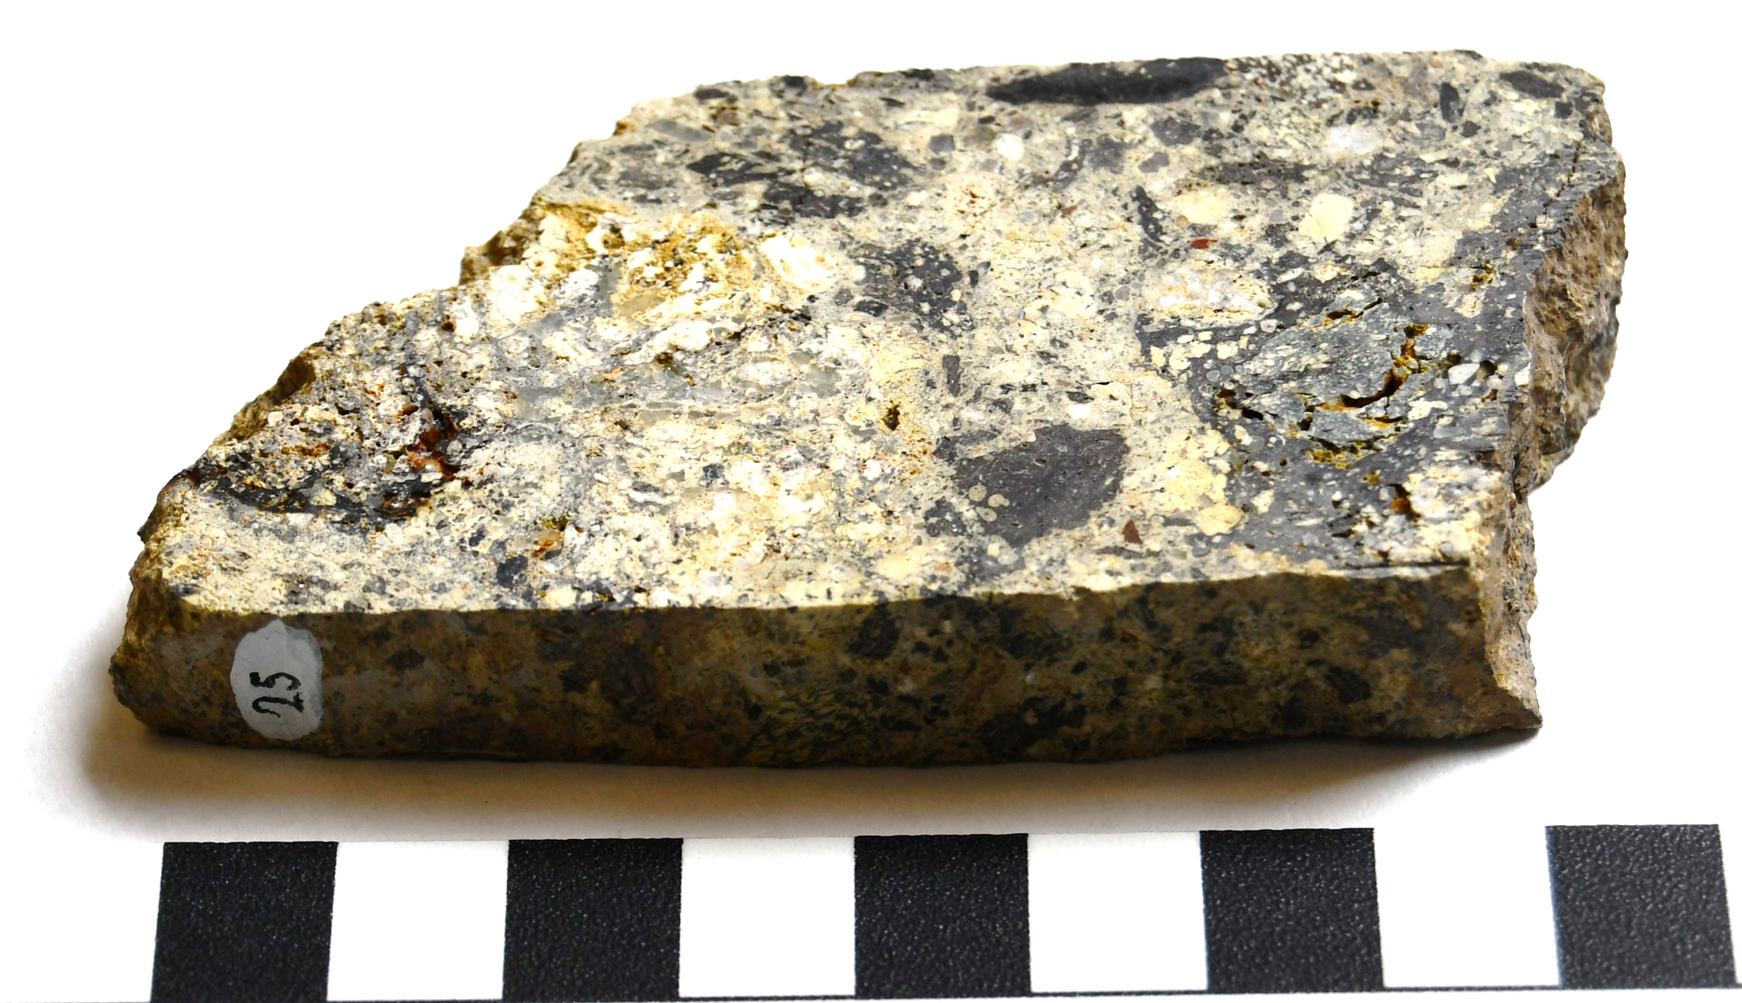
Grey, green, white
Grains and clasts
Made out of clasts of different sizes and compositions
Fuzzy clast outlines and undulating features indicate that some of it was molten
What is it?
This is a suevite. It is an impact breccia (rock made when the bedrock was broken up and reassembled by an impact) which contains parts that were molten.
Fun fact: this rock came from the Ries crater in Germany, the town of Nördlingen was built in the crater!
1 cm

Slide 16

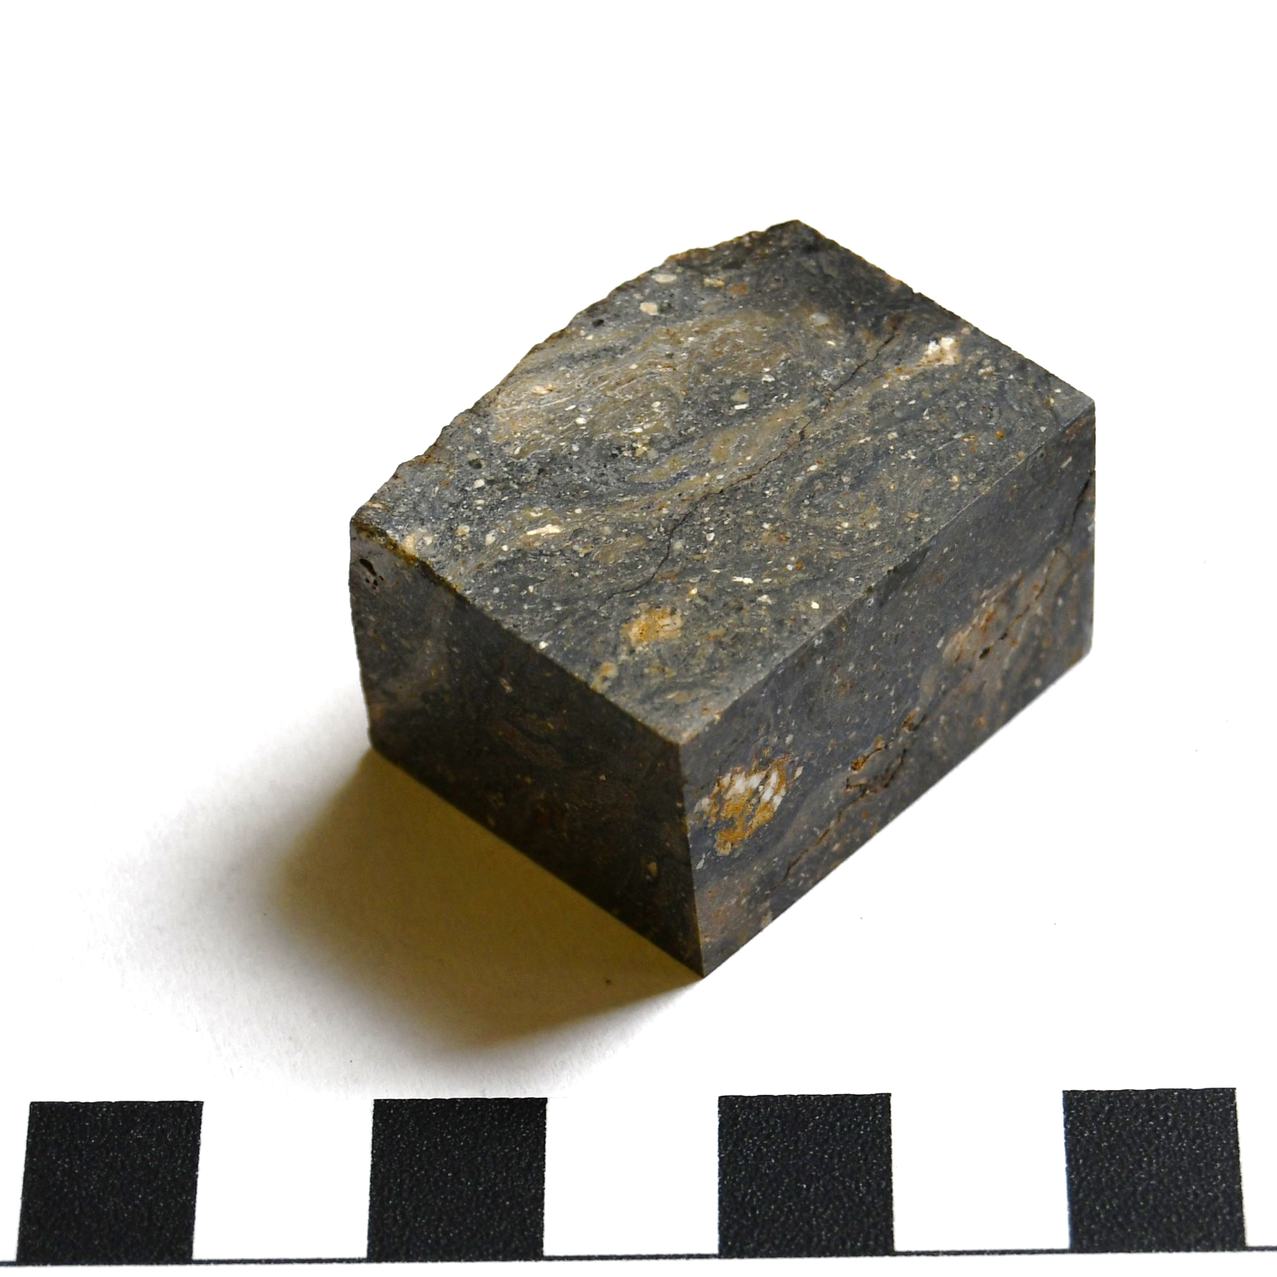
Dark grey-greenish
Grains
Undulating bands and laminations (‘flow banding’) indicate that some of it was molten
What is it?
This is a suevite. Like the previous rock, parts of this suevite were molten, which caused the flow banding (visible bands or layers caused by friction of melted rock in contact with solid rock).
Fun fact: this rock came from the Mien crater in Sweden, Lake Mien lies within the meteorite crater!
1 cm

Slide 17

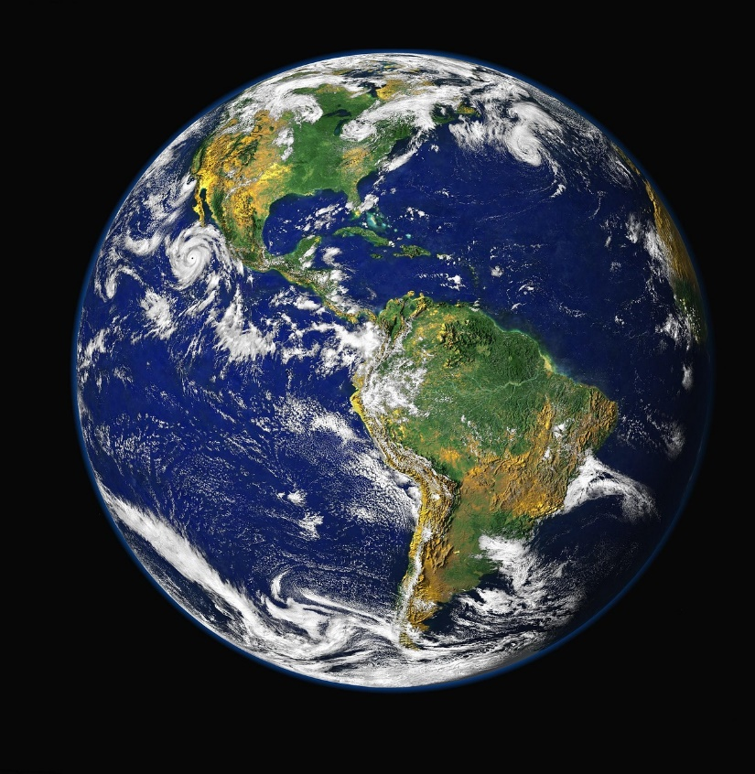
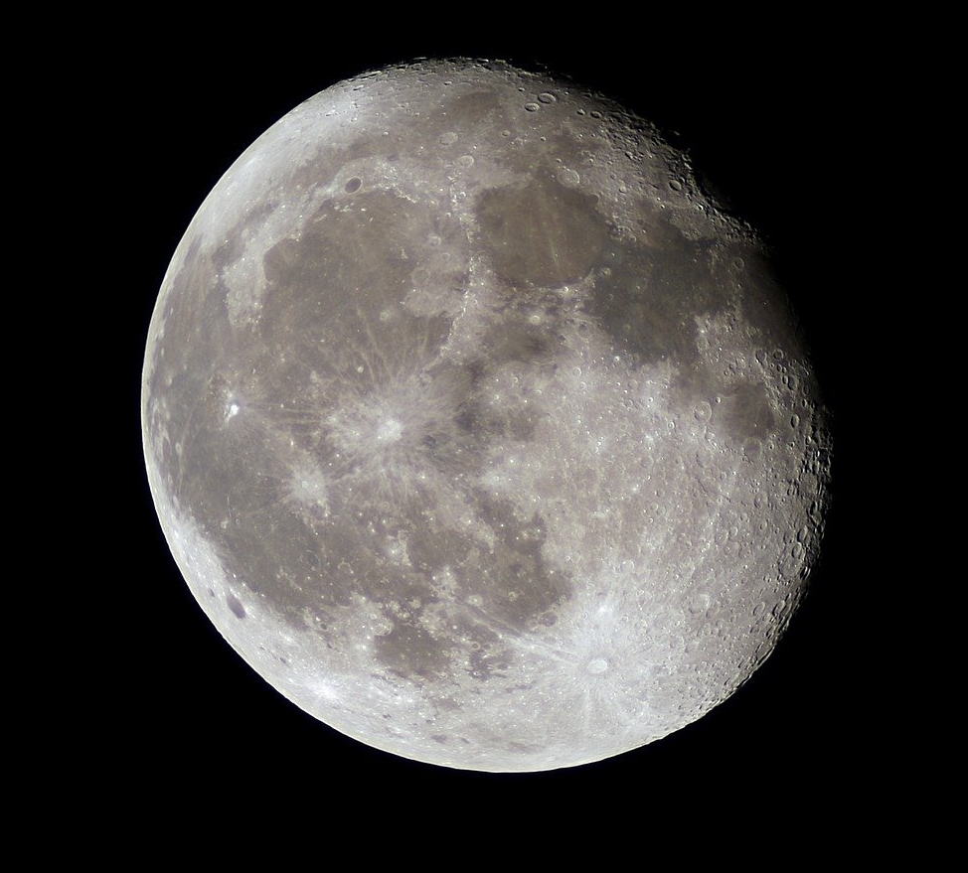
Very few craters
Entire surface covered in craters
Notes:
Why are there so many more craters on the Moon, Mars, Mercury, and even Venus, than on the Earth?
Answer: Firstly, it’s important to note that large meteorite impacts are rare nowadays, but they were very common a long time ago (when planets like the Earth were forming), simply because there were more asteroids back then. The Earth and the other planets probably experienced a similar number of impacts, but on the Earth, they were erased due to several reasons:
Tectonics and the rock cycle: plate tectonics and reprocessing of the Earth’s crust mean that the rocks on the surface of the Earth now are not the same as early in the planet’s history, so craters were buried or destroyed
Water: unlike all other planets in the Solar System, the Earth’s surface is 70% covered by water, which erased most craters or may have prevented them from forming in the first place.
Vegetation: more recent craters may be covered by vegetation

Slide 18

Thank you for your attention!
Contact our education team at education@geolsoc.org.uk
This lesson was created as part of a project funded by the
UK Space Agency ‘Space for All’ fund

