Slide 1


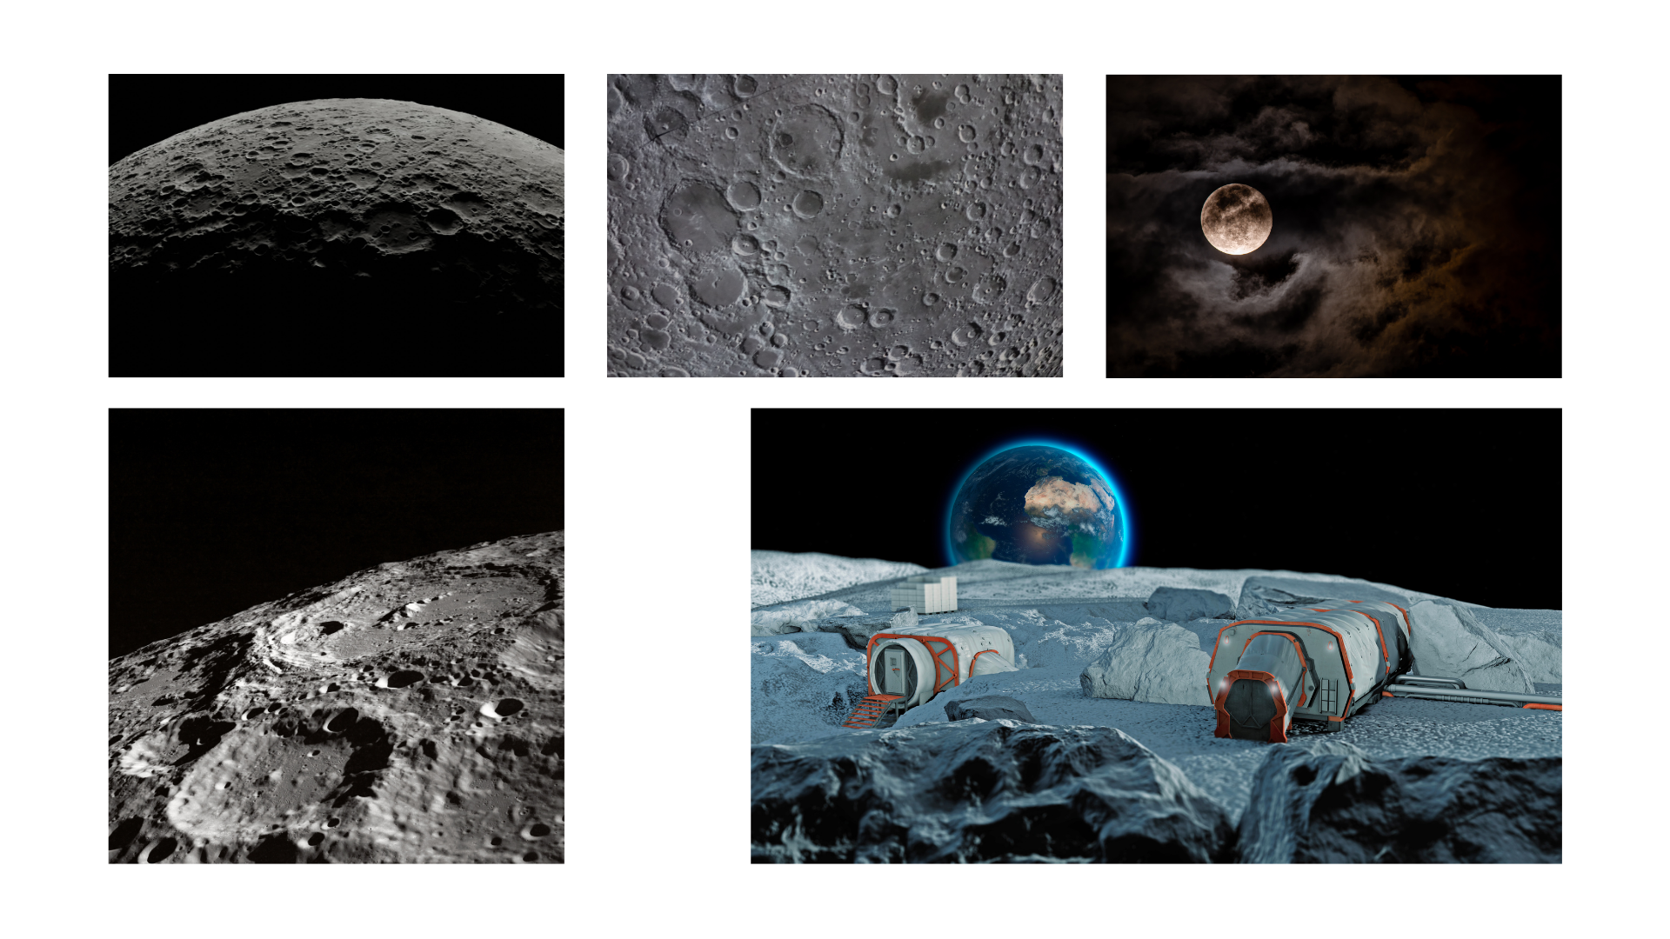

Slide 2


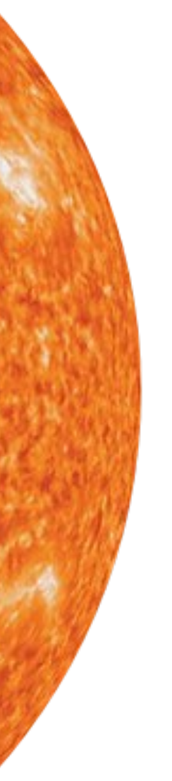
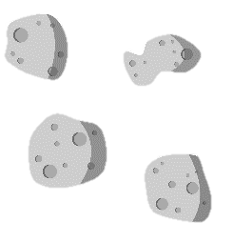
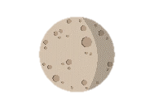
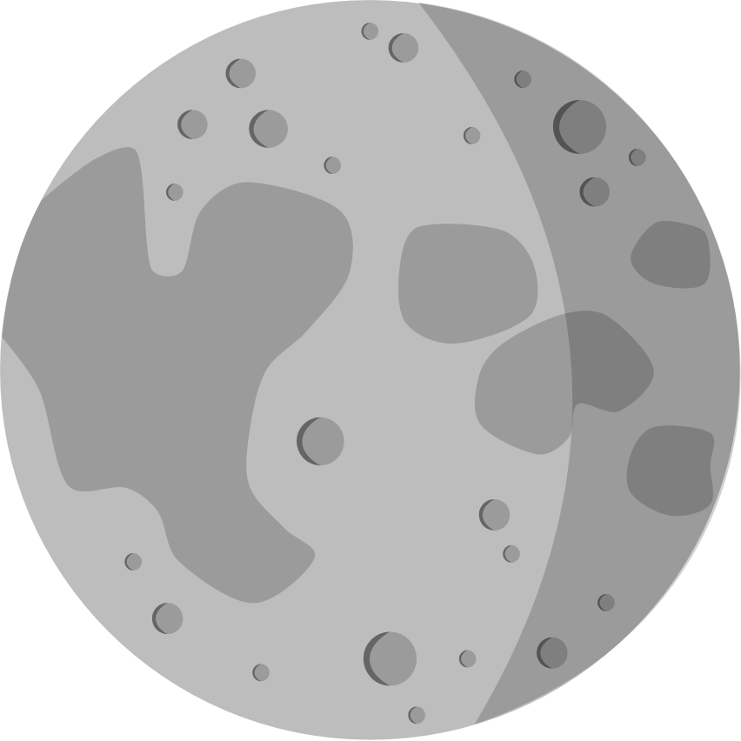

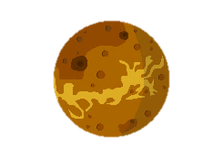
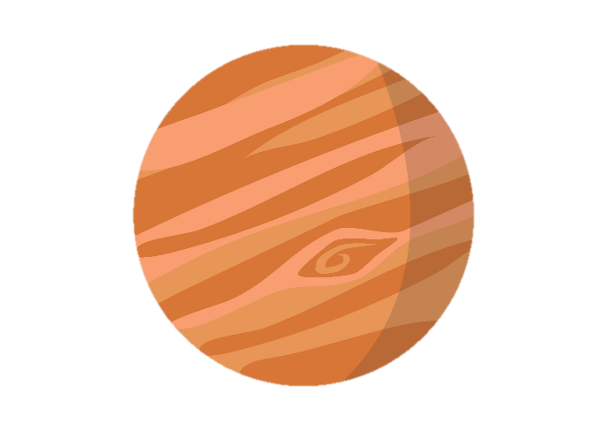


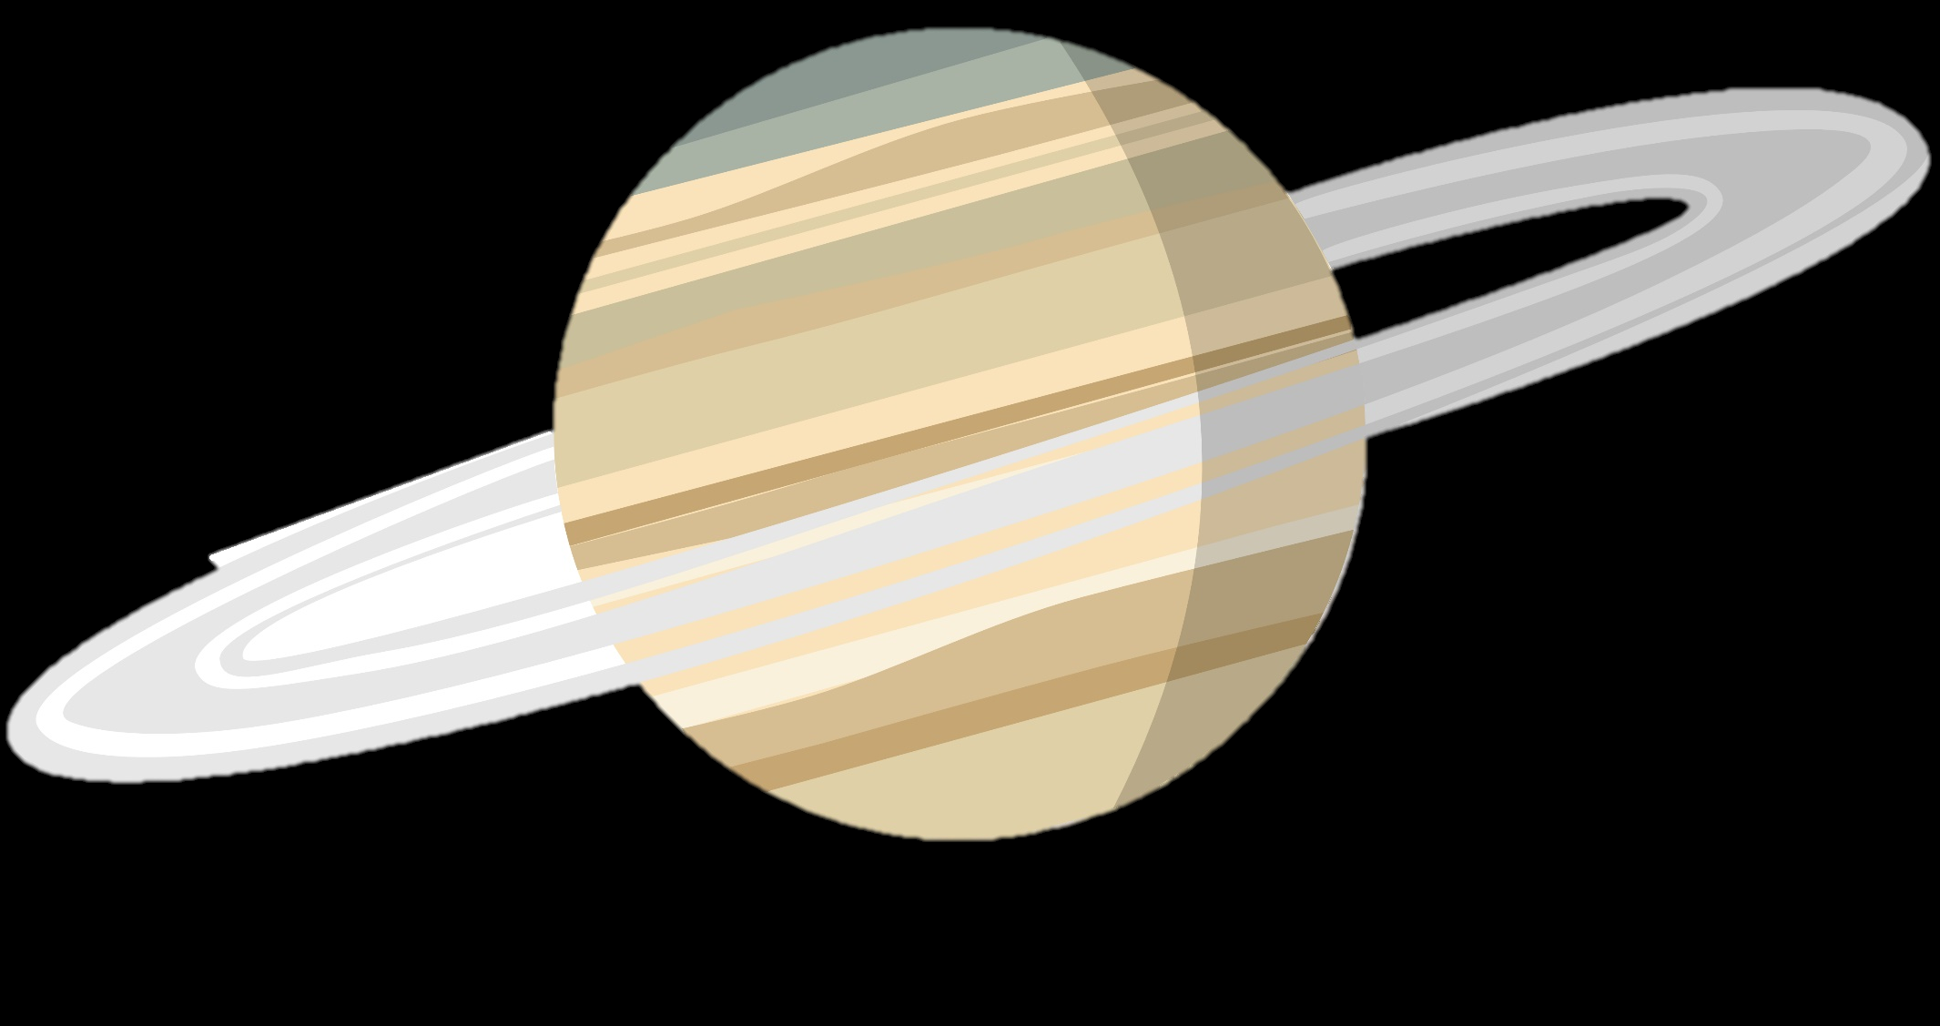



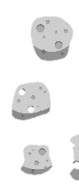
OUTER PLANETS
INNER PLANETS
ASTEROID BELT
Not to scale
Notes:
As a recap, this is our Solar System! Before we can go explore any further, we will need a semi-permanent base on our closest planetary neighbour – the Moon!
Can anyone point at the Moon?

Slide 3

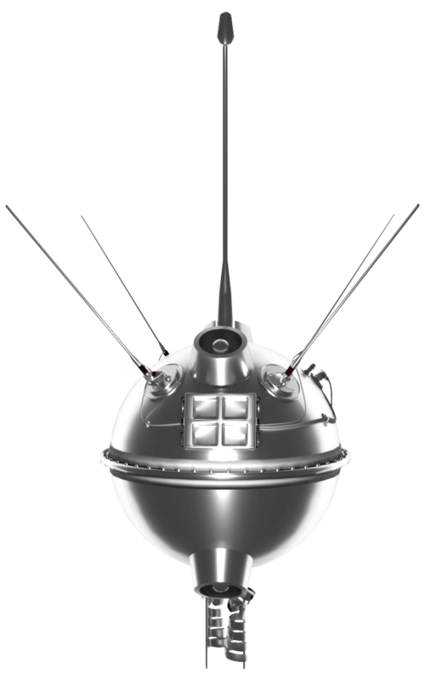
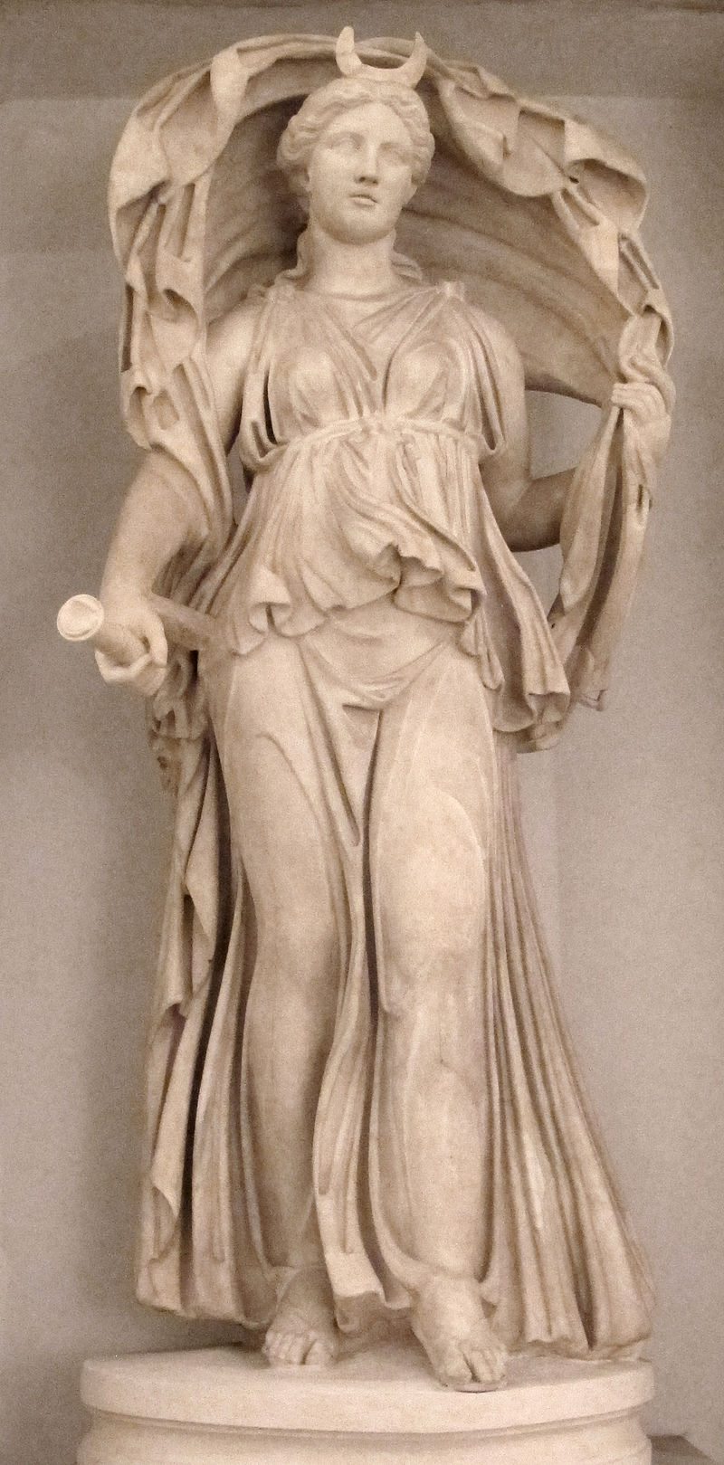
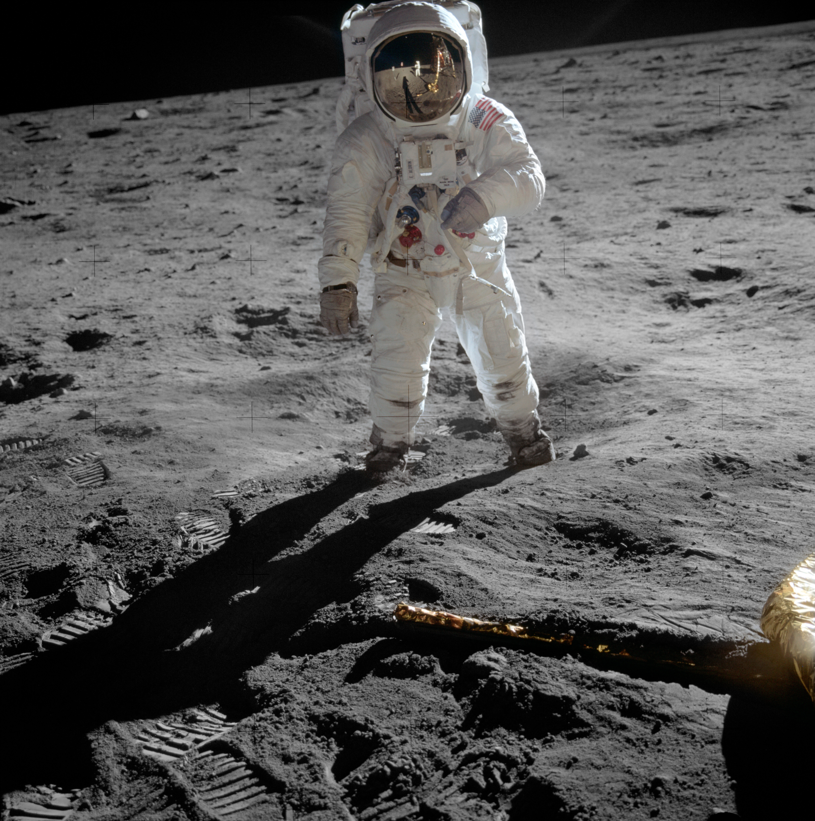
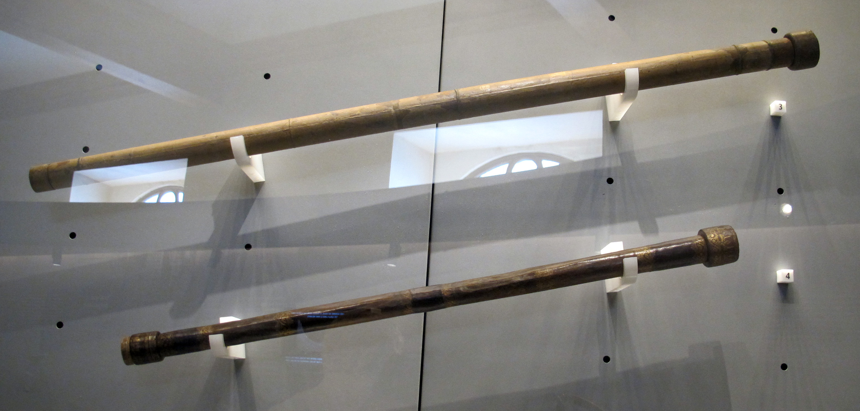
Prehistory & Ancient world
Paintings, statues & rock carvings
1609
First telescope observations
(Galileo)
1959
First orbiter
(Luna 2)
1969
First Moon landing
(Apollo 11)
2020
Robotic exploration restarted
(Chang’e 5)
Model of the
Luna 1-2 spacecraft
(Photo: NASA/NSSDCA)
Statue of Selene, ancient Greek goddess of the Moon (Photo: Musei Capitolini, via Wikipedia)
Galileo’s telescopes
(Photo: Museo Galileo, via Wikipedia)
Photo from Apollo 11
(Photo: NASA)
Notes:
The Moon is the Earth’s natural satellite, and it has fascinated civilisation for millennia – there are depictions of the moon in prehistoric cave paintings, ancient rock carvings, and sculptures.
The first telescopic observations came from Galileo in 1609, but the first physical exploration of the moon began with Luna 2, a Soviet mission in 1959.
You’re probably familiar with NASA’s Apollo missions following shortly after, which included the first crewed Moon landing, as part of the Apollo 11 mission in 1969. For geologists, the Apollo missions were really valuable because they returned Moon rocks to the Earth, which allowed us to learn a huge amount about how the Moon formed. They also allowed us to confirm that some meteorites found on Earth originally came from the Moon!
Since the Apollo era, there haven’t been any crewed lunar landings, but there were various spacecrafts sent into lunar orbit to study it from afar. Robotic lunar landings restarted recently, with the Chang’e missions targeting the far side of the Moon, which previous missions hadn’t previously explored.
At the moment, multiple space agencies and private companies are investigating how to build permanent moon bases that humans could survive in, which could be used as a base to travel even further in the Solar System. Just like a space agency, today we are also going to think about how to build a Moon base.

Slide 4

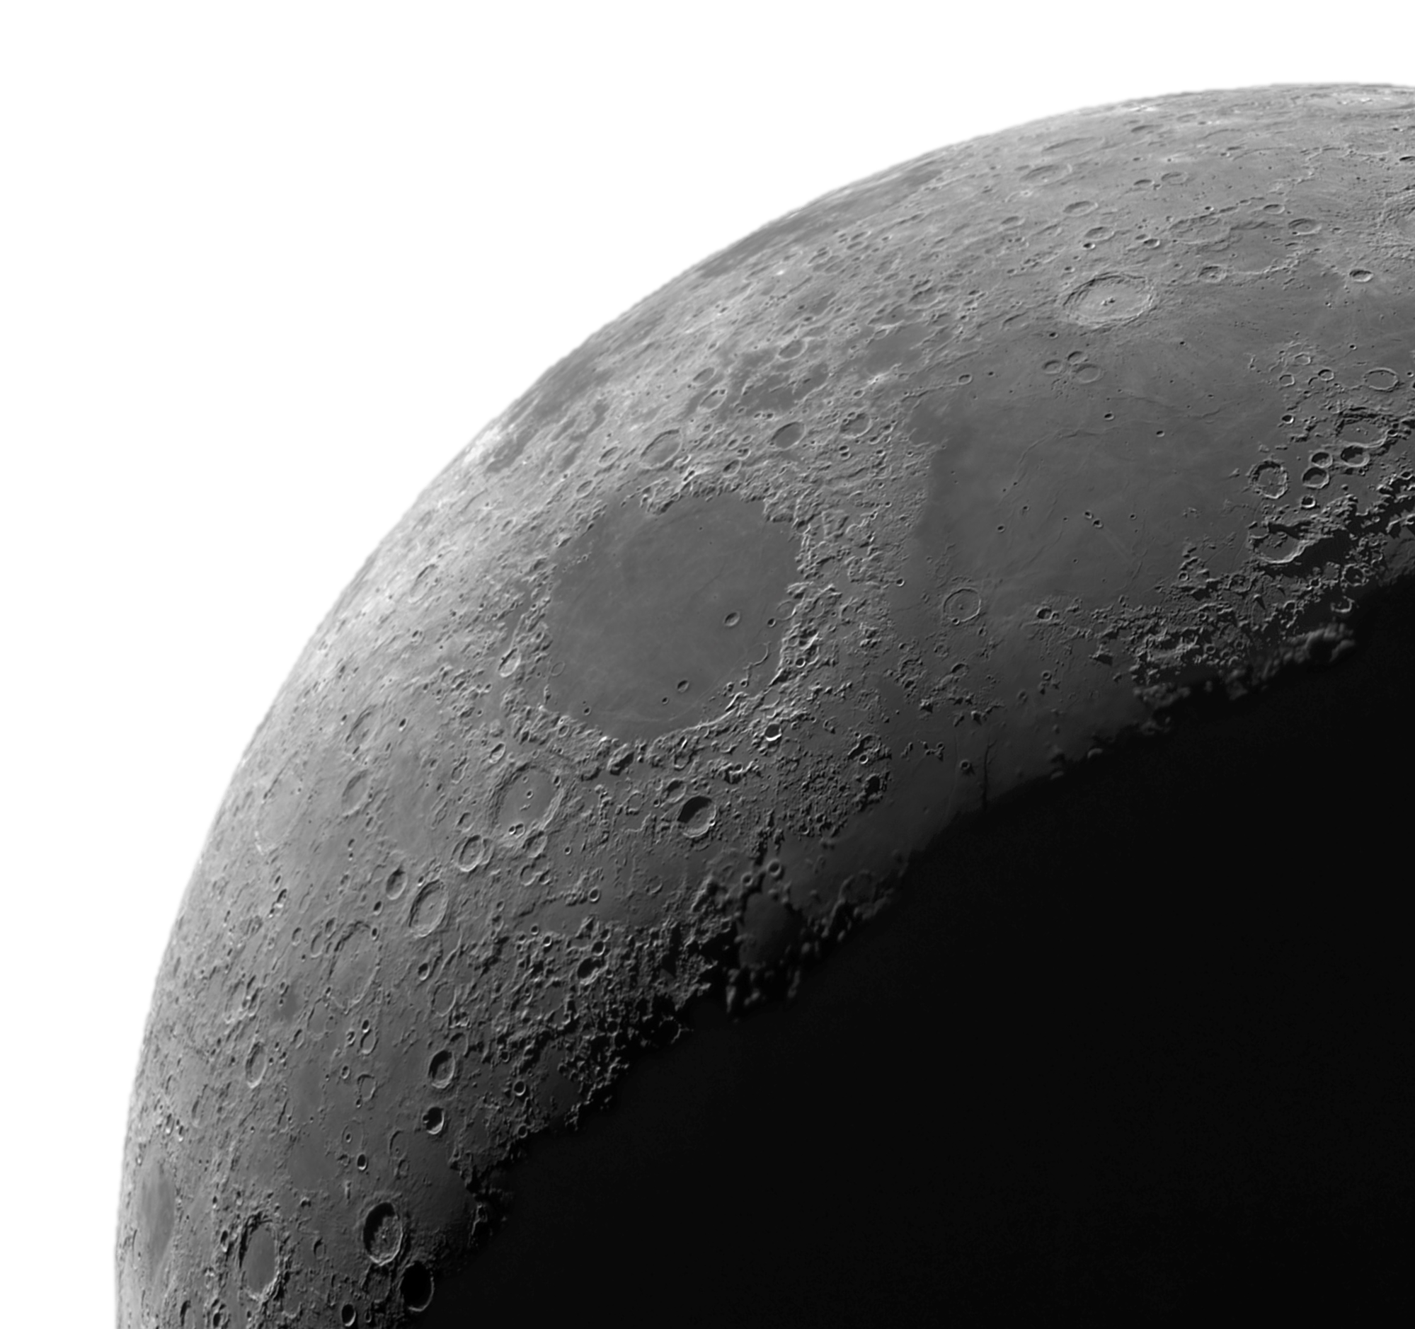



What do we need to consider?
Power
Location
How to build it?
Notes:
We are in mission planning phase! We have decided we need a permanent moon base. What do we need to consider in order to build one?

Slide 5
What do we need to consider?
Power
Location
How to build it?
Notes:
We are in mission planning phase! We have decided we need a permanent moon base. What do we need to consider in order to build one?

Slide 6


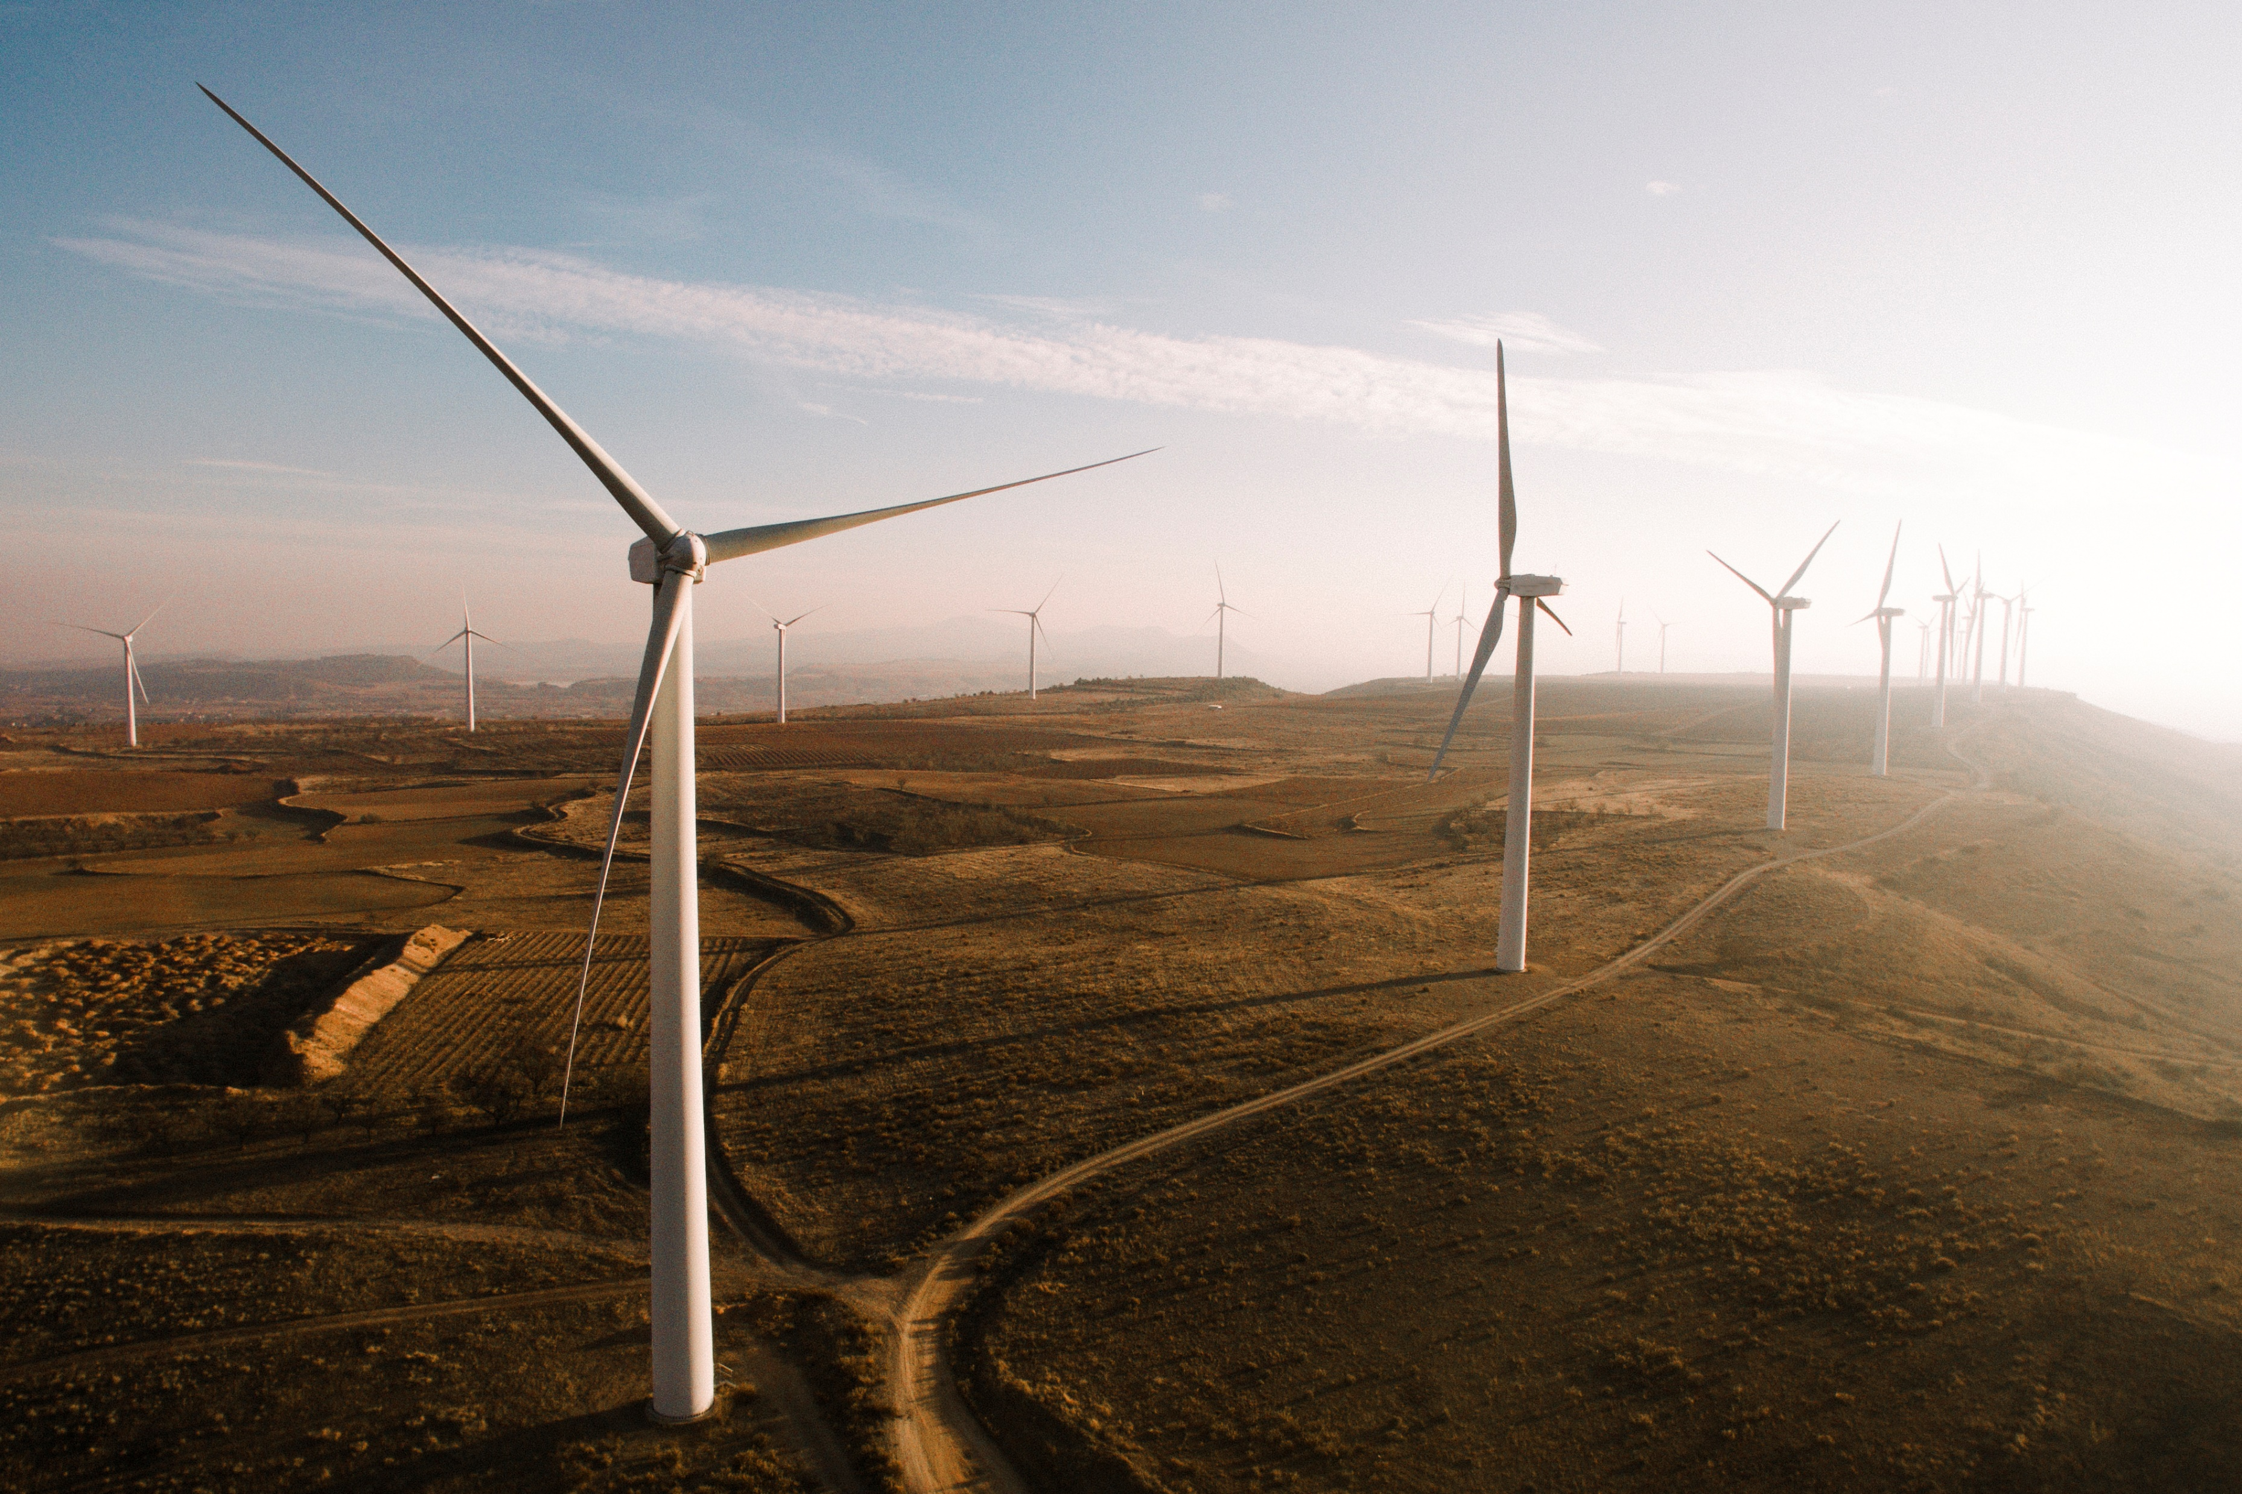
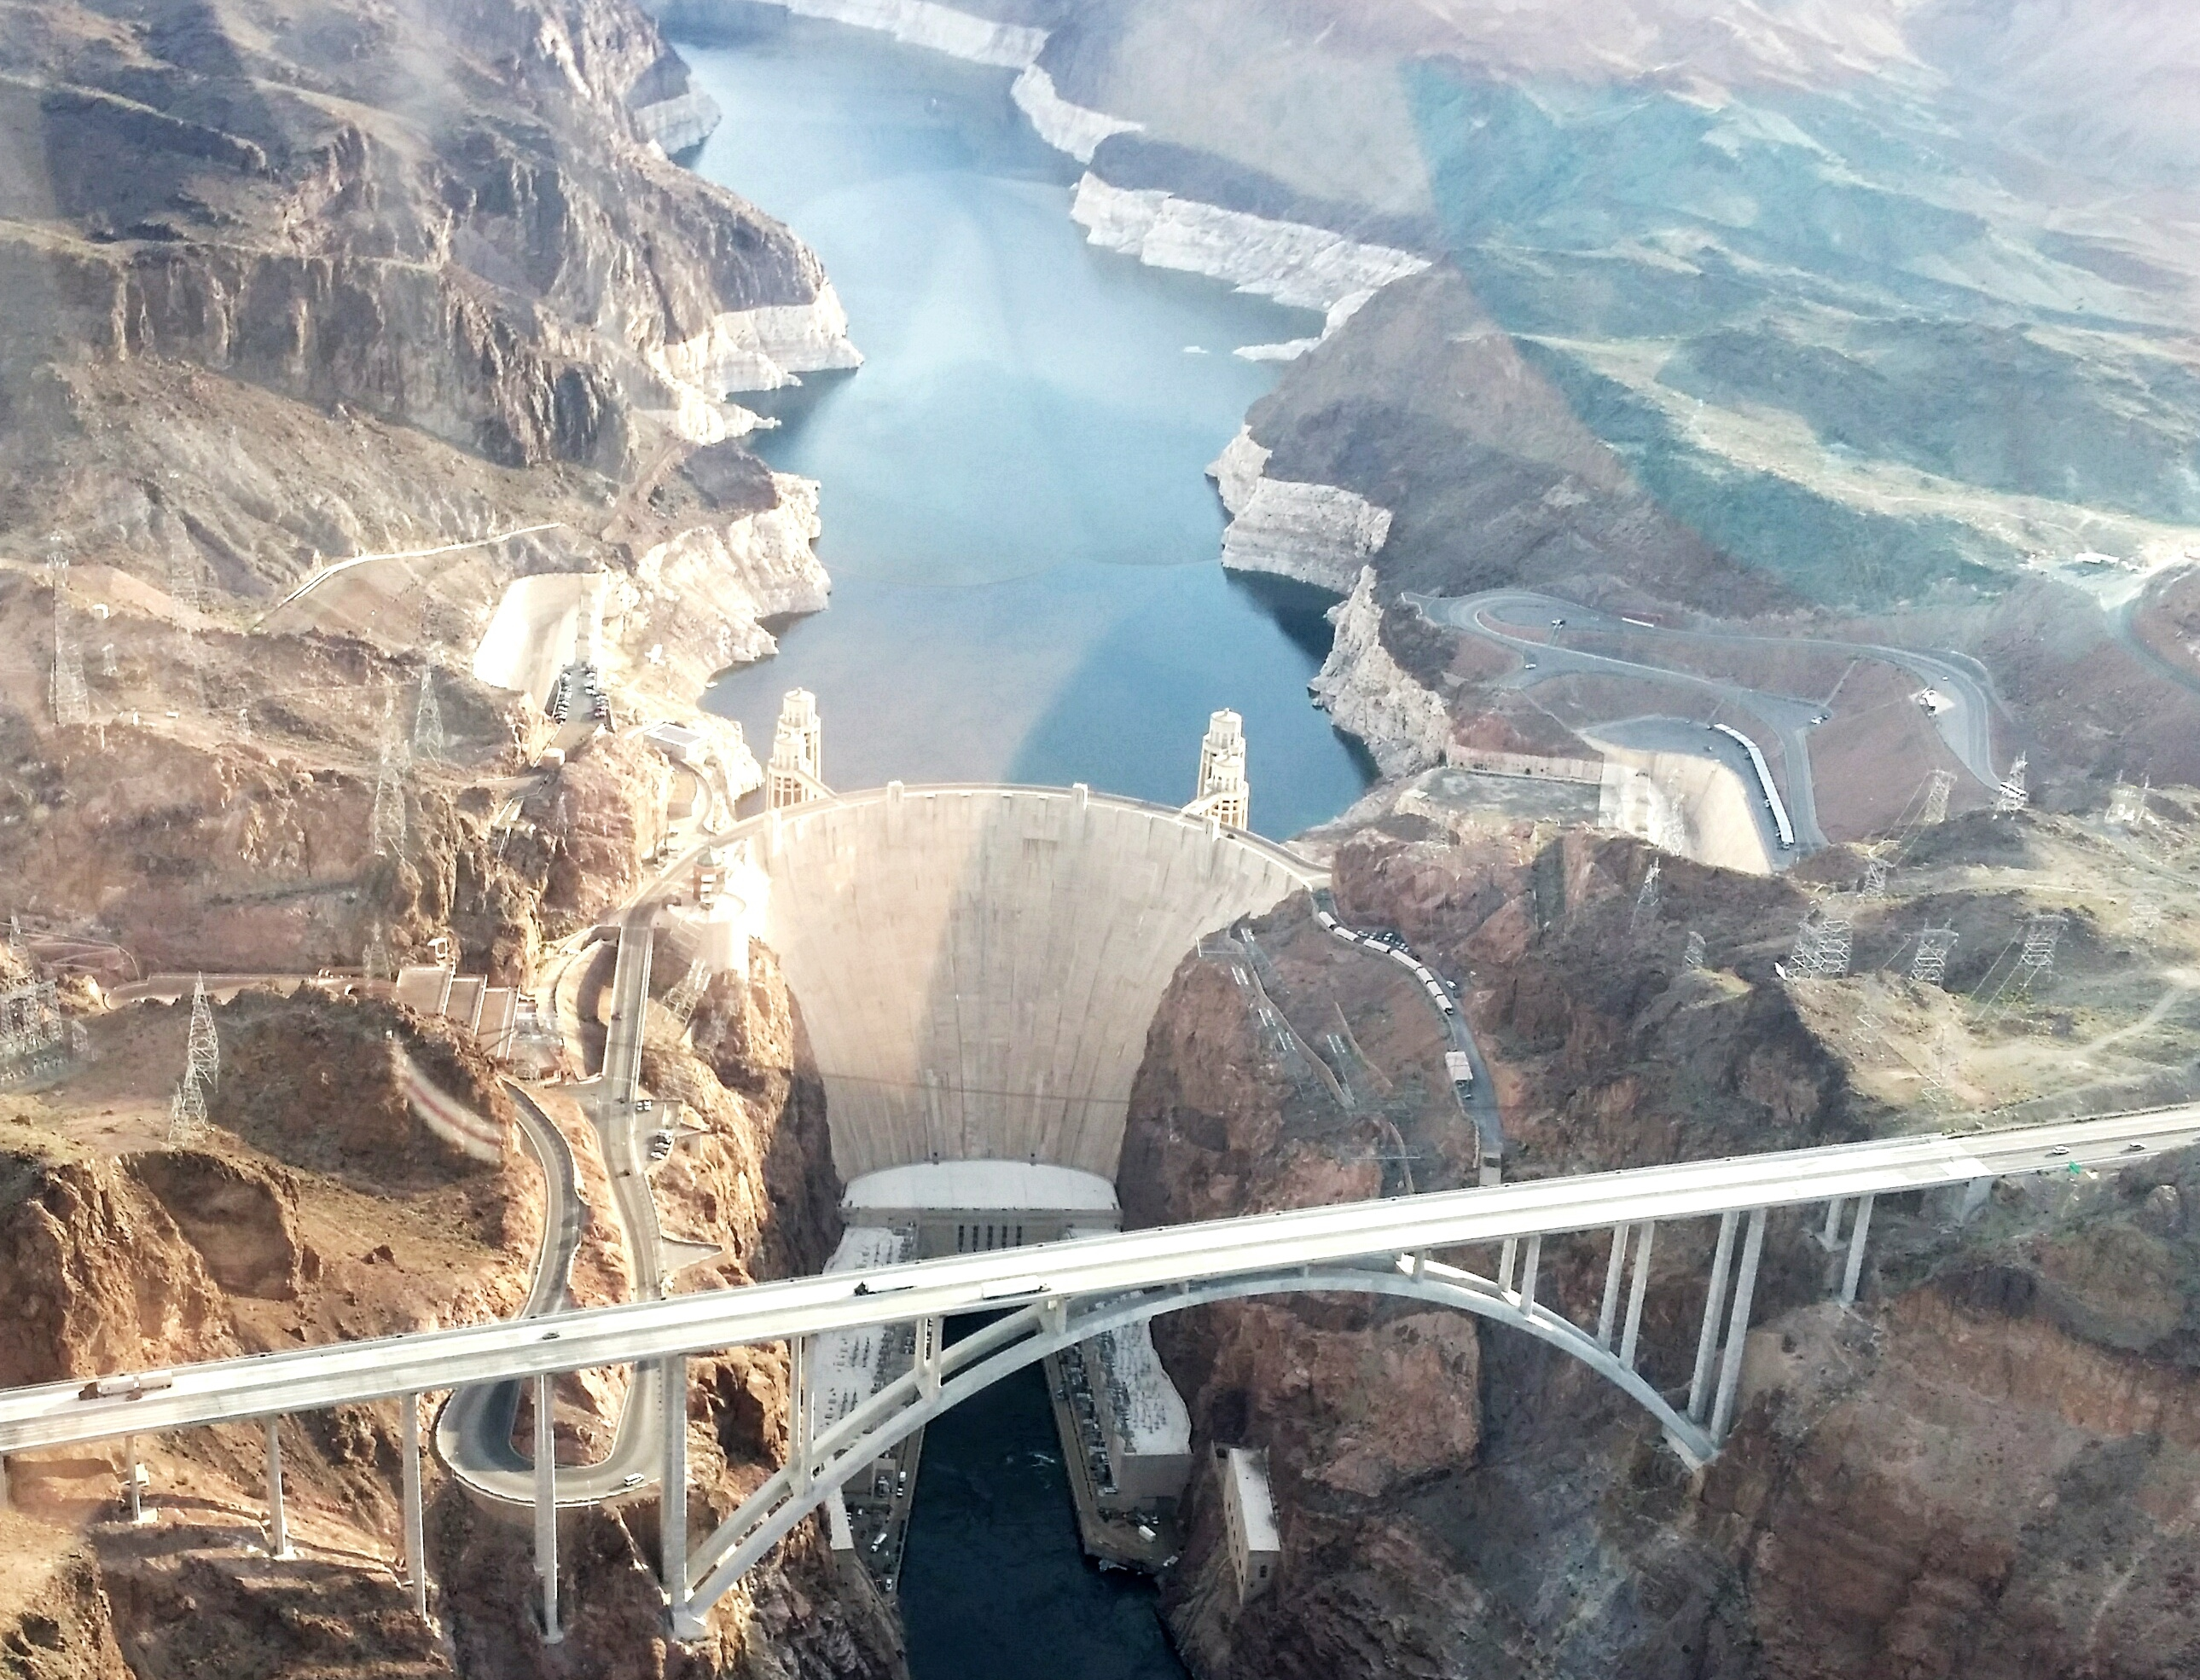
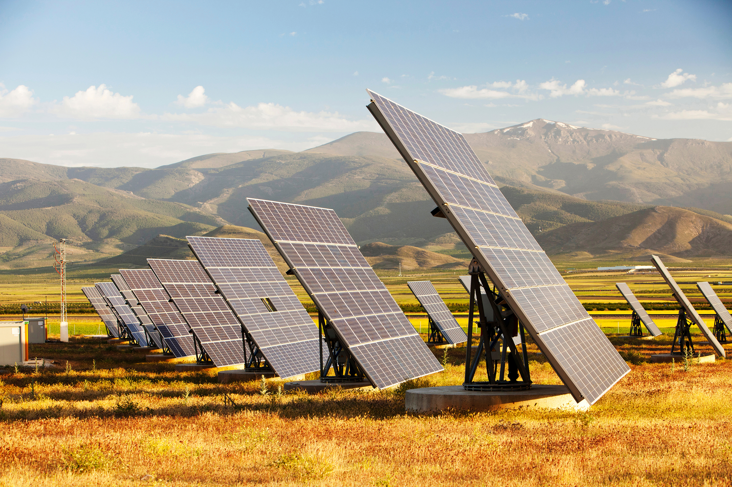
Notes:
Here are a few sources of power we picked: fossil fuels, hydroelectric, wind and solar power. These both work on Earth, but what about the Moon?
The Moon doesn’t have any fossil fuel resources because we don’t think it ever had plant or animal life from which fossil fuels form. There is also no liquid water and no atmosphere, so wind and hydroelectric power are not options. The only viable option is solar power.

Slide 7
What do we need to consider?
Power
Location
How to build it?
Notes:
Next, we need to find the best location for our base, considering that we need solar power.

Slide 8

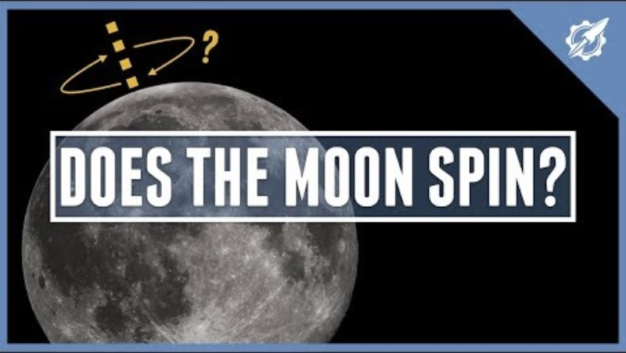
Which part of the Moon receives the most sunshine?
Notes:
Which places on the Moon get the most sunshine, so we can put solar panels there?
Think about the Moon’s rotation. Any ideas?
(play the video with sound on until 1:17)
So the dark side of the Moon is not actually dark, it receives just as much sunshine as the near side. In fact, the Moon going around the Earth doesn’t actually matter here! We just need to think about the Moon rotating on its axis, like the Earth does. For this reason, both sides of the Moon get around 14 days of sunshine.
However, scientists recently discovered that some crater ridges at the south pole are raised enough to receive more than 14 days of sunshine – they actually get around 21 days! If the Moon base can be powered most of the time, that’s the best we can hope for, so the south pole seems like the best place to put a Moon base.
What else tends to exist at the poles of a planet that might be helpful for a moon base?
Hint: what’s the at the Earth’s south pole?
Answer: ice sheets! There is ice on the Moon too, in permanently shaded regions inside craters, at the poles. This could be melted to make water!

Slide 9
What do we need to consider?
Power
Location
How to build it?
Notes:
Finally, now we have a location and power, we can start thinking about how to build our base.

Slide 10



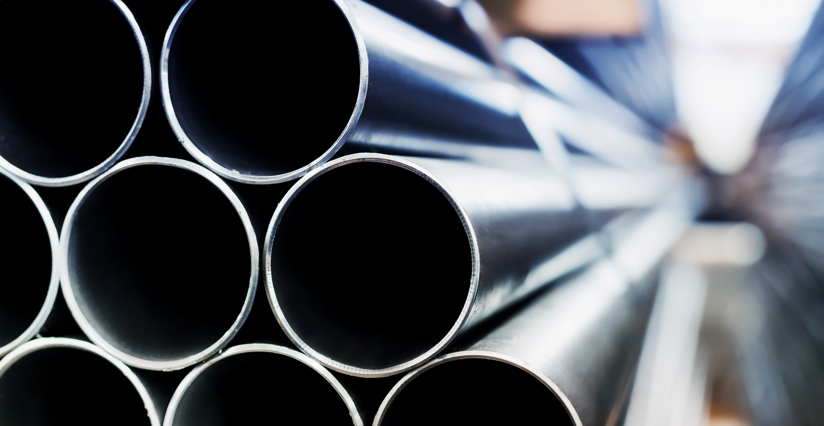

What building materials do we use on Earth?
Notes:
What should we build a moon base out of? To start, let’s consider what building materials we use on Earth. How many can you name?
Here are a few we thought of: wood, bricks, metal and glass. Unfortunately, we won’t be able to transport any of these to the Moon – we would need too much! So any material we use must come from the Moon itself, we have to work with whatever resources are available there.
What is the Moon made of?

Slide 11

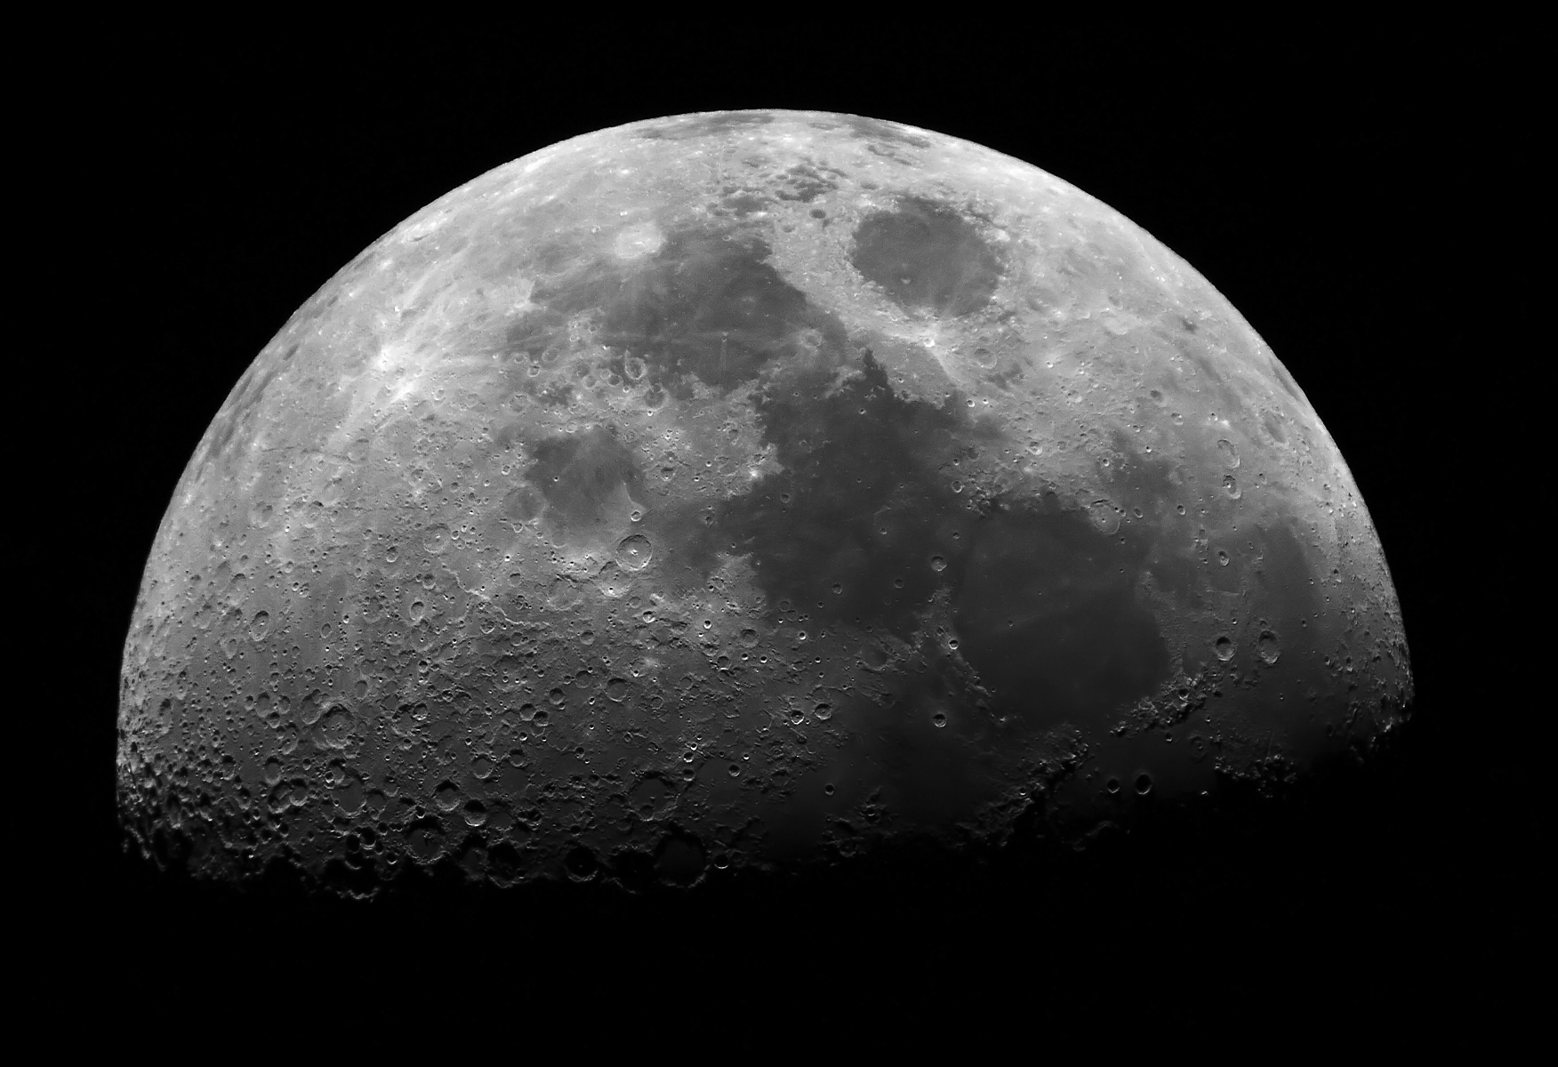
Basalt = dark volcanic rock (very hard)
Anorthosite = light igneous rock (very hard)
Regolith = fine sediment covering the rocks (soft, unconsolidated)
Breccia = sedimentary rock containing clasts of other rocks and/or regolith (sometimes crumbly)
Notes:
Here are the main rocks and materials found on the Moon:
Basalt is a fine igneous rock found in the dark areas, called lunar maria.
Anorthosite is a light, coarse igneous rock, found on the lunar highlands. Both of these rocks are very hard.
They are both covered in regolith, which is fine, soft sediment – like in the vials
Sometimes, this sediment becomes consolidated enough to form a sedimentary rock called breccia. Breccia can be found in both dark and light areas. It can be hard, but sometimes it’s also crumbly – it depends on how well consolidated the sediment is
Show hand specimens of each.

Slide 12
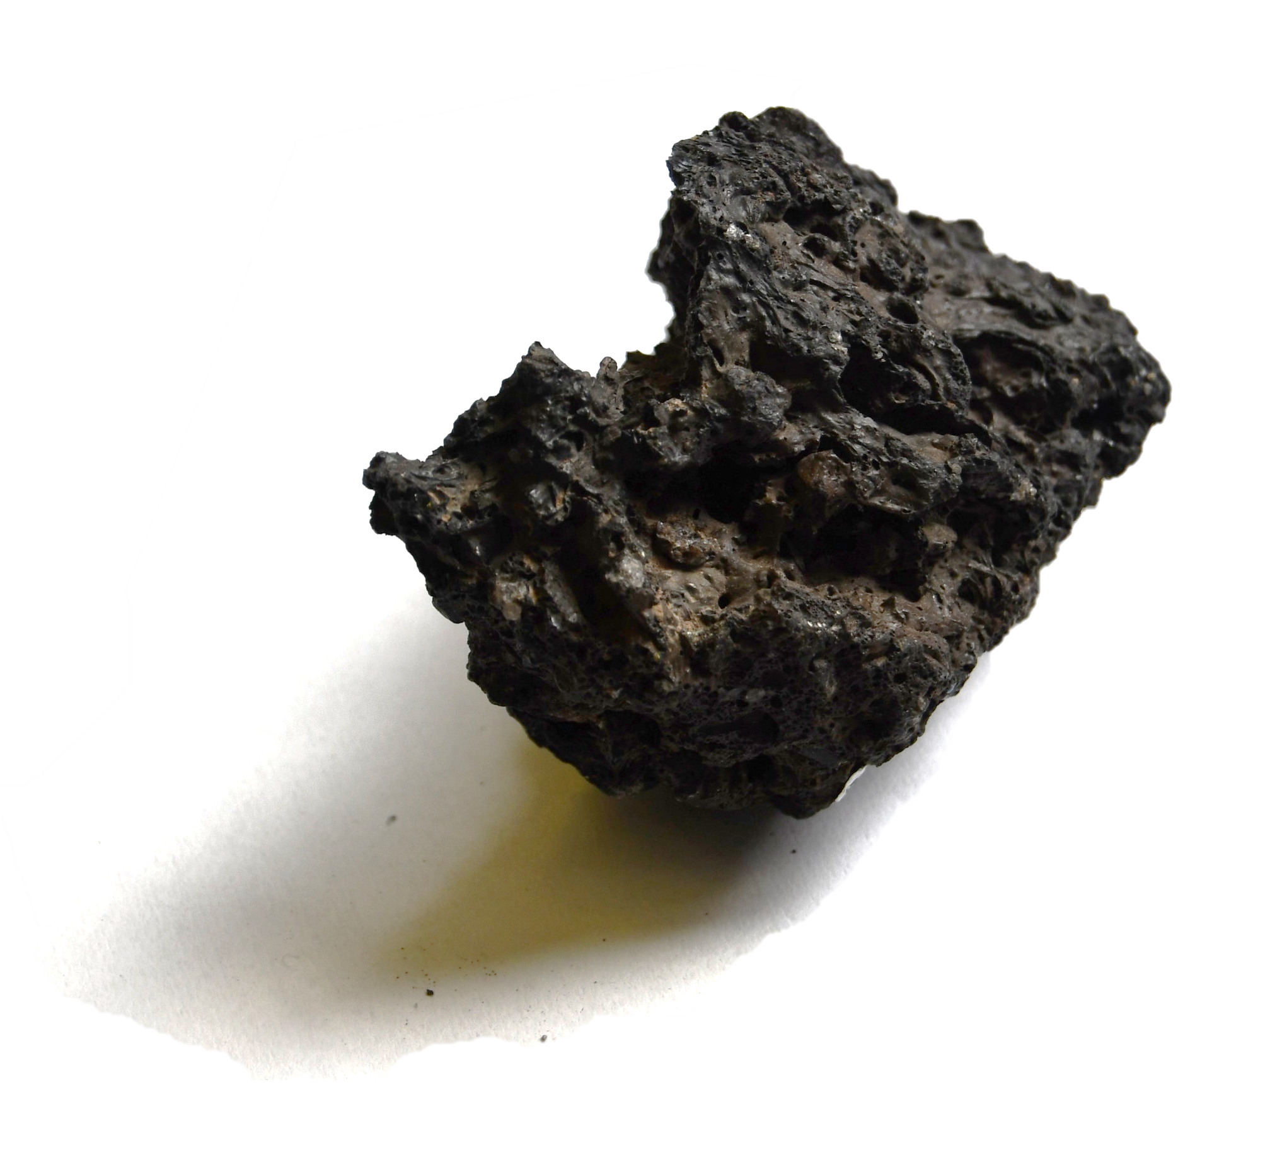
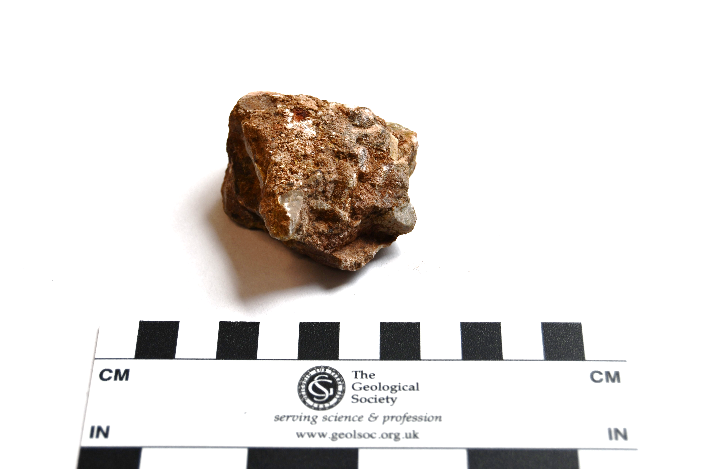
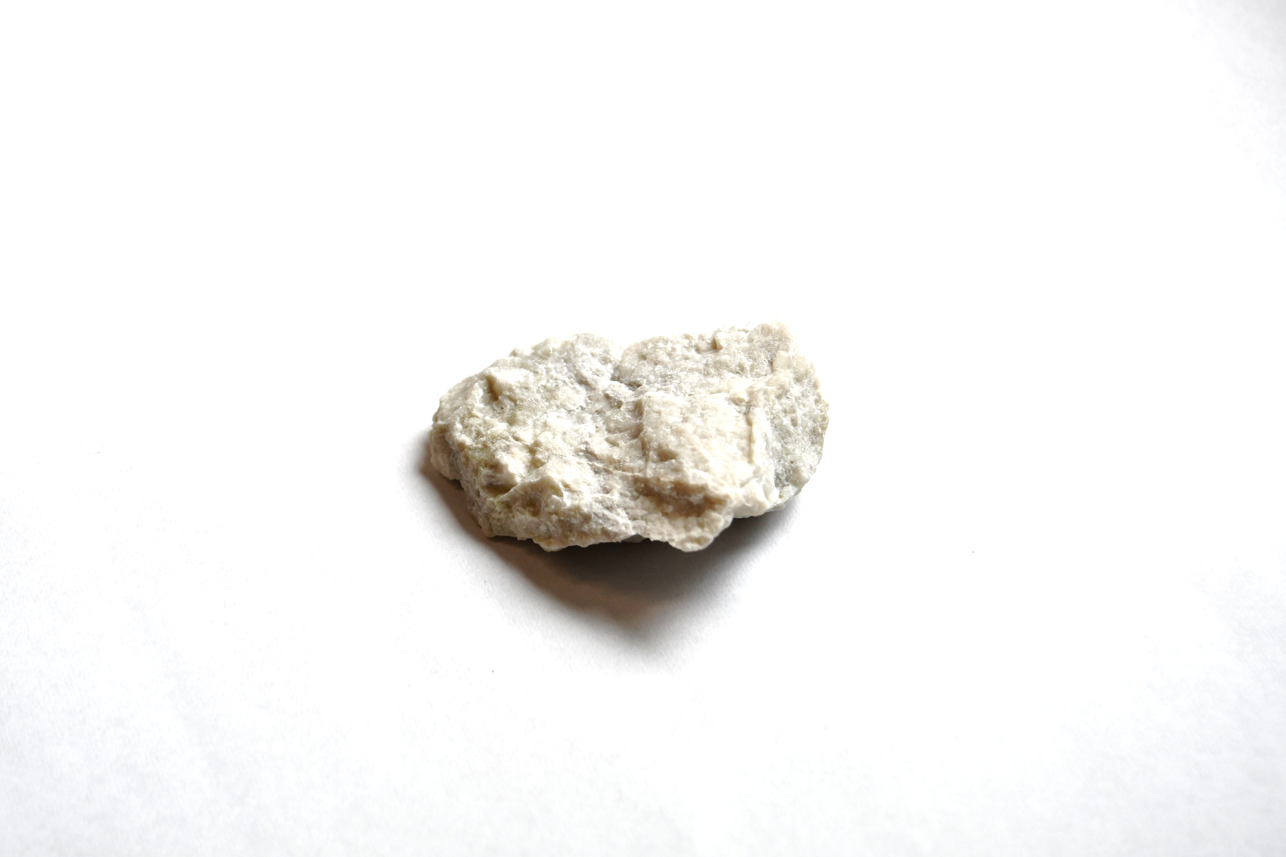
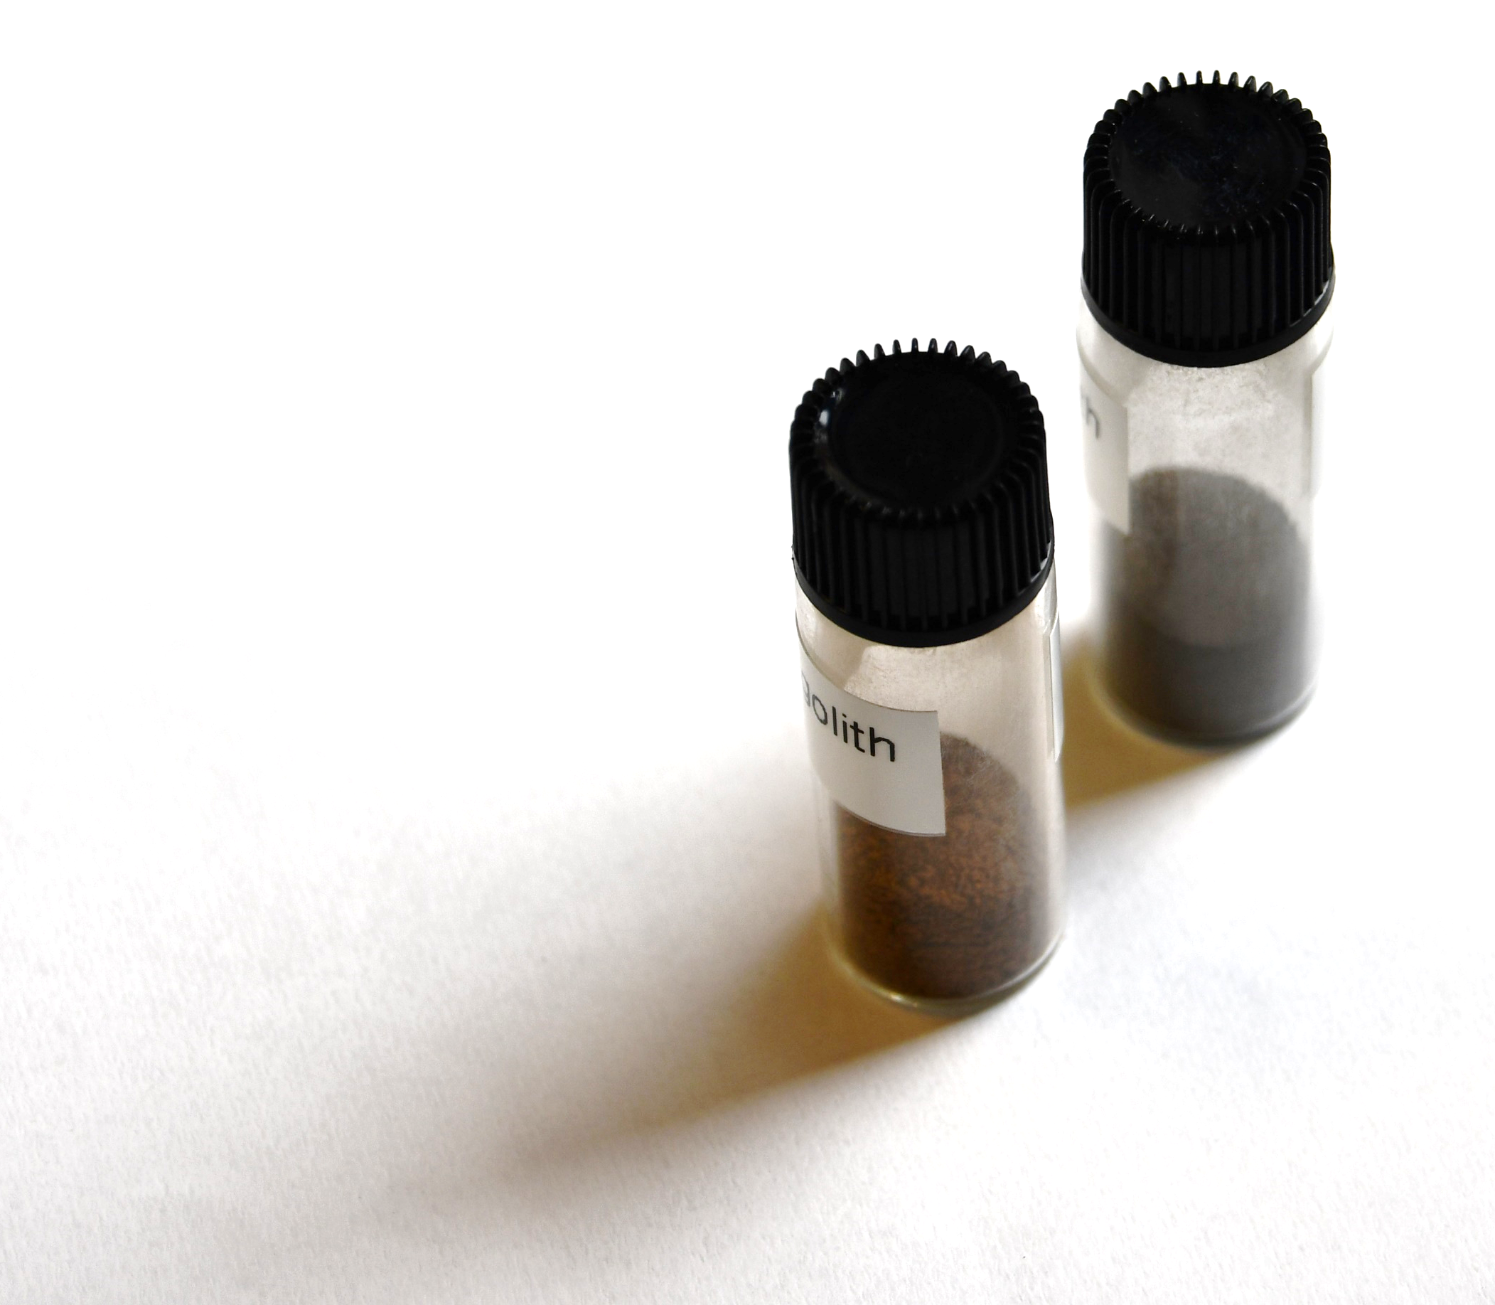
Look at the rocks and vials and make the following observations:
Does it contain crystals or grains?
What is the size of the crystals or grains?
How hard is it? Is it easy to mine? (Hint: if a rock is really hard, it will also be relatively hard to mine)
Any other features?
Now consider the pros and cons of using each material to build your Moon base. Why would a rock be good for building? Why not?
Notes:
Now it’s time for the students to inspect some rocks like those found on the Moon, and assess the pros and cons of using a material to build their Moon base.

Slide 13

Pros | Cons
Crystalline | Difficult to mine
Large crystals | Difficult to turn into bricks
Hard to break
1 cm

Slide 14

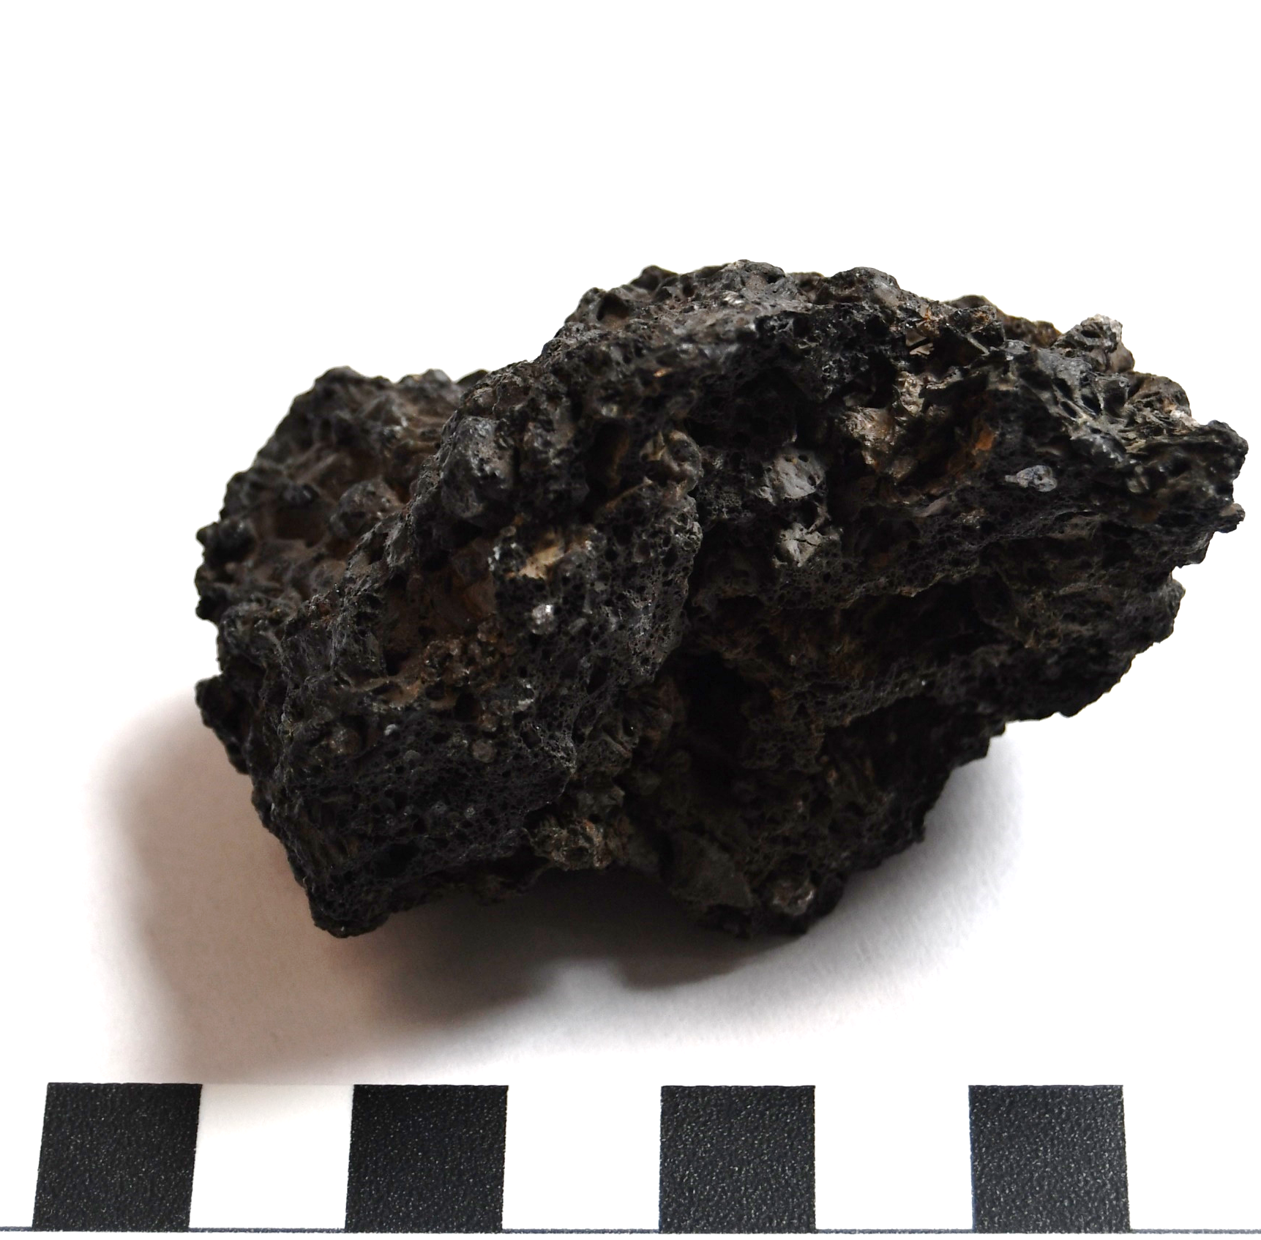
Pros | Cons
Crystalline | Difficult to mine
Hard to break | Difficult to turn into bricks
1 cm

Slide 15

Pros | Cons
Found everywhere | Can be crumbly
Can be hard | Made up of clasts of different rocks
1 cm

Slide 16

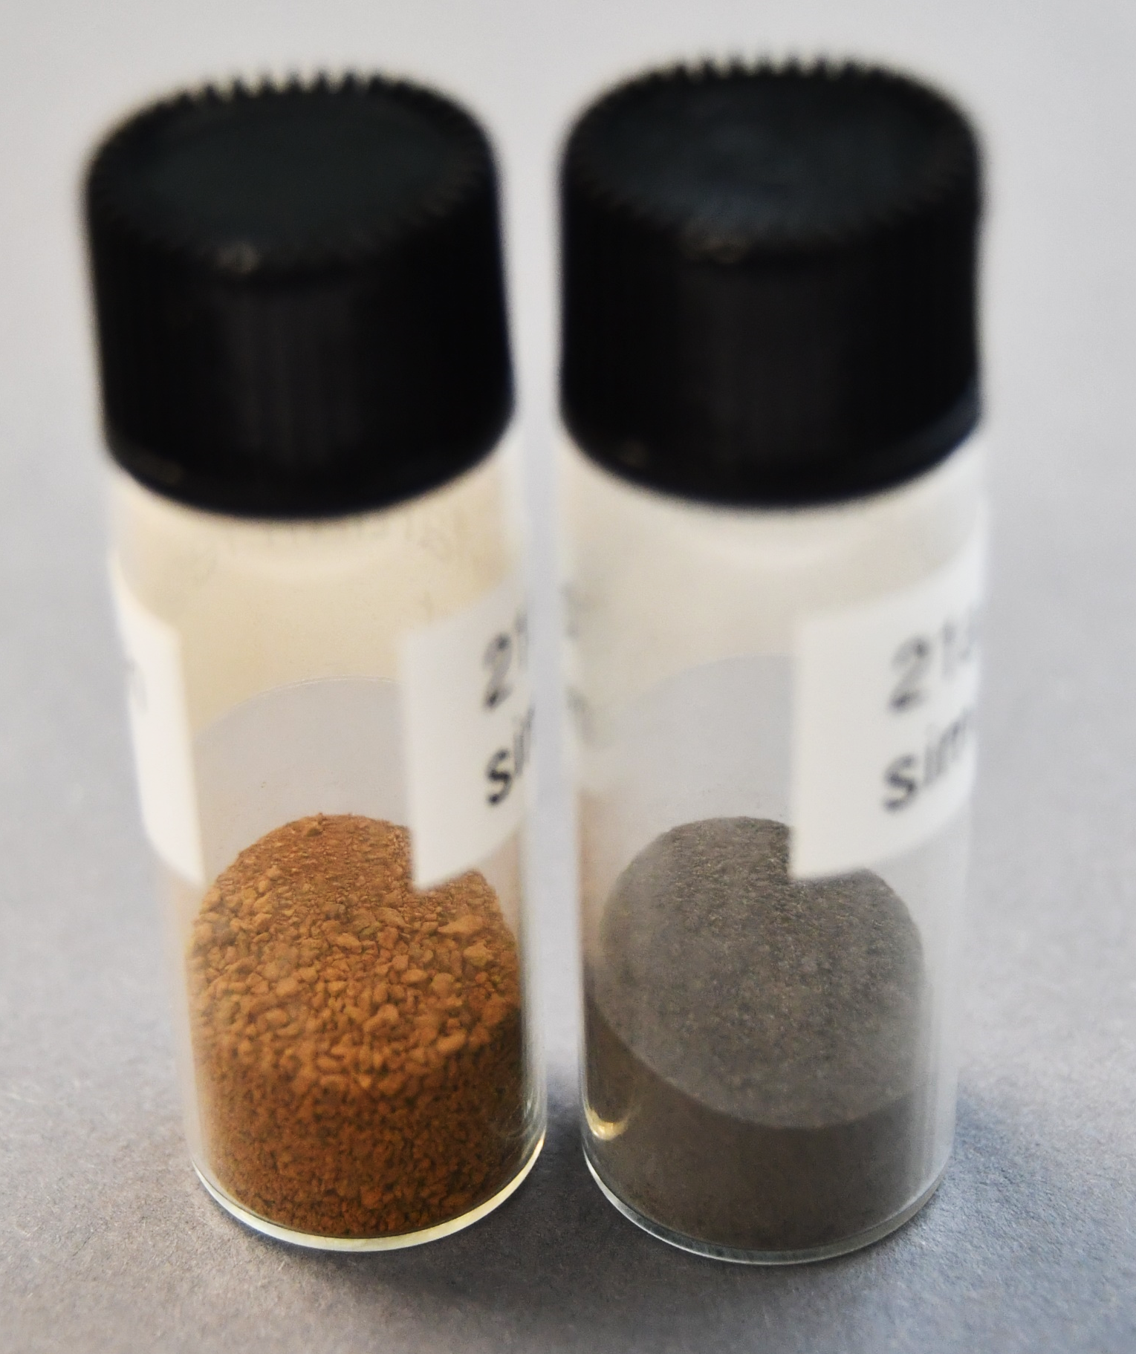
Pros | Cons
There is a lot of it | Soft and crumbly
Found everywhere
Easy to shape however we want

Slide 17


Slide 18

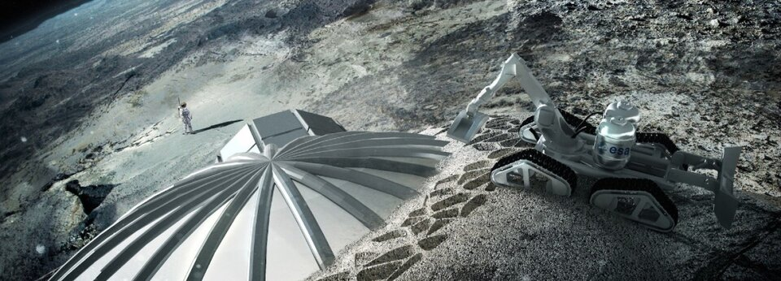
Takes in regolith -> melts it -> forms moon bricks in any shape!
Image: European Space Agency
Notes:
3D printing would take in loose regolith, melt it, and form bricks! This is similar to what the natural rock cycle does on Earth.
It could be shaped directly into a structure, like in ESA’s 2013 study using a lightweight structure similar to the interior of a bird’s bone. They propose building a regolith dome around the capsule that the astronauts landed in. Alternatively, CNSA (China National Space Administration) is considering 3D printing bricks, which would then be used to form eggshell-shaped buildings.

Slide 19
Prehistory & Ancient world
Paintings & rock carvings
1609
First telescope observations
(Galileo)
1959
First orbiter
(Luna 2)
1969
First Moon landing
(Apollo 11)
2020
Robotic exploration restarted
(Chang’e 5)
Notes:
This is the history of lunar exploration we showed you before. Let’s now look towards the future ☺

Slide 20
1969
First Moon landing
(Apollo 11)
2020
Robotic exploration restarted
(Chang’e 5)
2030s
International Lunar Research Station
+ Artemis IV lunar station
2026 - 2028
Exploration of lunar South Pole
(Artemis III, Chang’e 7&8)
Notes:
Right now, several space agencies are thinking about building these moon bases in the 2030s – so really, this could even happen 5 years from now!
NASA’s Artemis program, which the UK and European Space Agencies are involved in, is currently ongoing and training astronauts for Artemis II, due to launch next year. Artemis III aims to land astronauts on the Moon again around 2026. Meanwhile, the CNSA wants to build an International Lunar Research Station, also at the South Pole, so it’s a very exciting time to be looking up at the Moon!

Slide 21

Thank you for your attention!
Contact our education team at education@geolsoc.org.uk
This lesson was created as part of a project funded by the
UK Space Agency ‘Space for All’ fund

