Slide 1


The Engineering Group of the Geological Society of London Presents
Annual General Meeting
followed by
Insights into Geotechnical and Geological Challenges in HDD for Energy Infrastructure
Serena Che
When: 6pm, 1st of July
Location: Burlington House, London & web stream
Scroll for more

Slide 2
The Engineering Group of the Geological Society of London Presents
Insights into Geotechnical and Geological Challenges in HDD for Energy Infrastructure
Abstract
Join Serena Che, Senior Geotechnical Engineer at Geotechnical Consulting Group, for an evening lecture exploring the geotechnical and geological risks in Horizontal Directional Drilling (HDD) for energy infrastructure.
Drawing on her experience and recent publications, Serena will present a case study on HDD installations for the cable landfall of an offshore wind farm. The session will explore some key HDD challenges including hydro-fractures, drilling fluid management, and cuttings transport, in the context of the geological conditions encountered and the construction site practices. She will share practical insights from on-site monitoring, highlighting the importance of integrating these observations with geological and geotechnical understanding. Serena will also provide comparative insights from her experience with other geological settings. Attendees will take away lessons learned to help anticipate problems, along with recommendations to support successful HDD delivery.
When: 6pm, 1st of July
Location: Burlington House, London & web stream

Slide 3
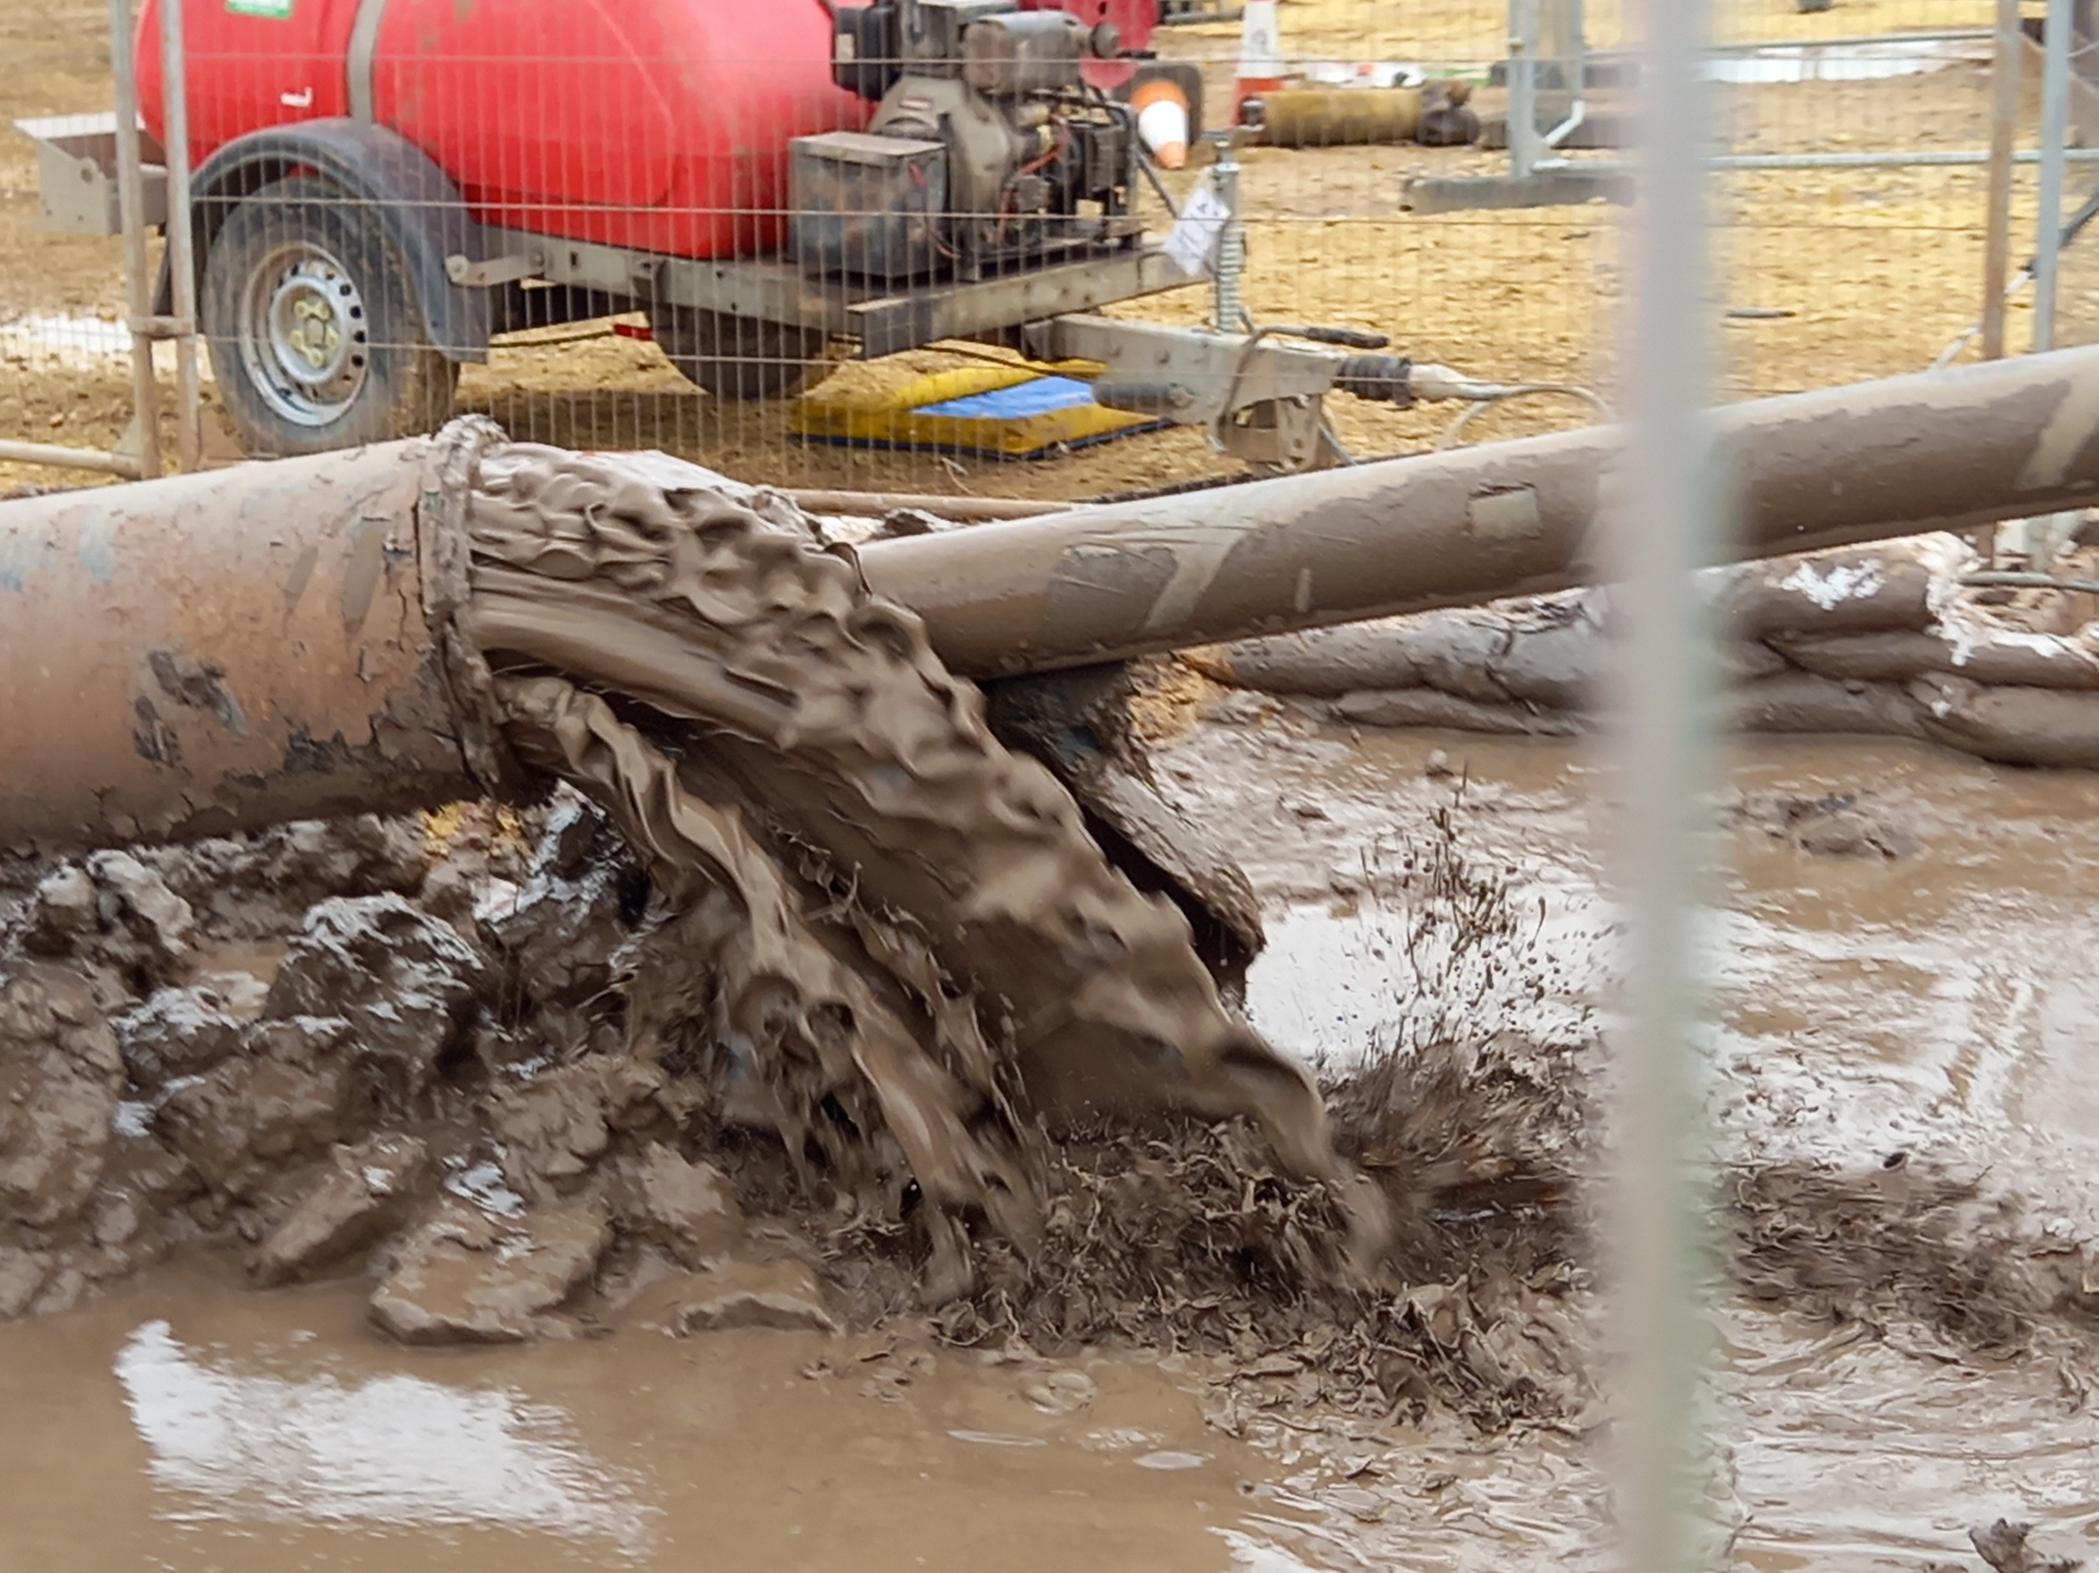
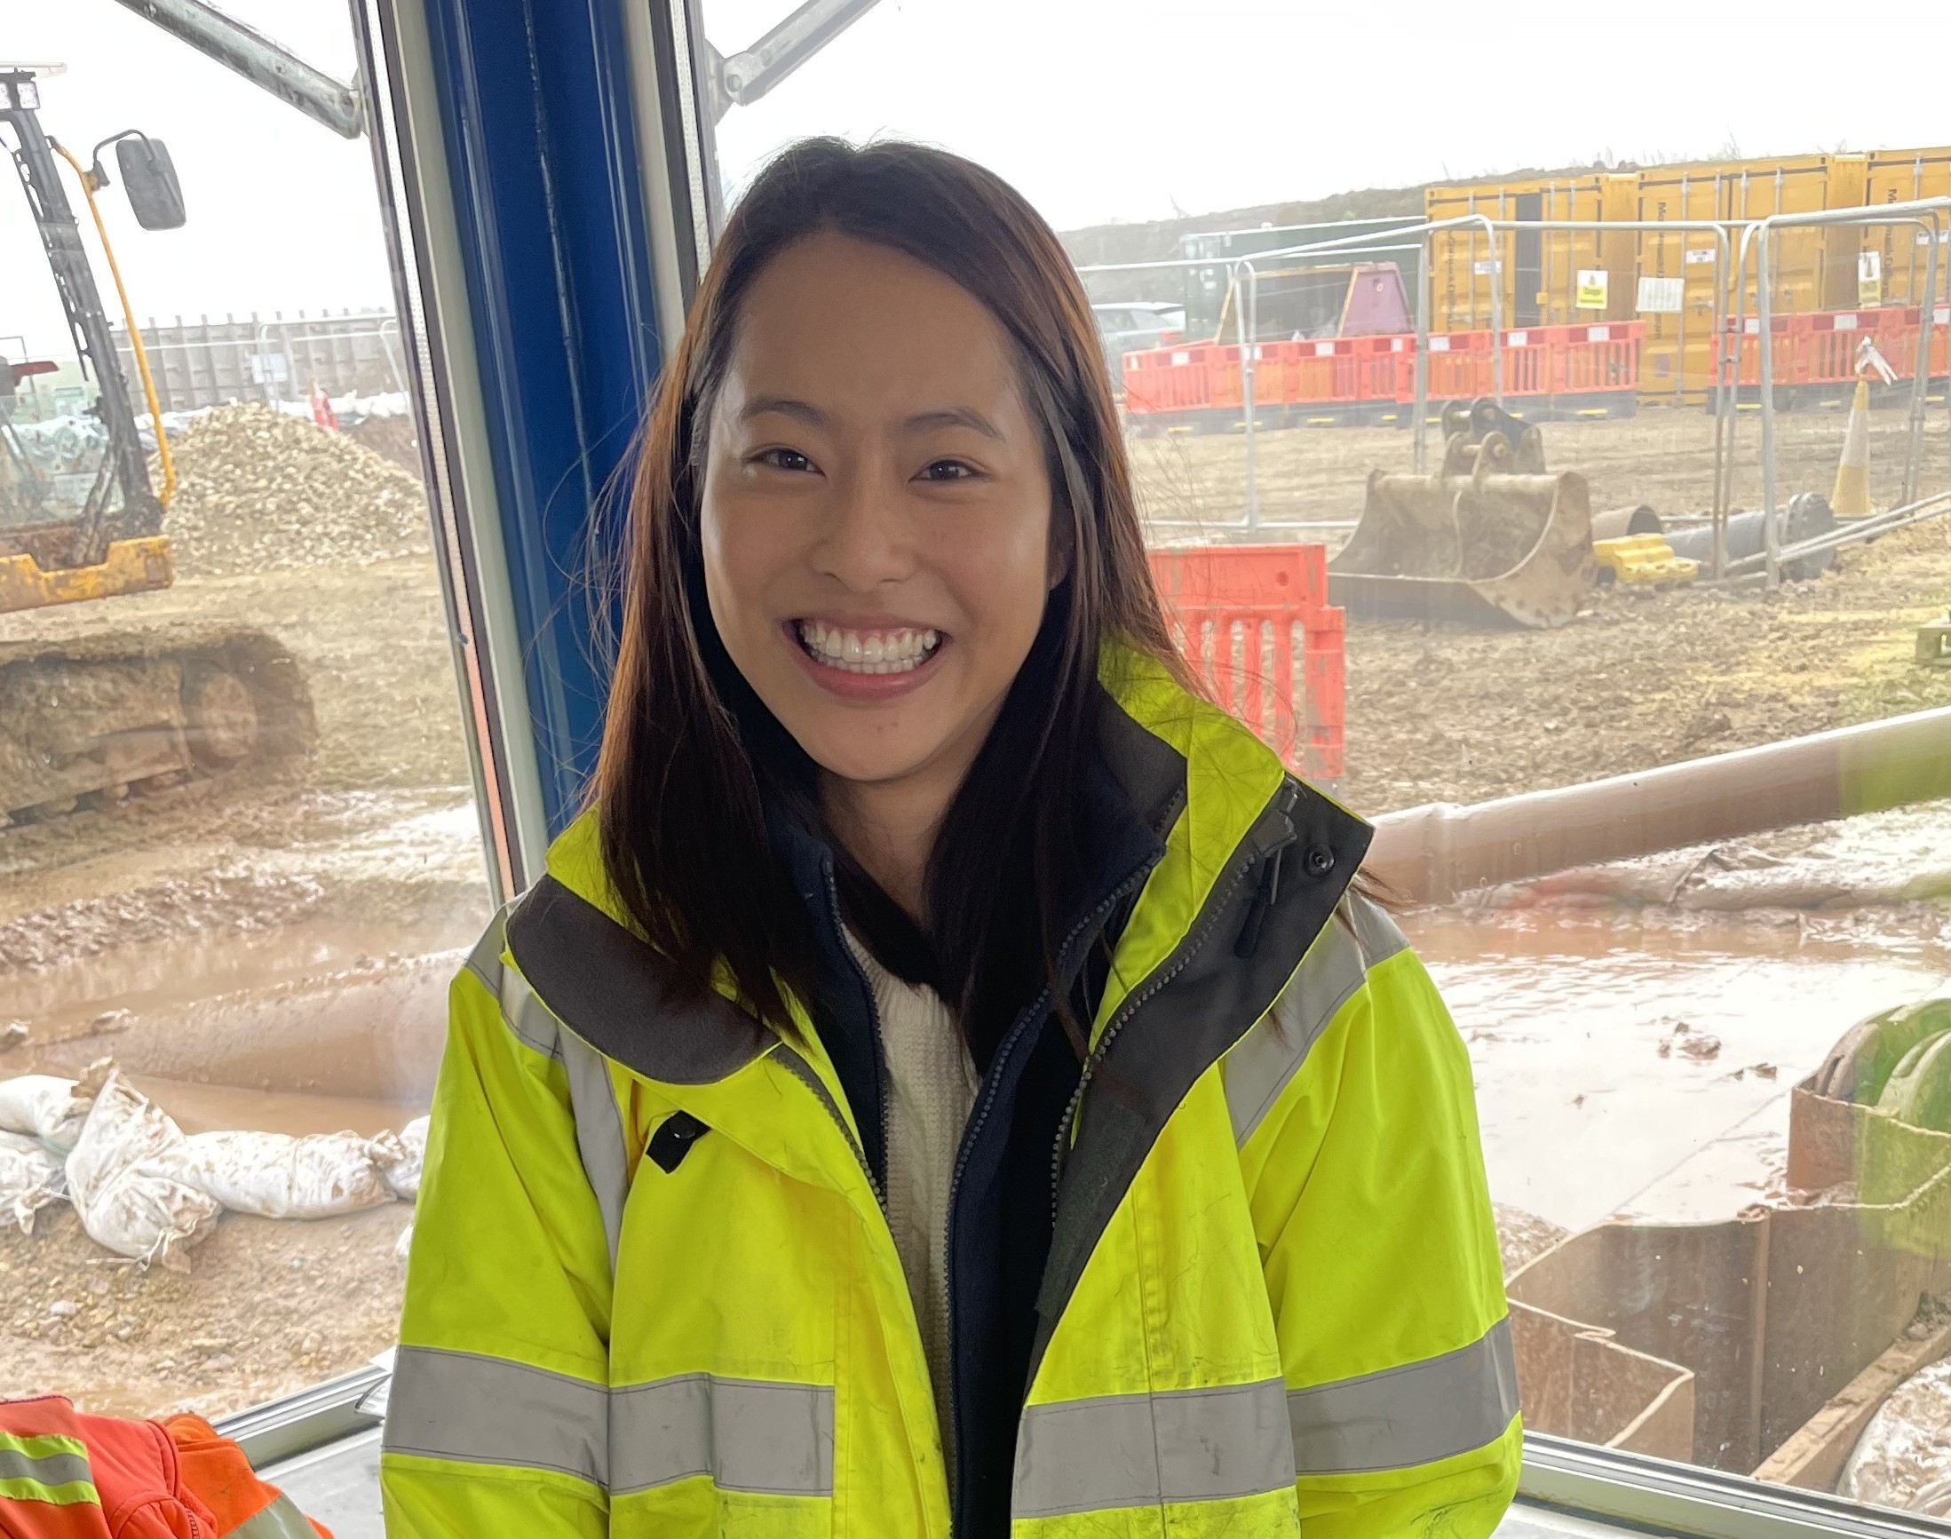
The Engineering Group of the Geological Society of London Presents
When: 6pm, 1st of July
Location: Burlington House, London & web stream

