Slide 1



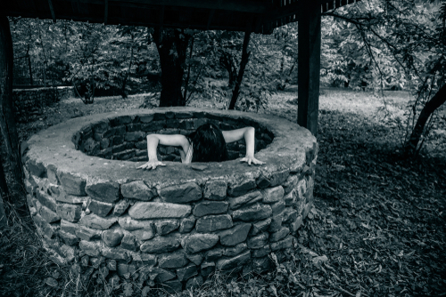
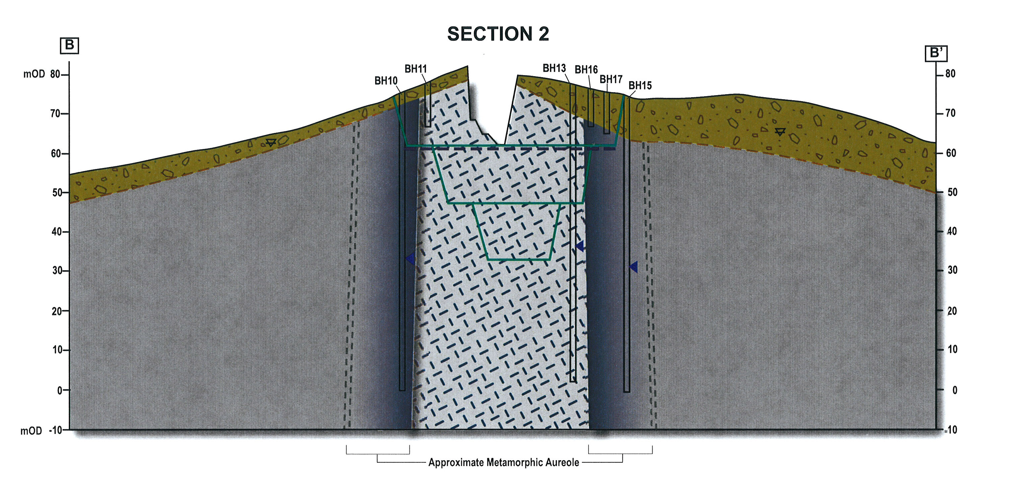
Supernatural Geology? – debunking strange phenomenon in Ireland’s Aquifer Systems
David McLorinan, MCL Consulting
NI Geotechnical Group, Belfast Geologists’ Society &
NI Regional Group (Geological Society of London)
Online (MS Teams) Hydrogeology Lecture
Date: Tuesday 17th February, 2026
Presentation: 18:30 to 19:45
Questions/discussion: 19:45
Everyone welcome
MS Teams Meeting _________________________________________________________________
Join the meeting now
Meeting ID: 328 803 479 779 9
Passcode: 44iJ9uw3
ID: 328 803 479 779 9
Passcode: 44iJ9uw3
Contacts:
Paul Sargent: P.Sarent@ulster.ac.uk
Alastair Ruffell: a.ruffell@qub.ac.uk
Karen Parks: kparks601@outlook.com
Image c/o D.McLoriman: Shutterstock by subscription

