Slide 1


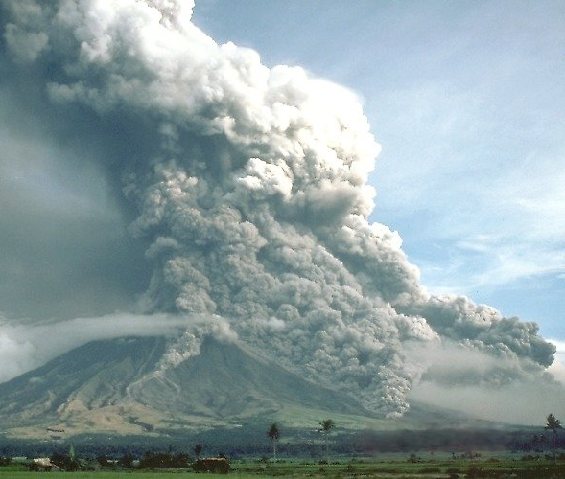
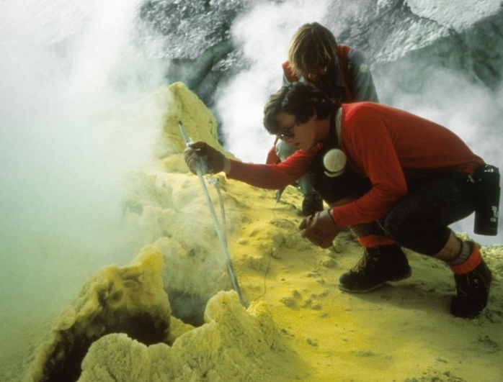
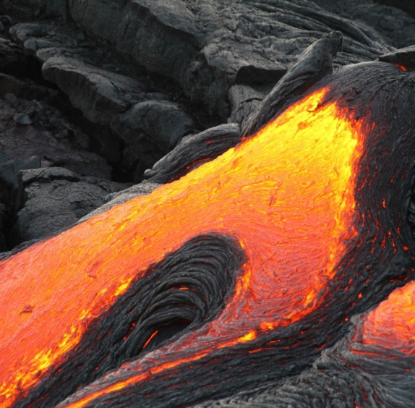
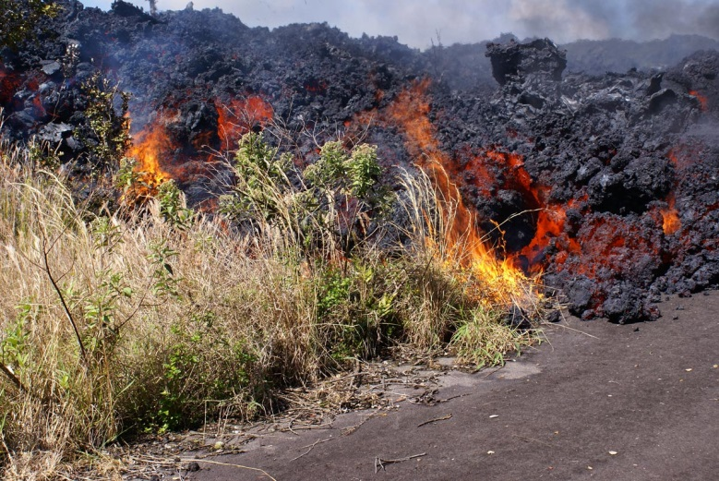
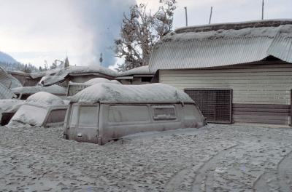
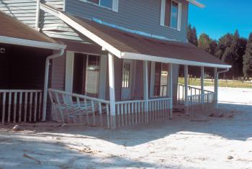
USGS

Slide 2

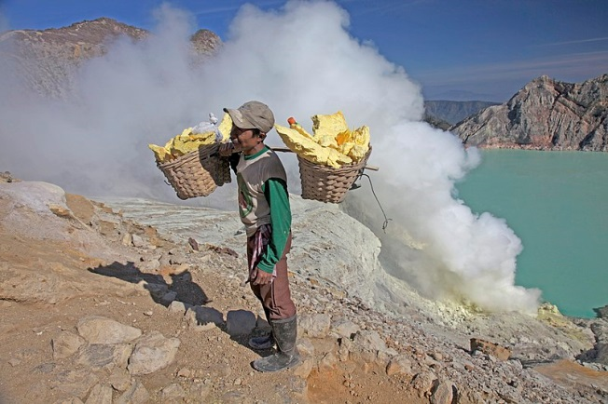
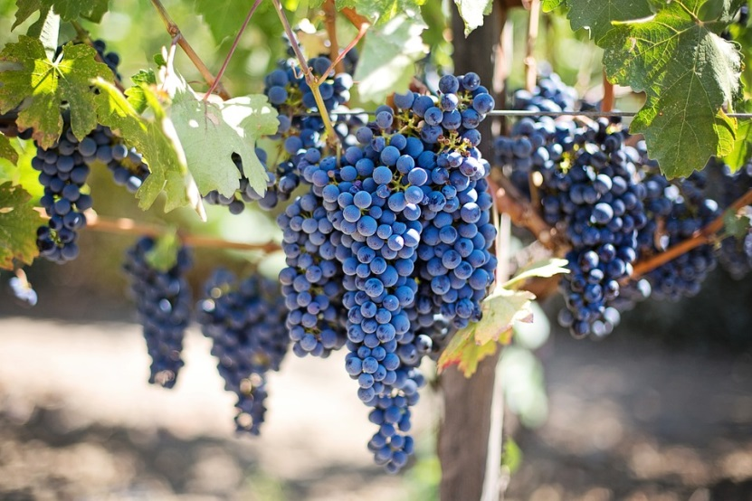
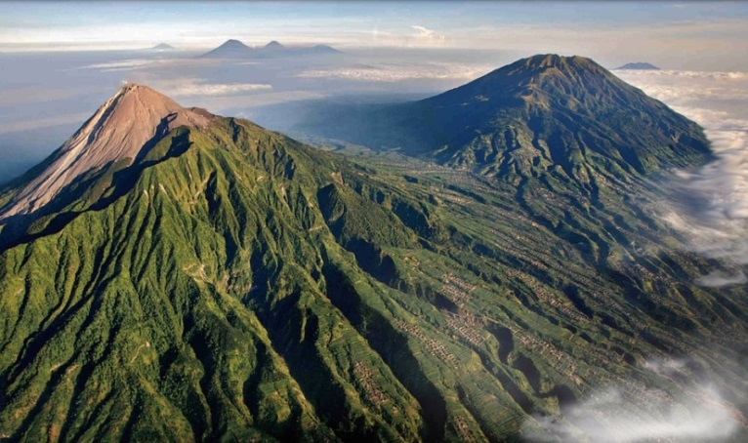
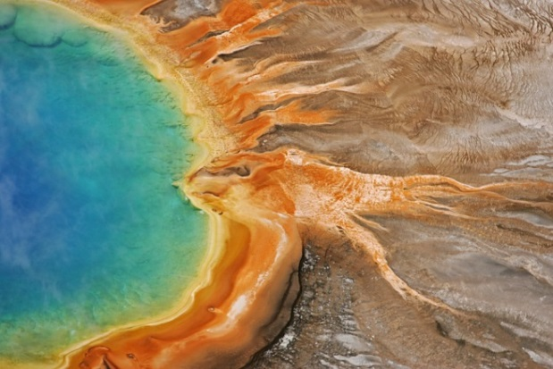
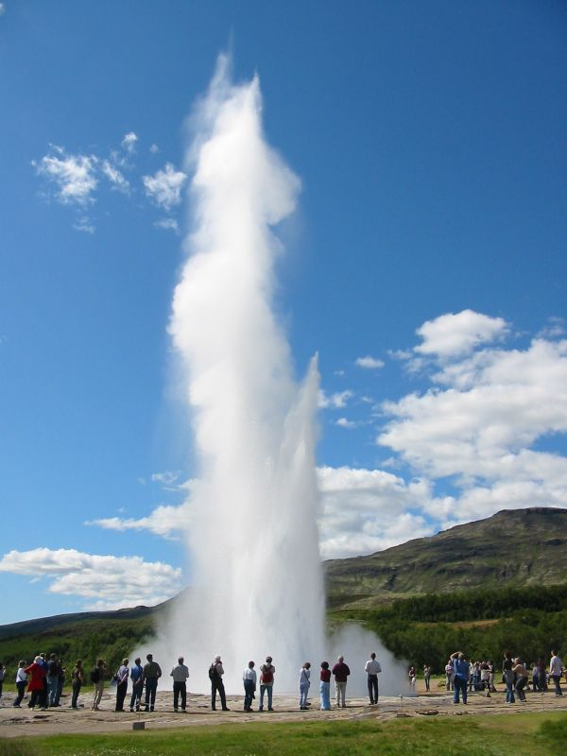
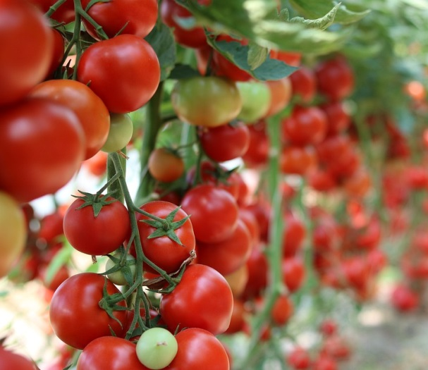
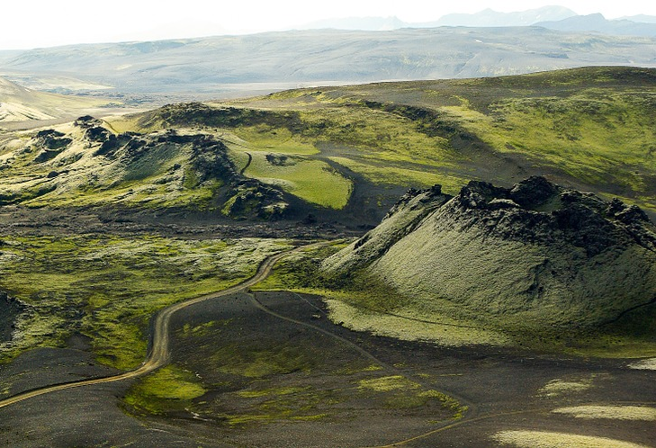
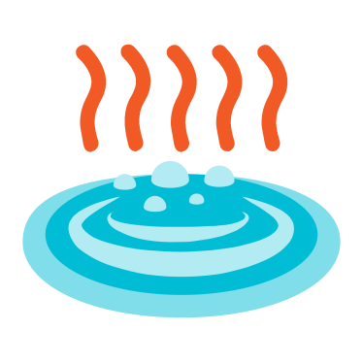
Photo: Scubabeer/CC-By-SA 2.0
Notes:
Hundreds of millions of people around the world choose to live very near and even on the slopes of active volcanoes. Some major cities have even been built close to active volcanoes. Popocatapetl is a volcanic mountain less than 50 miles from Mexico City in Mexico which is home to almost 9 million people.
Q: Why might people choose to live near volcanoes?
People choose to live near volcanoes because for them the positives outweigh the negatives.
Volcanic ash and lava are rich in minerals so over time they break down to provide valuable nutrients for the soil. This creates very fertile soil which is good for growing fruit and vegetables. The regions around Mount Vesuvius in Italy are particularly well-known for growing grapes, tomatoes and other vegetables in the rich volcanic soils.
Volcanoes create beautiful landscapes. They are important tourist attractions for many countries because they can attract millions of visitors every year. This generates tourism jobs for local people (tourist guides, shops, hotels, restaurants etc.) and brings in money to the country or region.
Volcanic areas are sources of heat energy from the Earth – geothermal energy. The heat from underground steam is a type of renewable energy and can be used to drive turbines and produce electricity, or to heat water supplies that are then used to provide household heating and hot water. In Iceland 85% buildings are heated by geothermal energy and 25% of the nations electricity is generated from geothermal energy.
Important minerals such as zinc, lead, tin, copper, silver and gold can be found in volcanic rocks. Hot gasses escaping through vents of active volcanoes also bring minerals to the surface, particularly the mineral sulfur which is a chalky yellow colour and often smells of eggs! Mount Ijen in Indonesia is known having a lot of sulfur, so much so that the volcano actually glows blue at night (sulfur is yellow in colour but when it burns, which it does when it meets the oxygen in the air, it does so with a blue flame). Locals collect the sulfur at the volcano crater and carry it down the mountain where they sell it for around 8 US cents per kilogram.
People might not be able to afford to leave their homes to move to somewhere with less risk of eruptions. Even when people can afford to leave the area they may be attached to their homes and not want to leave as their families have lived there for generations.

Slide 3


NATURAL HAZARD:
An extreme natural event that causes loss of life and/or extreme damage to property and creates severe disruption to human activities
Lava flows
Lahars
Ash
Landslides
Gas
Earthquakes
Pyroclastic density currents
Ash erupting from Mount Etna, Italy
Notes:
Volcanoes are openings in the Earth’s crust from which lava, ash and gases erupt. Volcanic eruptions are natural hazards - extreme natural events or process that causes loss of life and/or
extreme damage to property and creates severe disruption to human activities
There are many hazards associated with volcanoes: lava flows, volcanic ash, gas, pyroclastic density currents, lahars, landslides, earthquakes (the next slides will go through these hazards in more detail)

Slide 4

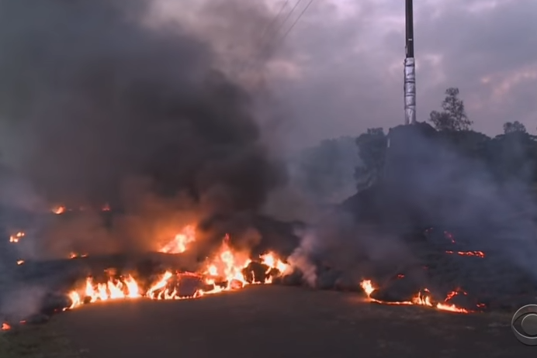

1000 - 2000°C – will burn anything flammable
Thick lava flows bury buildings, roads & agricultural land
Basalt lava (low viscosity) can flow > 10km from volcanic vent and can flow at speeds up to 10km/hr
Can initiate jökulhlaups
Toxic gases
USGS
Notes:
Lava flows are not usually dangerous to people because they move quite slowly which means that people can usually get out of the lava flows path. However lava flows can burn down buildings in their path and bury roads and agricultural land.
News report YouTube video on lava flow in Hawaii – click image or go to https://www.youtube.com/watch?time_continue=28&v=zwpFzzmlSfM
In cold countries such as Iceland, volcanoes often have ice caps and glaciers. The heat from erupted lava can melt the snow and ice in these ice caps and cause outburst floods called jökulhlaups.
Lava itself releases toxic gases, including carbon dioxide, sulfur dioxide, hydrogen sulfide and hydrofluoric acid. When lava interacts with seawater a variety of other toxic gases are produced, including hydrochloric acid, which is highly corrosive. The lava haze, or laze, as it is called, can be deceptively deadly.

Slide 5
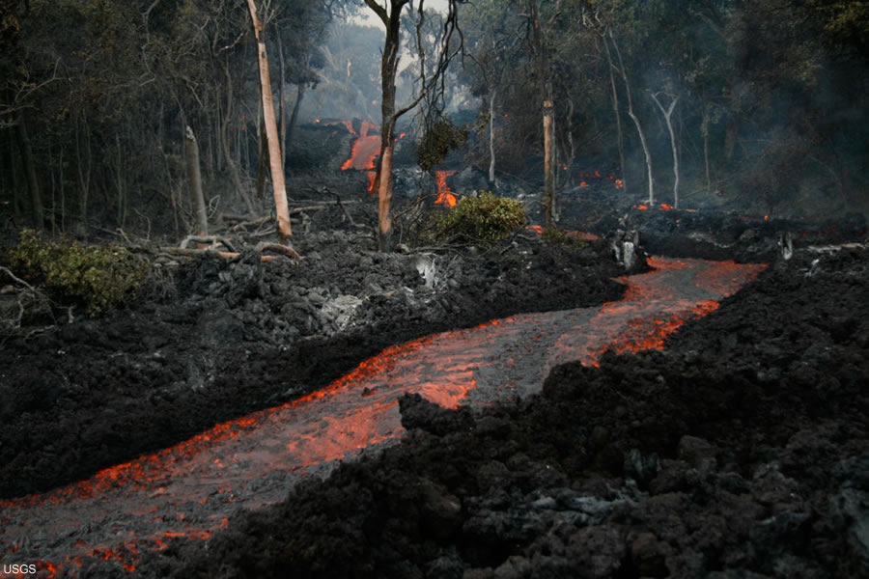
Prince Avenue Lava flow, Kilauea, Hawaii
Notes:
Lava flow

Slide 6

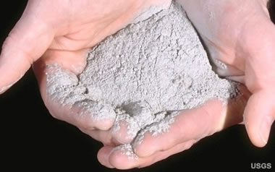
Tephra – all rock fragments and particles ejected in a volcanic eruption
> 64mm (volcanic bombs) - < 1mm (ash)
Ash can clog up aircraft engines and abrade aircraft wings and nose
Smother farmland and vegetation
If the ash cloud is big enough it can block out the sun and lower global temperature e.g. Tambora eruption in 1815 lowered global temperature by 0.5°C.
Notes:
Volcanic ash and other rock fragments ejected in explosive volcanic eruptions are together known as tephra. Tephra includes large volcanic bombs which can >64mm in diameter right down to volcanic ash at < 1mm.
Volcanic ash is made from tiny fragments of rock and glass it can get inside aircraft engines and clog them up causing the engines to fail, it can also poison water supplies, smother farmland and vegetation and cause breathing problems in humans and other animals.
Tephra of any size is made up of pulverized rock, and can be extremely heavy, especially if it gets wet. Most of the damage caused by falls occurs when wet ash on the roofs of buildings causes them to collapse.
Volcanic ash injected into the atmosphere can have global as well as local consequences. When the volume of an eruption cloud is large enough, and the cloud is spread far enough by wind, ash can block out sunlight and cause temporary cooling of the Earth's surface. Following the eruption of Mount Tambora in 1815, so much pyroclastic material reached and remained in the Earth's atmosphere that global temperatures dropped an average of about 0.5 °C. This caused worldwide incidences of extreme weather, and led 1816 to be known as 'The Year Without A Summer.'

Slide 7

Magma contains dissolved gases such as carbon dioxide, fluorine, chlorine and hydrogen sulfide - can be extremely harmful
A limnic eruption or lake overturn occurs when dissolved CO2 suddenly erupts from deep lake waters.
Lake Nyos, Cameroon is a crater lake sitting above a dormant volcano.
In 1986 more than 100,000 tons of carbon dioxide spilled out of the lake and descended on three villages.
1746 villagers and 3000 cattle were suffocated from lack of oxygen.
Notes:
Magma is molten rock containing dissolved gases, these gases are released to the atmosphere during an eruption. Most of the gas in magma is water vapour which is generally harmless however other gases such as carbon dioxide, fluorine, chlorine and hydrogen sulfide, can be extremely harmful to humans and other animals.
A limnic eruption or lake overturn occurs when dissolved carbon dioxide suddenly erupts from deep lake waters, forming a suffocating gas cloud these can be associated with volcanoes.
Lake Nyos, is a lake in a volcanic crater in Cameroon, West Africa. The magma beneath the lake contains a lot of carbon dioxide gas which seeps into the lake from below. In 1986 a limnic eruption occurred and over 100,000 tons of carbon dioxide spilled out of the lake and flowed silently down a valley. Carbon dioxide is heavier than air so displaces it. The gas spread through three villages where over 1746 people lived and caused them all, and over 3000 cattle, to suffocate from lack of oxygen.

Slide 8

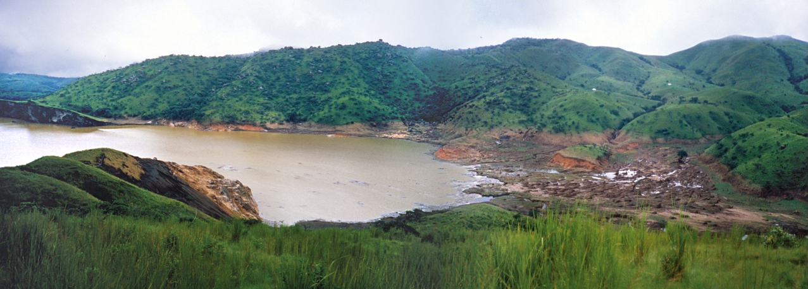
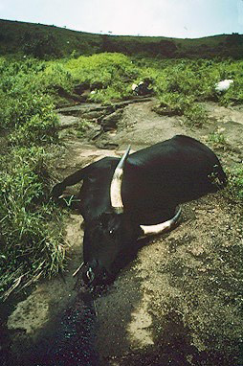
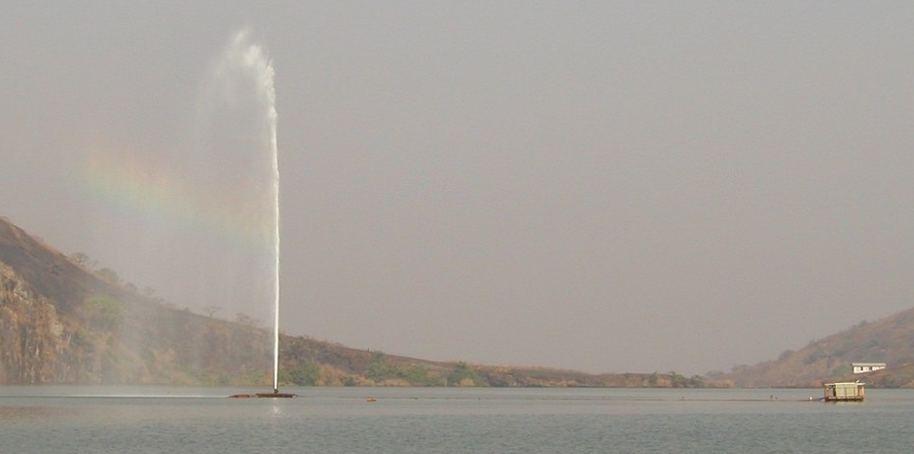
Water + CO2
Notes:
Lake Nyos in 1986
Suffocated cattle after limnic eruption
Lake Nyos degassing system set up after the catastrophe – estimates of the amount of CO2 entering the lake from the magma below indicate that a limnic eruption could occur every 10-30 years. To help prevent further tragedies pipes were installed in Lake Nyos to release the CO2 from the bottom of the lake so that it doesn’t build up to such dangerous levels.

Slide 9

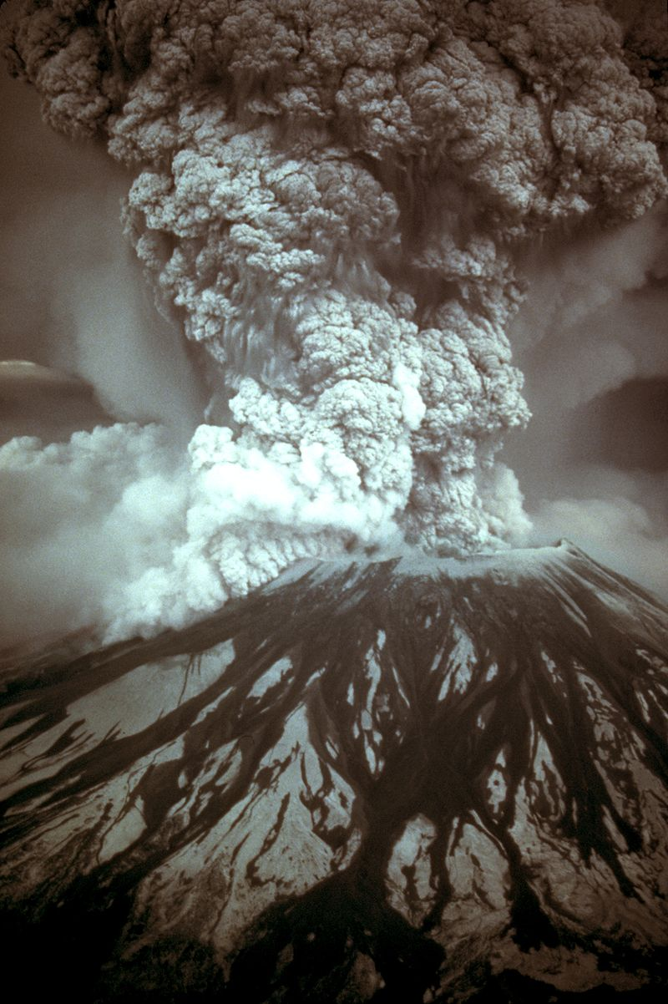
Ash column collapse
Mixtures of ash, rock and gas
Temperatures > 400°C
Speeds of up to 1000km/hr
Boiling and crushing anything in their path
Vesuvius eruption in 79AD buried ancient Roman cities of Pompeii and Herculaneum
Notes:
Pyroclastic density currents, often called pyroclastic flows occur when an ash column from an explosive eruption collapses and starts to flow down the sides of a volcano. Pyroclastic flows are a mixture of extremely hot ash, gas and rock fragments, and can be deadly. They can race down the sides of a volcano at speeds of up to 1000kmph and temperatures more than 400°C instantly boiling and crushing anything in their path including people, animals and plants.
When Vesuvius erupted on 24 August 79AD huge pyroclastic flows smothered the nearby cites of Pompeii and Herculaneum boiling inhabitants and burying buildings under volcanic ash. These ancient cities remained buried and undiscovered for almost 1700 years until excavation began in 1748. Pompeii and Herculaneum are preserved as they were on the day in 79AD when they were hit by the pyroclastic flows, they provide a uniquely preserved snapshot of Roman life and culture.

Slide 10

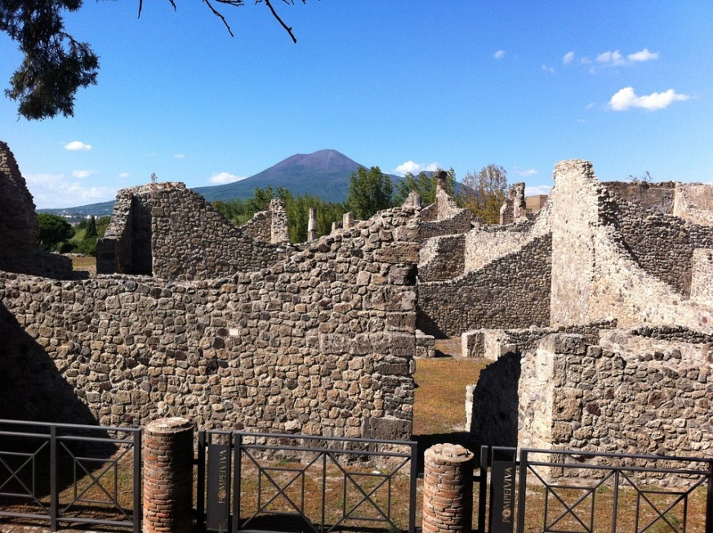
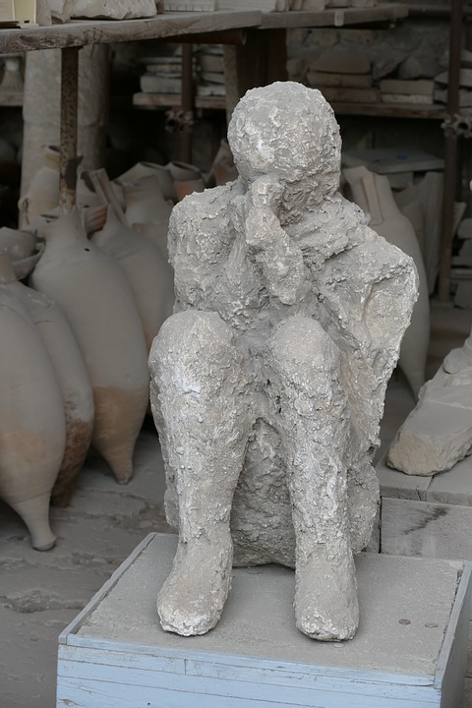
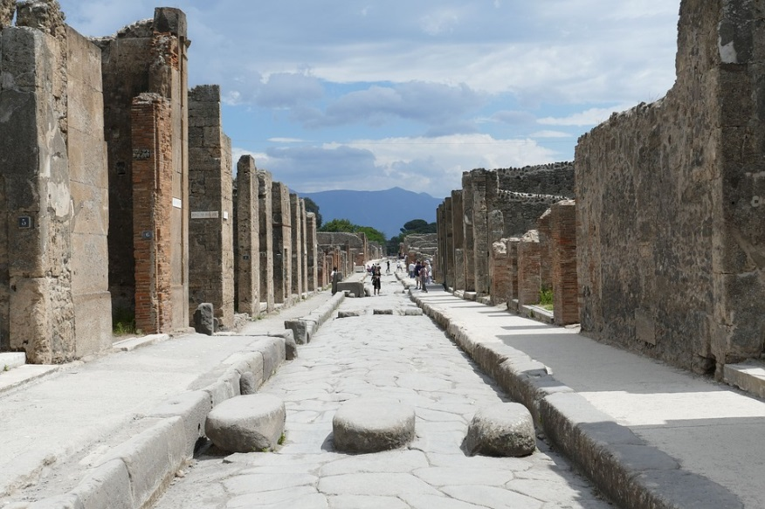
Notes:
Pompeii with Mount Vesuvius in the background
Typical Pompeii street with stepping stones these stones allowed people to cross the road without getting their feet wet or dirty as the streets were often filthy due to the lack of a proper sewer network. The slabs were placed in such a way that carts could still pass, as can be seen by the ruts left in the road by the cart wheels.
Plaster cast of Pompeii pyroclastic flow victim made from centuries old hollow in the solidified volcanic ash – life like poses of the victims show that their cause of death was not suffocation, they instead died instantly from extreme heat

Slide 11

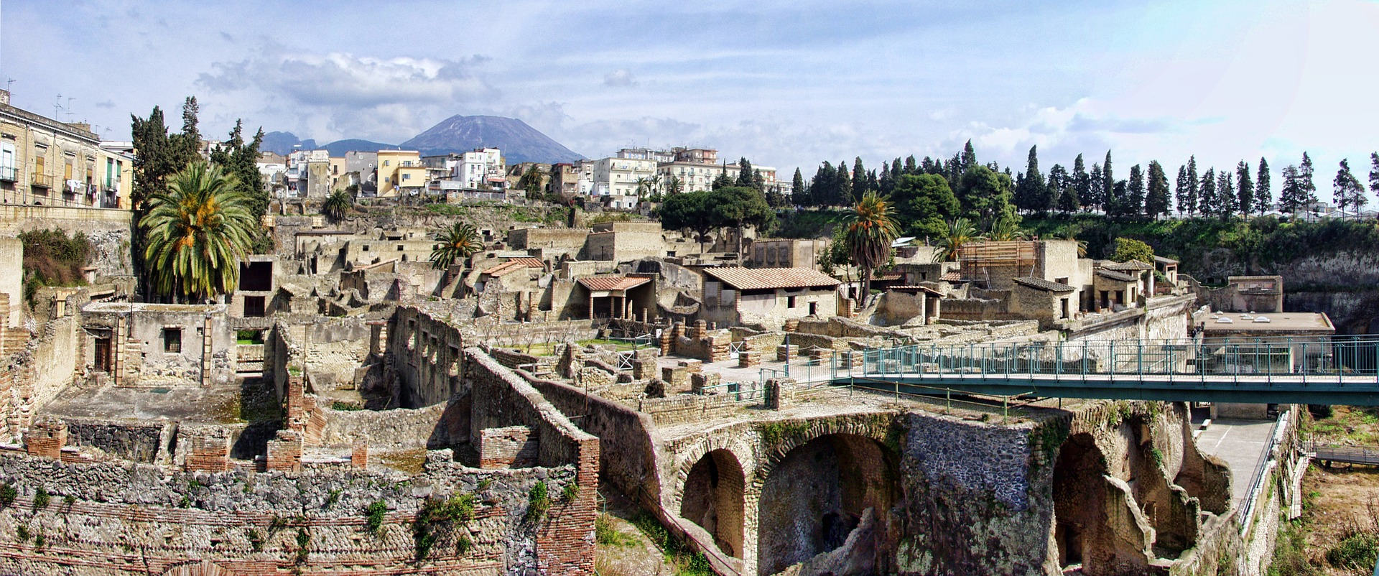
Notes:
The ancient city of Herculaneum with Mount Vesuvius in the background.

Slide 12

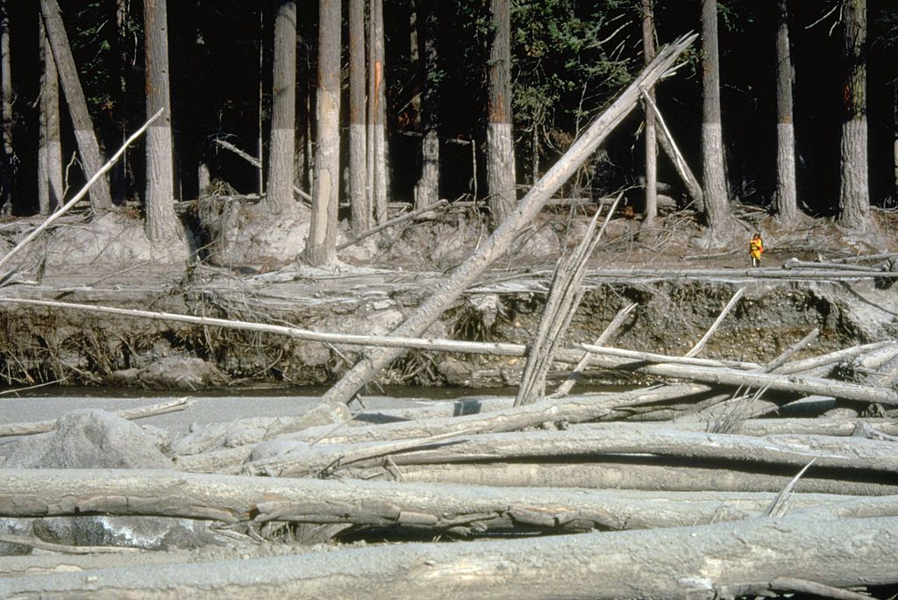
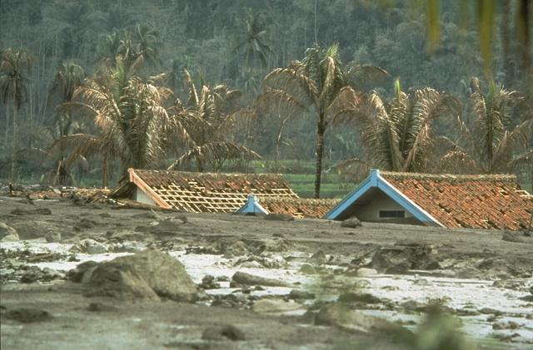
Mudline
Volcanic mud flow when volcanic ash and other volcanic debris mixes with water
Concrete like texture – bulldoze and bury anything in their path
Can be hot - 60-70°C and flow at 200km/hr in steep areas
Can occur years after a volcanic eruption
Lahar
Notes:
Lahars are a type of mud flow caused when volcanic ash and other volcanic debris mixes with water. Lahars flow like water, have a similar texture to wet concrete. They can be 60-70°C and flow at speeds of 200km/hr in steep areas. They may not be as hot as pyroclastic flows however they are extremely destructive. Lahars move rapidly like rivers of concrete, often down preexisting river valleys, and can bulldoze and bury anything in their path.
An initial lahar flow may be relatively small, but lahars can grow as they pick up rocks, soil, vegetation, and even buildings and bridges. They commonly increase in volume by about 10 times as they flow downslope
Pyroclastic flows can trigger lahars but they can occur years after a volcanic eruption when fresh volcanic material mixes with heavy rainfall.
Image 1 – bulldozed trees and mudline after the Mount St Helens eruption in 1980. Scientist for scale on right hand side shows how high the lahars got.
Image 2 – aftermath of a lahar in Java, Indonesia caused by the eruption of Mount Galunggung in 1982.

Slide 13

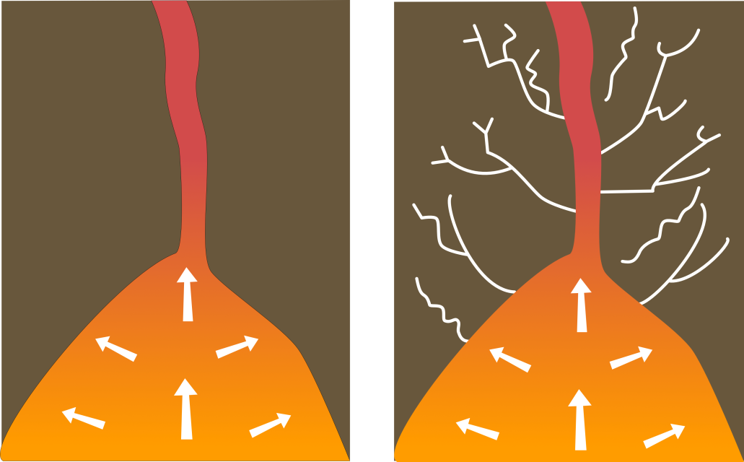
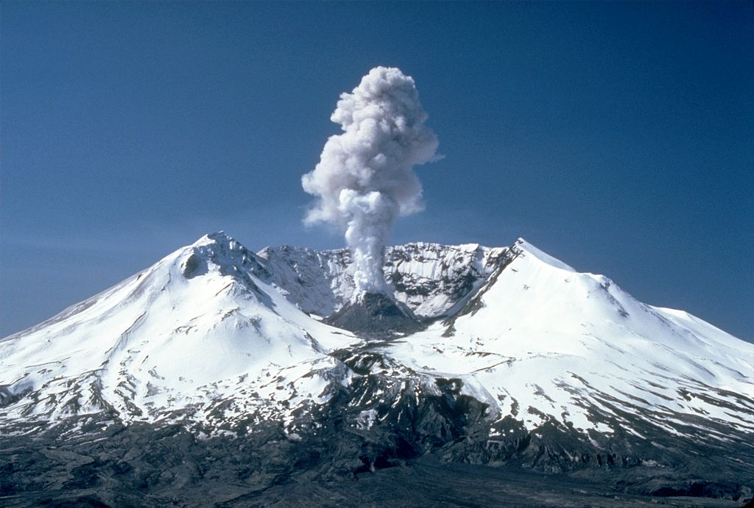
Earthquakes, landslides and tsunamis can be associated with volcanic eruptions
Volcano-tectonic earthquakes – from ‘normal’ tectonic stresses
Long period earthquakes – cracks made from magma and gas moving towards the surface
Landslides are masses of rock and soil that fall or slide due to gravity
Landslides can become lahars
Landslide scarp
Notes:
Other hazards such as earthquakes, landslides and tsunamis can be associated with volcanic eruptions
Earthquakes can occur near volcanoes from the stresses induced by tectonic plates grinding against each other (volcano-tectonic earthquakes) or from cracks caused by magma moving towards the surface (long period earthquakes). This can cause fracturing, ground deformation and damage to buildings.
Landslides are masses of rock and soil that fall or slide under the force of gravity. They are very common on volcanic cones because they are tall, steep and weakened by the rise and eruption of molten rock. If a landslide is large enough and contains enough water it may turn into a lahar.
Historically, the most deadly volcano landslide occurred in 1792 when sliding debris from Mt. Mayuyama near Unzen Volcano in Japan slammed into the Ariaka Sea and generated a tsunami that reached the opposite shore and killed nearly 15,000 people.

Slide 14

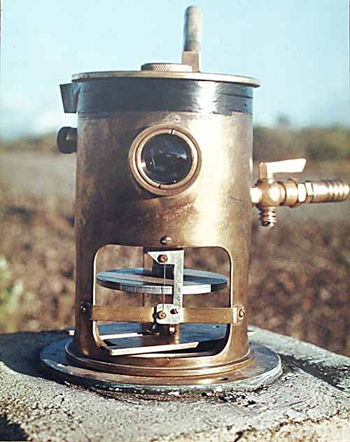
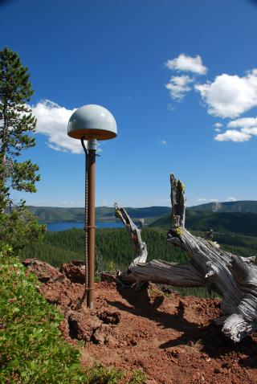
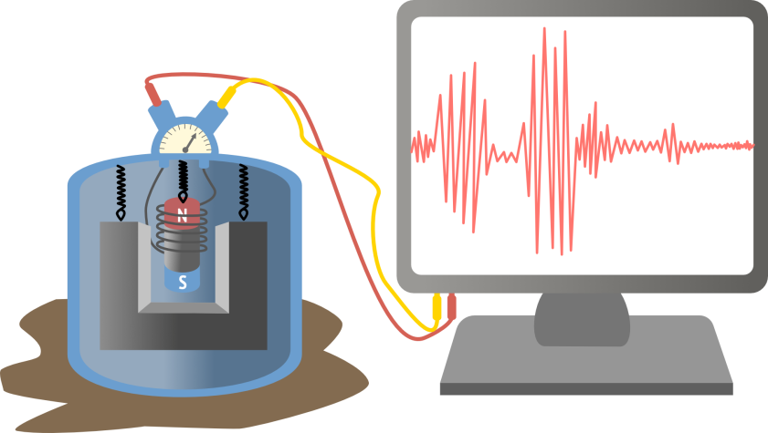
Volcanic gas sampling, Mount Baker, Washington
Seismometer for detecting earthquakes
Tiltmeter on Mauna Loa, Hawaii
GPS receiver at Newberry volcano, Oregon, USA
Photo: USGS
Notes:
Because volcanoes can harm people, animals and the environment when they erupt, it is important for geologists to monitor volcanoes around the world so that they can work out if an eruption might occur. Monitoring a volcano requires geologists to use of a variety of techniques that can hear and see activity inside a volcano so they can detect when a volcano might be reawakening.

Slide 15

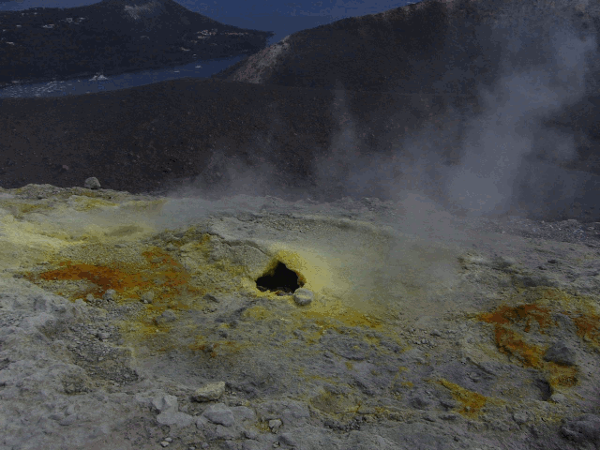
Fumaroles, Sicily
Benjamín Núñez González/ CC-BY- S.A 4.0
As magma rises the pressure acting on it decreases allowing gases to come out of solution
Gas rises more quickly than magma because it is less dense.
Comes out through vents called fumaroles.
Increase in gas volume, change in gas chemistry and appearance of new vents can indicate increased volcanic activity.
Notes:
Geologists can monitor volcanoes to see whether they might be close to erupting by looking at the volcanic gases that come out. As magma rises toward the surface the pressure acting on the magma decreases and gas bubbles separate out from the liquid . Because the gas is less dense than the magma, it rises quickly and can be detected at the surface of the Earth and comes out through vents called fumaroles. An increase in the amount of gas given off, the appearance of new gas vents, or a change in the chemical makeup of the gas can be some of the first aboveground signs of increased volcanic activity.

Slide 16

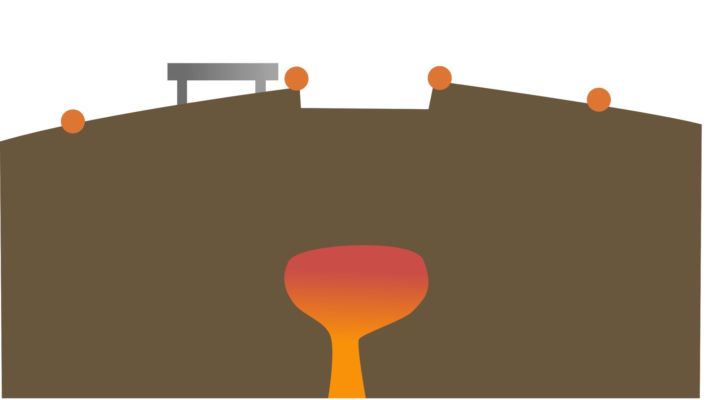
GPS stations
Tiltmeter
Volcano crater
Magma chamber
Notes:
Magma, gas, and other fluids moving underground before a volcanic eruption can cause changes in a volcano's ground surface. These changes can be swelling, sinking, or cracking. Often, this surface change is very small – a few centimeters or less so geologists must use very sensitive instruments to monitor these changes.
Instruments called tiltmeters are used to detect land surface changes. Tiltmeters continuously measure the tilt of the ground surface – if magma is collecting beneath a volcano it will usually cause the surface above to inflate and tiltmeters can measure these changes.
Another way land surface changes are monitored is to use satellite data. To do this, multiple GPS (global positioning system) receivers are placed around a volcano, satellites travelling around the Earth can then detect whether any of these receivers have moved over time which might indicate that the volcano is bulging with magma and ready to erupt.

Slide 17

GPS stations are elevated
Tiltmeter changes angle
Magma chamber expands
Fractures cause earthquakes
Notes:
As the magma chamber fills with new magma the surface of the volcano is elevated

Slide 18


Magma and gases rising can cause fracturing and earthquakes
Most volcano related earthquakes are too small to be felt by humans but can be measured using seismographs
Volcanic eruptions re usually preceded by swarms of earthquakes
Notes:
Earthquakes - as magma and volcanic gases rise to the surface from depth they can cause earthquakes. Most volcano related earthquakes are too small to feel by humans so geologists monitor the earthquakes with instruments called seismographs, which detect the amount of shaking form an earthquake, to work out their location, how strong they are and how often they are occurring to determine whether or not an eruption may occur.

Slide 19

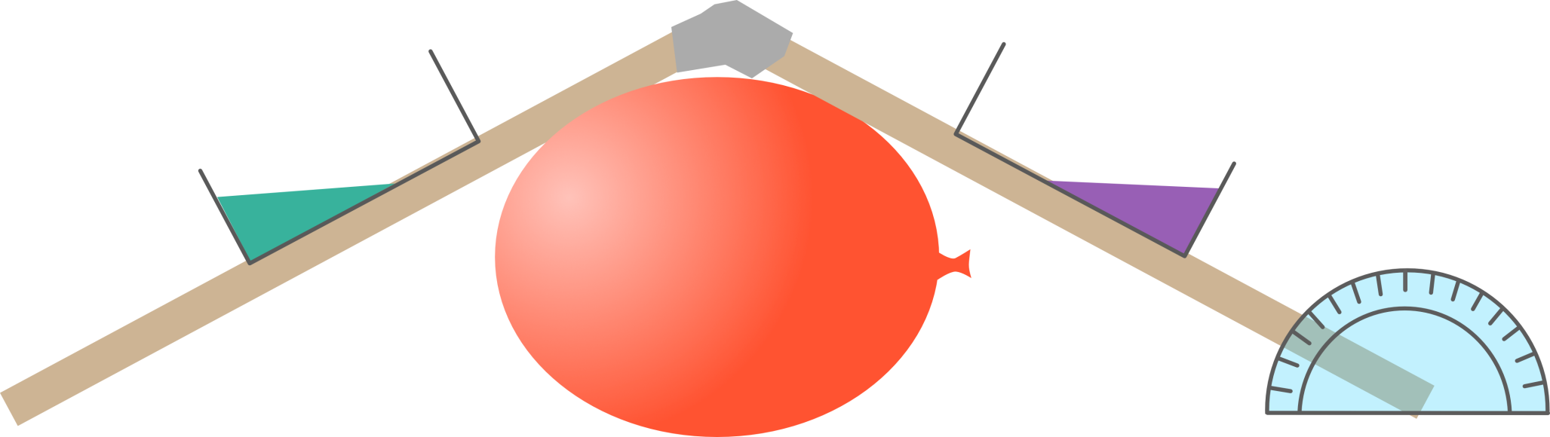
Plastic container
Two boards taped together
Water
Balloon
Protractor
Notes:
Classroom Tiltmeter (Earth Learning Idea www.earthlearningidea.com)
Tape two boards together along one edge, and place them near the edge of the table.
Pour about 1cm depth of water into two containers and colour the water with food colouring/ink.
Place one container on each board, equal distances from the join, held in place by tape.
Place a balloon beneath the boards this balloon represents your magma chamber. Students need to inflate the balloon gently! Students measure with a protractor how much the boards are tilted from the horizontal (this is most easily done in relation to the bench, which will give the same angle as that between the tilted boards and the water surface).
This is how tiltmeters placed on volcanoes work. If the volcano ‘bulges’, changing shape because the magma beneath is rising, the liquid in the tiltmeter will move – sending an electric signal ‘back to base’.

Slide 20

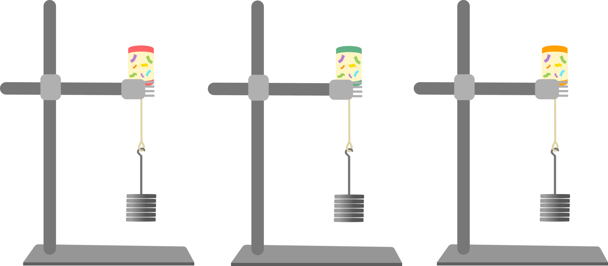
Party popper
1N/100g masses
Mass hanger
Volcano 1
Volcano 2
Volcano 3
Notes:
Party popper volcano (Earth Learning Idea www.earthlearningidea.com)
Set up three clamp stands, each with a party popper firmly clamped in place.
Tie the part popper string to make a secure loop, in order to hold a mass hanger.
Don’t clamp the party popper too high up the stand, to avoid a big crash when it explodes! Watch out for masses dropping to the floor.
Ask three students to take a clamp stand each and explain that they will be loading their mass hangers carefully, adding one 100g (1N) mass at a time, until the party popper goes off.
Before they start, ask the class to predict how much mass it will take to set off the party poppers. Then ask the three students to add each mass gently so that they don’t suddenly jerk the apparatus. They should avoid putting their heads above the party popper.
When all the poppers have popped ask the class how they think this relates to eruption prediction. There is usually considerable variability between the three different party poppers (a range from 300g (3N) up to 3300g (33N) has been found so far – for the latter, it is necessary to add another two mass hangers, each of which itself has a mass of 100g (1N).)

Slide 21

Volcanoes are associated with natural hazards including lava flows, volcanic gas, volcanic gas, pyroclastic flows, lahars, landslides and earthquakes
Geologists can monitor volcanic gas, ground deformation and earthquakes to predict when a volcano might erupt.
Notes:
Volcanoes are associated with natural hazards including lava flows, volcanic gas, volcanic gas, pyroclastic flows, lahars, landslides and earthquakes
Geologists can monitor volcanic gas, ground deformation and earthquakes to predict when a volcano might erupt
Case studies for 3 different volcanic eruptions with different associated hazards:
Eyjafjallajokull – severe air travel disruption due to ash cloud
Merapi – pyroclastic flows and lahars
Nyiragongo – lava flows

