Slide 1

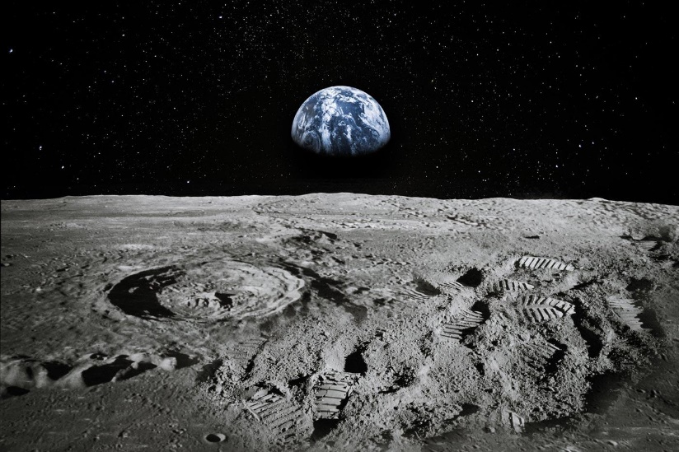
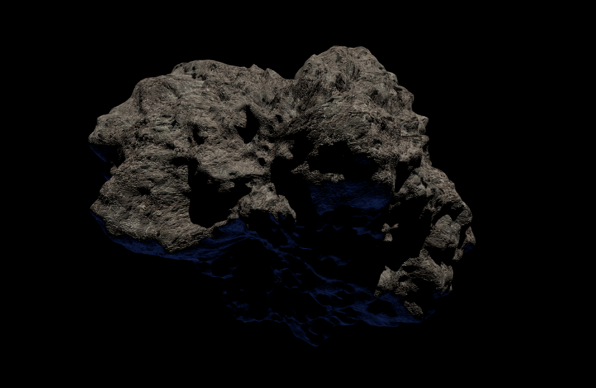
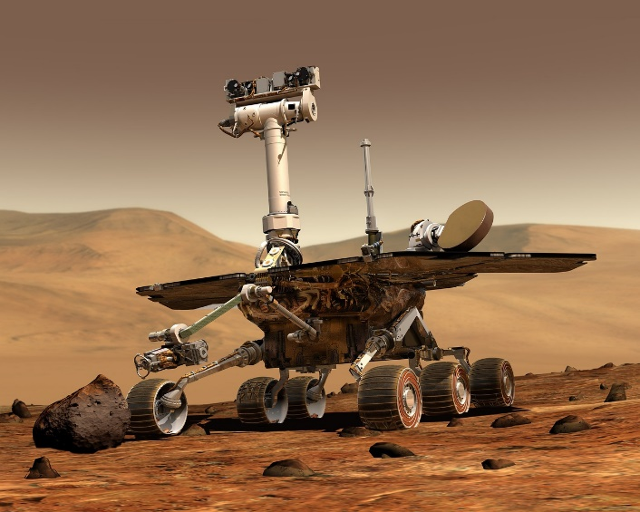
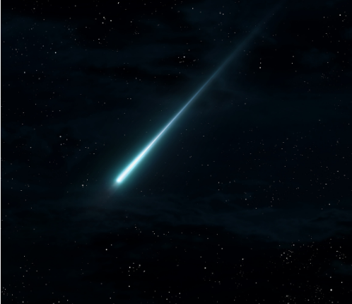
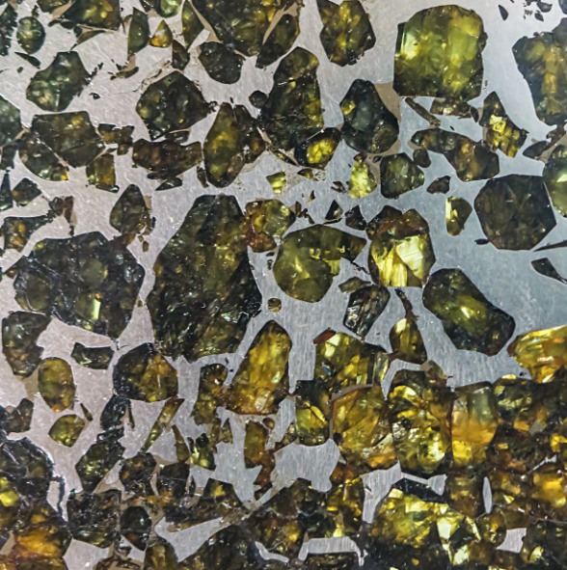
Notes:
In this lesson, you will be introduced to space rocks! What they are, how they form, and how to identify them.

Slide 2

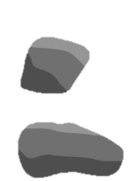



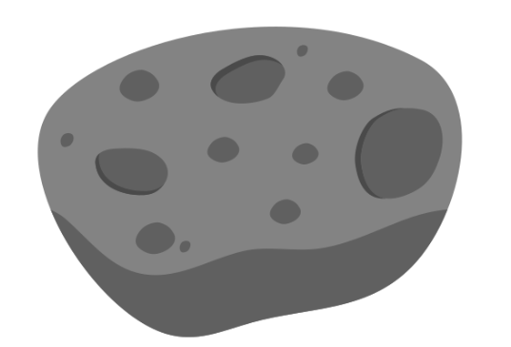


Meteorites
Asteroid
Meteoroids
Meteor
Planet
Meteor
Notes:
Just like on Earth, there are many rocks in space. You’ve probably heard a few words for them before, but what do we call them?
A planet is a large, spherical rocky body. An asteroid is much smaller, but still pretty big, and it doesn’t have to be spherical. Asteroids range in size between a few hundreds of metres, to 300 km!
Smaller rocks in space are called meteoroids, and they’re usually fragments of asteroids that hit each other.
When a meteoroid enters the Earth’s atmosphere, it starts burning up, forming a stunning phenomenon called a meteor, or a shooting star.
If any amount of rock survives going through the atmosphere, it lands on Earth as meteorites.
Note for teachers: if you prefer, instead of running the animations on this slide, you could play the first minute of this video from the Royal Observatory Greenwich: https://www.youtube.com/watch?v=rVdniqc_G_Q

Slide 3



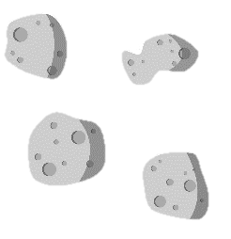
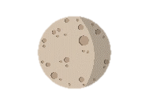


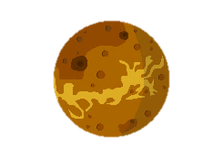
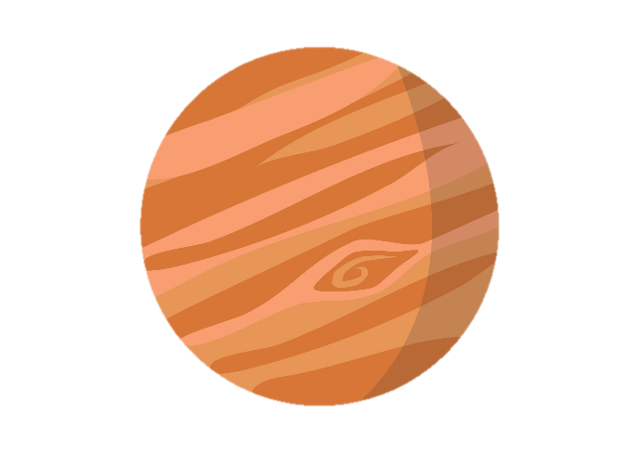
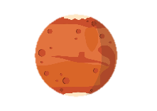
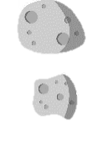
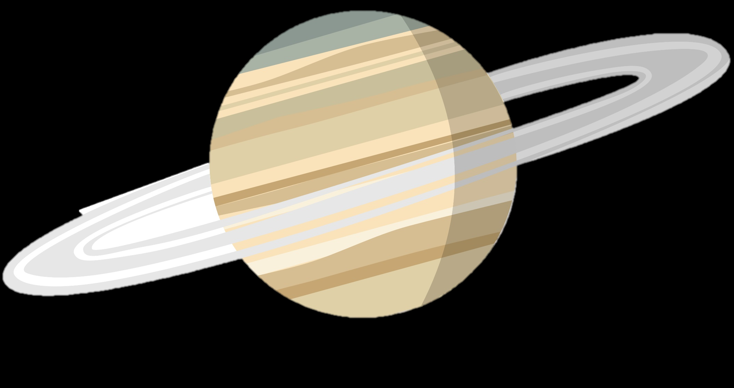
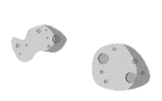

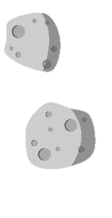
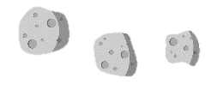
OUTER PLANETS
INNER PLANETS
ASTEROID BELT
Not to scale
Notes:
As a recap, this is our Solar System! Before we can go explore any further, we will need a semi-permanent base on our closest planetary neighbour – the Moon!
Can anyone point at the Moon?

Slide 4

Undifferentiated = same composition everywhere
Core
Undifferentiated = same composition everywhere
Differentiated = formed of different layers
Mantle
Crust
Notes:
When a planet forms, it is usually all molten and squishy at the start. When it’s molten, the heavy things go to the centre because of gravity, and the light things go to the surface. In time, this creates a layered body, with a crust, a mantle and a core.
Play animation

Slide 5

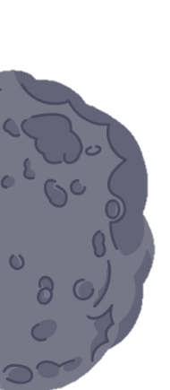

Planets
Differentiated asteroids
Core
Iron
meteorites
Mantle
Crust
Stony meteorites
Notes:
Just like planets, some asteroids are layered too. Different layers have different compositions, so meteorites from different layers are called different things.
At the surface of an asteroid, we find stony meteorites. In the middle of a rocky body, we find iron meteorites. We can never reach the Earth’s core, so looking at iron meteorites is the closest we will get!

Slide 6
Undifferentiated asteroids
Differentiated asteroids
Core
Iron
meteorites
Mantle
Chondrites
Achondrites
Crust
Stony meteorites
Notes:
Unlike planets, some asteroids never differentiate. This means that they keep the same composition at all depths, and heavy elements can be found in the same places as light elements. As such, rocks from undifferentiated asteroids are quite unique – these are called chondrites, and are a subtype of stony meteorites. The other subtype is achondrite (stony meteorites from the crust or mantle of differentiated asteroids).

Slide 7
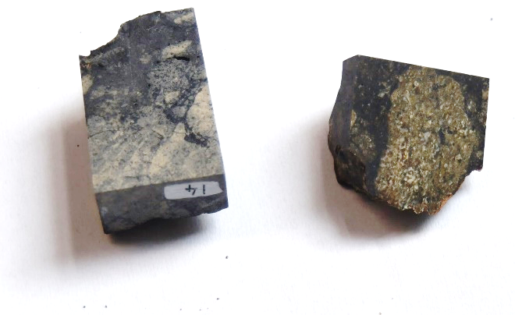
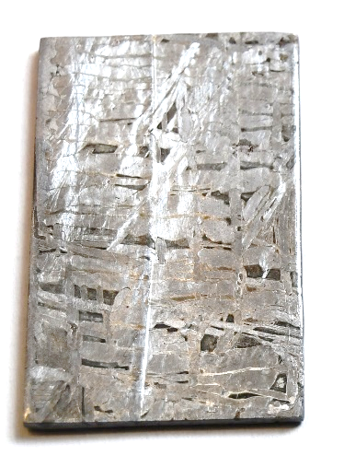
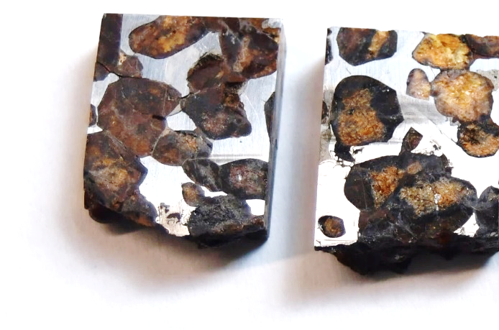
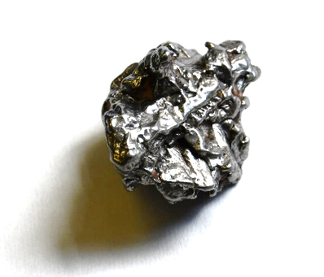
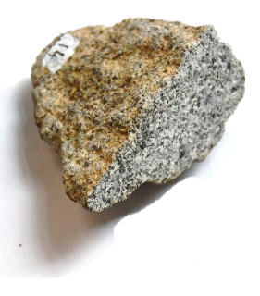
Stony Iron Stony-iron
Combination of silicate minerals and metal
Formed through mixing of stony and iron meteorite material
Very different from Earth rocks!
Made of silicate minerals
Usually from the crust or mantle of a rocky body (achondrite) or from an undifferentiated asteroid (chondrite)
Made of metal, mostly iron
Usually from the core of a rocky body
Very different from Earth rocks!
Notes:
Stony meteorites are made of the same minerals as Earth rocks (especially pyroxene and feldspar) and they usually look the same as Earth rocks, just a bit darker. They usually come from the crust or mantle of a rocky body (achondrites), or from undifferentiated asteroids (chondrites)
Iron meteorites are made of almost pure iron. They usually come from the core of a rocky body.
Stony-iron meteorites are half and half. They form when the two types of meteorites above somehow get combined into one rock! The pallasite that they saw earlier is an example of a stony-iron meteorite.
Iron and stony-iron meteorites don’t have a direct equivalent to Earth rocks that we know of. Maybe rocks like this exist deep in the Earth, but it would be too deep for us ever to reach them! That’s why studying meteorites is the closest we can get the finding out what the Earth’s deep interior is like.

Slide 8



Step 1: Rock observations!
Go to each rock station and make observations about the rocks:
1. Colour(s)
2. Does it contain shiny metallic bits?
3. Does the inside look different from the outside? How?
4. What does the outside look and feel like? (smooth, rough, shiny, glassy, pitted?)
5. Does it feel unusually heavy, unusually light, or just right?
Notes:
Before they can figure out which rocks came from outer space, they need to make basic rock observations, just like they would if they were on a meteorite expedition!
Note: a handout is provided to write down observations on.

Slide 9
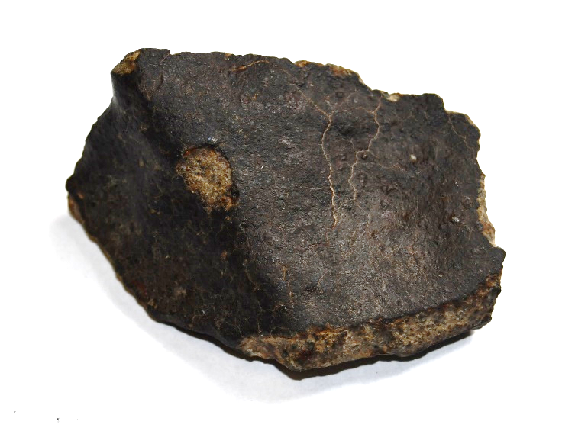
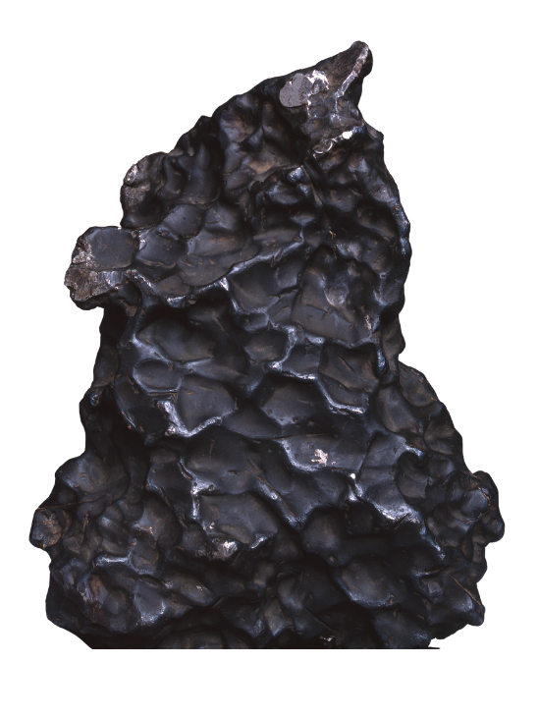


Step 2: Meteorite checklist
Go through your observations and tick the box next to each question if the answer is yes:
Is it unusually heavy?
Does it have a dark outside crust?
Does the outside have an irregular shape, with fingerprint-sized pits?
Can you see metal?
Notes:
Based on their previous observations, the students can now try to figure out if something is a meteorite based on this checklist. The answer does not have to be ‘yes’ to all questions for something to be a meteorite, but the more positive answers, the more confident they can be that they found a meteorite.
The last question refers to metal in general too (if a meteorite is entirely metallic), or small grains.

Slide 10


Slide 11

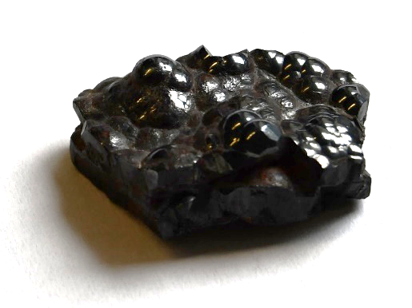

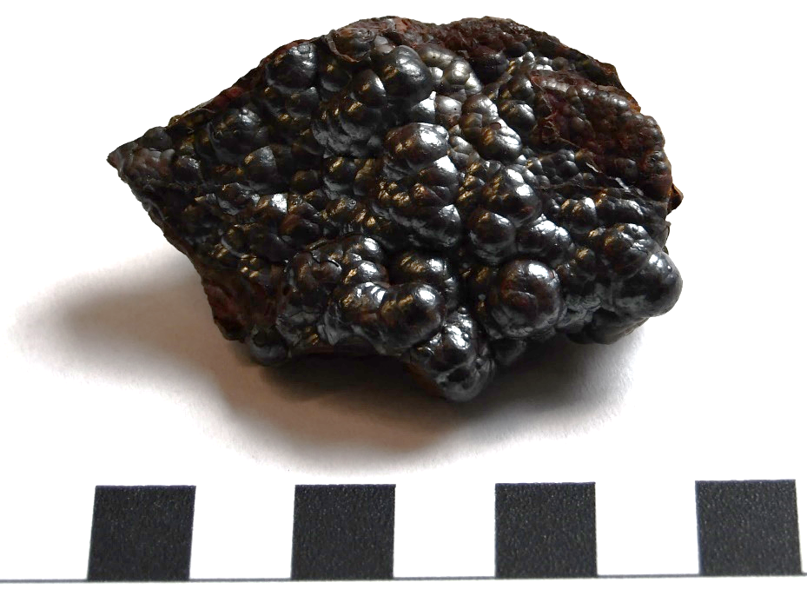
Meteorite checklist:
Is it unusually heavy?
Does it have a dark outside crust?
Does the outside have an irregular shape, with fingerprint-sized pits?
Can you see little metallic bits?
x
x
This is…
Haematite!
This is a mineral from the Earth. It’s often confused with meteorites, but haematite has round bumps rather than pits on the outside.
1 cm

Slide 12


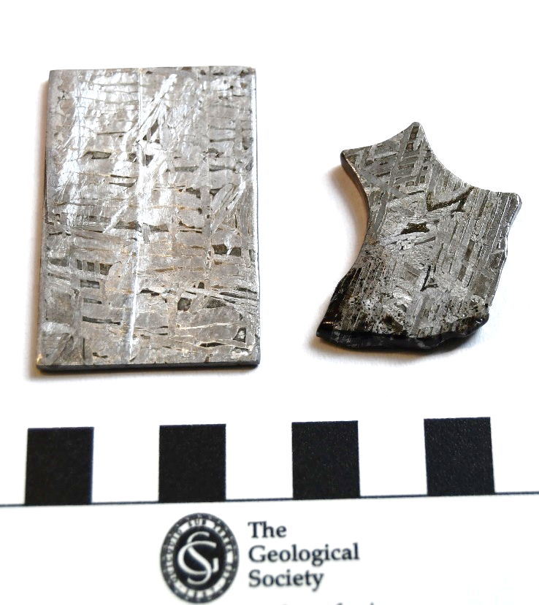
Meteorite checklist:
Is it unusually heavy?
Does it have a dark outside crust?
Does the outside have an irregular shape, with fingerprint-sized pits?
Can you see little metallic bits?
This is…
Iron meteorite!
They form in the cores of differentiated asteroids, and they’re made entirely of metal.
1 cm

Slide 13

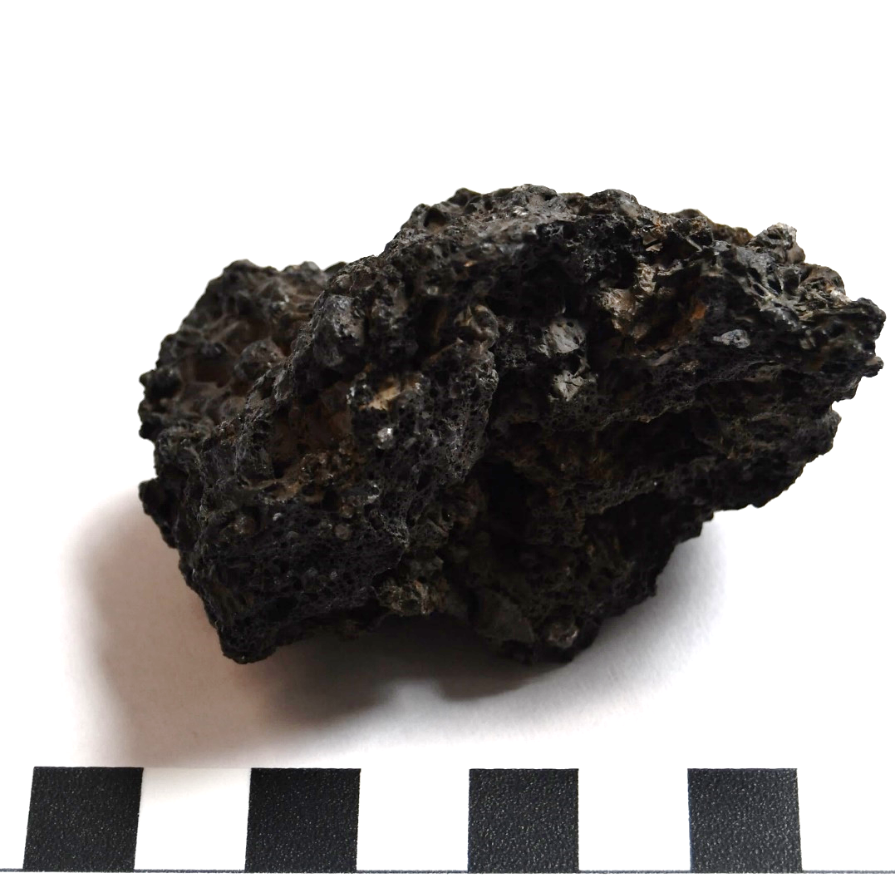
Meteorite checklist:
Is it unusually heavy?
Does it have a dark outside crust?
Does the outside have an irregular shape, with fingerprint-sized pits?
Can you see little metallic bits?
x
x
x
x
This is…
Lava!
It came out of a volcano on Earth, hence the little bubbles!
1 cm

Slide 14

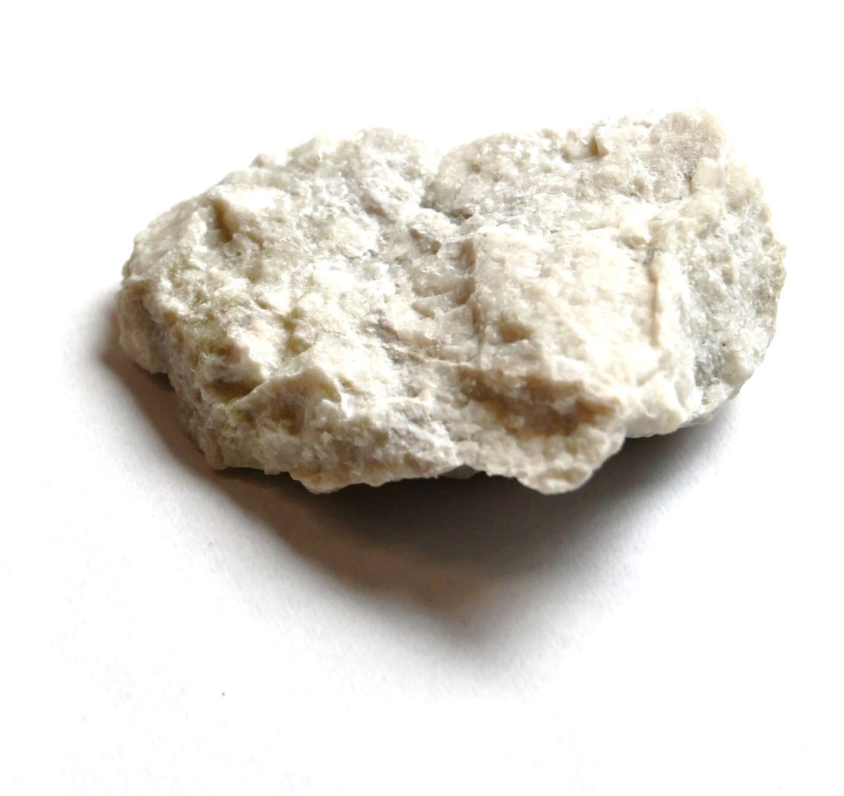
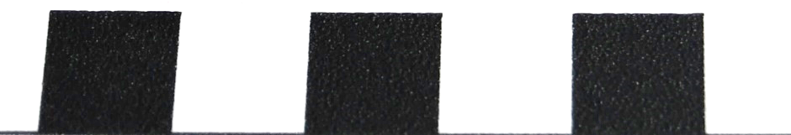
Meteorite checklist:
Is it unusually heavy?
Does it have a dark outside crust?
Does the outside have an irregular shape, with fingerprint-sized pits?
Can you see little metallic bits?
x
x
x
x
This is…
Anorthosite!
This is an igneous rock formed on Earth when magma gets into the crust but never erupts. It’s similar to the rocks on the Moon!
1 cm

Slide 15

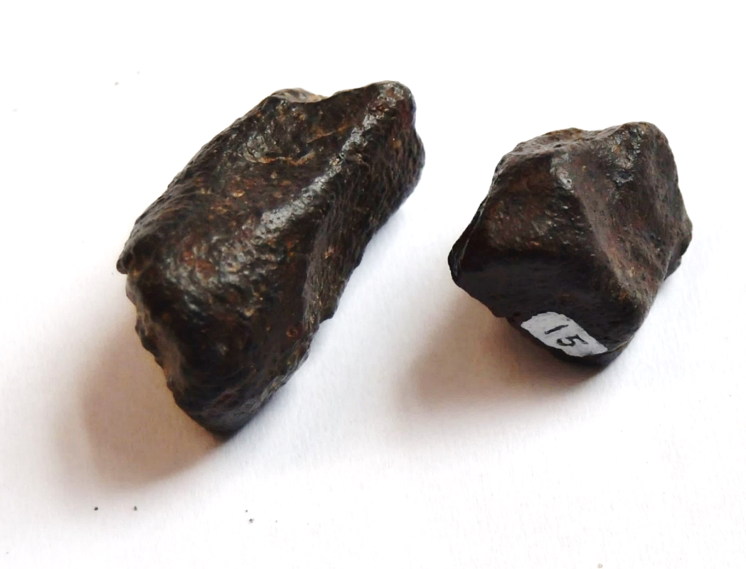
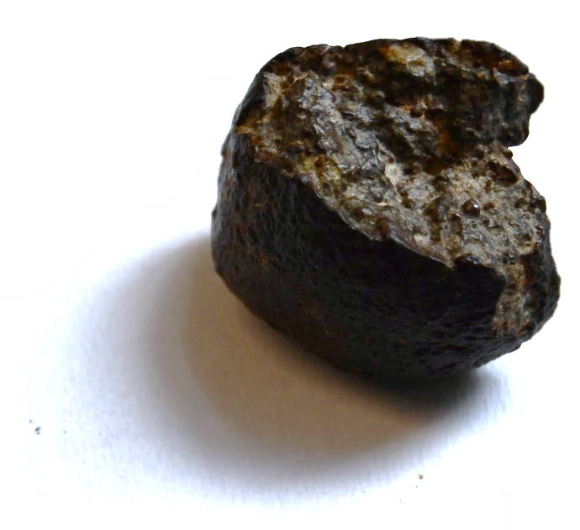

Meteorite checklist:
Is it unusually heavy?
Does it have a dark outside crust?
Does the outside have an irregular shape, with fingerprint-sized pits?
Can you see little metallic bits?
x
This is…
Stony meteorite!
It may not be heavy, but the dark, glassy, pitted outside crust gives it away as a meteorite.
1 cm
Notes:
Note: some samples have very small (sub-millimetric) metal grains which students might identify using a hand lens.

Slide 16

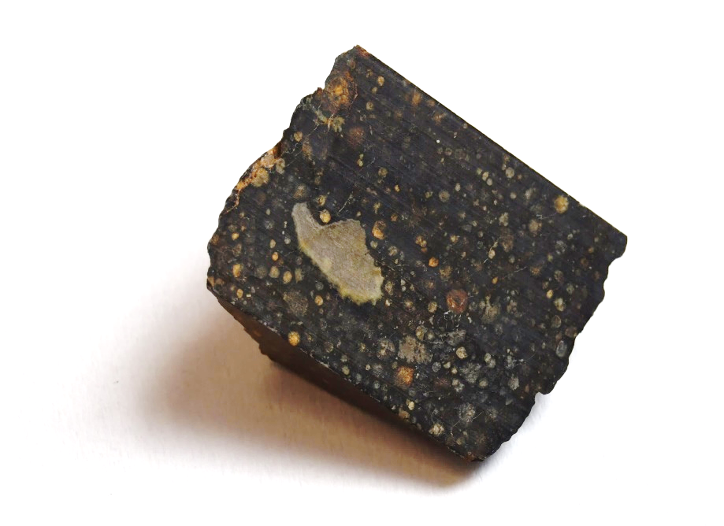
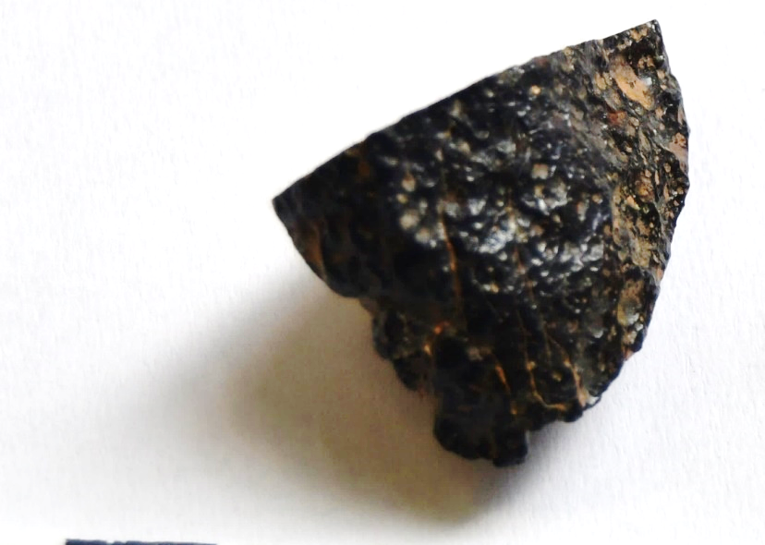
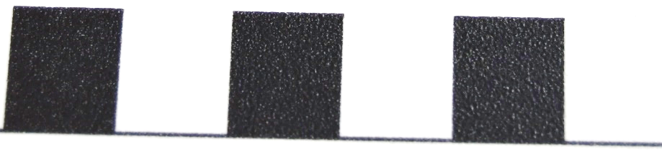
Meteorite checklist:
Is it unusually heavy?
Does it have a dark outside crust?
Does the outside have an irregular shape, with fingerprint-sized pits?
Can you see little metallic bits?
x
This is…
Stony meteorite!
It may not be heavy, but the dark, glassy, pitted outside crust gives it away as a meteorite.
1 cm
Notes:
Teacher notes: these meteorites actually do contain very small metal grains (<1mm size), so a very observant student using a hand lens may spot some.

Slide 17

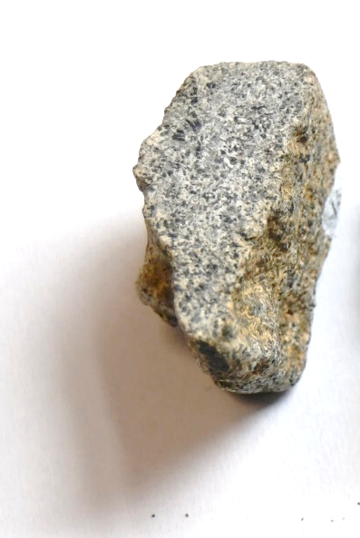
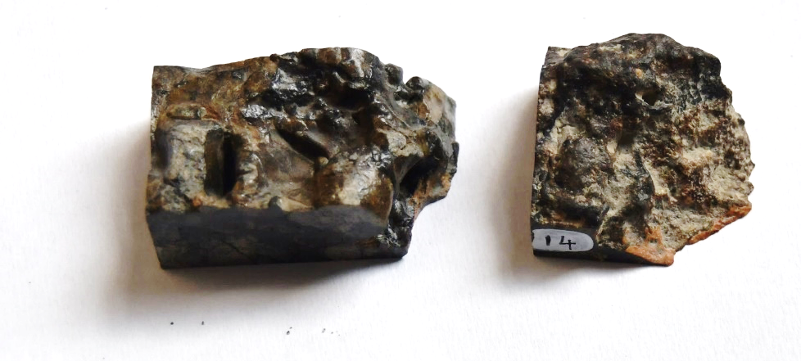
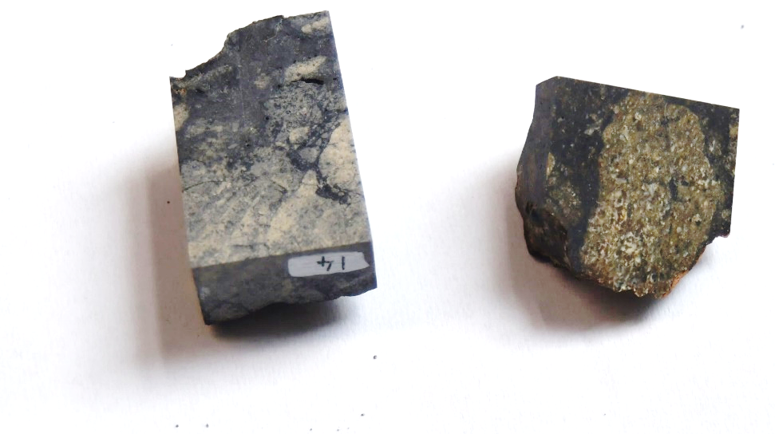
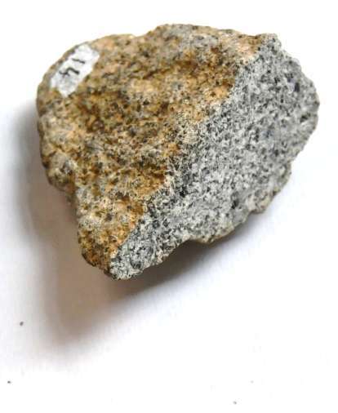

Meteorite checklist:
Is it unusually heavy?
Does it have a dark outside crust?
Does the outside have an irregular shape, with fingerprint-sized pits?
Can you see little metallic bits?
x
x
This is…
Stony meteorite (achondrite)!
This is an achondrite, a type of meteorite with Earth equivalent (some igneous rocks) – that’s why it’s so hard to identify as a meteorite!
1 cm
Notes:
The answer to the second question varies based on which achondrite is in your box – tick for the dark achondrites, or an ‘x’ for the light ones.

Slide 18

= mission to bring back samples from space
1960 - 1980 Apollo Luna
2000 - 2010 Genesis Stardust Hayabusa
2020 Hayabusa-2 Chang’e 5
2024 OSIRIS-Rex
Late 2020s-2030s Tianwen-2 MMX Luna-Glob Mars-Grunt
Mars
moons
Moon
Mars
Comet
Asteroids
Notes:
[Optional slide]
To get extraterrestrial rocks, we don’t always have to wait for them to come to us. We can also send spacecrafts to space to bring back samples. These space missions are called sample return missions.
There have been a few sample return missions so far, starting with the Apollo missions to the Moon. But did you know that we brought back material from comets and even asteroids? More missions are in the planning stage, aiming to return samples from the Moon and asteroids, as well as Mars, and even the moons of Mars!
It seems ideal to go and get our own rocks for scientific reasons, but is it worth it? Discuss the pros and cons or sample return missions.
[allow some discussion time]
Pros:
When a meteorite lands on Earth, it’s extremely hard to find out which asteroid it came from originally. If we collect samples from asteroids and they have the same composition, we can be very sure that a meteorite came from that asteroid!
Meteorites burn as they fall through the Earth’s atmosphere, which can change their composition. That’s not a problem for samples taken directly from space
Cons:
Sample return missions are very expensive!
The missions are also high risk, so they may fail, losing a lot of time and money.
In the unlikely event of finding microbial life on an extraterrestrial body, we have to be very careful not to introduce the microbes to the Earth because no living creature is immune to them, so they could potentially be dangerous.

Slide 19

Thank you for your attention!
Contact our education team at education@geolsoc.org.uk
This lesson was created as part of a project funded by the
UK Space Agency Space for All fund

