Slide 1


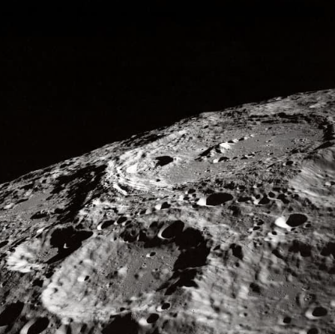
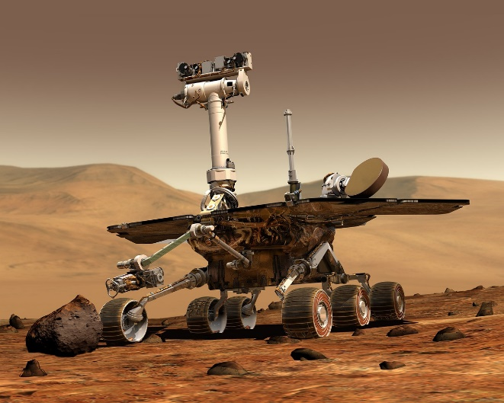
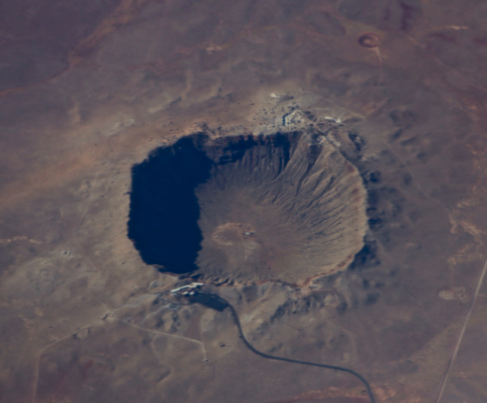
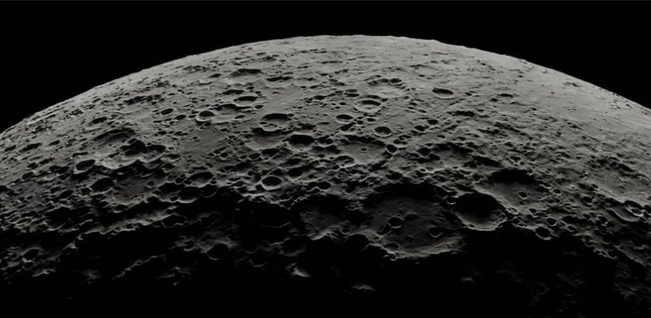
Notes:
In this lesson, pupils will learn about impact craters – what they look like, how they form, and what the rocks in a crater are like.

Slide 2

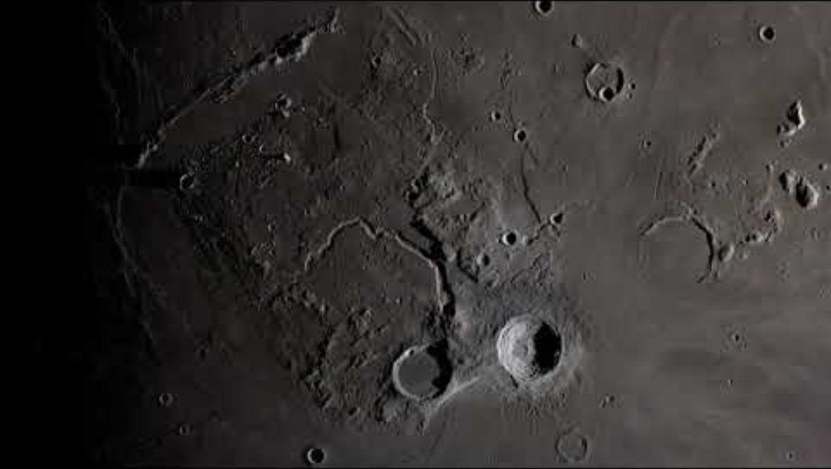
Notes:
Does anyone know what happens when a meteorite hits a planet?
Answer: a crater forms! A crater is a round hole or depression in the surface of a planet.

Slide 3

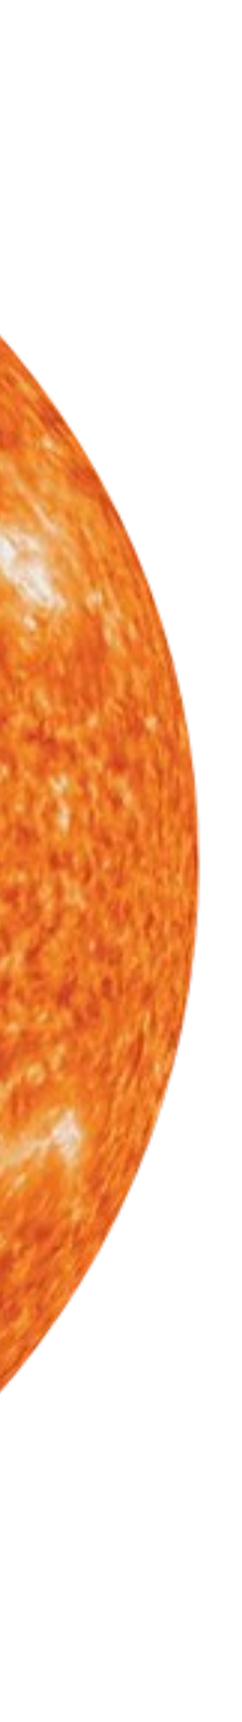
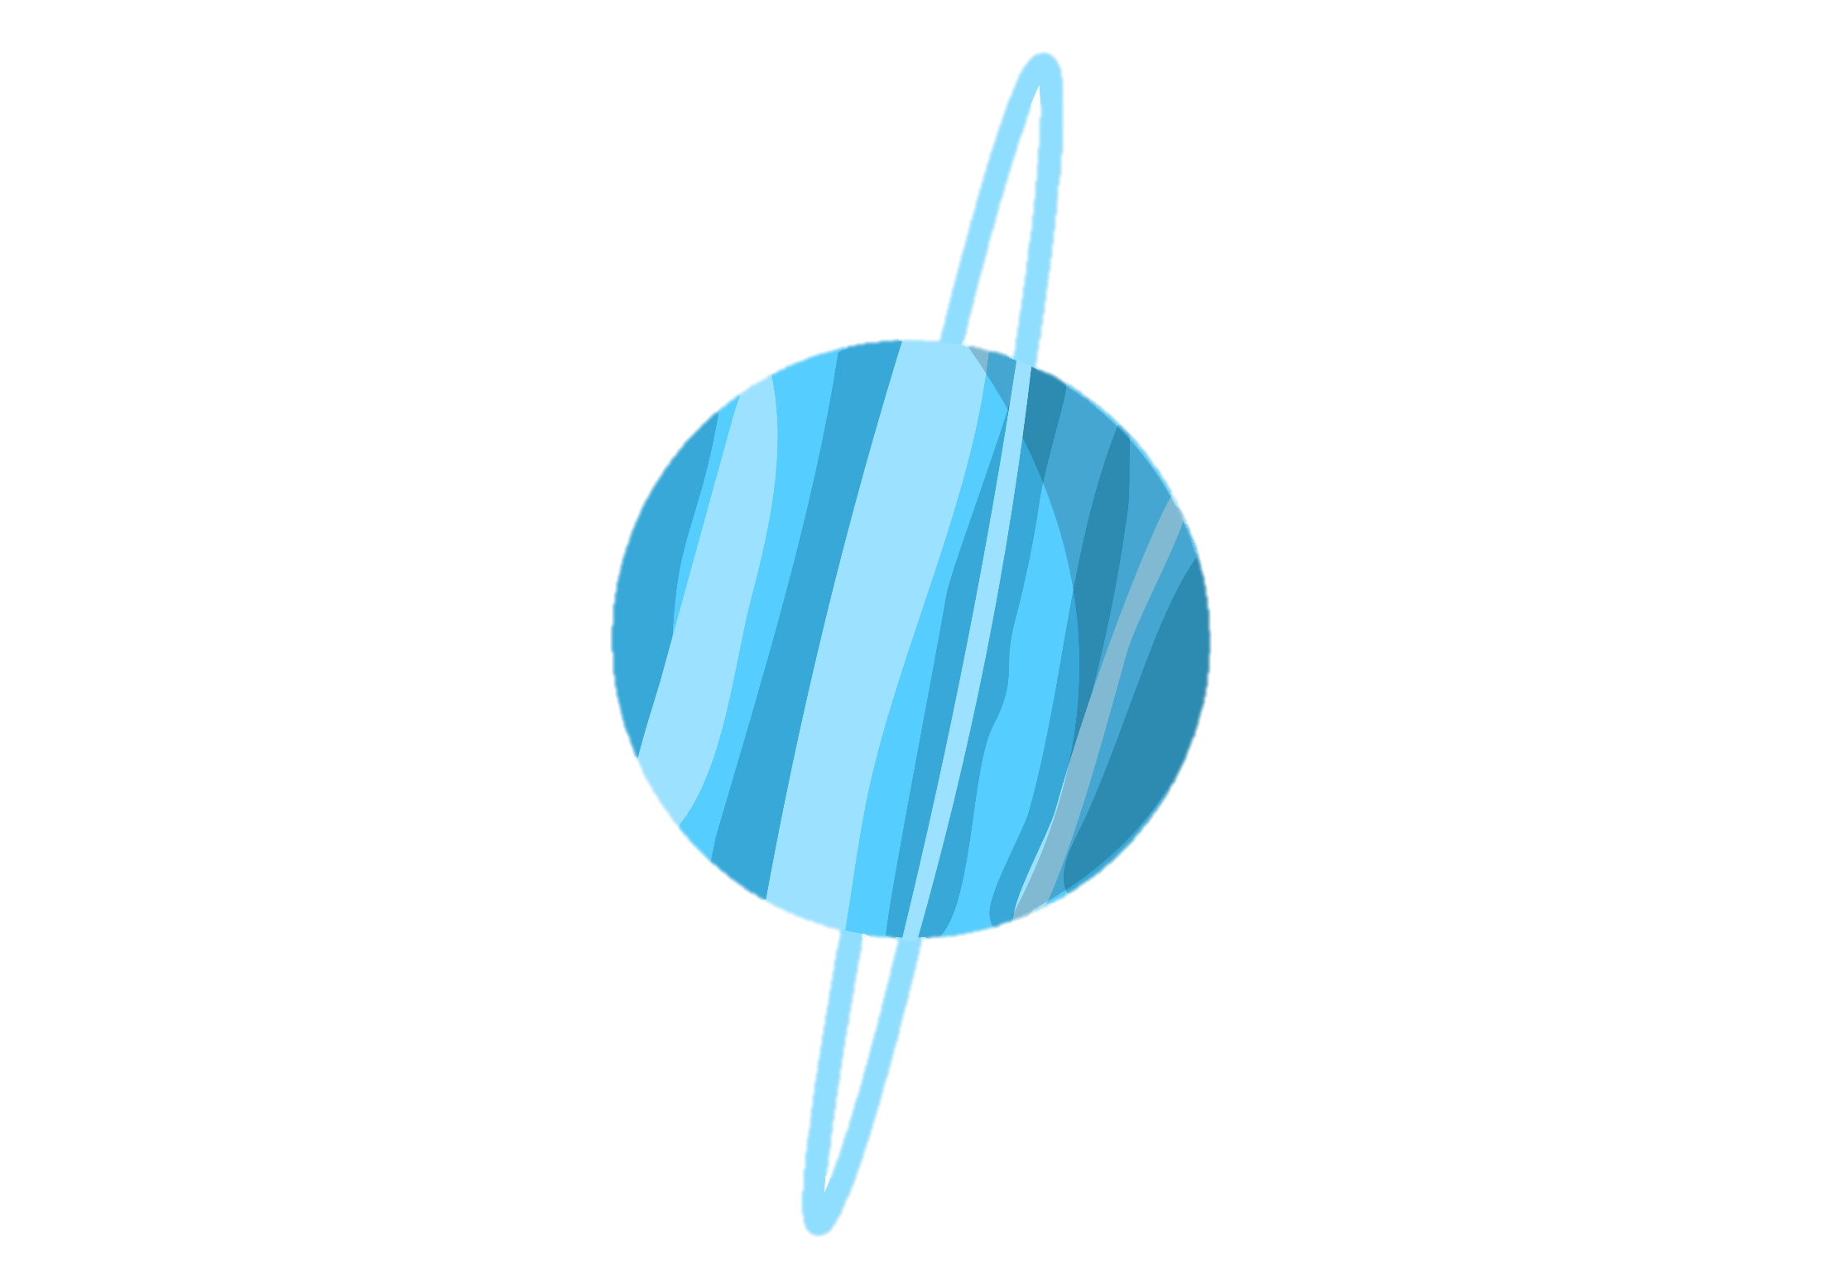
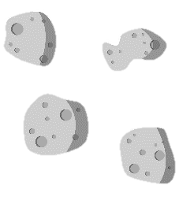
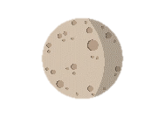

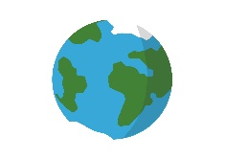
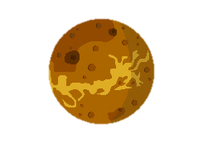
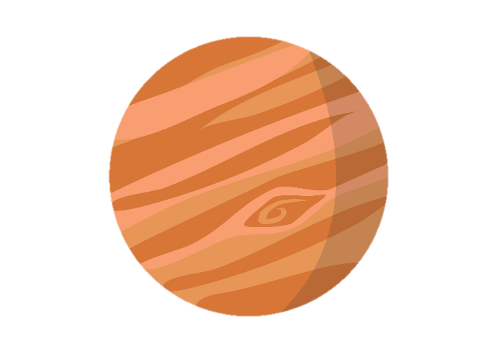
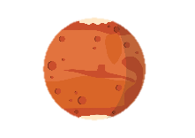

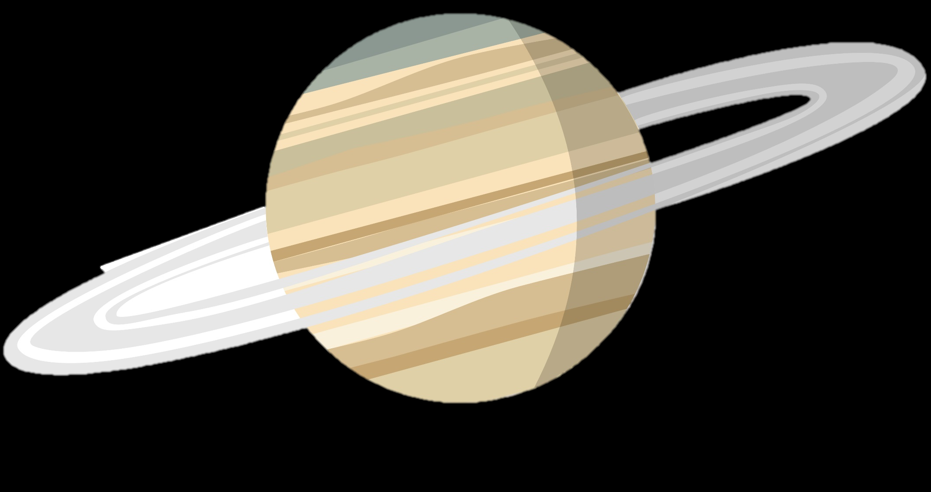

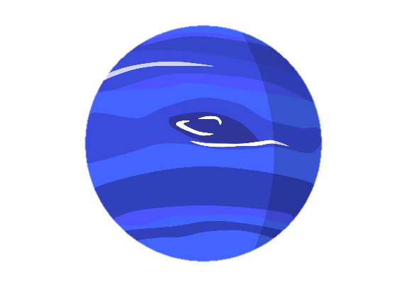

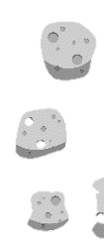
OUTER PLANETS
INNER PLANETS
ASTEROID BELT
Not to scale
Notes:
Can you name a place in the solar system that has craters?
Answer: Craters are almost everywhere! All the inner planets, especially Mars and Mercury, have lots of craters. There are some craters on Venus too, lots on the Moon, and most asteroids have craters as well.
We also have impact craters on the Earth (e.g. the Barringer crater in Arizona), but most of them are buried or erased (like the Chicxulub crater, made by the meteorite which killed the dinosaurs, which is buried). One mechanism that erases craters is erosion due to water and wind.

Slide 4
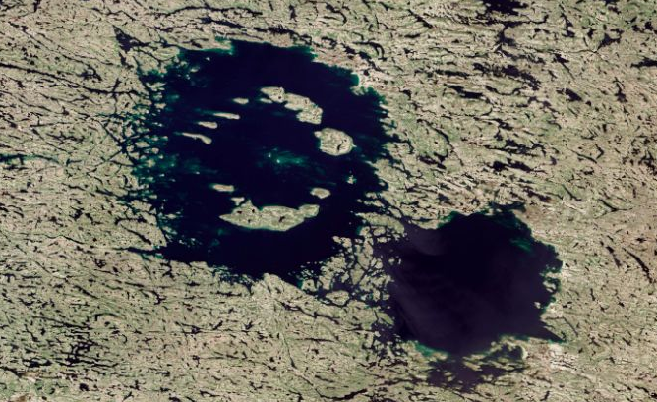
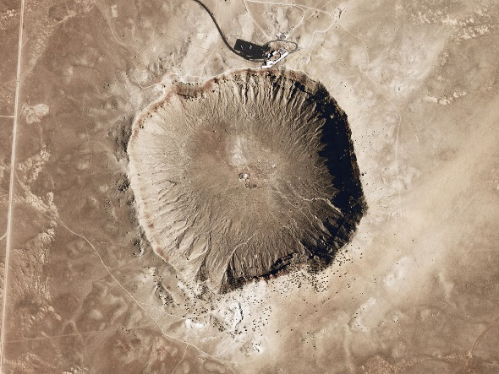
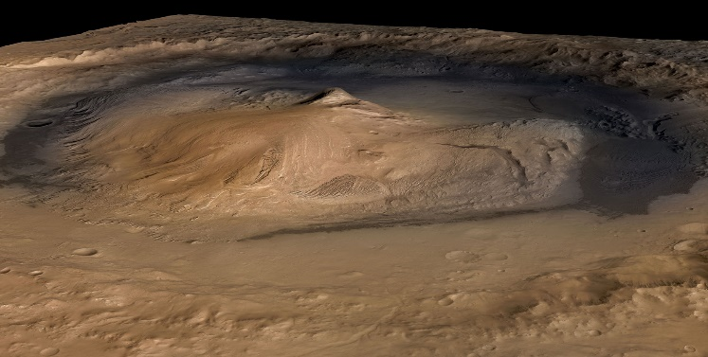
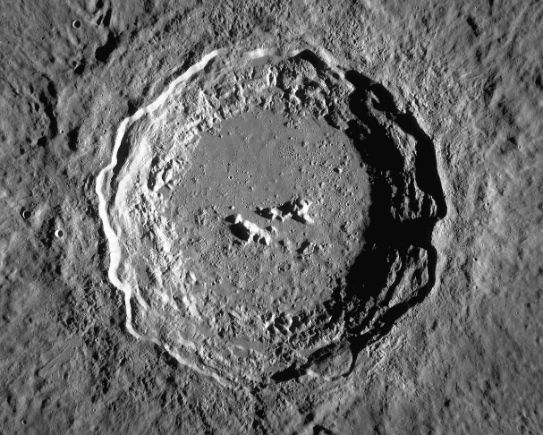
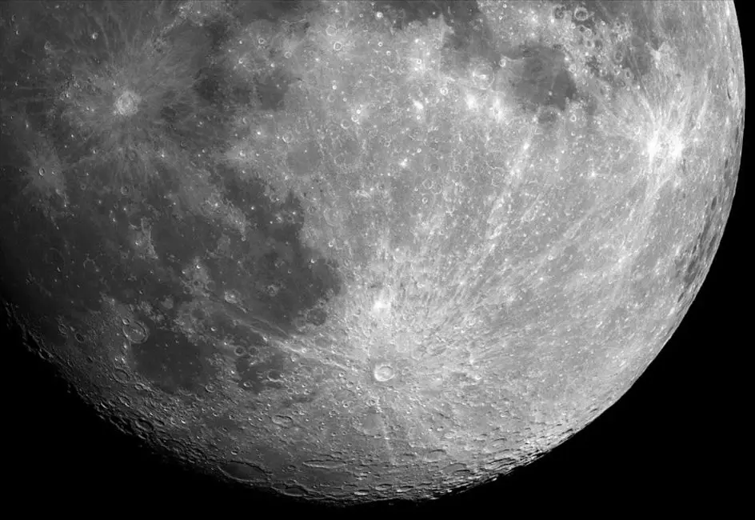
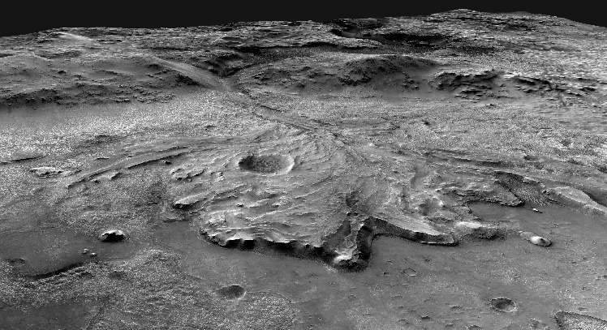
Earth:
Mars:
Clearwater craters, Canada
Barringer crater, USA
Gale crater
Moon:
Photo: NASA
Photo: NASA
Photo: NASA
Jezero crater
Copernicus crater
Tycho crater
Photo: USGS
Photo: NASA
Photo: NASA
Notes:
Here are some examples of craters.
Fun fact: the two Mars craters shown are the homes of the Curiosity and Perseverance rovers, respectively.

Slide 5

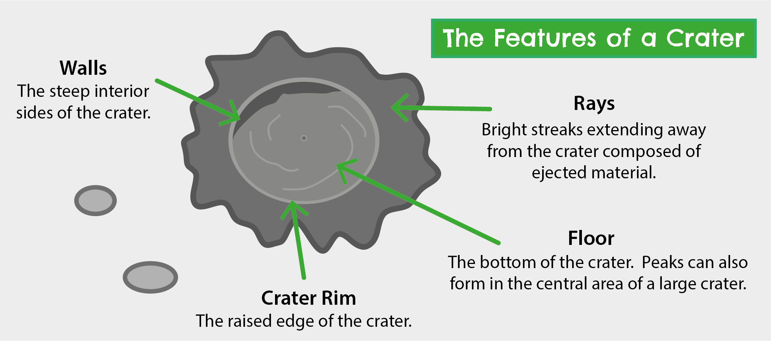
1. Have a look and feel of the craters on your tables. Can you find the features below on the samples?
Image credit: Geobus
2. Pick a crater and sketch it!
Notes:
Now for our first activity! Have a look at the crater samples on your tables. Can you find the features on this slide? You’re looking for a crater rim, walls, floor and ejecta.
Please pick a crater and sketch it, labelling these features.
(Note: the students will not be able to find ejecta rays because these are not obvious on the 3D samples)

Slide 6
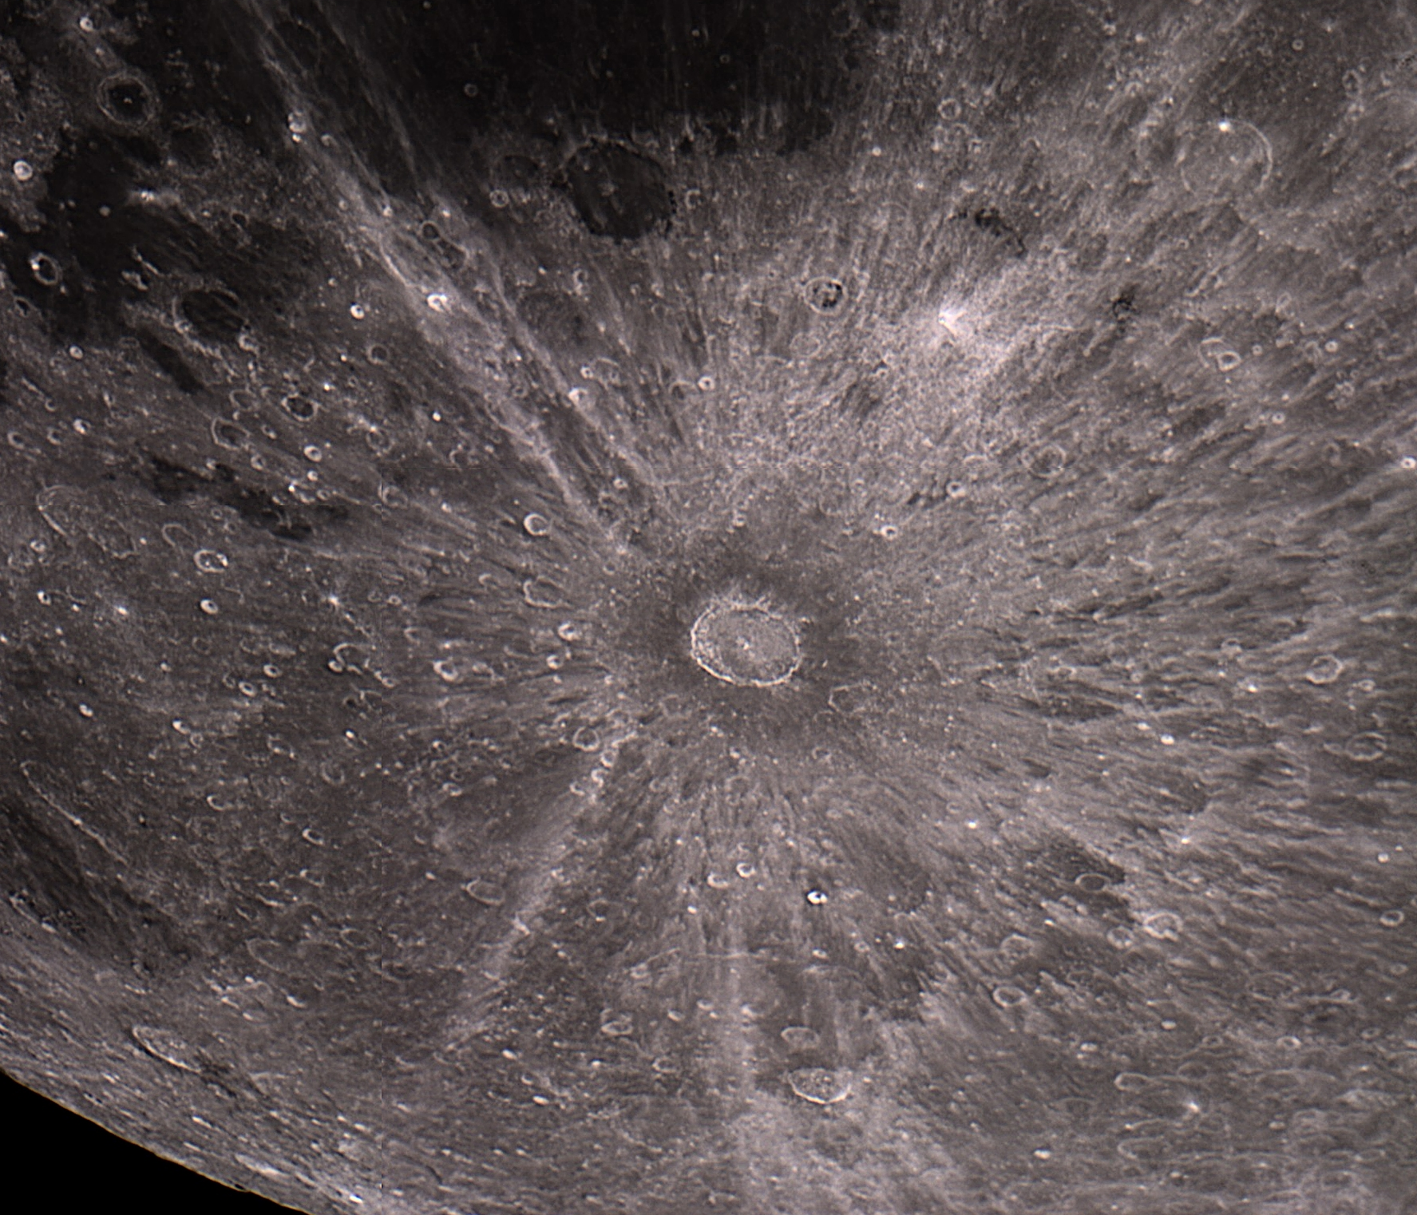
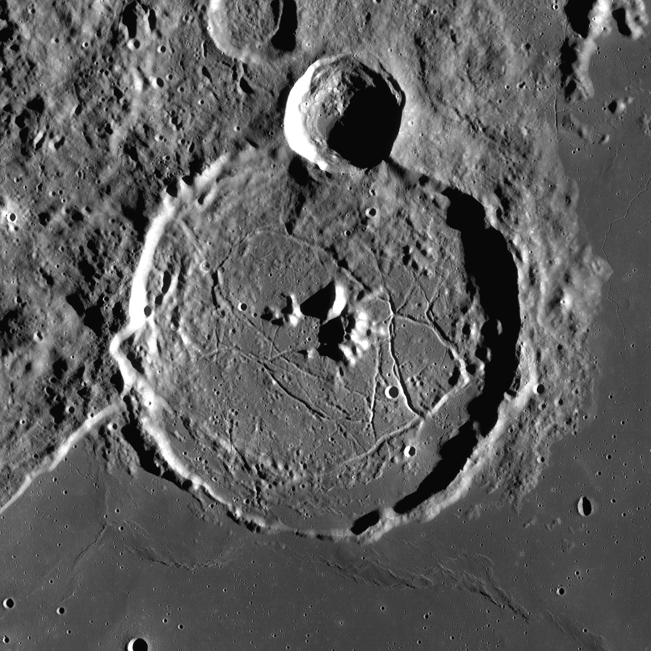
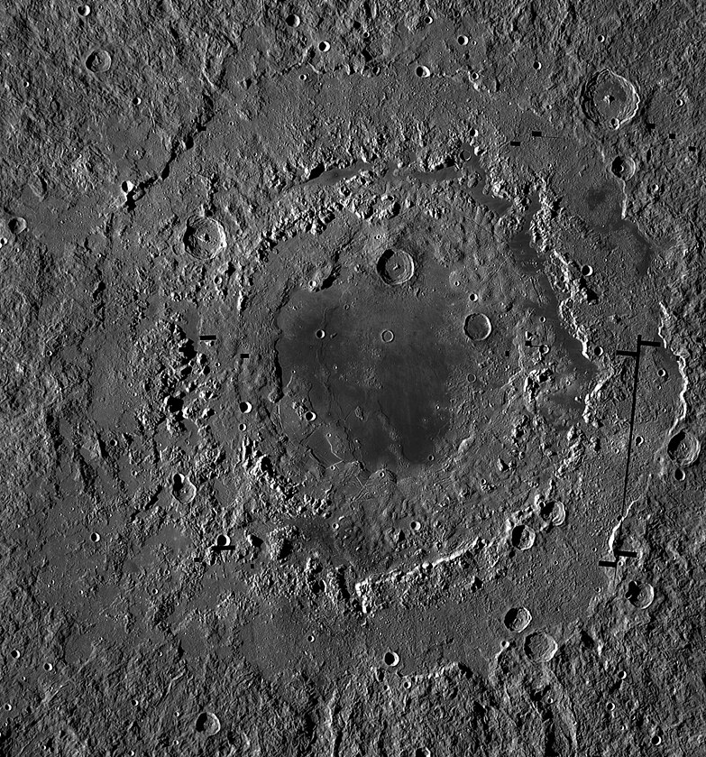
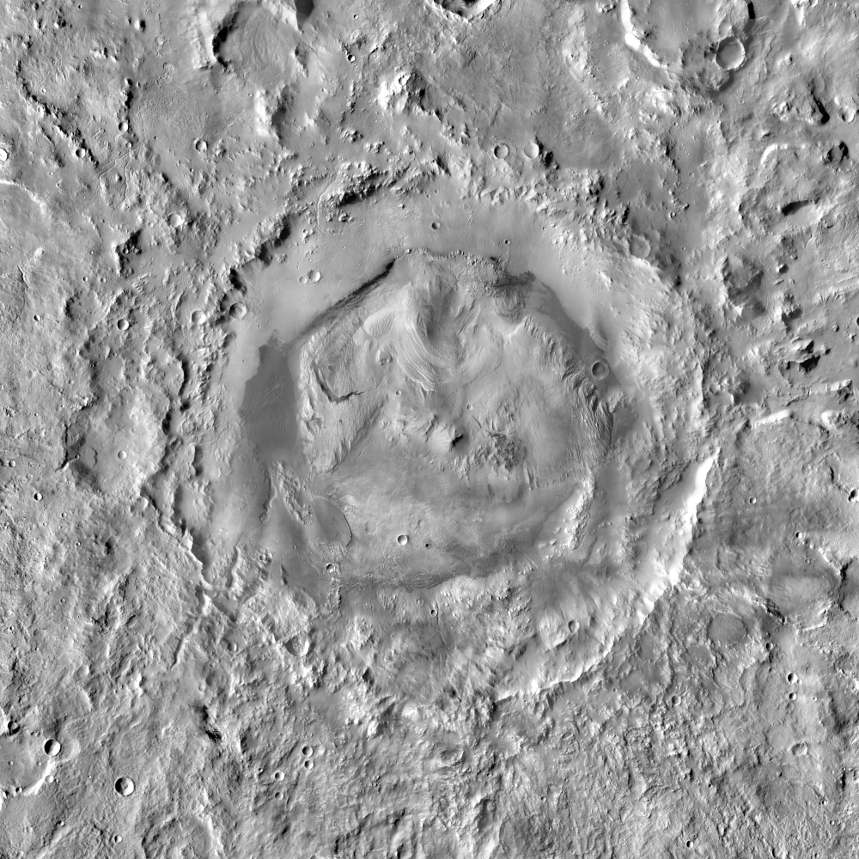
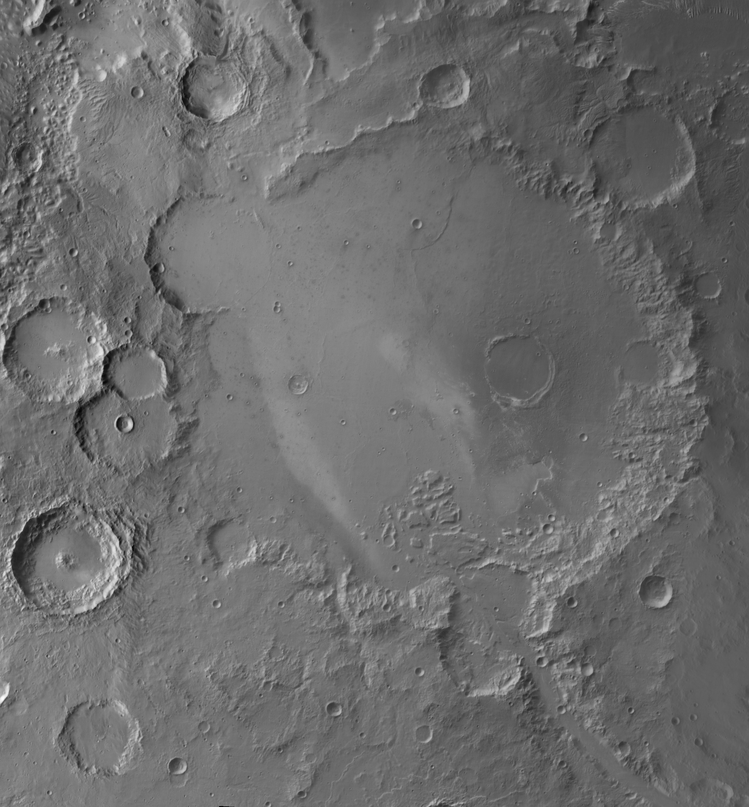
Moon:
Copernicus crater
Tycho crater
Gassendi crater
Mare Orientale
Mars:
Earth:
All images courtesy to NASA
Gale crater
Gusev crater
Barringer crater
Notes:
These are digital images of the 3D crater samples the pupils are looking at.

Slide 7

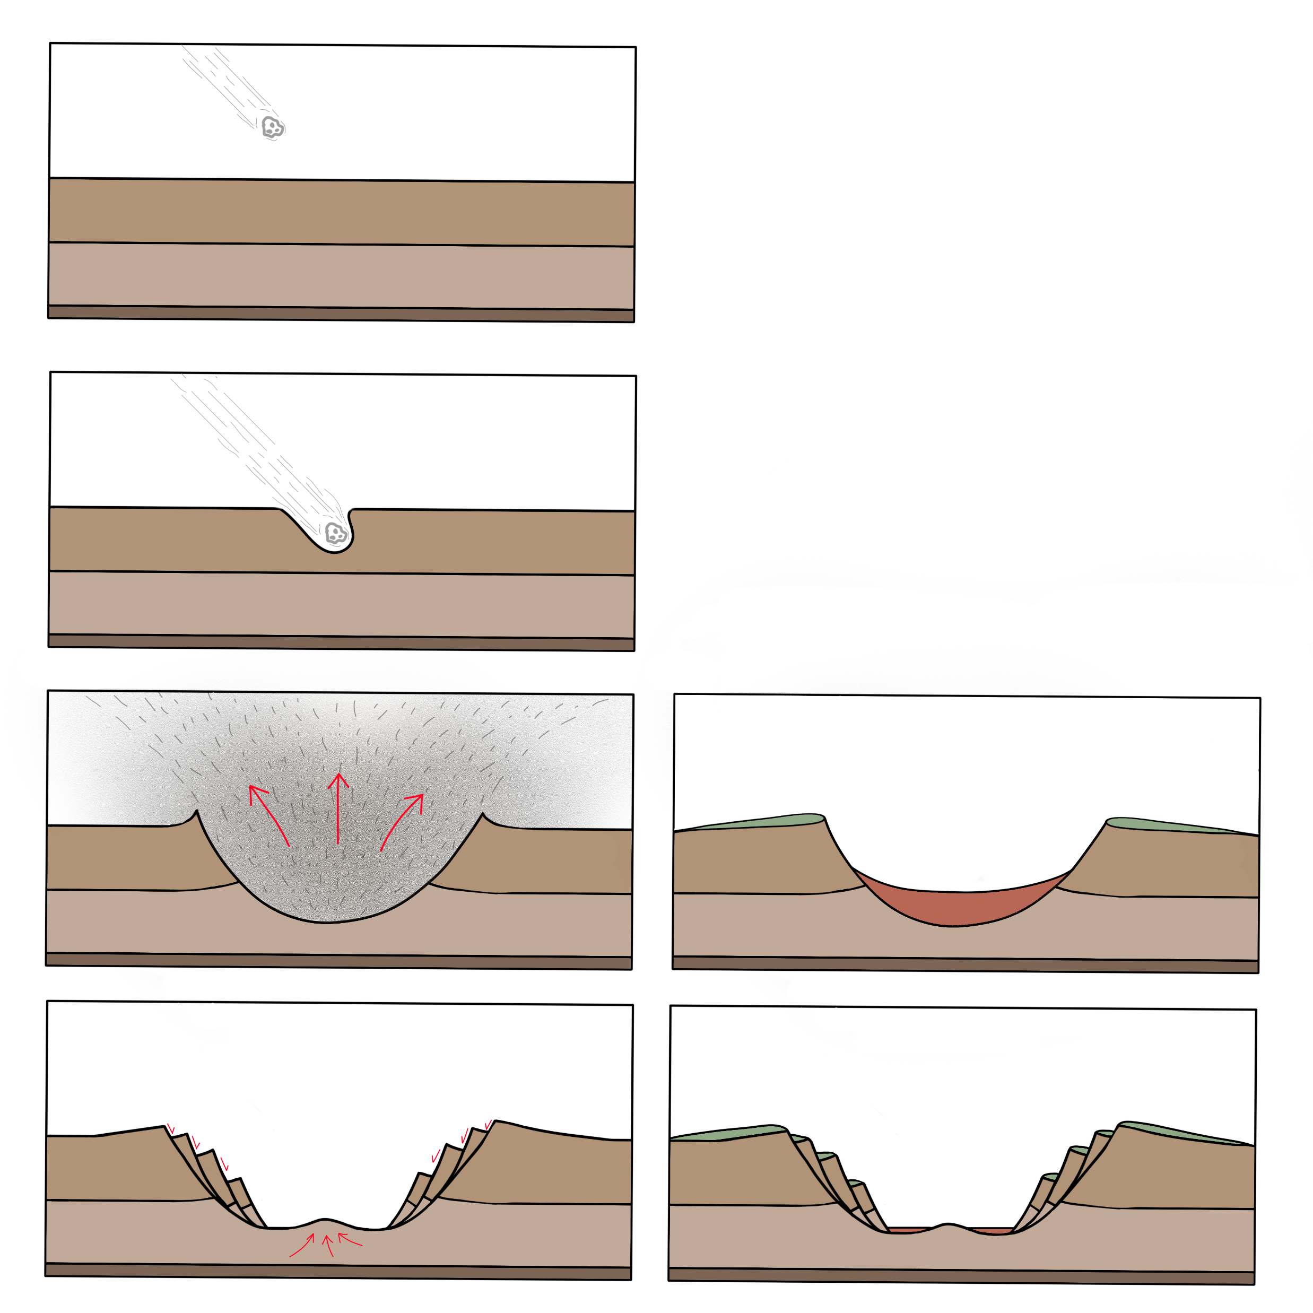
Rims
Walls
Floor
Have you noticed any other crater features?
Notes:
So how do craters form? A crater is caused by a smaller object (like a meteorite) crashing into a bigger object (like a planet).
The small object travels very fast, so when it hits, it creates an explosion and lots of rock gets thrown out from the impact site. This material forms rims which are taller than the surrounding area. At the same time, the explosion causes a depression (hole) that’s either flat or bowl-shaped. The flat or bowl-shaped bottom of the depression is called a crater floor, and the sides are called walls.
Have you noticed any other features on your craters?
The main complex feature of a crater is the central peak(s), which are peaks formed in the central area of a large crater. They form when the impact is very powerful – immediately after the initial impact, the rocks relax and go back up, forming a peak in the middle (you can use a bouncy castle analogy, which is not perfect but will help them visualise the process better)
Other features that they might notice are below, with explanations for your reference. If they don’t notice them, no need to bring them up.
Multiple rings: Very large craters (termed impact basins) can have as many as 5 or 6 circular rings of mountain chains surrounding the main crater. Their formation is not fully understood, but one proposed theory is that the central peak is so large that it becomes unstable, collapsing to form several rings. An example of a multi-ring basin is Mare Orientale on the Moon.
Terraced walls (stair-like): sometimes, the walls become too steep to remain stable, so they form several terraces

Slide 8
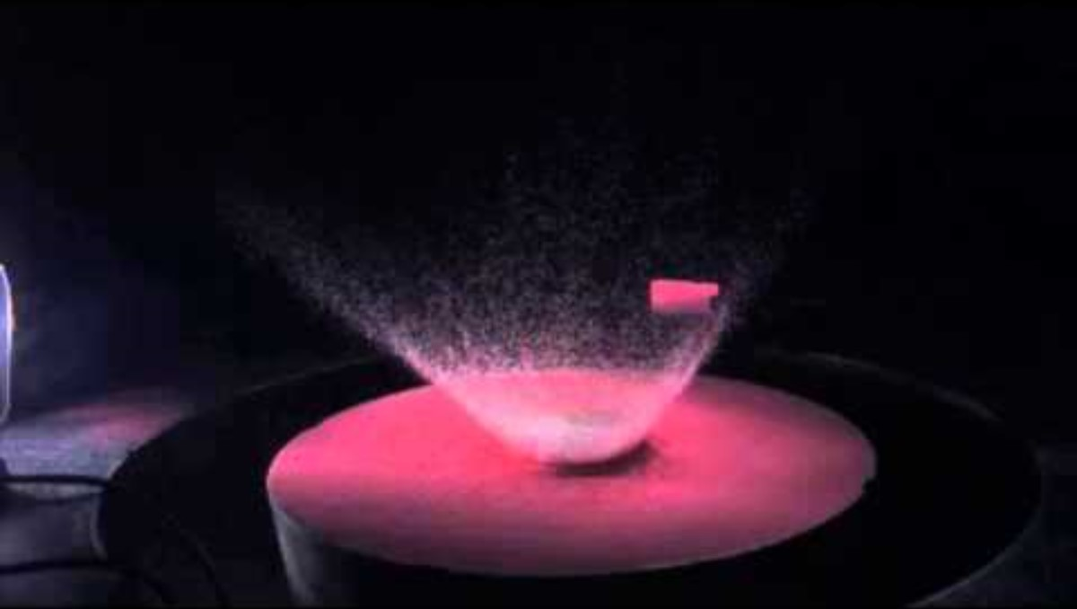
Notes:
Optionally, you could play this short NASA video of a hypervelocity impact to illustrate crater formation.

Slide 9

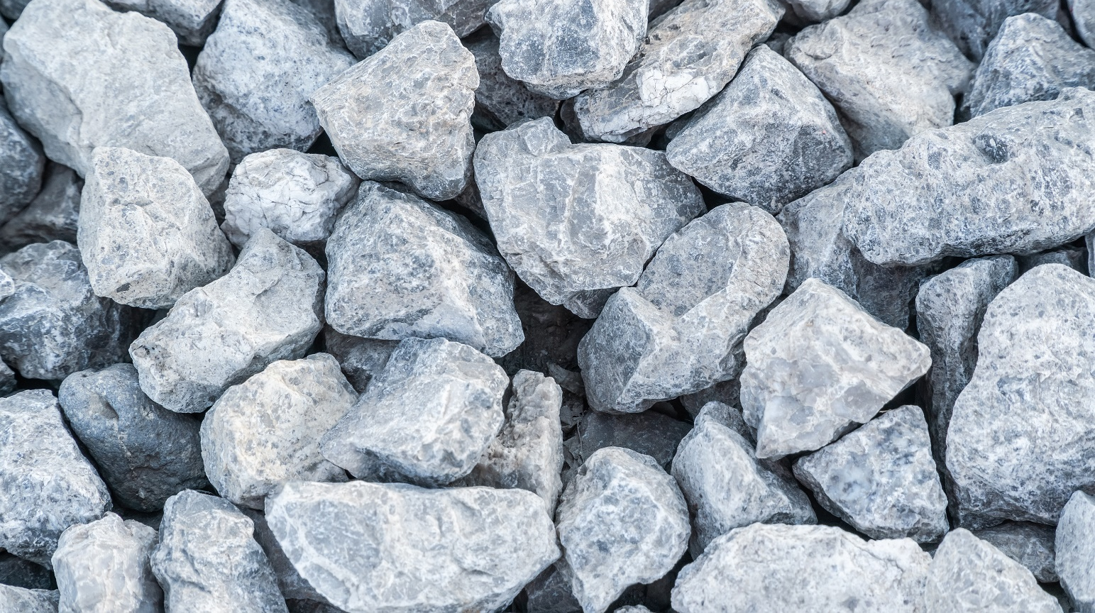
?
Notes:
What do you think happens to the rocks a meteorite lands on?
Answer: they can get squashed, broken up, or they can melt. Sometimes, all of these things happen to just one rock! For this reason, impact rocks are quite complicated and there are many subtypes. Altogether, they are known as impactites.

Slide 10
Rocks created or changed by impacts from meteorites are called impactites. We will look at 2 types:
1. Impact glasses
These form when the rock in the crater melts and then gets thrown out of the crater - it cools very quickly in the air
Usually found outside the crater.
2. Impact breccias
A breccia is a rock made up of bits broken off other rocks
Formed when the bedrock is broken up by an impact
Can be made up of molten rock or glassy bits (looks like glass)
Usually found inside a crater
Impact glasses
Impact breccias
Notes:
Note to teachers: this is highly simplified, and in reality, any rock generated by a meteorite impact is quite complex. Here are a few things we omitted for simplicity:
Impact glasses can be found inside craters if that is where they fell, or if sedimentary processes brought them back into the crater
Equally, impact breccias are not only found inside craters. It’s possible for them to be thrown out of the crater as ejecta too. Some might also be underneath the crater, if they impact fractured the bedrock
There are types of impactites not mentioned here:
Impact melts = rocks that melt completely because of an impact. If they cool down slowly, they don’t become glassy, instead resembling igneous rocks (even though their impact origin makes them metamorphic). Impact glasses are a subtype of impact melts.
Shocked rocks = rocks affected by shock metamorphism. Shocked rocks don’t melt or brecciate, but the pressure and heat of an impact causes different minerals and textures to form through shock metamorphism.

Slide 11


Look at the samples and use your observation skills to answer these questions:
1. What colour(s) can you see?
2. Do you see any small bits that look different to the rest of the rock? How big are they?
3. What does it look and feel like?
- smooth, rough, or shiny
- glassy (looks like glass, doesn't have to be clear)
- pitted (small shallow holes)
4. Do you notice anything else?
Don’t forget to use your hand lenses!

Slide 12

Notes:
For each rock, ask for a volunteer to name their observations. Then go through your observations and tell them what the rock is and how it formed.

Slide 13

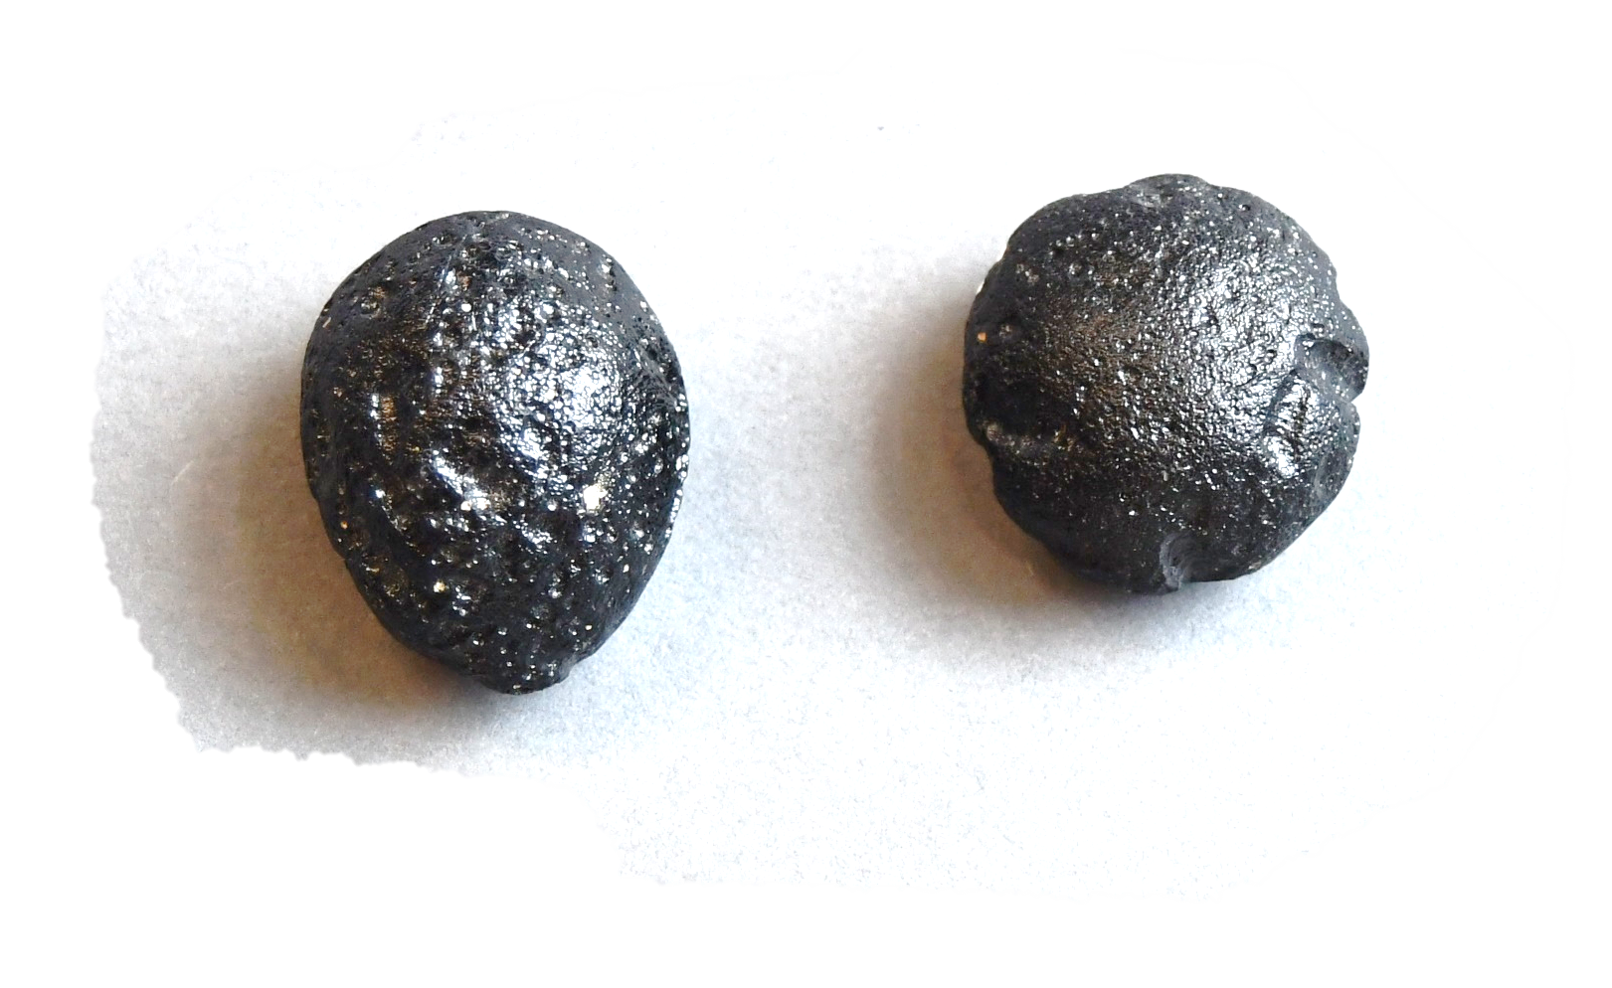
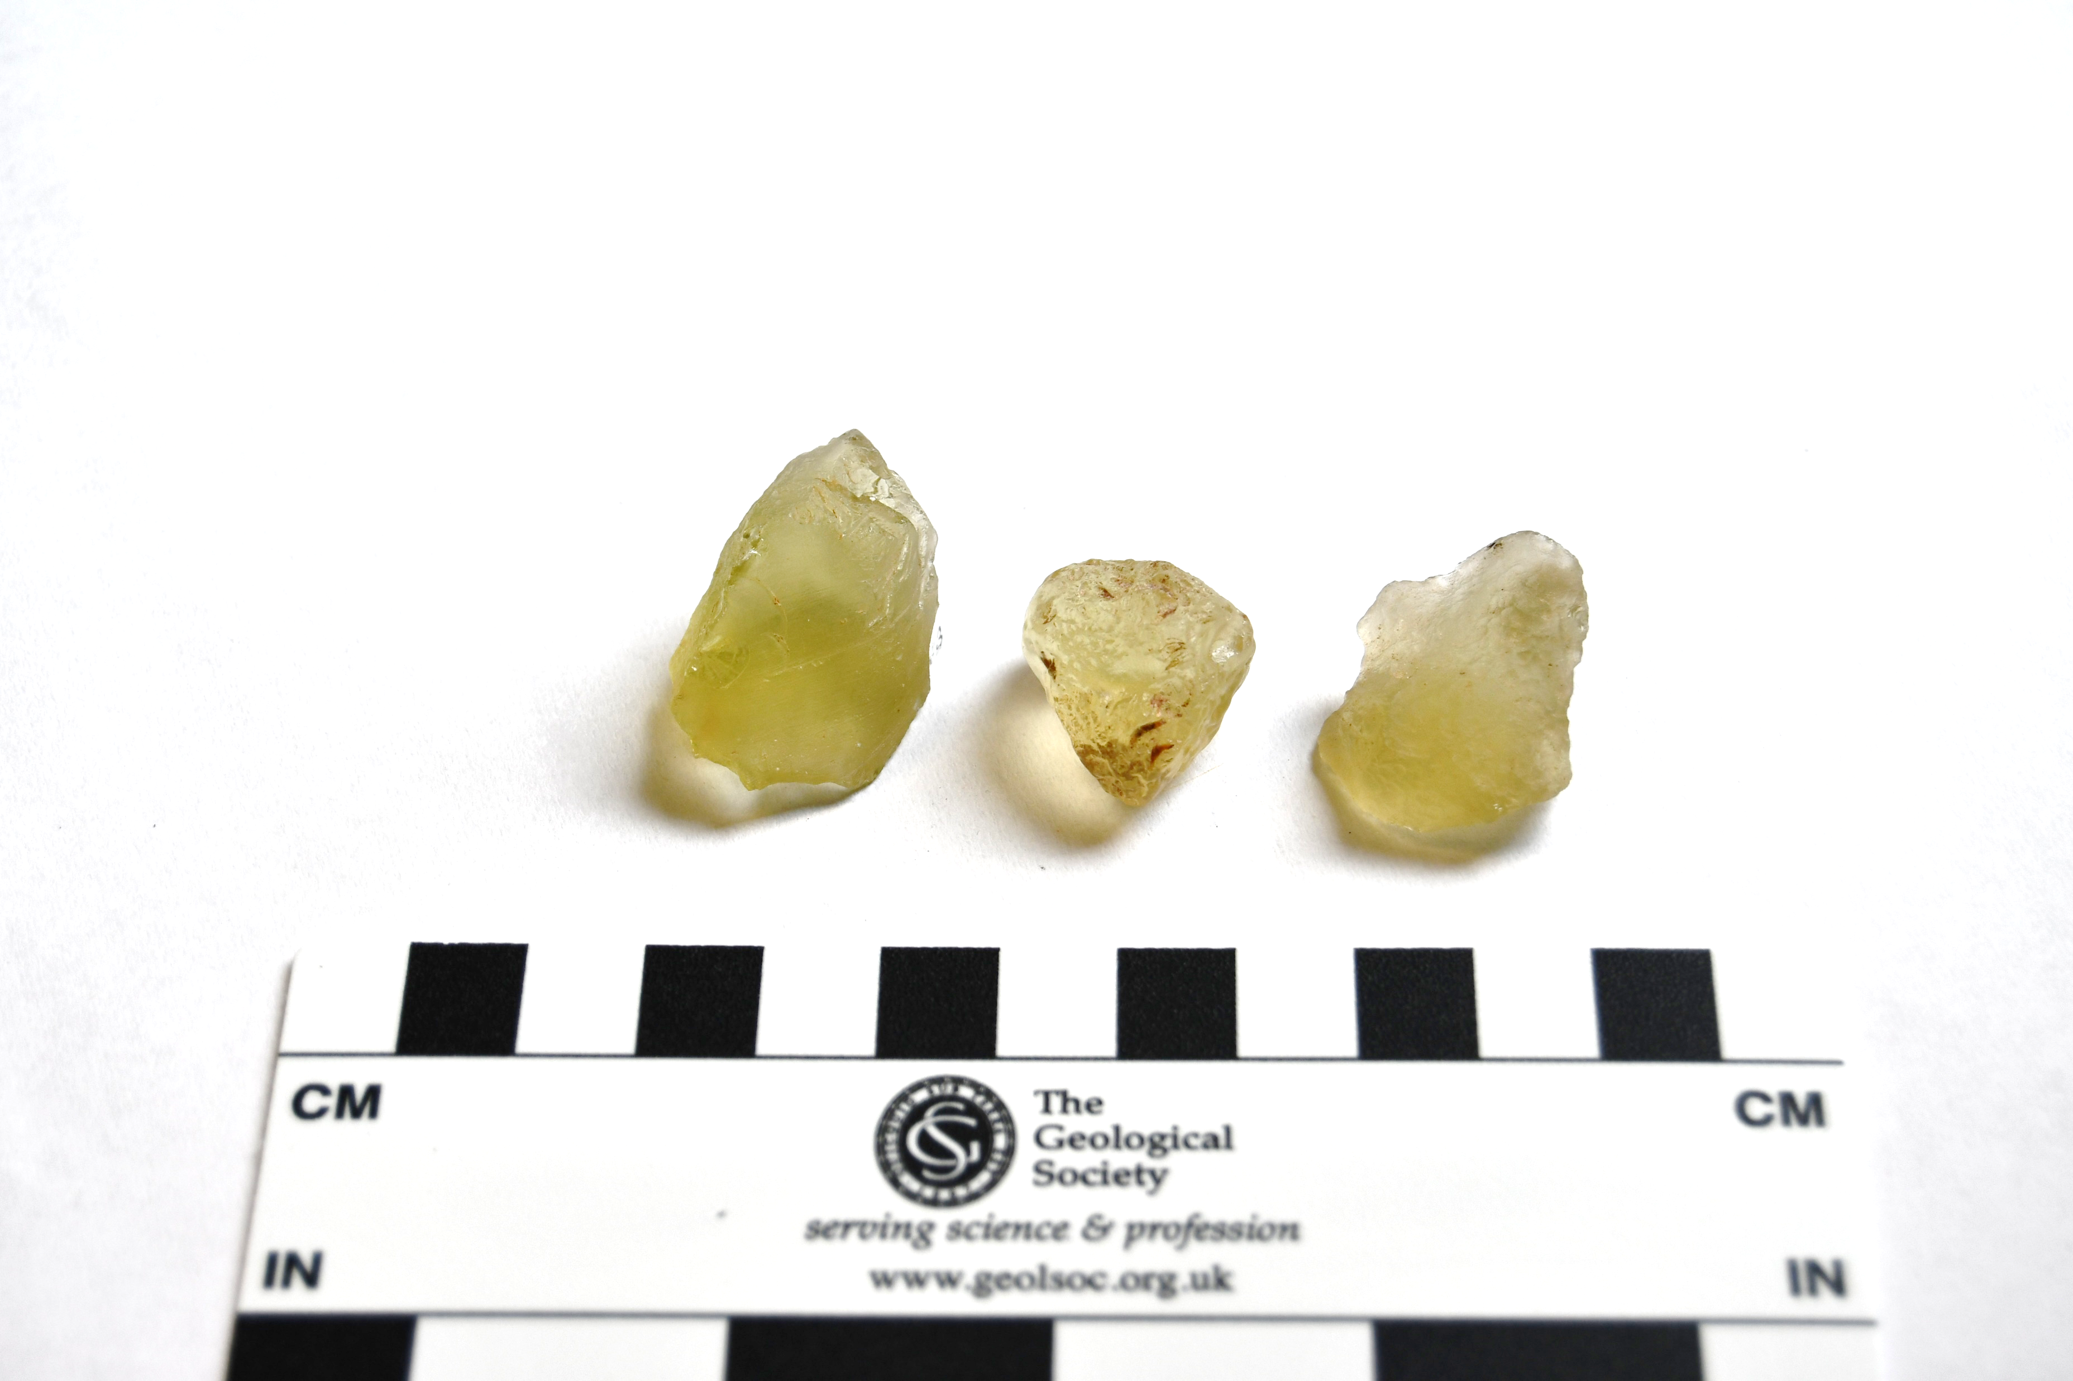
Black
Looks all the same, no different bits
Glassy on the outside with small bubbles
What is it?
A bicolite is an impact glass.
It forms when rocks from a crater melt and then cool down very quickly.
Fun fact: this rock is very similar to obsidian because they were both liquid rock that cooled very quickly
1 cm

Slide 14

Yellow/light green
Looks all the same, no different bits
Smooth and glassy on the outside
Partially transparent, can see light through it
What is it?
Libyan desert glass is an impact glass, like bicolite.
It forms when rocks from a crater melt and then cool down very quickly.
Fun fact: the colour of impact glasses is determined by the contents of the bedrock. Desert glass is yellowish-green because it’s formed out of sand.
1 cm

Slide 15

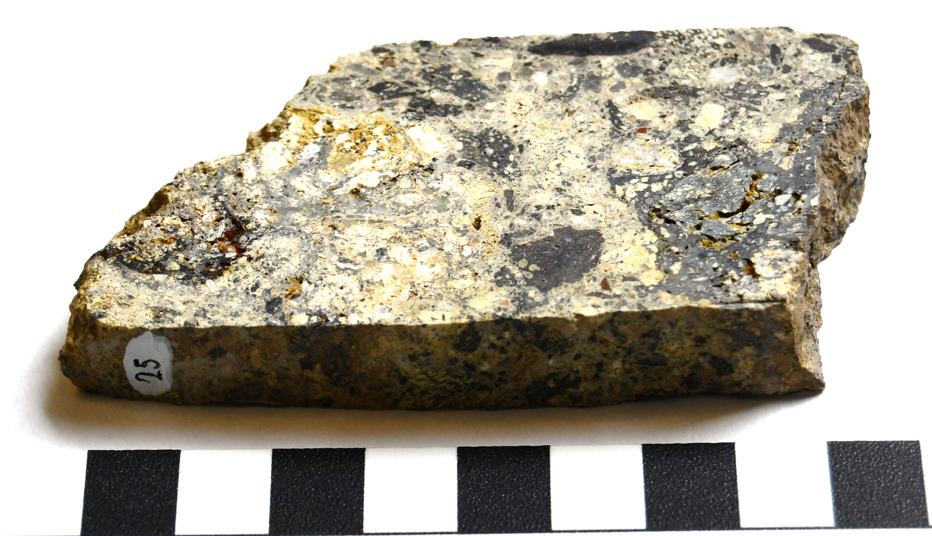
Grey, green, white
Lots of different bits make up the rock, from small (grains) to big (clasts)
The clasts are made up of different sizes and look different to each other
The outline of the clasts look fuzzy or 'wave-like' which means some of it was molten
What is it?
This is a suevite. It is an impact breccia (rock made when the bedrock was broken up and reassembled by an impact) which contains parts that were molten.
Fun fact: this rock came from the Ries crater in Germany, the town of Nördlingen was built in the crater!
1 cm

Slide 16

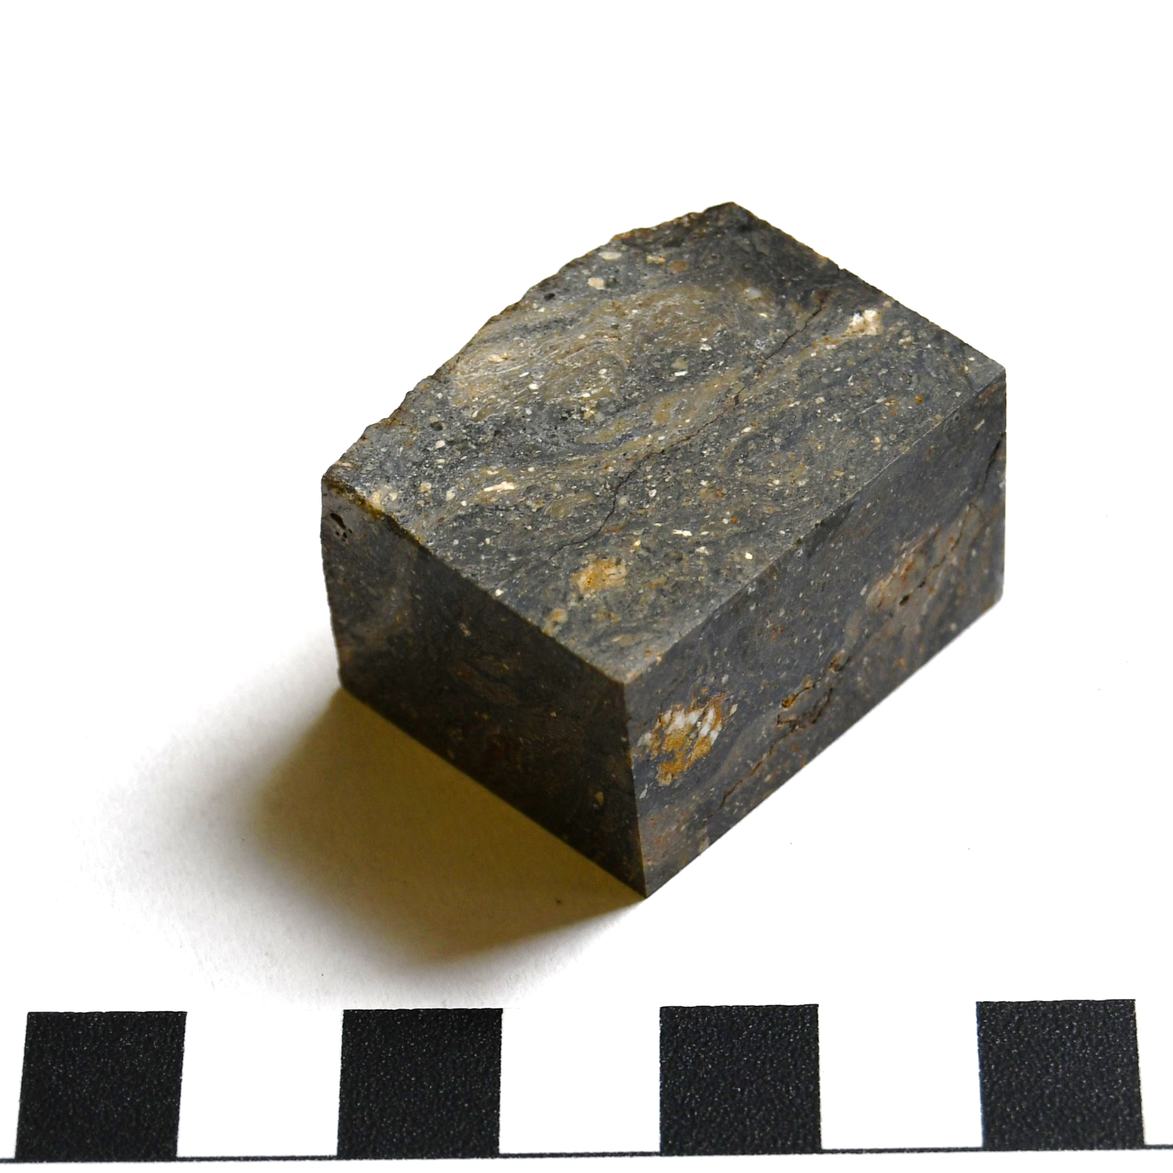
Dark grey-greenish
Small bits in the rock (grains)
'Wave-like' bands show some of it was molten
What is it?
This is a suevite. Like the previous rock, parts of this suevite were molten, which caused the wave-like banding.
Fun fact: this rock came from the Mien crater in Sweden, Lake Mien lies within the meteorite crater!
1 cm

Slide 17

Thank you for your attention!
Contact our education team at education@geolsoc.org.uk
This lesson was created as part of a project funded by the
UK Space Agency ‘Space for All’ fund

